Slide 1
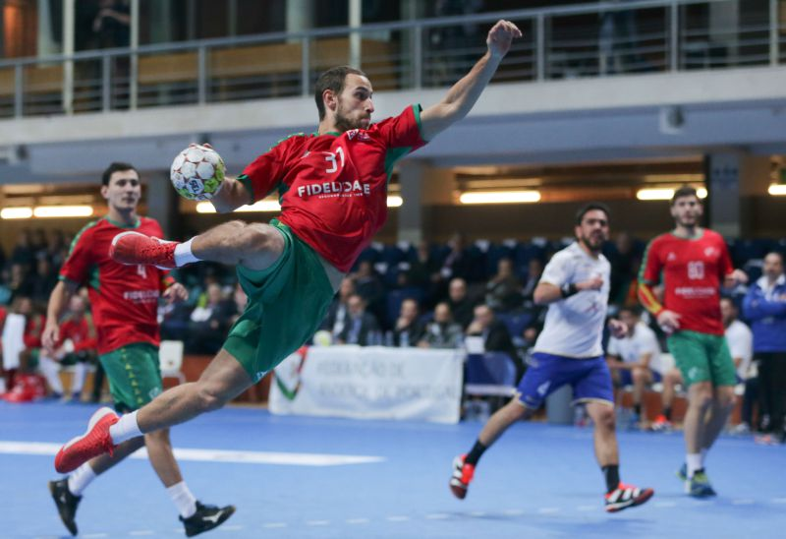
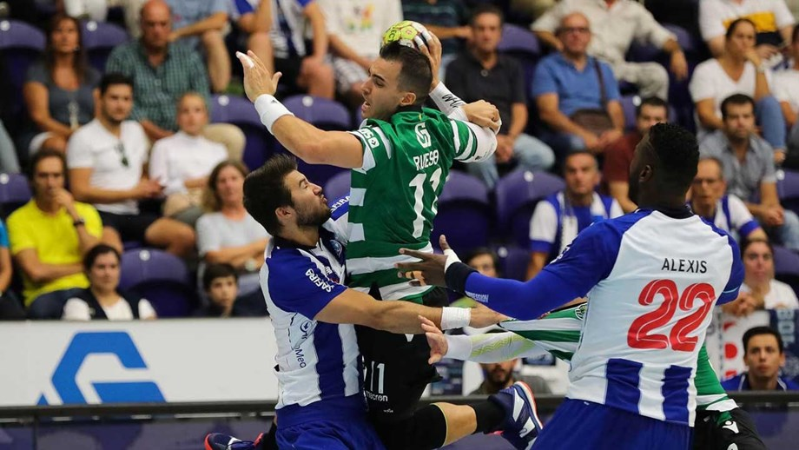
handball

Slide 2
iNdEX
What is handball? ---------------------------------------------------------------------------- slide 3
Origins -------------------------------------------------------------------------------------------- slide 4
Origins in Portugal -------------------------------------------------------------------------- slide 5
Required Equipment ------------------------------------------------------------------------ slide 6
Best Portuguese Handball players ----------------------------------------------------- slide 7
My Handball Team -------------------------------------------------------------------------- slide 8
Videos -------------------------------------------------------------------------------------------- slide 9

Slide 3
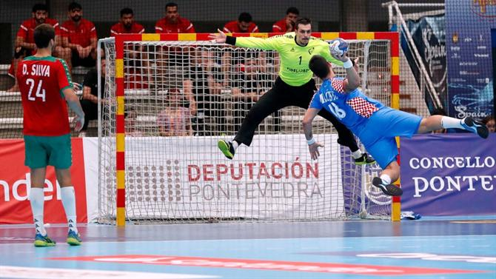
WHAT IS HANDBALL?
Handball is a team sports, each team with 7 players, whose objective is to introduce the ball on a goal net of the opposite team and also to avoid the same ball being introduced on their own goal net, respecting the rules of the game.
A team wins a game when, after the end of the regular time, has the highest number of goals, although there can be draws on handball games, when after the regular time, both teams have the same amount of goals.

Slide 4
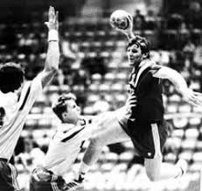
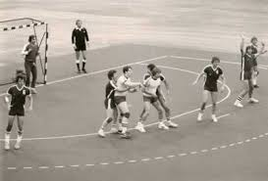
origins
Handball was created in 1919 by the german Karl Schelenz based on other sports practiced since the end of the 19th century in the north Europe and Uruguay.
It was originally played by women on Germany, being later played also by men and spread throughout all Europe.
Handball was first introduced in the Olympic Games for men in 1936, then it was kicked out and came back only in 1972. In 1976 it was first introduced on the Olympic Games for women.

Slide 5
Origins In portugal
Handball appeared in Portugal in 1929, in Porto, where had its first oficial game on 31st January 1931.
Then a lot of teams dedicated to handball were founded like, for example:
Football Club of Porto (1932)
Academic Basket Club (1933)
Sport Lisbon and Benfica (1932)
Sporting Club of Portugal (1932)

Slide 6
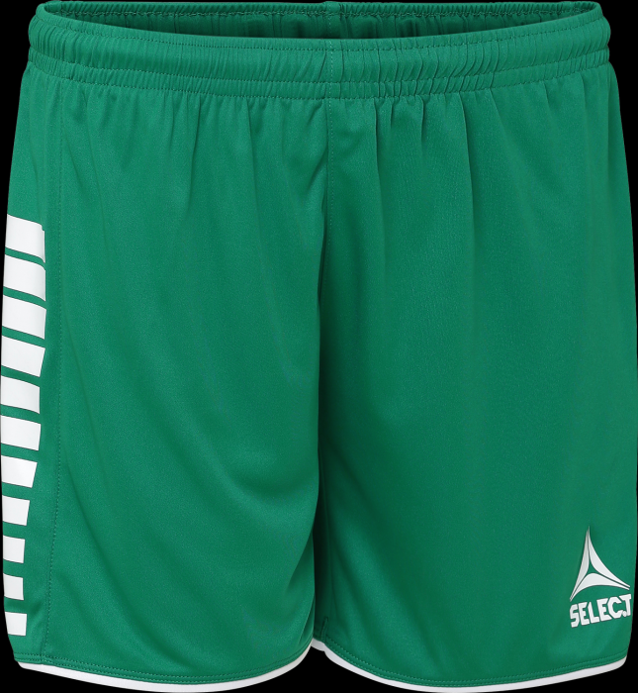
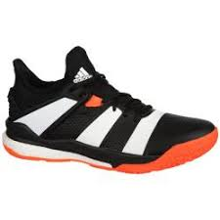
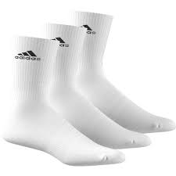
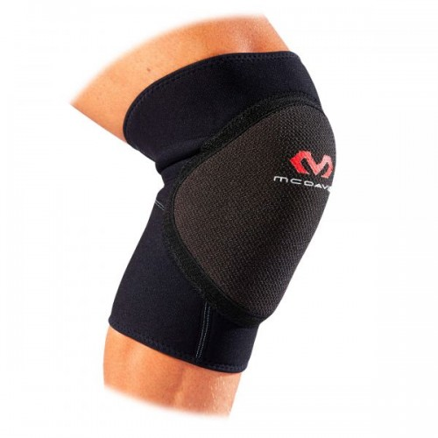
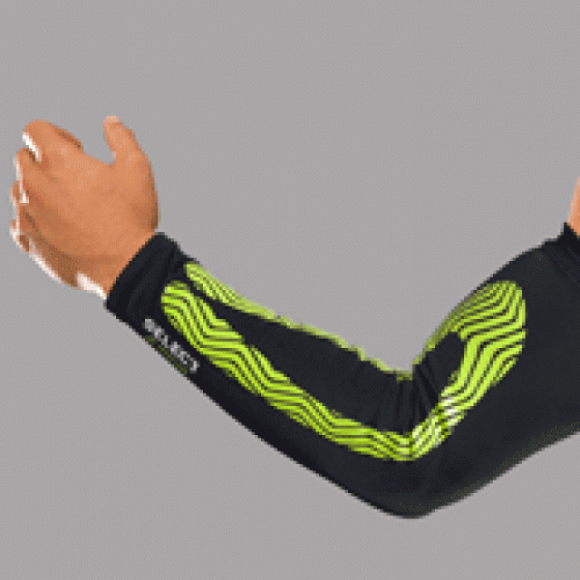
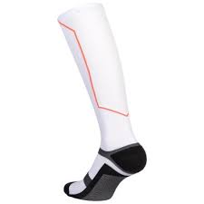
required equipment
T-shirt
Shorts
Sneakers
Socks
Knee pads (optional)
Compression cuffs (optional)
Compression socks (optional)

Slide 7
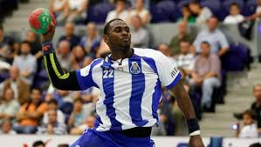
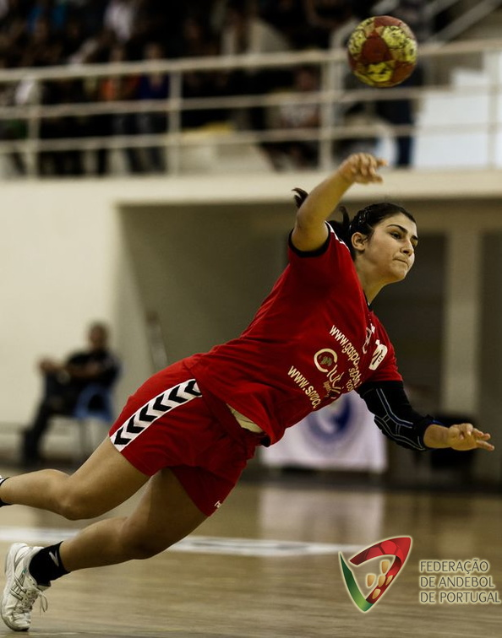
Best portuguese handball players
Gizelle Carvalho (25 years old)
Gilberto Duarte (29 years old)
Alexis Borges (27 years old)

Slide 8
My handball team
My handball team is called Club Vela of Tavira. It was founded in 1975. At the moment we stand at the ranking of juvenils of 2nd year and we are also playing the 2nd Division of the National Championship trying to pass for the 1st Division.
We train 4 days a week (one of them is in the gym, where we do cardio and bodybuilding to recover from the previous games) and have official games at the weeked.

Slide 9
Videos
https://www.youtube.com/watch?v=KlMdxZKhiWY – Best Goals in Portuguese Handball games
https://www.youtube.com/watch?v=XA8UQy7_nyw – Best goalkeeper saves in Portuguese Handball games

Slide 10
THE END!
Thanks to all for your attention!
Work done by Daniel Sares

