Slide 1
Roller Hockye in Portugal

Slide 2
Portugal National Roller Hochey team
It`s the team that represents Portugal, through the Portuguese Roller Sports Federation, in the most diferent international competitions.
The Portuguese National Roller Hockey team is one of the most successful roller hockey teams of the world, having 21 European records and being one of the teams winnig more worldwide competitions (14). The Portuguese National Roller Hockey team is the one with more trophies in this sport.

Slide 3
Portuguese Roller Hockey First Division
The Portuguese Roller Hockey First Division was founded in 1939 being Sporting CP the fisrt champions, and Porto the present champion. This league is contested by 14 teams. The three bottom teams are qualified for the Portuguese Roller Hockey Second Division, the fifth to eight placed qualified to CERS Cup and the four first placed teams to the CERH European League.

Slide 4
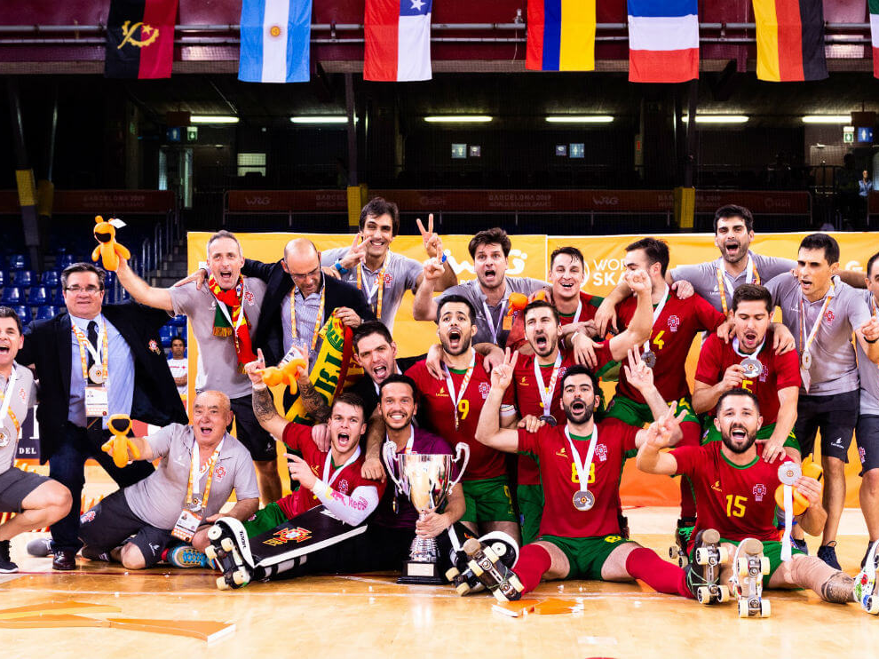
Work done by:
Beatriz Silva

