Slide 1
National Sports of Turkey

Slide 2
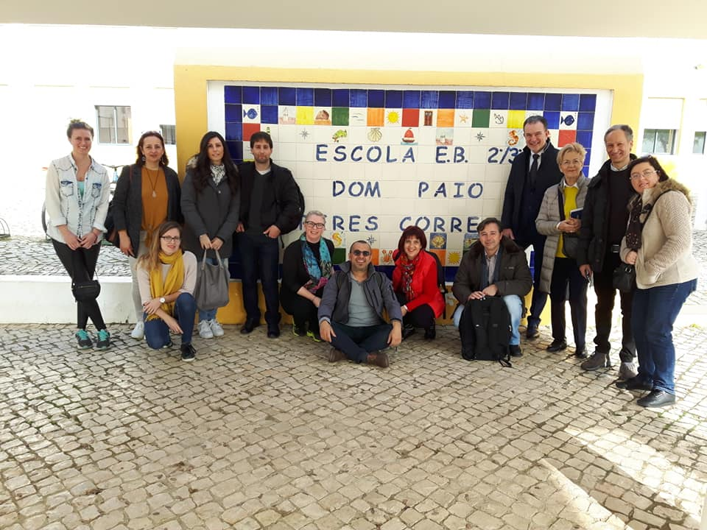
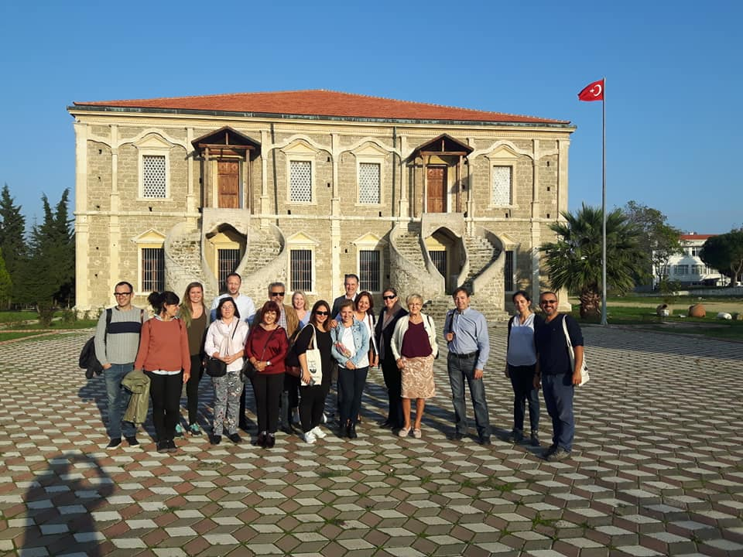
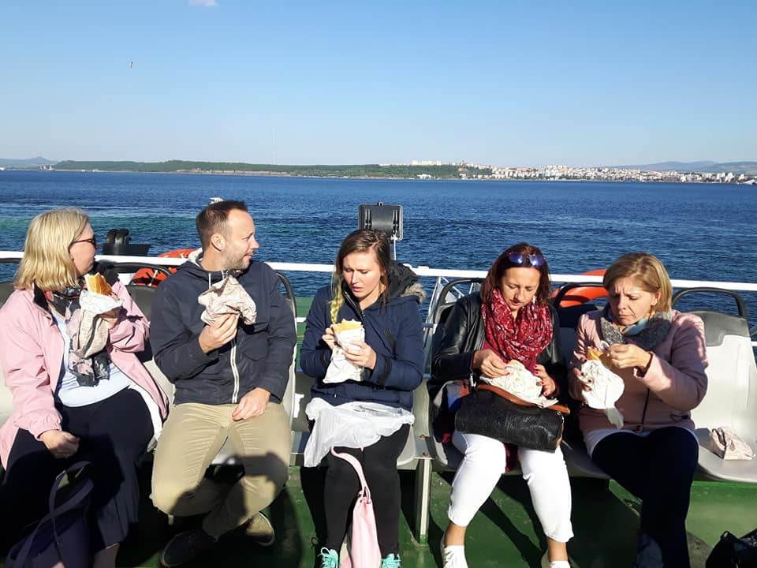

Slide 3
THE NATIONAL SPORTS IN TURKEY 29.SEP - 03.OCT.2019 SKÖVDE – SWEDEN MEETING

Slide 4
Cirit – Javelin Throw
Javelin, a team game, is played between two teams on a horse in a large area. Cirit is the name of the stick. In the play, the competitors try to shoot each other with the cirit. They ride fast, then begins to run back and the players chases eachother. The aim is to throw the javelin in his hand to the opponent player. Meanwhile, one tries to throw the javelin in his hand to the player who is chasing his friend. The game lasts that way.

Slide 5
In Javelin, the only target is the rider on horseback. If the javelin touches the horse, the player who threw the javelin is out of play. Therefore, the riders make various movements on the horse for protection; they lean, hang sideways and even show movements up to acrobatics. Each hit gives the scorer one point. Meanwhile, the riders try to catch the javelins thrown at them in the air.

Slide 6
The rider who catches the javelin in the air gets a new shot with this javelin. After all players have finished their javelin, the game is finished. The number of hits of the javelins thrown against the opposing team players determines the outcome of the match.

Slide 7
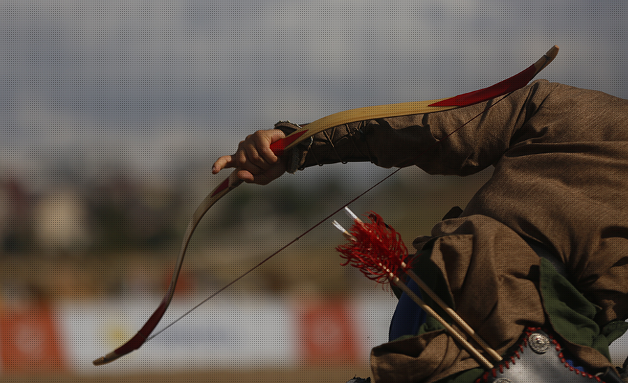
Archery (Okçuluk)
Archery is an old Turkish sport. Archery has two types named modern archery and traditional archery. Traditional archers don’t use sight, arrow rest or something like them.

Slide 8
Based on historical hunting period. The aim of the game is to send the arrow to the target and hit the target. Today it is used as a sport branch. The target board is the circle. This circle is painted in 5 colors. The archers try to shoot the target in the middle.

Slide 9
Horse-Riding(Binicilik)
The history of riding sport in Turkey dates back to the earliest times when man began to ride by horse taming. It is considered to be one of the oldest sports branches with a history of four thousand years.

Slide 10
It is known that nomadic communities in Central Asia used horses as animals for at least two thousand years before Christ.

Slide 11
Horses have been a common passion of Turks throughout history. In the Turkish culture, the horse was seen as sacred and poems, epics and folk songs were written on it.

Slide 12
Wrestling (Yağlı Güreş)
Wrestling is a traditional Turkish sport.This is called oiled wrestling because wrestlers are rubbing their body with oil.

Slide 13
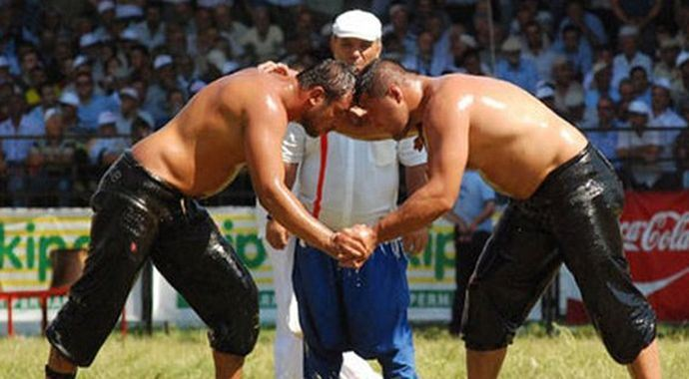
It is a sport that requires great strength and mastery, as it is difficult for wrestlers to hold each other because their bodies are oiled.

