Slide 1
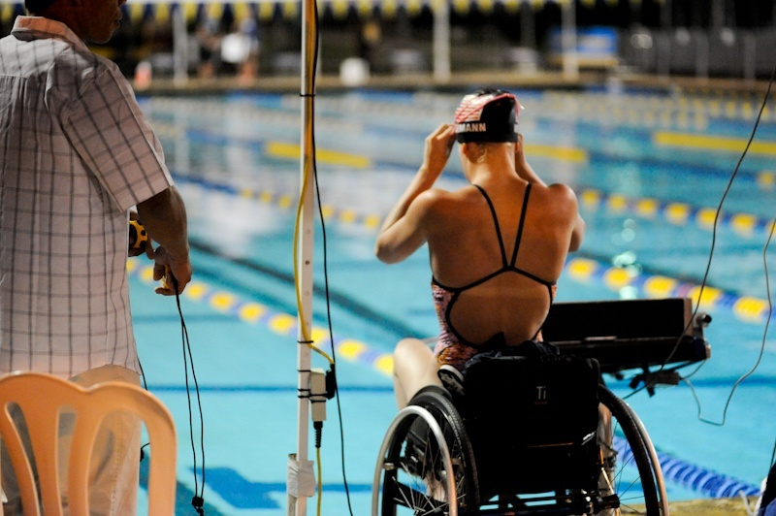
Paralympic Swimming
Work by: João Pedro Fernandes Silva – from Portugal

Slide 2
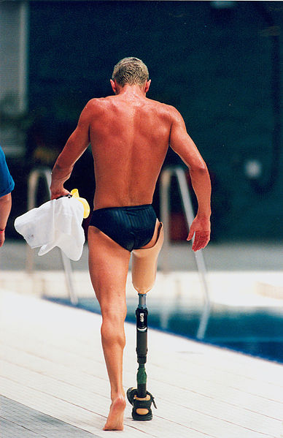
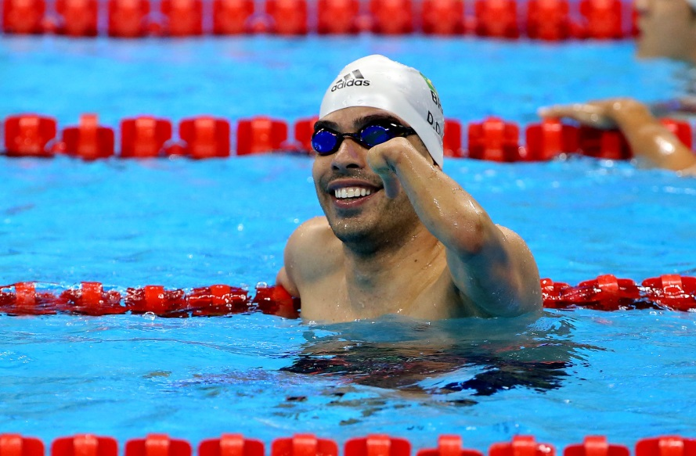
Adapted Swimming
It is an adaptation of the sport of swimming for athletes with disabilities.

Slide 3
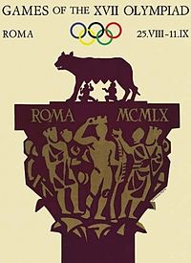
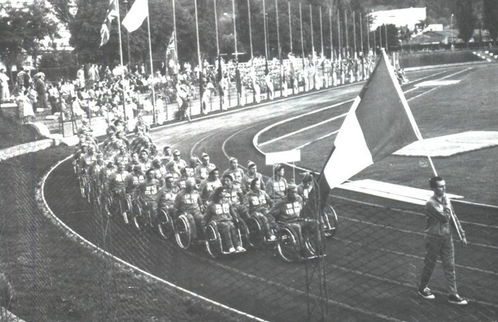
The Paralympic Swimming Beginning
The first adapted swimming competition happened in Rome in 1960.

Slide 4
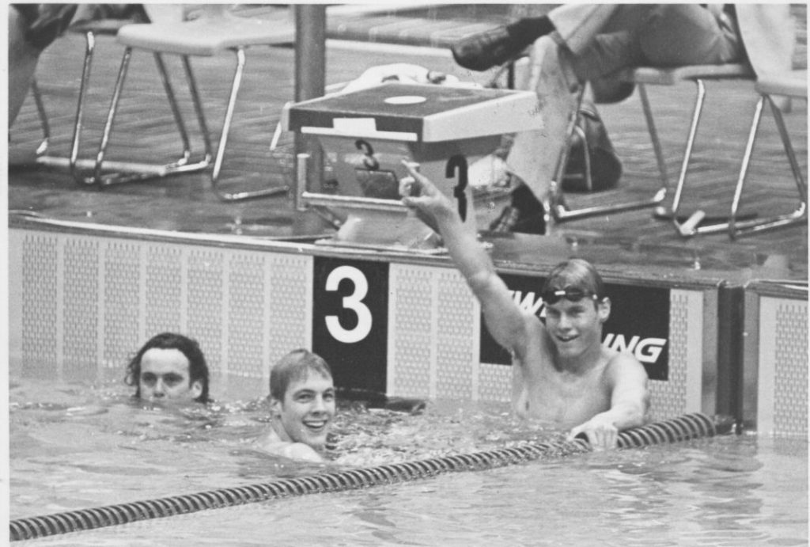
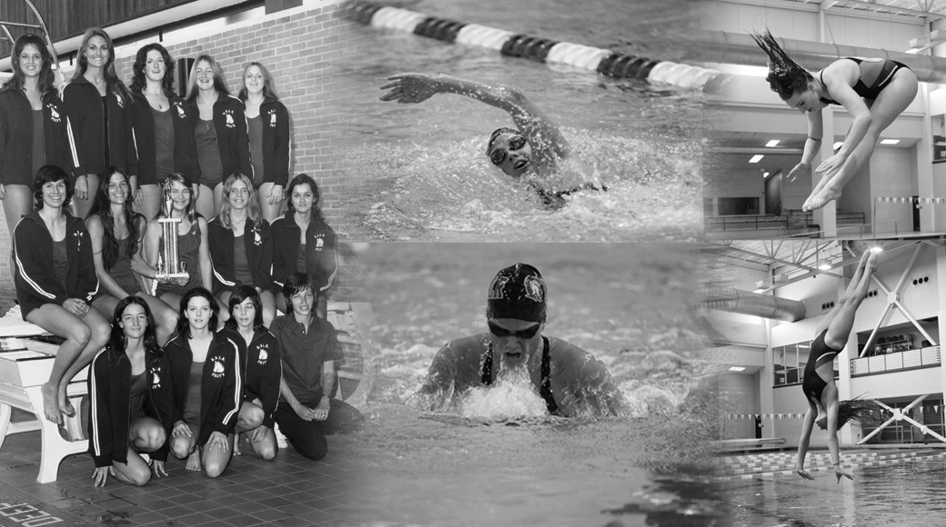
Portugal´s entry in the Paralympic Swimming
Portugal joined the paralympic swimming in 1972 in the Summer Games of the former Western Germany.

Slide 5
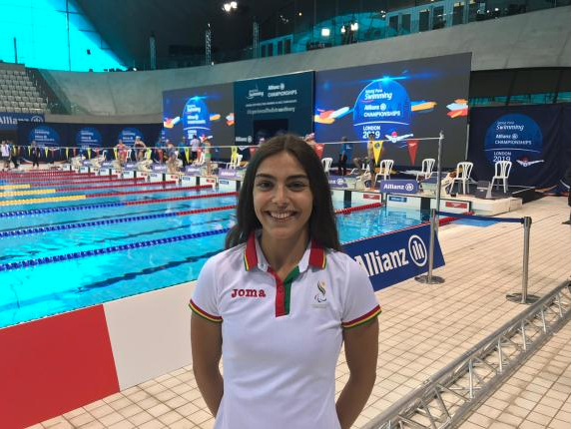
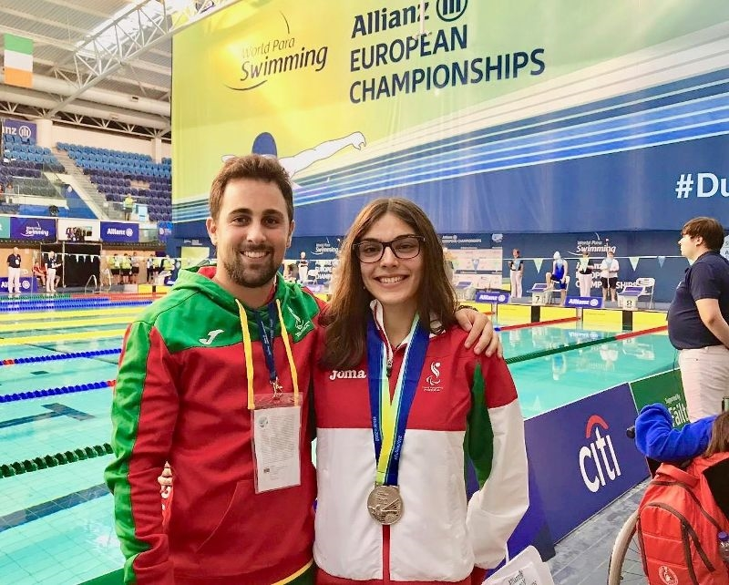
Famous paralympic swimming champion of Portugal
Susana Veiga – Vice-Champion of 50m (freestyle)

Slide 6
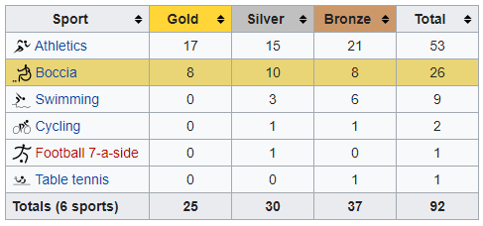
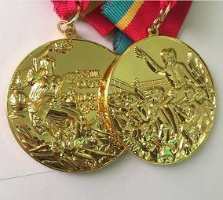
Portugal´s Paralympic Medals
Portugal is one of the countries known for its paralympic athletes.

