Slide 1
ERASMUS PLUS IES HUELIN
Diego Chacón Álvarez
2º ESO A

Slide 2
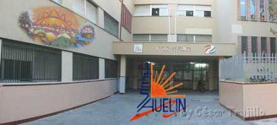
THIS IS ME AND MY HIGH SCHOOL
My name is Diego and I am a student at Huelin high school. I am in 2º ESO and I want to participate in Erasmus Plus project because I love languages and I would like to meet people from other countries.

Slide 3
WE CARE ABOUT ENVIRONMENT
From our school we work the 17 SDG Sustainable Development Goals through various programs and projects such as ALAS, ALDEA, Green Passport or Erasmus.

Slide 4
TERRACYCLE
People can come to the high school during the opening hours to deposit the writing instruments in the trash can located at the hall. For every 20 kg of writing instruments we send to the company Terracycle they give us 20 € to donate to a charity or non-profit organization. Watch this video to know more about it:
https://youtu.be/8tQdFJCmUfo

Slide 5
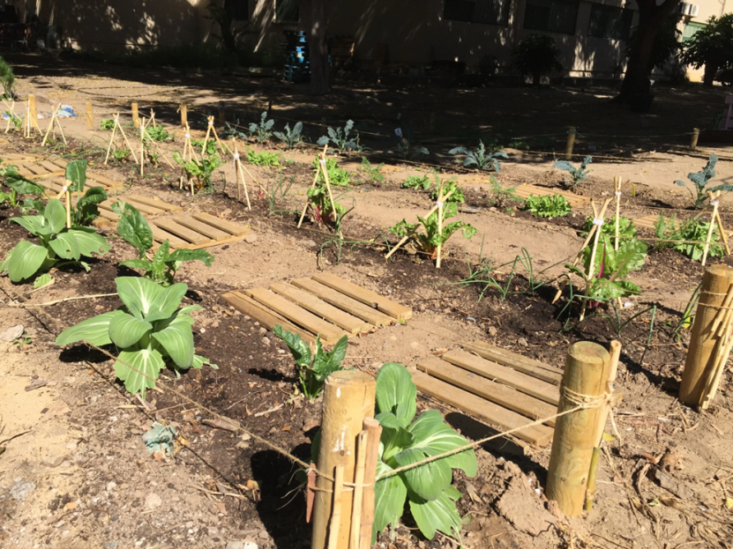
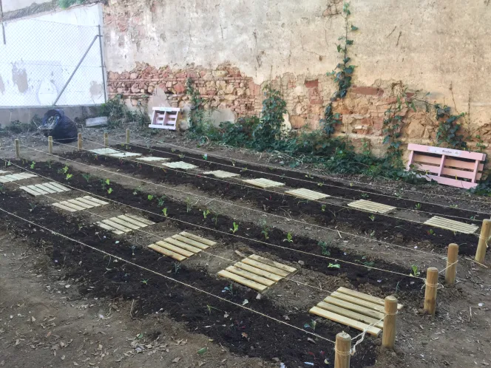
SCHOOL GARDEN NETWORK
We are part of this project which consists of the creation of natural spaces in school facilities.
Here we have a video explaining it:
https://youtu.be/hw-_57sJAGI

Slide 6
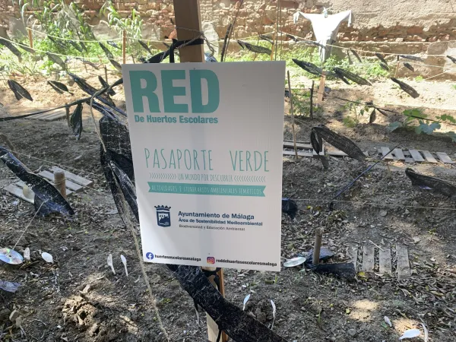
GREEN PASSPORT
We have also the green passport: a teacher gives us a green stamp when we bring bottles or reusable containers with our breakfast.

Slide 7
WE RECYCLE
We have several recycling points in classrooms, corridors and recreation areas.
We have yellow bins for plastic and blue bins for paper and cardboard.

Slide 8
Special containers for batteries and electronic objets

Slide 9
Printer cartridges and contaniners for energy saving light bulbs and LEDs

Slide 10
THANK YOU

