Slide 1
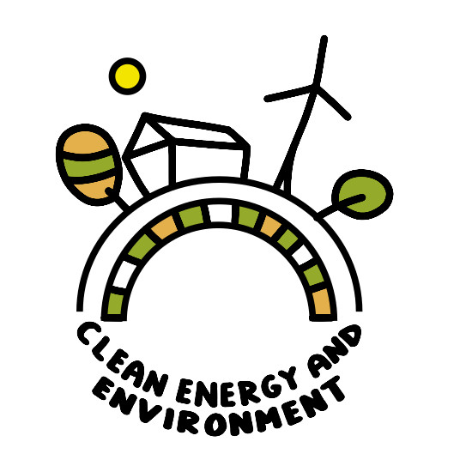
Energy Consumption in Lithuania Erasmus - a European green goal: clean energy and environmental sustainability against climate change
Prienai "Žiburys" gymnasium, 2020 Austėja Simonaitytė IIc Austėja Visockaitė Id Jokūbas Šimukaitis Id Lauryna Jankauskaitė Id Meda Valatkaitė Id

Slide 2
Aims and Objectives
To find out what energy is;
To gain better insight into the country’s overall fuel and energy consumption;
To determine what is the final energy consumption and its impact on Lithuania;
To identify what is the indicator of energy dependence and its impact on Lithuania;
To realise what is the promotion of renewable energy sources and its impact on Lithuania;
To observe information on energy consumption during quarantine;
To graph Lithuanian energy consumption.

Slide 3
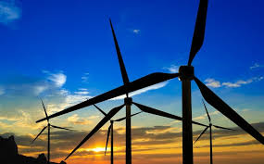
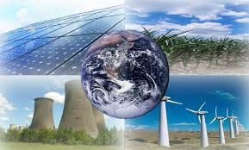
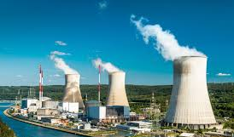
What is energy?
Energy – an area of economic activity of the state, which includes all energy resources and production of various types of energy, operation of energy systems and equipment.

Slide 4
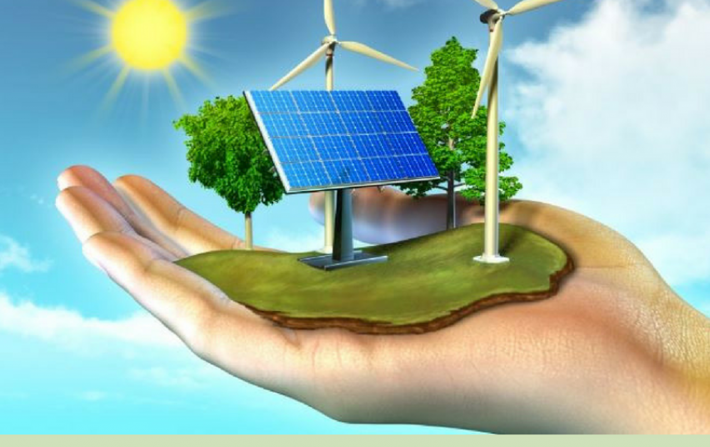
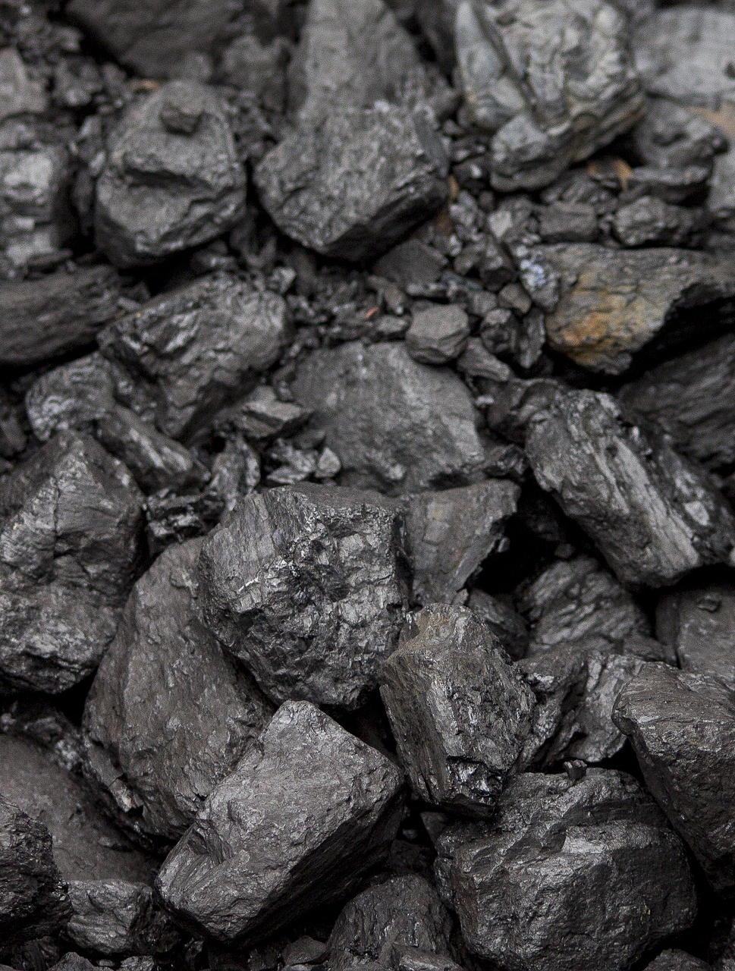
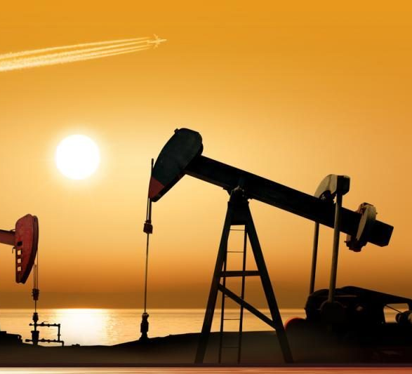
Gross inland fuel and energy consumption
Gross inland fuel and energy consumption - the amount of energy required to satisfy consumer needs.
In 2018, gross inland fuel and energy consumption amounted to 7.69 million tons of oil equivalent and, against 2017, grew by 0,2 per cent.
The largest proportion in gross inland fuel and energy consumption was made up of:
Crude oil and petroleum products (39,6 per cent),
Natural gas (23,1 per cent),
Renewable energy sources and electricity (19,8 and 10,8 per cent)
Fell within coal, peat, etc. (6,7 per cent)

Slide 5
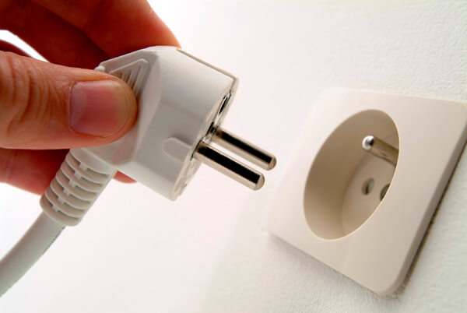
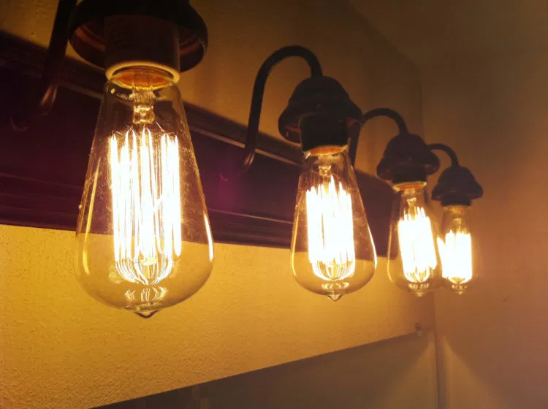
Final energy consumption
Final energy consumption is the amount that shows how much energy a country consumes after deducting exports and the costs used in energy production.
In past years, final energy consumption has been increasing, for instance, in 2018 compared to 2017, it increased by 3.8 % , except in 2019,as compared to 2018, it decreased by 0.6 %
In the future, this number is speculated to rise as its increase is related to population.

Slide 6
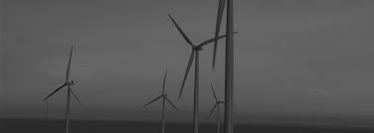
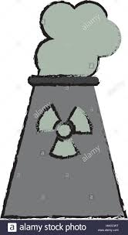
Energy dependence indicator
Energy dependence indicator — an indicator showing the extent to which an economy relies upon imports in order to meet its energy needs. It is calculated as net imports divided by the sum of gross inland energy consumption plus bunkers.
To satisfy Lithuanian energy consumer's needs, both domestic and imported fuel and energy resources are used.
Lithuania remains energetically dependent on imported energy.

Slide 7
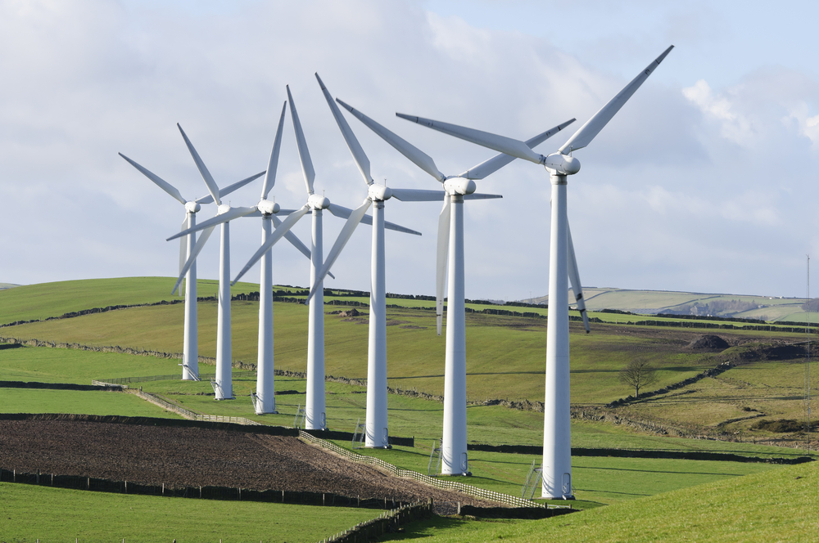
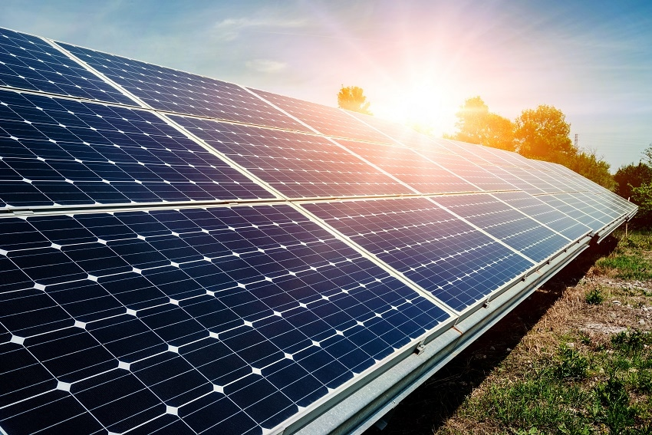
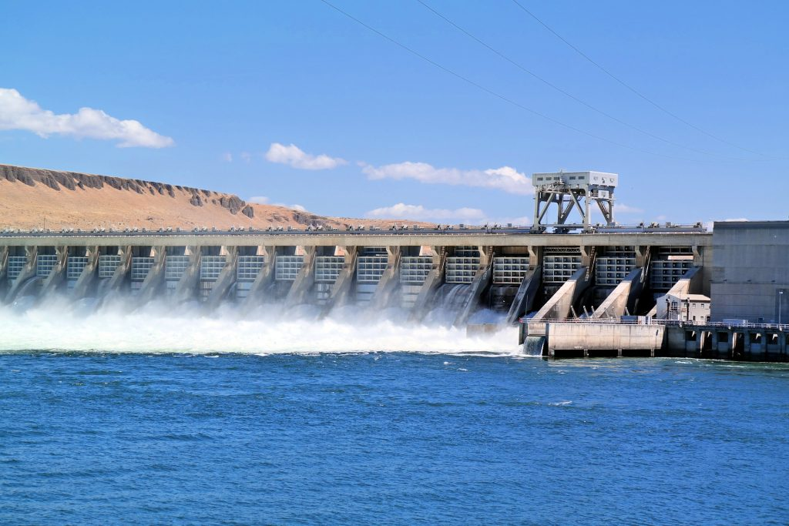
The promotion of use of renewable energy resources
The promotion of use of renewable energy resources is one of the best decisions to satisfy energy needs by preserving nature and its resources.
The greatest renewable energy potential in Lithuania is shown by solid biofuel.
In 2018, 23 wind farms operated in Lithuania. Electricity production by these wind farms together with small wind power plants was the highest in the energy history of the country.
In 2018, hydropower plants produced 431 million kWh of electricity.
As regards renewable electricity, in 2018, electricity produced by solar power plants amounted to 86.6 million kWh.

Slide 8
Energy consumption during quarantine
According to official statistics, energy consumption decreased during quarantine. In February, 2020 energy demand was 36 GWh per day, and in mid-March it was 32 GWh per day.

Slide 9
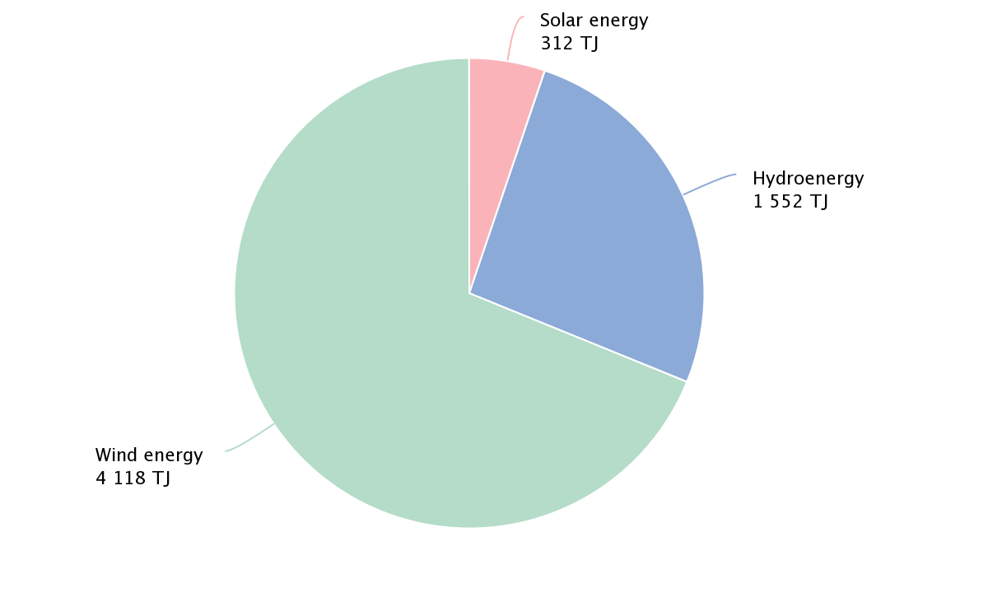
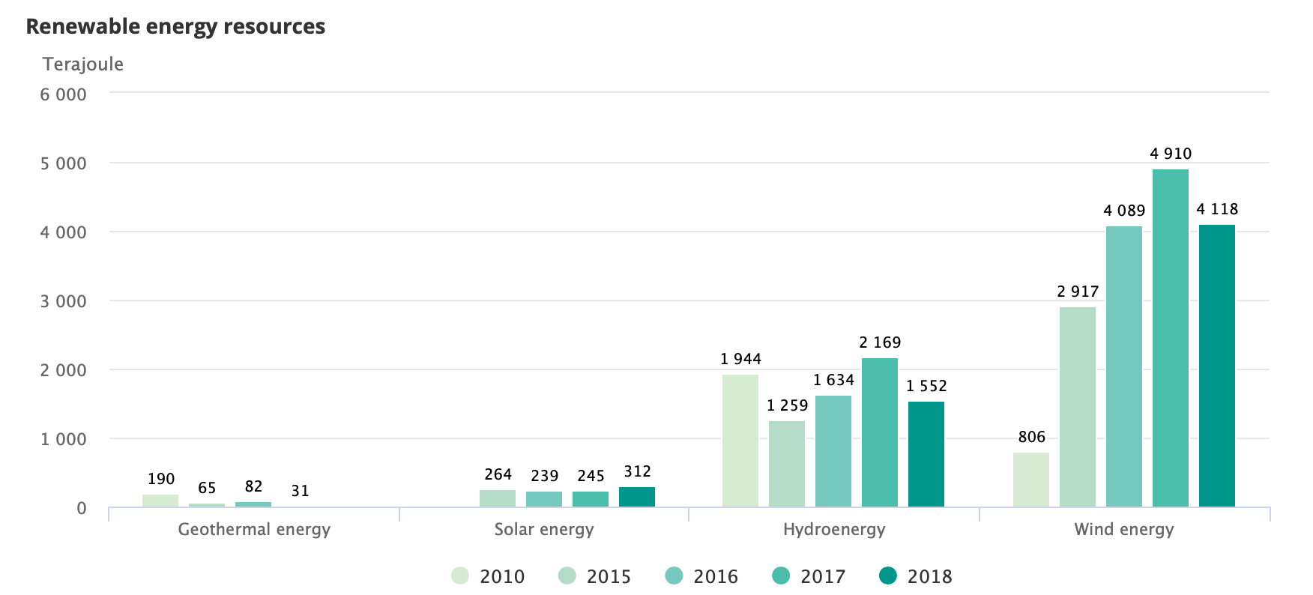
Diagrams
Renewable fuel commodities and energy resources, 2018
Renewable energy resources

Slide 10
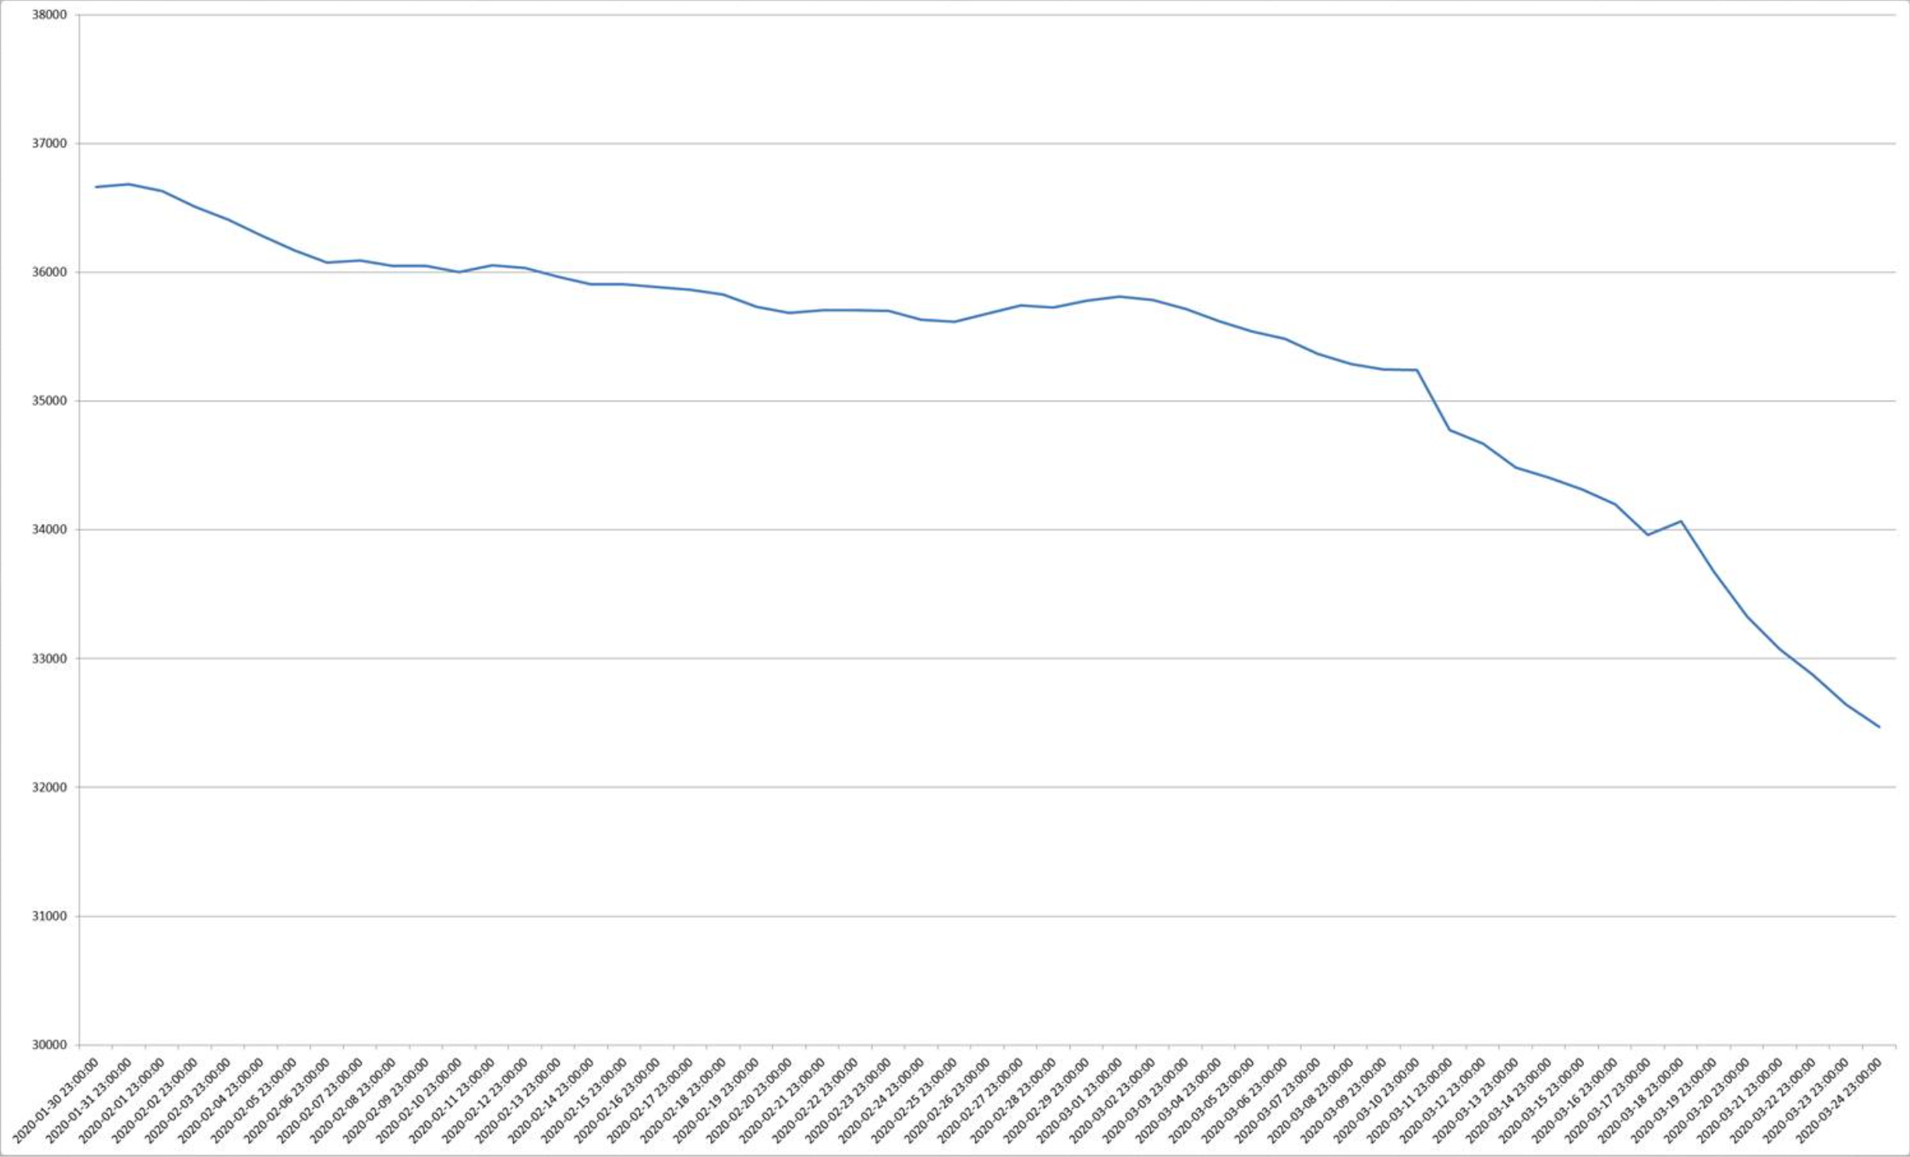
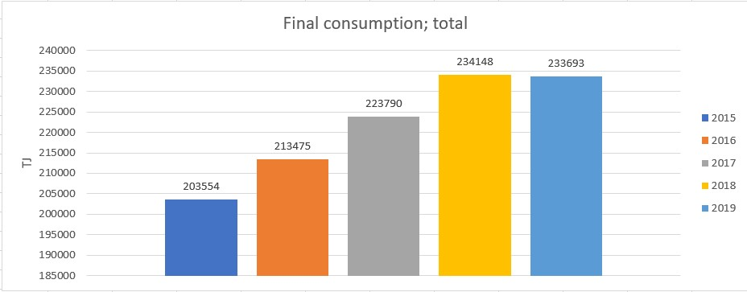
Energy consumption during quarantine
Final Energy Consumption

Slide 11
Conclusions
Lithuania relies too much on other countries in the field of energy. Lithuania imported 74.7 per cent of energy in 2018 and still considerably exceeded the EU average (in 2017, 55.1 per cent).

