Slide 1
High School Pedinis

Slide 2
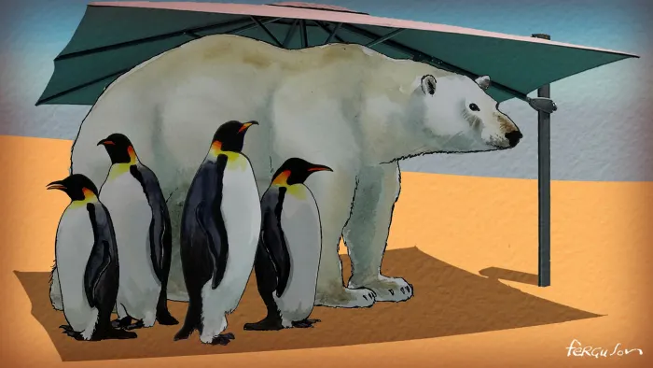
Action must replace talk on climate change before it’s too late!

Slide 3
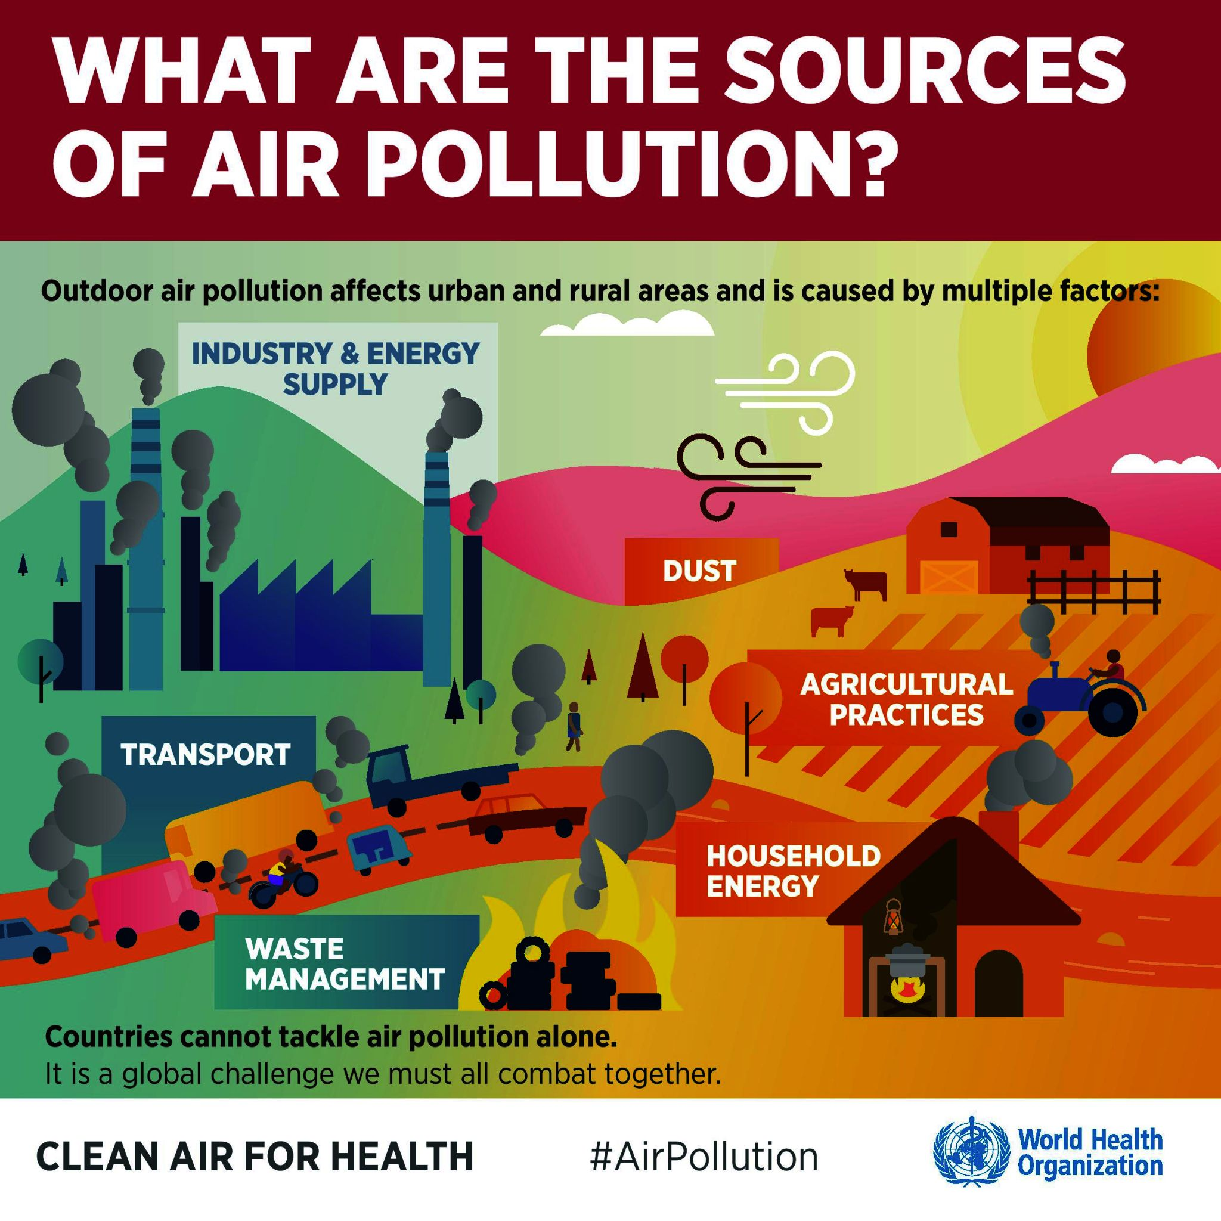

Slide 4
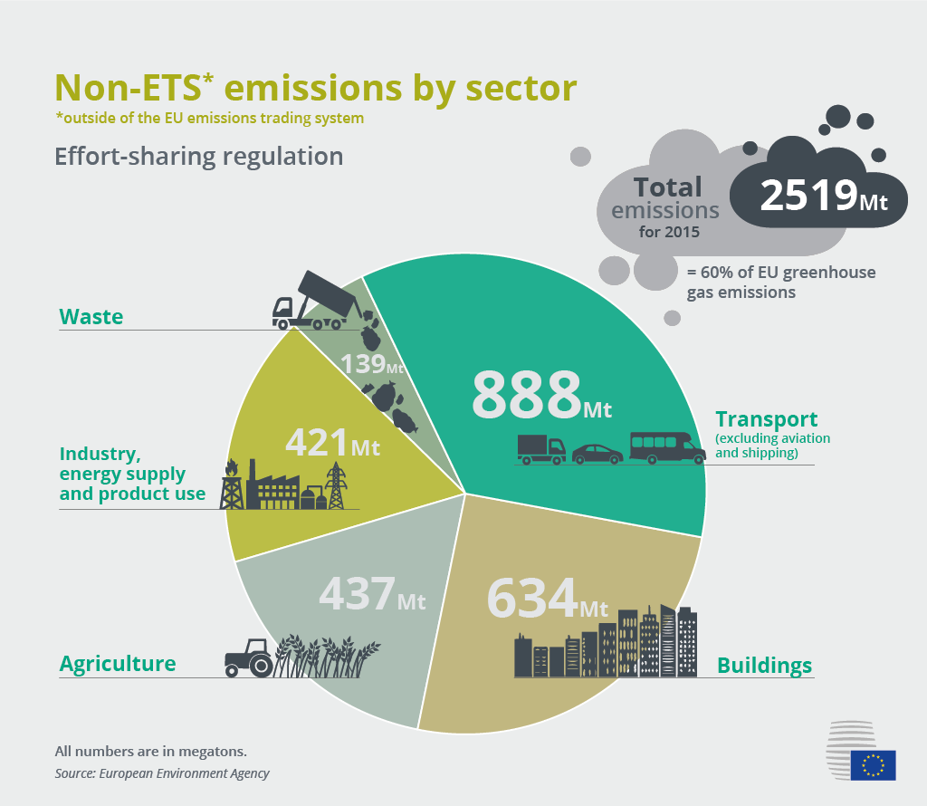
Who is to blame ?

Slide 5
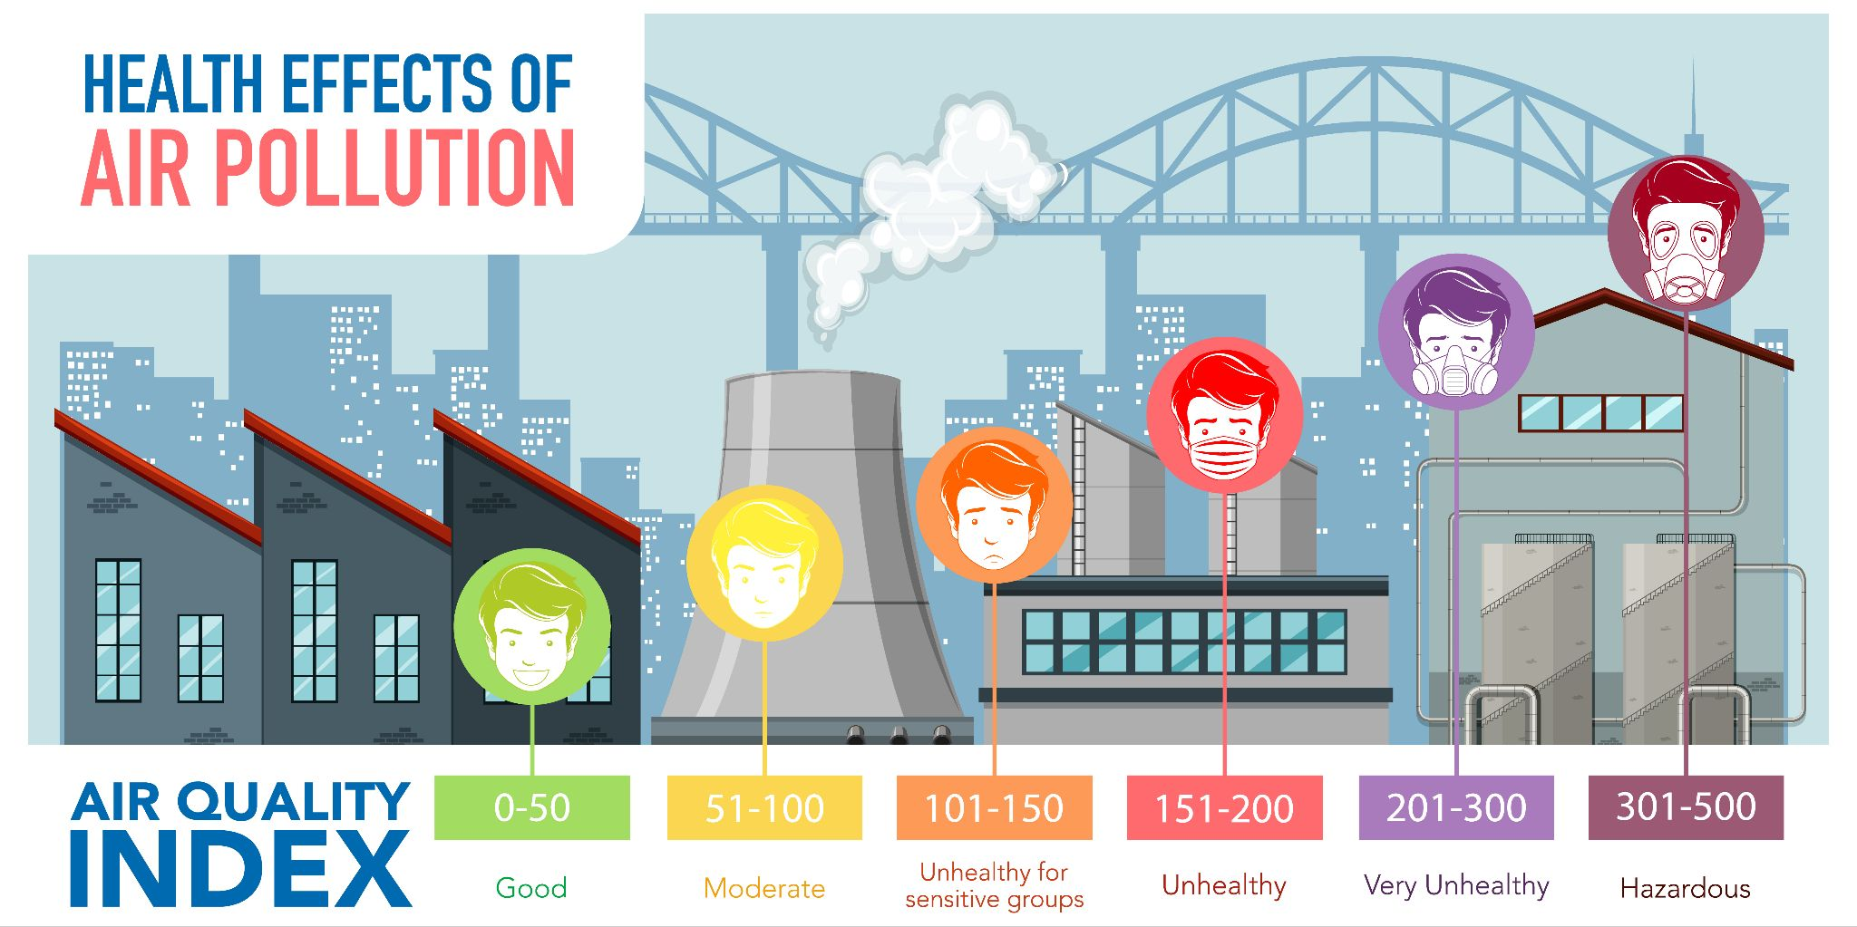
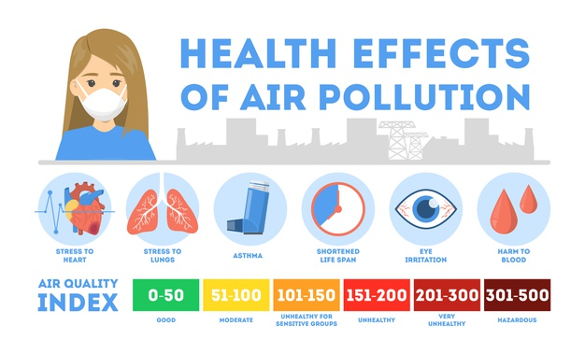
Does air quality matter?

Slide 6
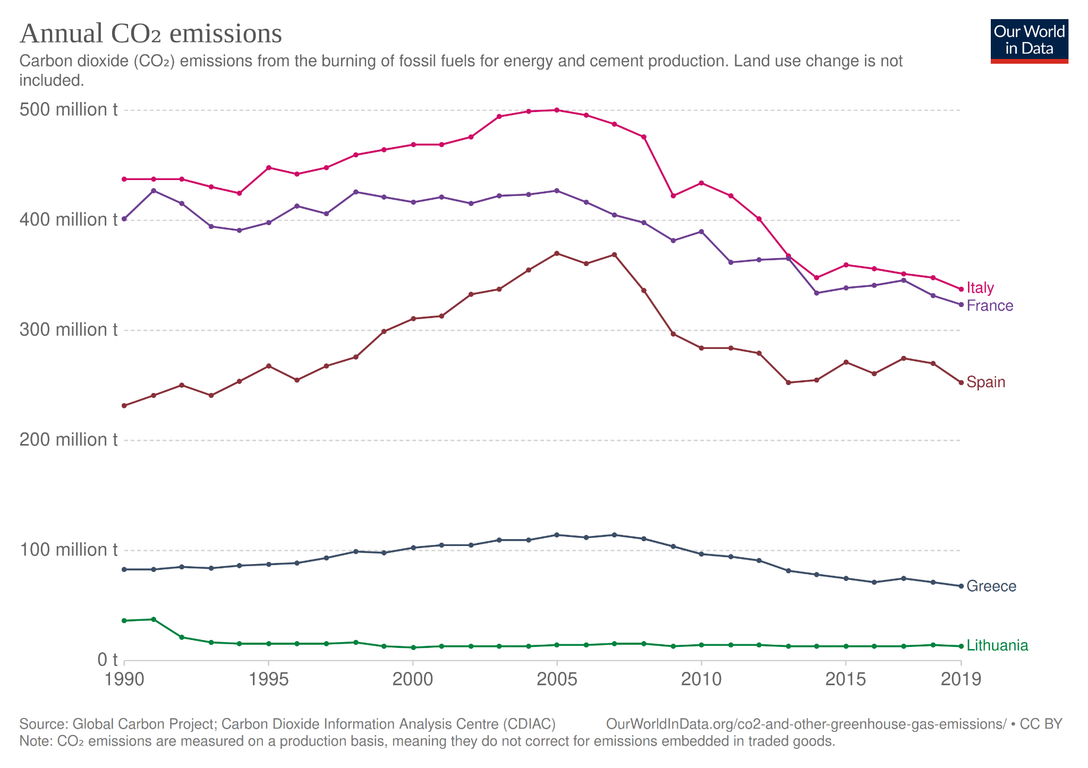
How much my country contribute to emissions;
Greece ‘s footprint
is relatively small compared
with other countries due to
small size and luck of heavy
industries.

Slide 7
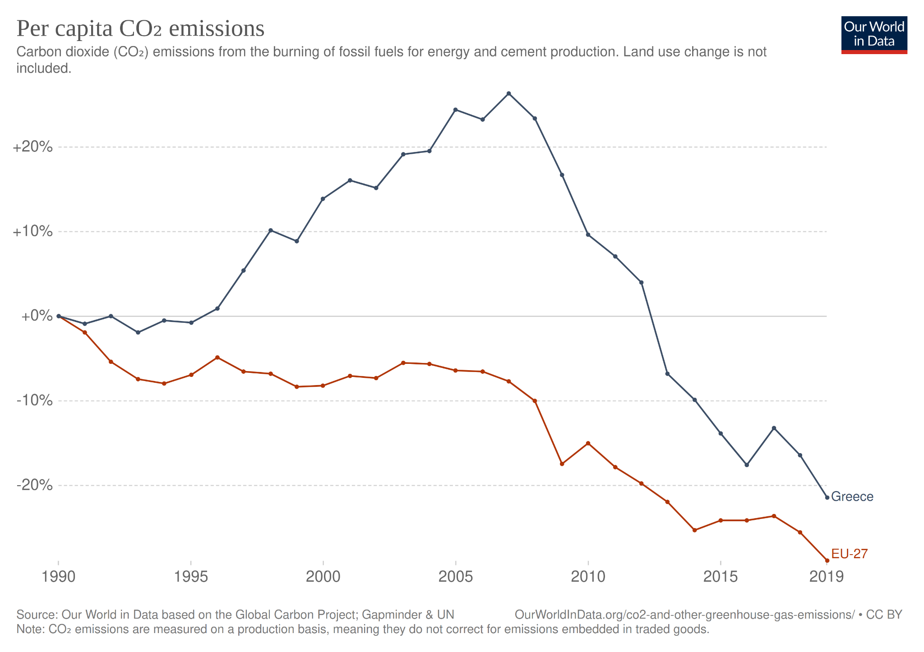

Slide 8
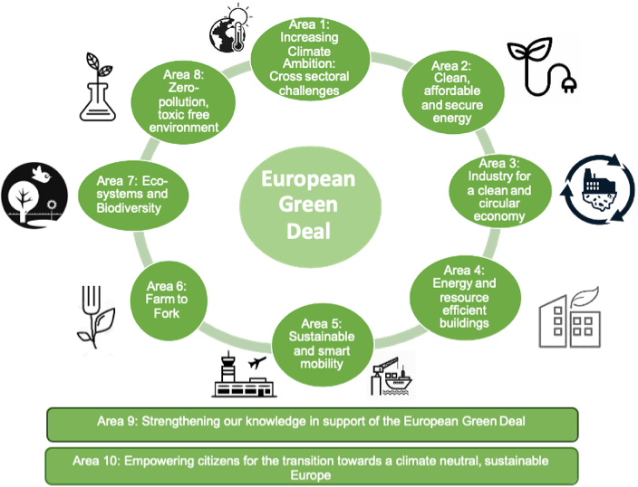
What has EU done to enforce behaviour change ?
European
Green
Deal

Slide 9
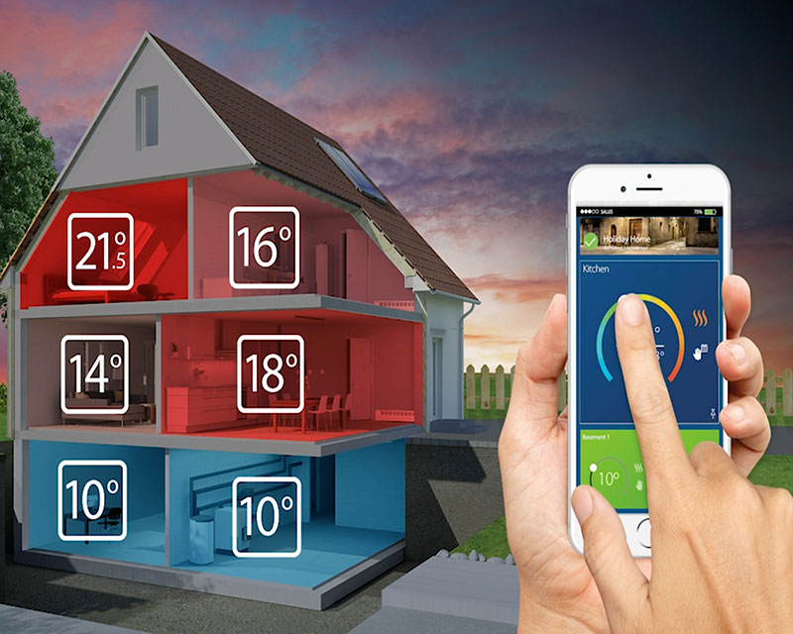
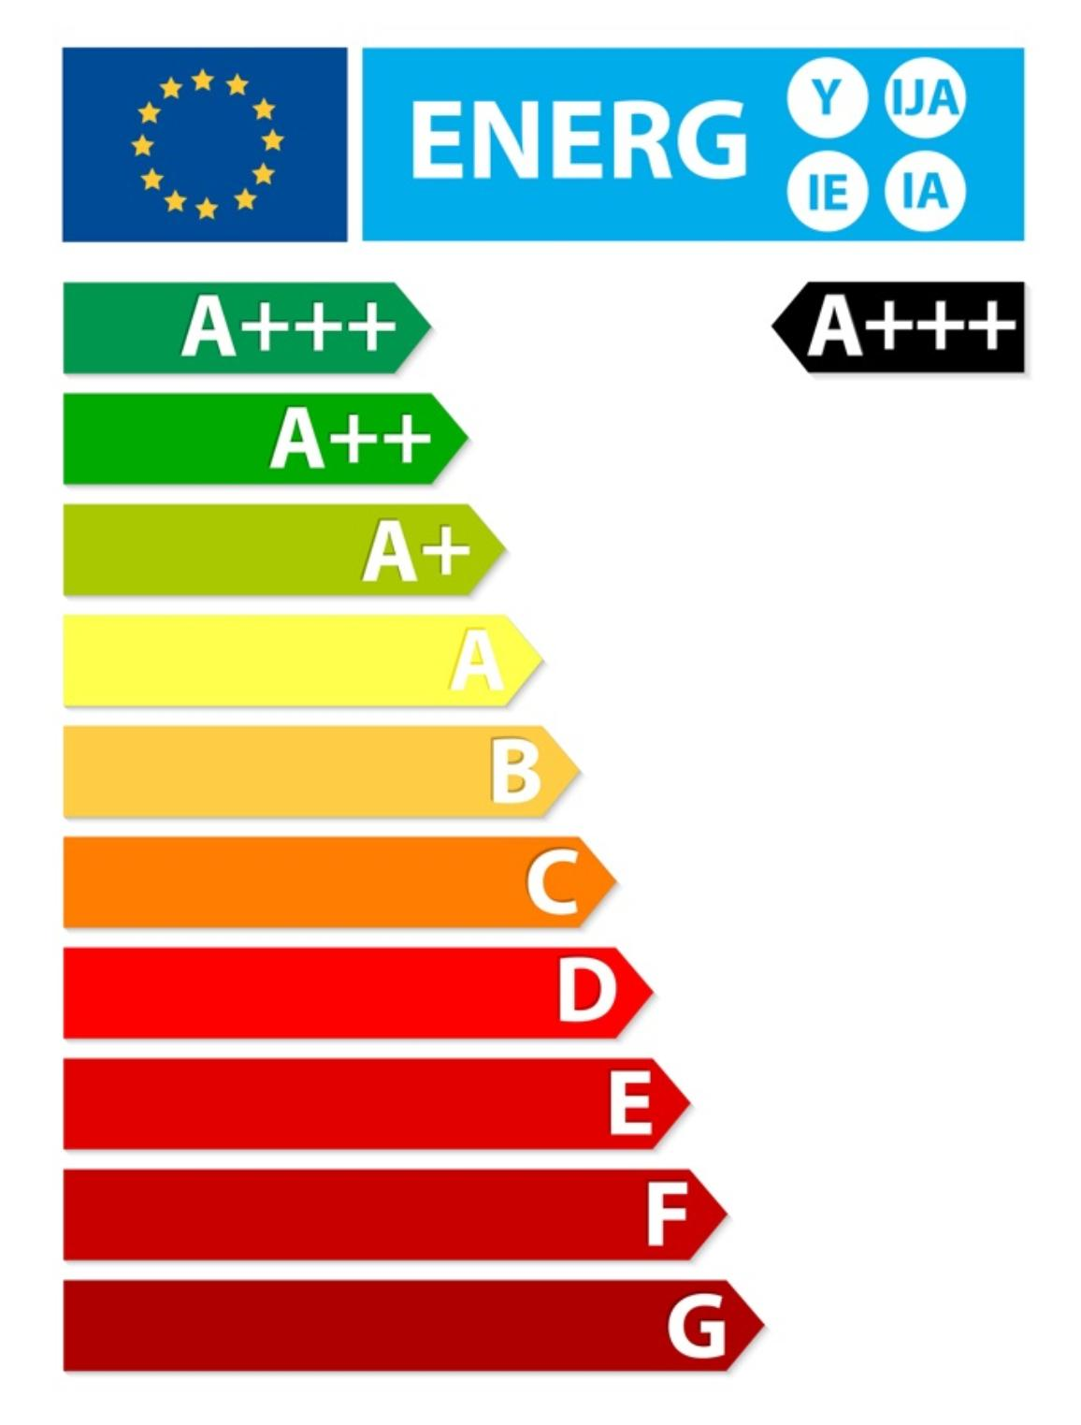
What can we do ?
replace lights
with led ones
use more efficient appliances
(washing machines, refrigirators, ac
use smart controls - devices to monitor energy needs

Slide 10
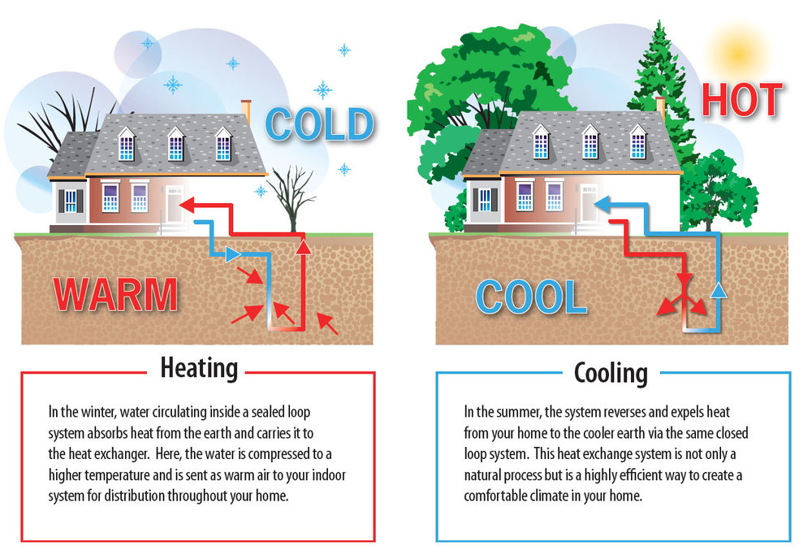
What can we do ?
replace heating system (heat pumps, solar energy)

Slide 11
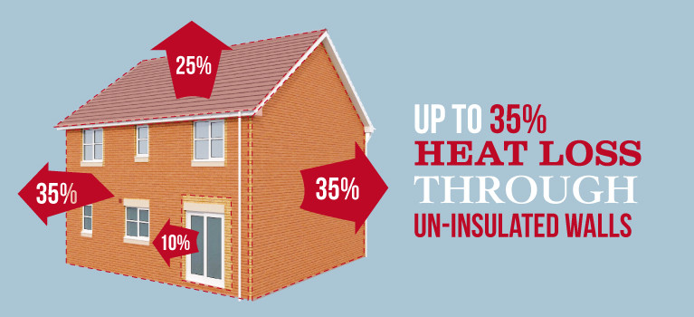
What can we do ?
insulate your home

Slide 12
What can we do ?
adopt plant based diet
don ‘t buy packaged food
don’t waste food
compost
grow your own food

Slide 13
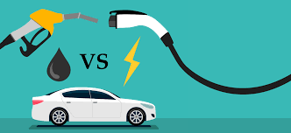
What can we do ?
use hybrid - electric cars
fly less if possible
use public transportation
walk when possible
avoid unnecessary travels
carpooling

Slide 14
What can we do ?
Educate people about what is really recyclable
Have industries deal with their packaging choices

Slide 15
What can we do ?
Minimalism

