Slide 1
ENVIRONMENTAL PROBLEMS IN OUR COMMUNITY

Slide 2
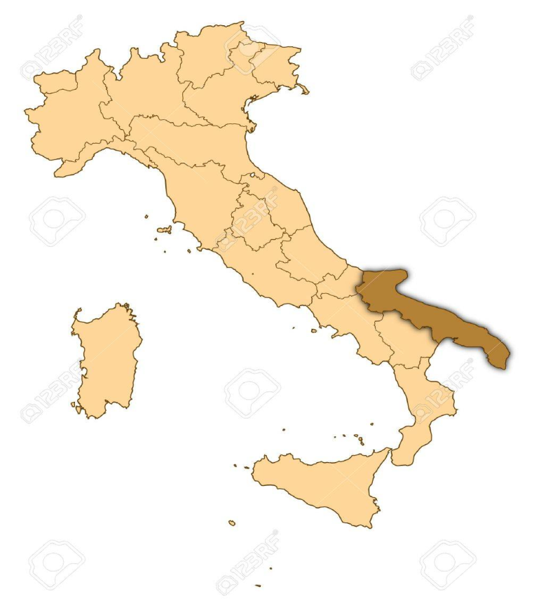
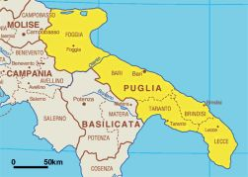
Where we live…
Italy geographical map
Apulia geographical map

Slide 3
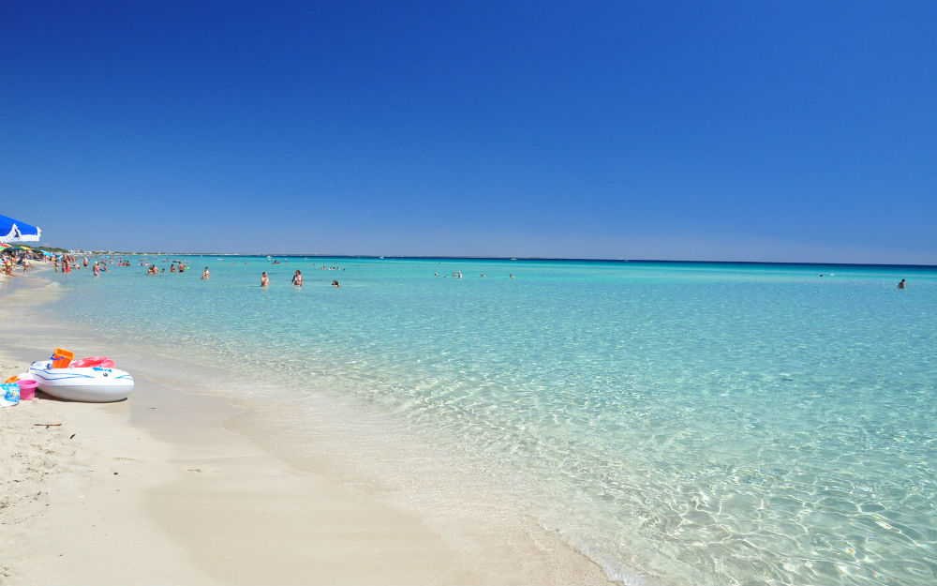
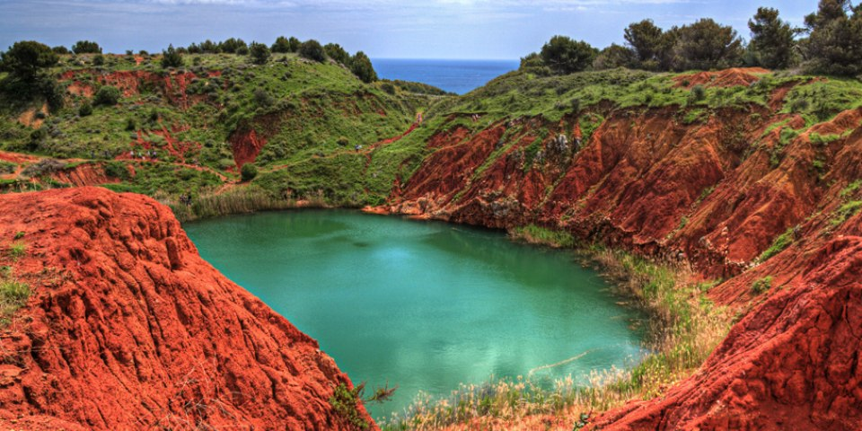
Our surroundings are characterized by very different landscapes:
Seaside located in the south side of Apulia
Bauxite cave, as known as ‘The Red Lake’

Slide 4
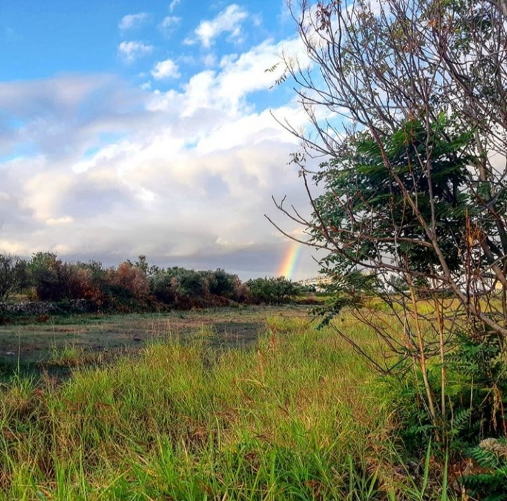
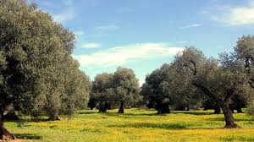
Countryside
Olive trees

Slide 5
Unfortunately, people often don’t take care of their environment
Reasons can be:
Bad habit
towards present and future generations
Lack of respect
towards the places around us

Slide 6
There are three types of pollution:
air pollution
soil pollution
water pollution

Slide 7
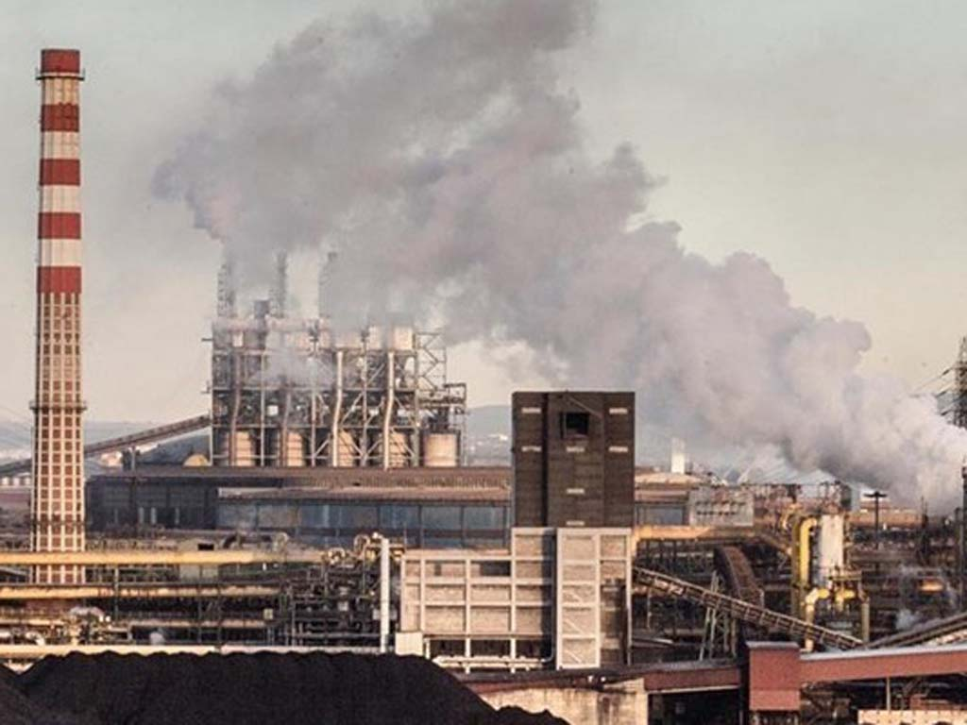
Air pollution
In Taranto we have the biggest steel industry of Europe called ‘ILVA’ that have always caused problems due to CO2 and other fossil fuels emissions.
Moreover the industry has also caused a lot of health diseases such as cancer

Slide 8
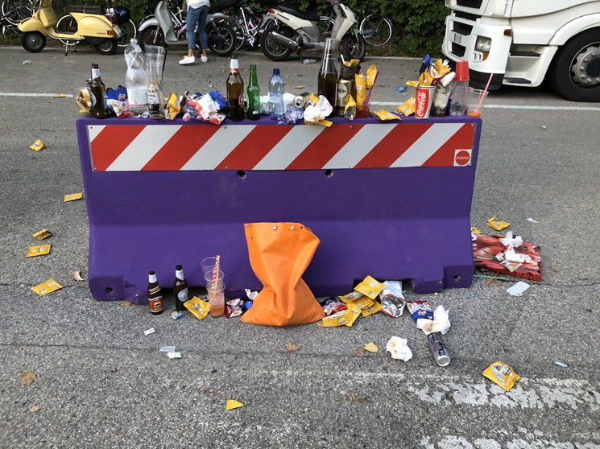
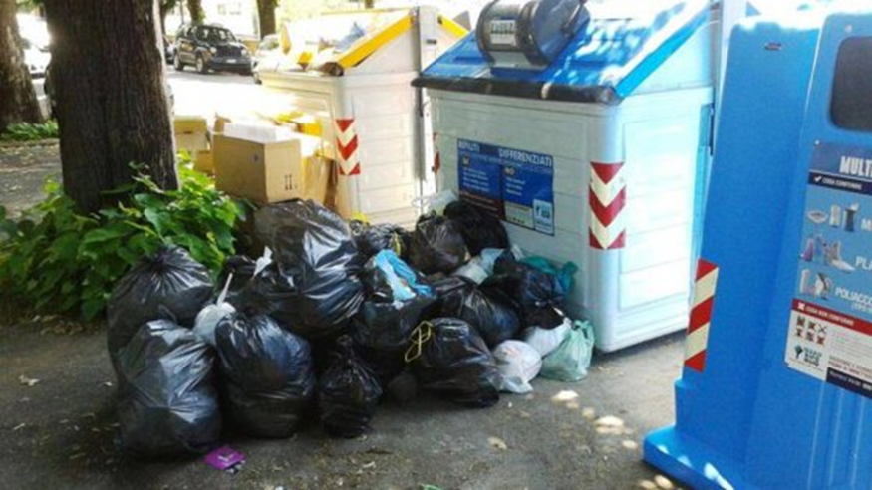
Soil pollution
People, often throw rubbish also when our cities are provided with litter bins

Slide 9
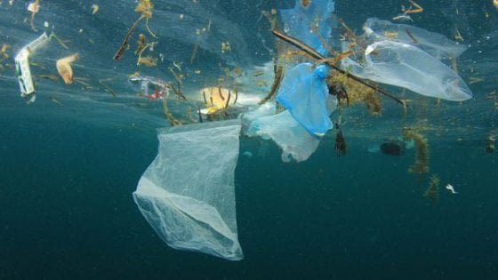
Water pollution
Seldom, seas, rivers and lakes are polluted by plastic and microplastics that comes from cosmetics such as shampoo and shower gel.
They can be dangerous to all the species that live there and as a consequence is seriously compromising for the food chain

Slide 10
Not every municipality has the same attitude towards the environment. Indeed, Bitetto, where our school is located, has been rewarded for having reached and overcome the average rate of recycling.
It is recognized as a Smart Green City because the 73% of the population showed an impressive committment in recycling

