Slide 1
Metereological Comparison in Villena (Spain)

Slide 2
Index
1-Graphic temperatures September, October and November 2019
2-Comparison with the previous 4 years
3-Wind Graphics September, October and November 2019
4-Comparison with the previous 4 years
5-Graphical rainfall September, October and November 2019
6-Comparison with the previous 4 years
7-Conclusions

Slide 3
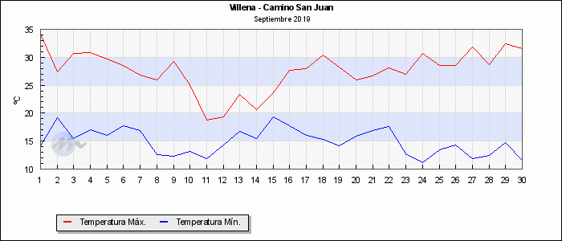
Temperatures for September 2019

Slide 4
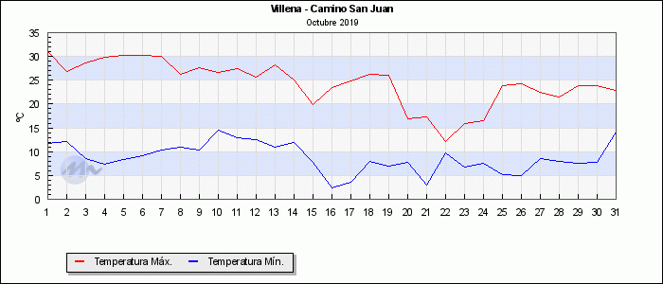
Temperatures for October 2019

Slide 5
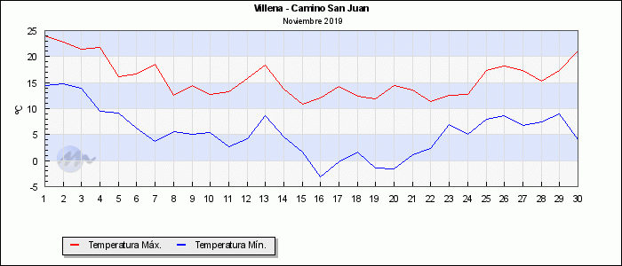
Temperatures for November 2019

Slide 6
Comparison of September temperatures during the last 5 years
September | Mean Temperature (ºC) | Mean High Temperature (ºC) | Mean Low Temperature (ºC)
2015 | 18.8 | 26.3 | 12.9
2016 | 21.0 | 30.1 | 13.2
2017 | 19.8 | 28.3 | 12.5
2018 | 21.0 | 29.0 | 14.9
2019 | 20.6 | 27.6 | 14.9

Slide 7
Comparison of October temperatures during the last 5 years
October | Mean Temperature (ºC) | Mean High Temperature (ºC) | Mean Low Temperature (ºC)
2015 | 15.4 | 21.7 | 9.9
2016 | 16.8 | 24.7 | 10.7
2017 | 16.3 | 25.6 | 9.0
2018 | 14.8 | 22.5 | 8.4
2019 | 15.8 | 24.4 | 8.8

Slide 8
Comparison of November temperatures during the last 5 years
November | Mean temperature (ºC) | Mean High temperature (ºC) | Mean Low temperature (ºC)
2015 | 10.0 | 17.7 | 3.3
2016 | 10.1 | 17.0 | 4.3
2017 | 8.5 | 18.5 | 0.4
2018 | 9.9 | 16.3 | 4.6
2019 | 10.4 | 15.8 | 5.4

Slide 9
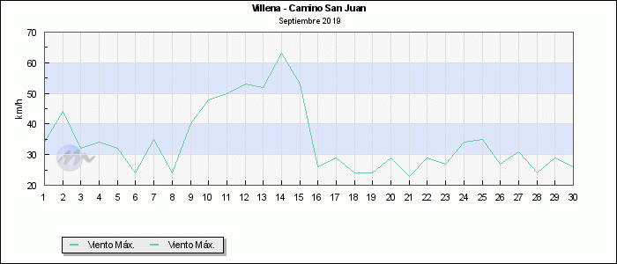
High Wind Speed for September 2019

Slide 10
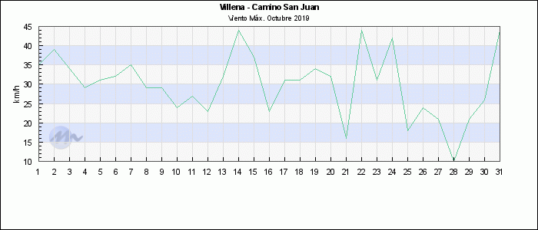
High Wind Speed for October 2019

Slide 11
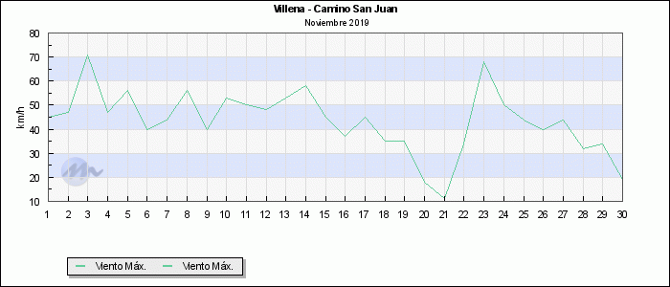
High Wind Speed for November 2019

Slide 12
High Wind Speed comparison during the last 5 years
September | Mean High Wind Speed (Km/h)
2015 | 27.6
2016 | 35.0
2017 | 34.3
2018 | 32.5
2019 | 34.5
October | Mean High Wind Speed (Km/h)
2015 | 23.1
2016 | 28.1
2017 | 28.7
2018 | 34.6
2019 | 29.8
November | Mean High Wind Speed (Km/h)
2015 | 21.9
2016 | 30.9
2017 | 26.0
2018 | 34.0
2019 | 43.3

Slide 13
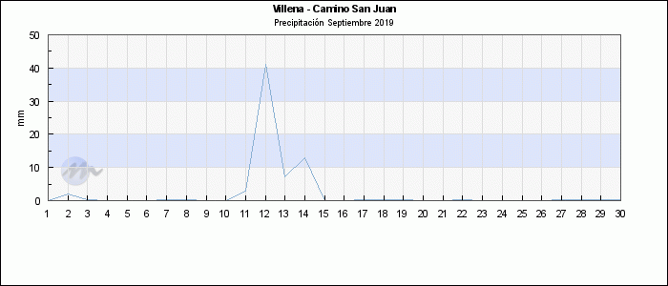
Precepitation for September 2019

Slide 14
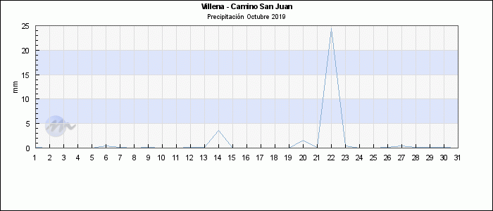
Precipitation for October 2019

Slide 15
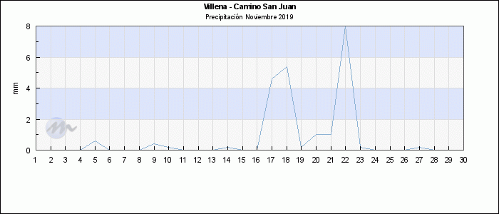
Precipitation for November 2019

Slide 16
Precipitation comparison during the last 5 years
September | Rain (L/m2)
2015 | 76.5
2016 | 21.8
2017 | 20.6
2018 | 36.2
2019 | 68.6
October | Rain (L/m2)
2015 | 23.4
2016 | 25.8
2017 | 7.8
2018 | 33.2
2019 | 32.8
November | Rain (L/m2)
2015 | 47.4
2016 | 45.2
2017 | 5.6
2018 | 44.4
2019 | 22.6

Slide 17
Conclusions
In 2019, September has been hotter (both the average maximum and minimum temperatures have been higher than in previous years). It has also been a rainier month than the average.
In 2019, October has had the same mean temperature but the mean maximum has been higher and mean minimum has been lower. It has also been a rainier month than the average.
In 2019, November has had a higher mean temperature with lower maximum temperature and higher minimum temperature. It has also been a less rainy month than the average.

