Slide 1
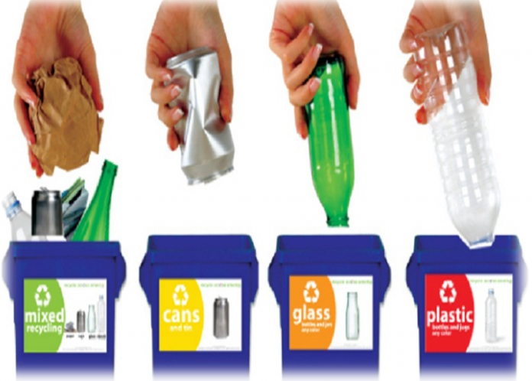
items from recyclable materials

