Slide 1
COLLECTION OF METEOROLOGICAL DATA

Slide 2
WHAT ARE METEREOLOGICAL DATA?
Metereological data are the result of an analysis of the present weather situation projected to the future thanks to complex mathematical models running on super computers
A mathematical model, in this context, is a computer program that produces weather information for future times related to certain geographical locations and altitudes.
To translate the data of these computers into something more understandable, such as the predictions that you normally see on television or on websites and newspapers, Often there are flesh-and-blood people who add their experience.

Slide 3
HOW TO COLLECT METEREOLOGICAL DATA?
Mathematical models work out predictions using very complicated equations (called differential equations describing physics and weather conditions dynamics). These are equations, impossible to solve exactly, that is analytically as you do with the school equations, because their nature is chaotic. The methods used to solve these equations are typical of numerical analysis and give only approximate solutions, that is with additional unavoidable errors.

Slide 4
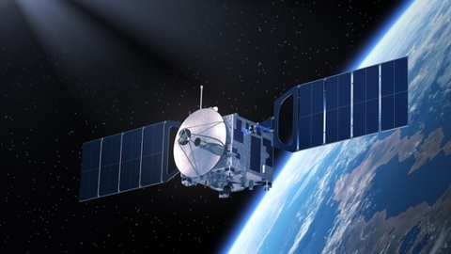
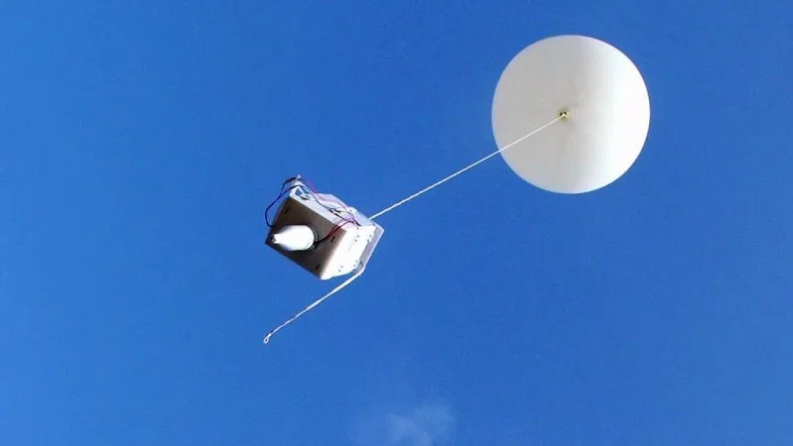
The data used to describe the initial situation are pressure, temperature, wind, relative humidity, etc. To obtain them, radio probes are used, meteorological satellites and surface meteorological observations or meteorological stations on land and ocean.

Slide 5
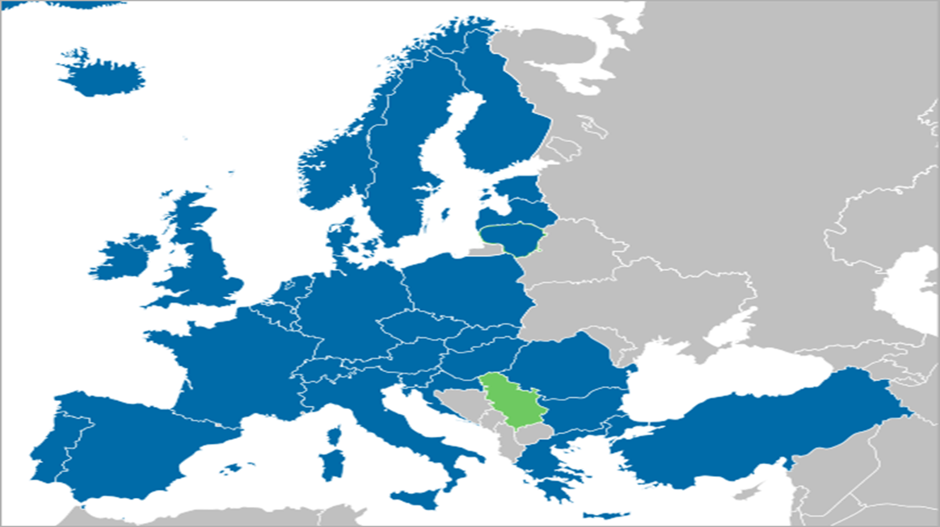
In Italy, who manage the collection of meteorological data is military air service. In turn, it receives data from an organisation called EUMETSAT which collects data for many European countries, including France.

Slide 6
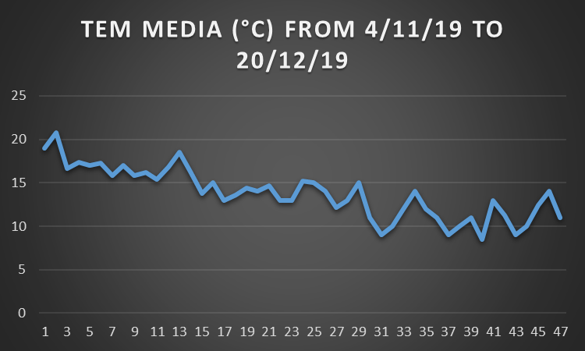
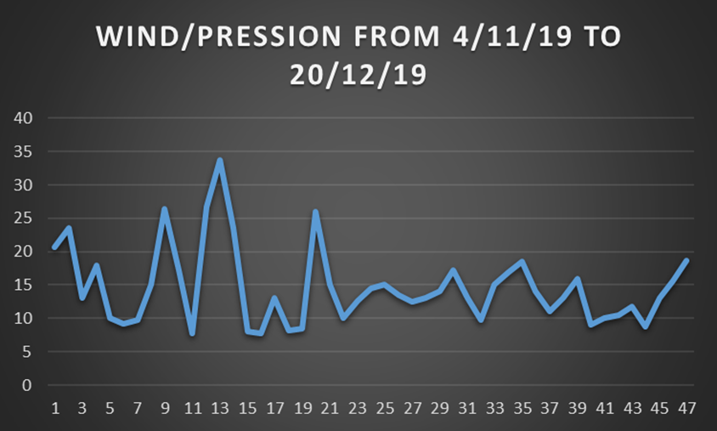
We decided to collect the meteorological data of our area in order to show you
(KM/H)

Slide 8
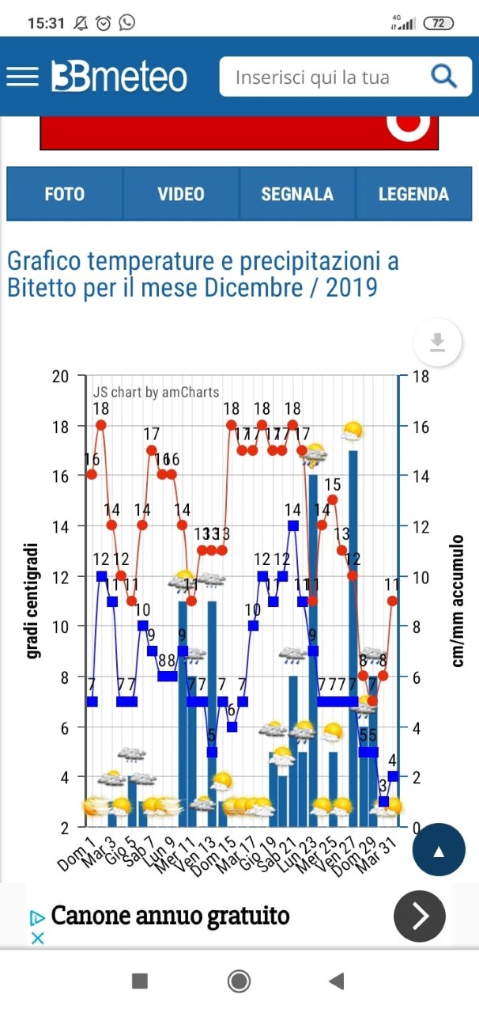
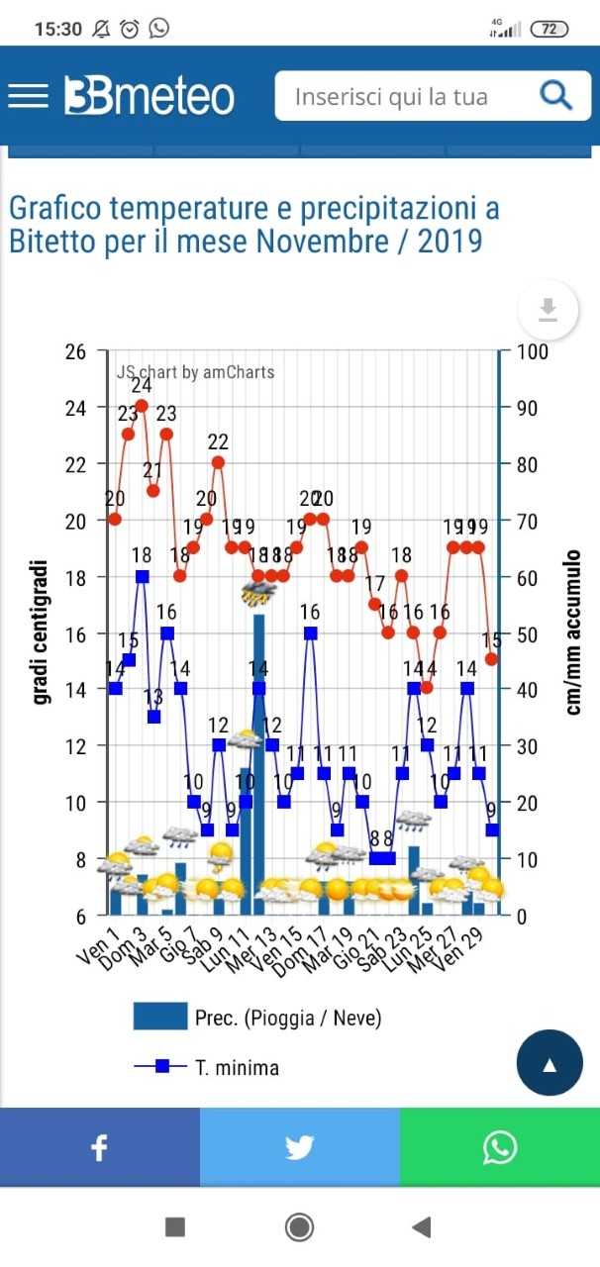

Slide 9
THE END
MADE BY:
VITUCCI STEFANIA
DI MAGGIO VITO

