Slide 1
PHOTOVOLTAICS
Celenza Margherita and Schiavone Annarita
A type of renewable energy

Slide 2
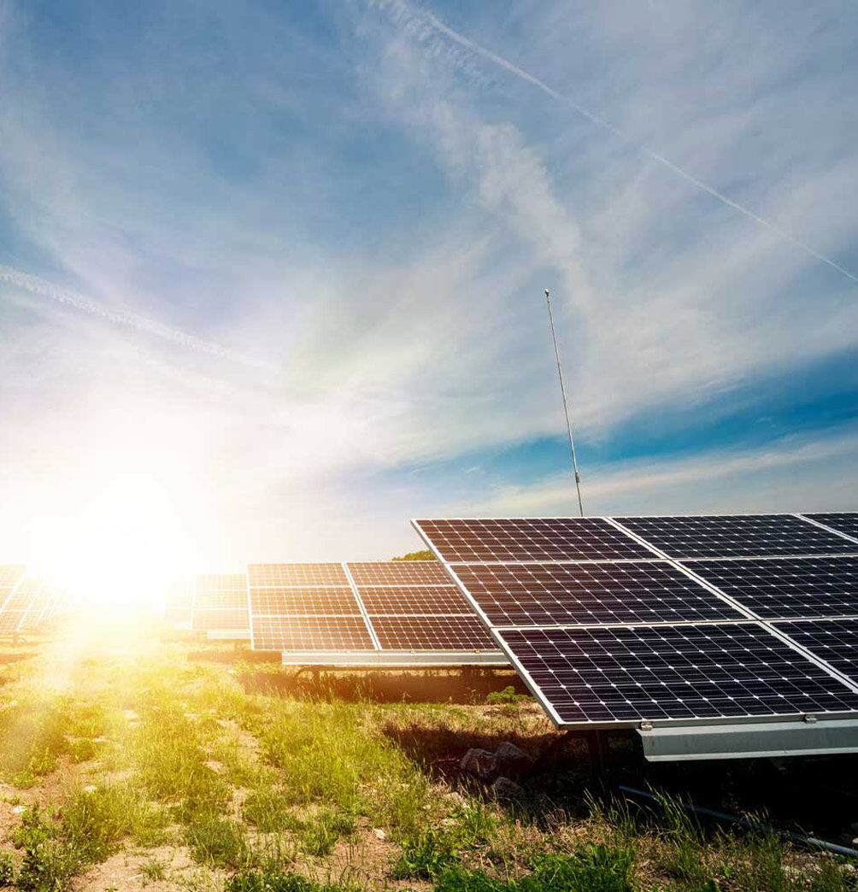
WHAT IS IT?
Energy from the sun’s rays is eco-friendly par excellence because it can be transformed into electrical energy in a direct and instantaneous way without using fuels.
Photovoltaic energy exploits the advantages of the solar source through the technologies of photovoltaic systems, consisting of solar panels that take sunlight and transform it into electrical energy. The conversion of light into electrical energy takes place in the photovoltaic cell, usually made up of silicon, the basic semiconductor of the energy generator.

Slide 3
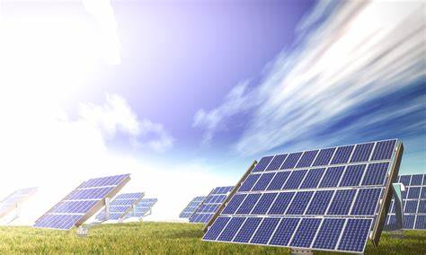
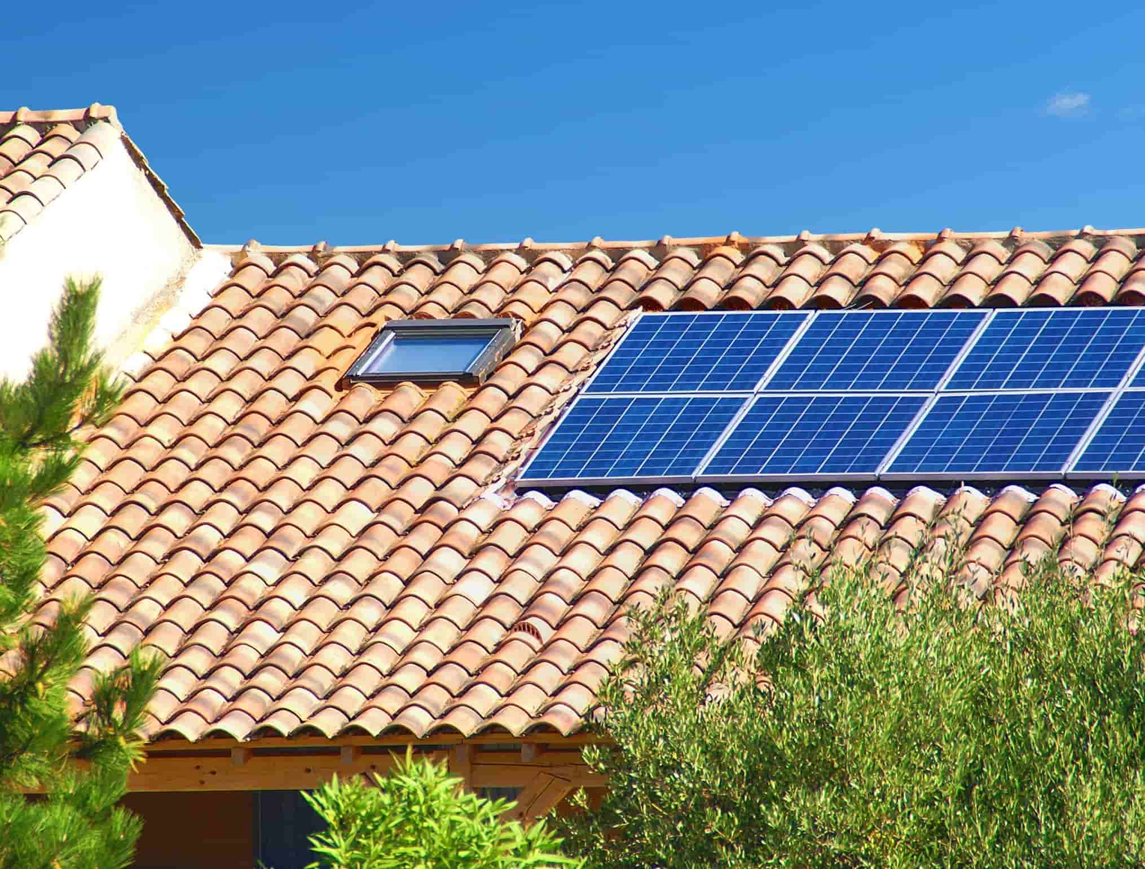
As a result, it is possible to produce renewable energy at home, for example by using a photovoltaic roof made of solar tiles that, according to the same principle, produce solar energy and guarantee energy efficiency.
In addition to domestic solutions, useful for guiding their daily choices towards a more sustainable future, most of the electricity production from solar sources in Italy is supported by large ground-based photovoltaic installations: understanding how it works allows us to deepen the benefits of photovoltaic energy and to understand why renewable energy production is a concrete solution for protecting the environment.

Slide 4
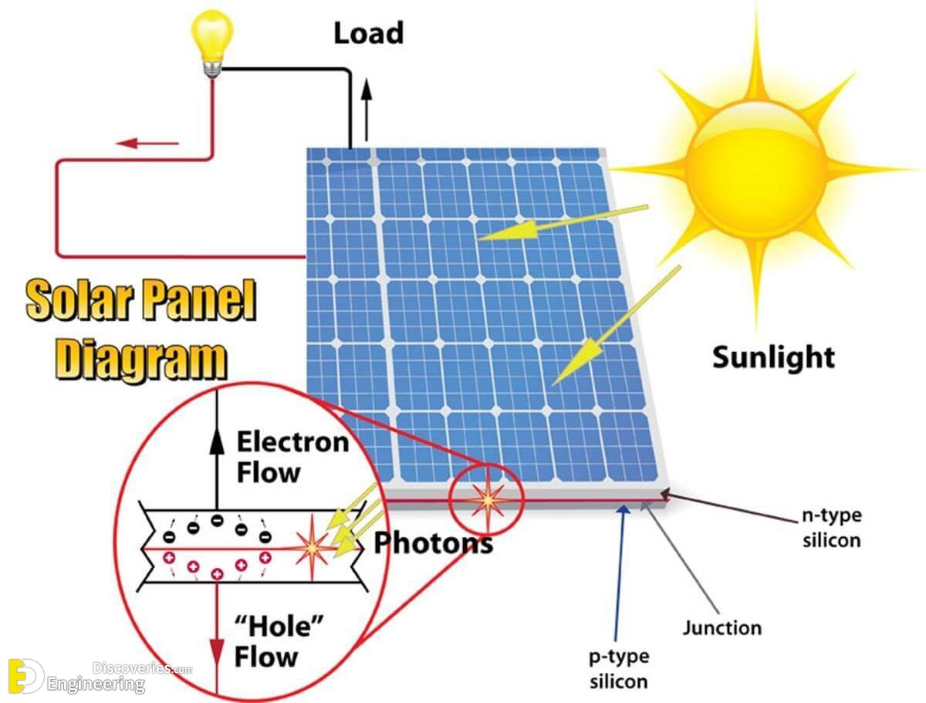
HOW THE SOLAR CELL WORKS?
The basis for the transformation of sunlight into clean electricity is the so-called "photovoltaic effect": when the sunlight hits a photovoltaic cell, consisting of a semiconductor material (similar, in principle, to that of computer chips), part of the energy contained in the light is captured and converted into electricity.

Slide 5
THE MATERIAL USED
The material used to build most photovoltaic cells is silicon, which can be
multi- crystalline
single
Monocrystalline photovoltaic cells have a pure, uniform and homogeneous silicon structure, higher efficiency, but higher cost.
Polycrystalline photovoltaic cells have a non-homogeneous silicon structure due to the less pure material used. Indeed, the efficiency of photovoltaic cells does not just depend on how they are produced, as polycrystalline cells are more efficient than single crystalline cells when temperatures are higher.

Slide 6
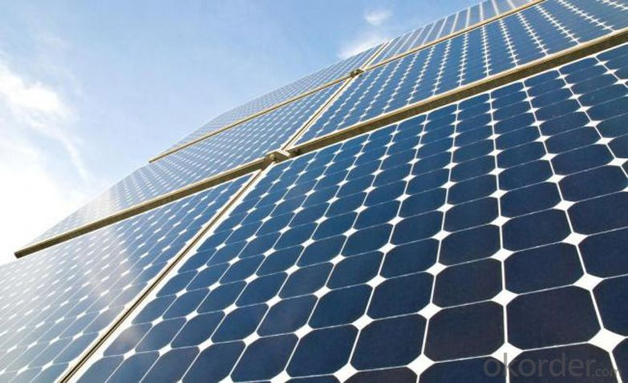
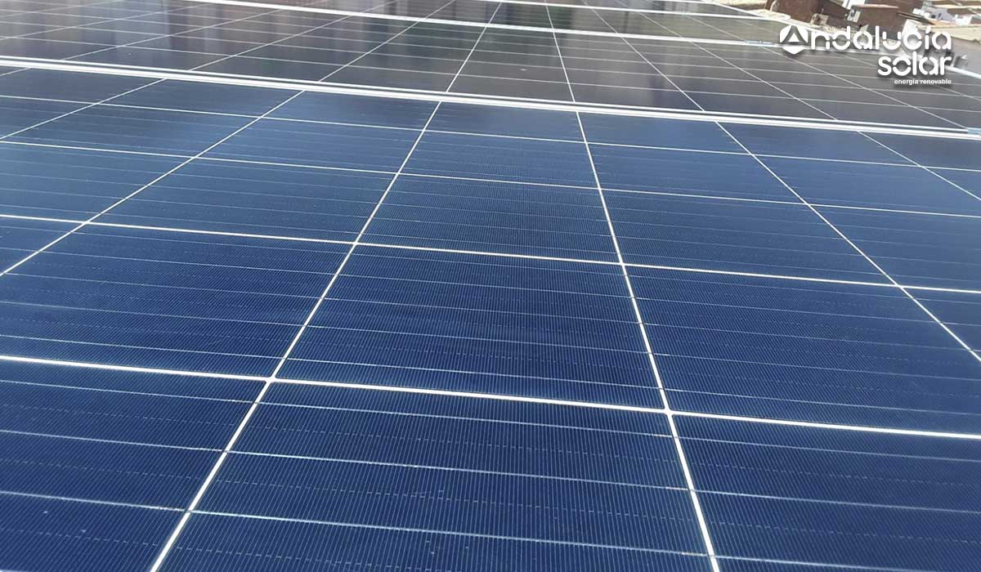
Polycrystalline photovoltaic cells
Monocrystalline photovoltaic cells
There are also other less common types of photovoltaic cells, such as amorphous silicon cells and those made not of silicon, but in other materials (cadmium tellurium or sulphide, gallium arsenide, indio- copper-gallium and others).

Slide 7
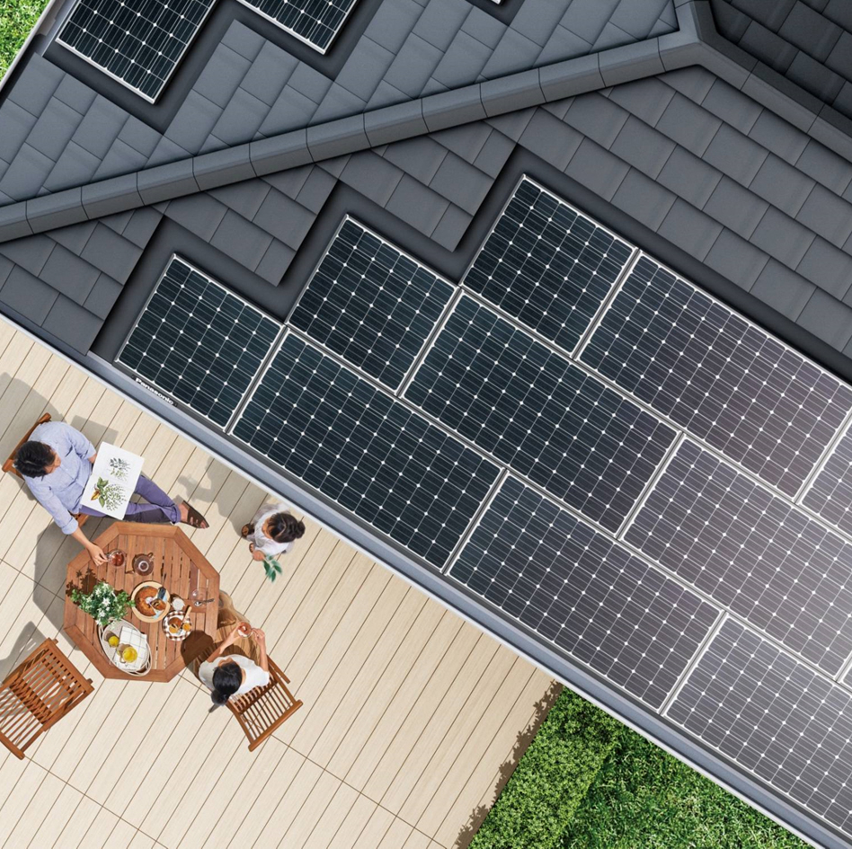
THE BENEFITS OF PHOTOVOLTAICS
The production of electricity from photovoltaic sources is entirely sustainable because it avoids the emission of CO2 and its primary source, solar energy, is unlimited.
Moreover, thanks to the simplicity of installation and operation of photovoltaic panels, it can also be used at home, directly on the roof of the house.
Finally, by not having to extract coal, methane or oil, it protects the environment from pollution and does not involve production, transportation or supply costs.

Slide 8
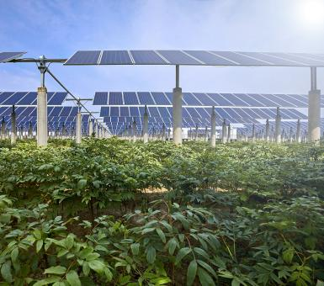
The greatest effort is planned for the large amount of photovoltaic panels needed for energy production: to optimize the spaces and not occupy fertile soils to be used for agricultural activity, large photovoltaic parks are installed on marginal or unusable land.
As with installation spaces, the management of the energy produced is also optimized: it can happen that in summer, due to the increased exposure, the production of solar farms is higher and leads to an excess of energy on the network. In this case, specific management methods begin to be used: storage batteries.
The latter, mounted near certain solar installations, have the task of accumulating the electricity produced in excess of the immediate needs, then returning it when the solar installation is inactive, for example in case of low sunlight or night.

Slide 9
HYDROELECTRIC ENERGY
Fazio Lavinia and Lomuscio Martina
Another type of renewable energy

Slide 10
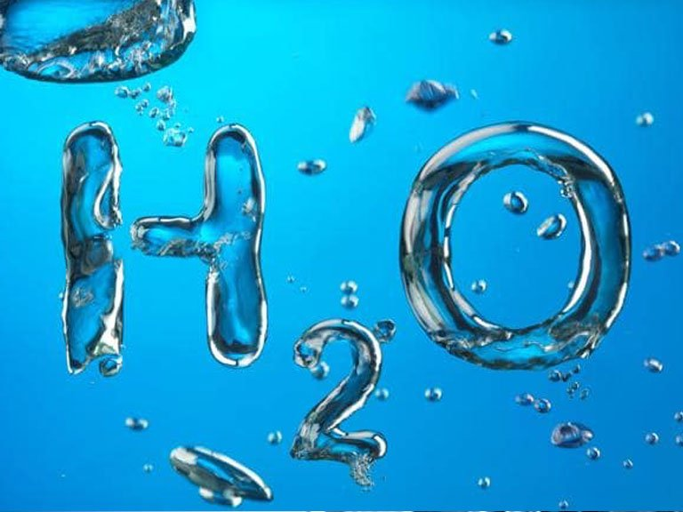
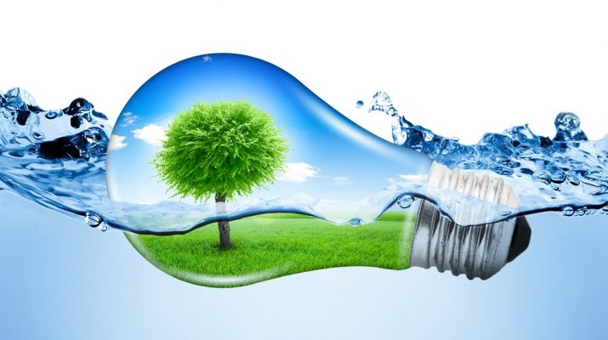
Hydroelectric energy, also called hydroelectric power or hydroelectricity, is a form of energy that harnesses the power of water in motion to generate electricity. People have used this force for millennia. Over two thousand years ago, people in Greece used flowing water to turn the wheel of their mill to ground wheat into flour.

Slide 11
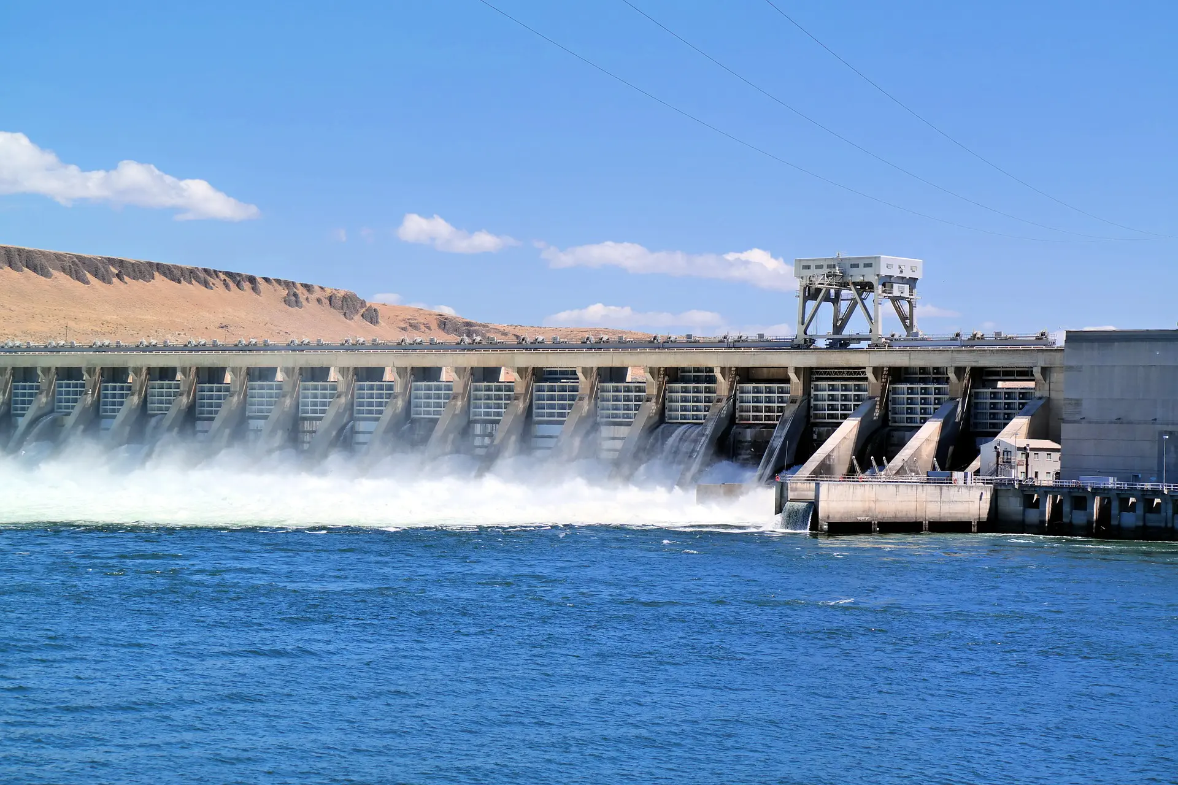
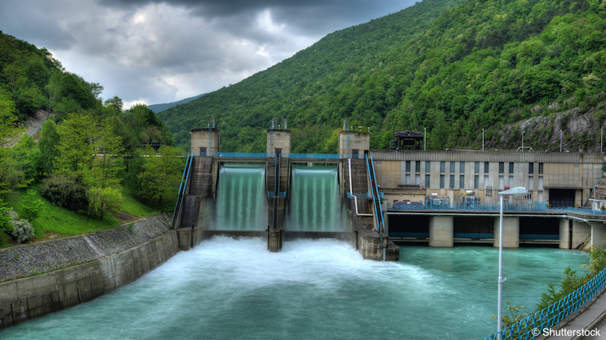
Most hydroelectric power plants have a reservoir of water, a gate or valve to control how much water flows out of the reservoir, and an outlet or place where the water ends up after flowing downward. Water gains potential energy just before it spills over the top of a dam or flows down a hill. The potential energy is converted into kinetic energy as water flows downhill. The water can be used to turn the blades of a turbine to generate electricity, which is distributed to the power plant’s customers.

Slide 12
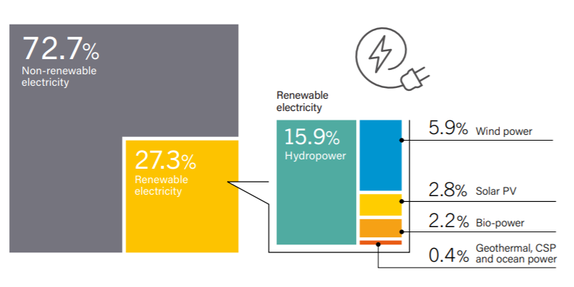
The single largest renewable energy source
•Hydroelectric energy is the most commonly-used renewable source of electricity. Approximately 71 percent of all of the renewable electricity generated on Earth is from hydropower.
•In its 2021 Hydropower Special Market Report, the International Energy Agency (IEA) reports that no country has come close to achieving 100% renewables without hydropower in the energy mix.

Slide 13
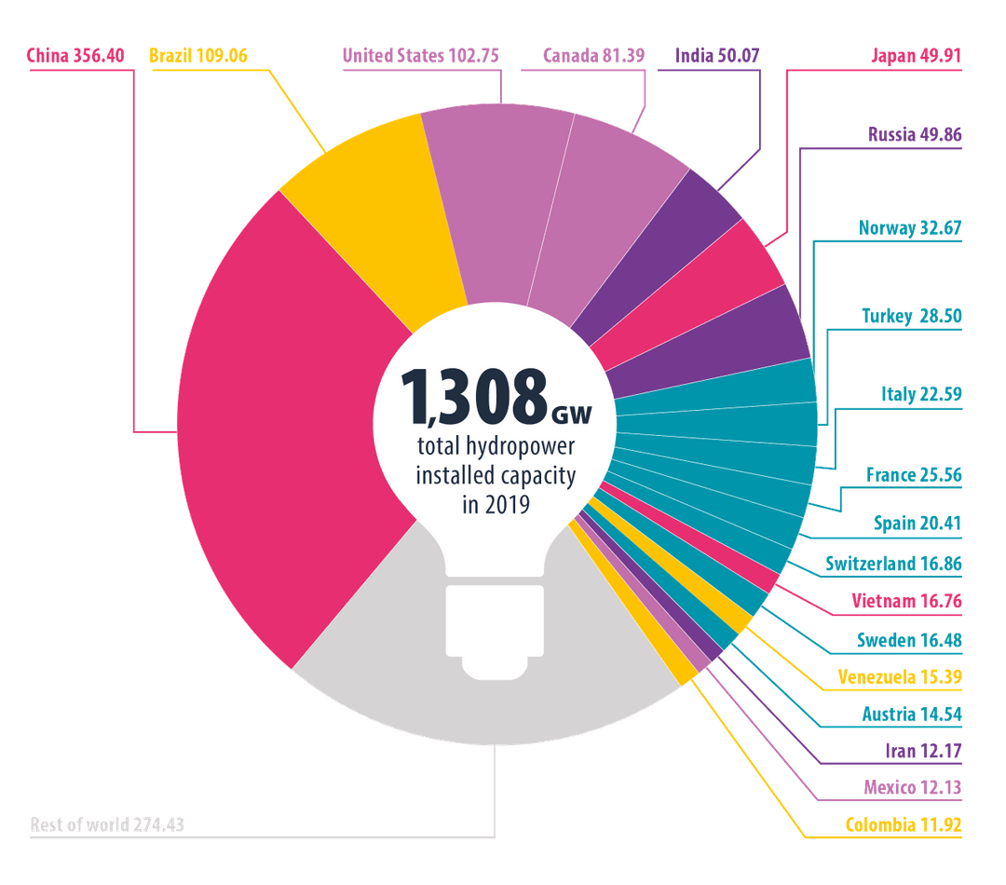
Hydropower installed capacity reached 1,330 gigawatts (GW) in 2020 as generation hit a record 4,370 terawatt hours (TWh). China, Brazil, the USA, Canada and India are the largest hydropower producers by installed capacity.
‍

Slide 14
Hydropower and the SDGs
Sustainable hydropower supports the achievement of the United Nations Agenda for Sustainable Development, as well as the Paris Agreement on climate change.
The 17 Sustainable Development Goals were adopted by all member governments of the United Nations and provide a blueprint of priorities for national governments, multilateral organisations, business and civil society. When responsibly developed and operated, hydropower projects can directly support the achievement of SDGs 6, 7, 9 and 13

Slide 15
WIND POWER
Afif Assiya and Stallone Dominga
ALTERNATIVE ENERGY SOURCES ENERGY SOURCES SOURCES

Slide 16
WIND POWER
Wind power is nothing more than the kinetic energy produced by the movement of air on the Earth’s surface, between high and low pressure areas. Able to contribute significantly to the creation of a carbon neutral future, wind power is constantly developing: if the current growth trends were confirmed, this green energy could by 2030 cover 20% of global electricity demand, with a consequent reduction in CO2 emissions of more than 3 billion tons per year.

Slide 17
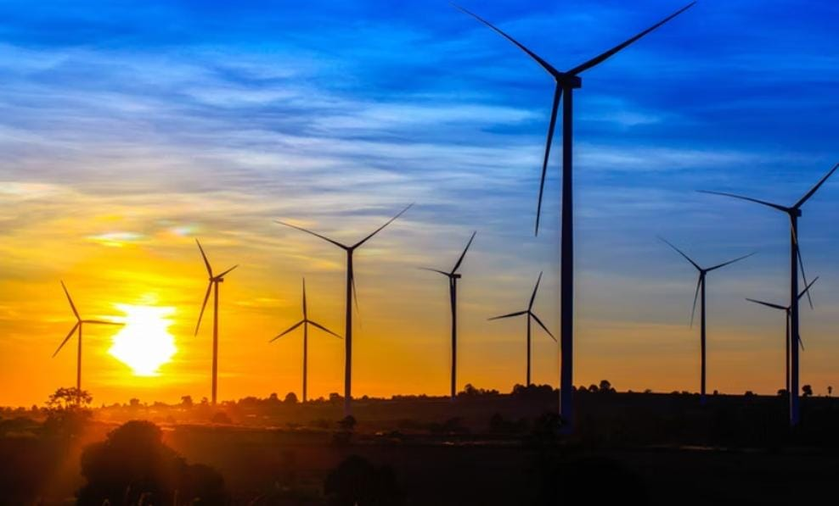
ADVANTAGES…
Wind does not pollute and does not produce waste because the wind is a renewable and clean energy source, as well as free of costs. It is an energy that is easy to find and produce. The useful life of wind turbines is amazing, so much so that wind farms can guarantee energy efficiency and be productive for 25 years without the need for special interventions. Developing in height, the wind turbines occupy little ground and have a reduced environmental impact, limited to their production and transport.

Slide 18
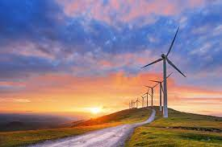
AND DISADVANTAGES
On the other hand, the wind
is a discontinuous energy source and the wind turbines, in addition to having a high cost that
can be amortized only in the long term, are a source of noise pollution and, especially in
coastal areas, impact visually and in a not inconsiderable way on the landscape.

Slide 19
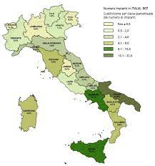
Wind energy
in Italy plays a central role: just think that 5% of European wind power is right in Italy and
that, according to data published at the end of the first half of 2019 by the National Agency
for New Technologies, energy and sustainable economic development, domestic wind
installations amount to 10,7 GW.

Slide 20
RENEWABLE RESOURCES IN ITALY
Sara Sassanelli,
Emanuele Polonio,
Devito Rossana

Slide 21
EVOLUTION OF FER IN THE THERMAL SECTOR IN ITALY
In Italy , the share of total consumption of thermal emergy (19,9%) is higher than expected (17,1%)
The renewable source most used in the thermal sector is solid biomass , mainly used in the domestic sector in the form of firewood ; the environmental heat exploited by heat pumps is also important , while the contributions oft he other sources are more contained .

Slide 22
EVOLUTION OF FER IN THE TRANSPORT SECTOR IN ITALY
Applying the fixed coefficients , the REF energy used in transport stands at 2.8 Mtep . The energy content of biofuels released for consumption is 1.35 Mtep .
The binding objective set by the Directive for the transport sector of 10% in 2020 was achieved : the share of REF is in fact equal to 10.7% , increase compared to the previous year .

Slide 23
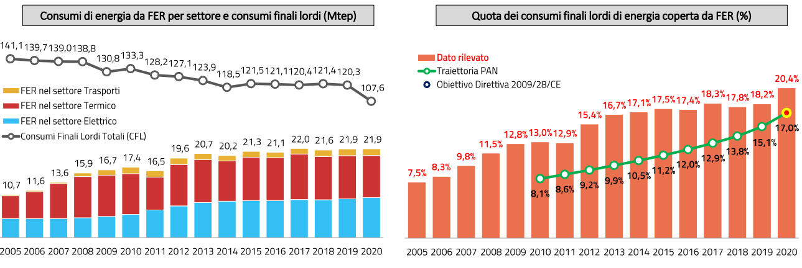
EVOLUTION OF RES AND TOTAL ENERGY CONSUMPTIONS IN ITALY
Between 2005 and 2020, in Italy, energy consumption from RES doubled, going from 10.7 Mtoe to 21.9 Mtoe. At the same time, it is possible to observe a progressive decrease in total gross final consumption (CFL) of energy, the significant decline was recorded in 2020 (from 120.3 to 107.6 Mtoe: -10.6%) is mainly caused by the contraction in consumption generated by the pandemic emergency.
In 2020, in Italy, 20.4% of energy CFLs are covered by RES. The 17% target set, for the same year, by Directive 2009/28 / EC and by the NAP - National Action Plan for renewable energy (2010), is therefore achieved.

Slide 24
EVOLUTION OF RES IN THE ELECTRIC SECTOR IN ITALY
In 2020 in Italy the quota of compulsive electricity consumption cut by RES (38.1%) resulted in significantly lower volumes than the prevalence of PAN per year (26.4%).
The font since 2020 has provided the main contribution to FER electricity production which is hydraulic (41% of complex production - normalized date); solar energy (21%), wind (17% - normalized data), bioenergy (17%) and geothermal energy (5%).

Slide 25
PUGLIA: ALTERNATIVE ENERGY SOURCES
Dattomo Marita,
Flora Daria,
Giovaniello Viviana,
Lacasella Sabrina,
Limitone Francesco

Slide 26
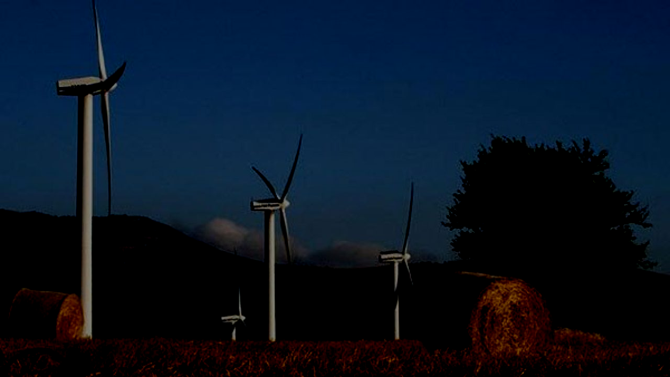
The Puglia region is the first Italian region producing alternative energy sources!
Let's see what it is...

Slide 27
On board the Green Train of Legambiente which arrived in Foggia, the Renewable Municipalities report was presented, which photographs the development of renewable sources in the Italian territories. The report shows that Puglia is confirmed as the top region for renewable sources. In Puglia, 100% of the municipalities have at least one renewable source plant on their territory. In the Puglierse area there are 43 thousand plants from renewable sources.

Slide 28
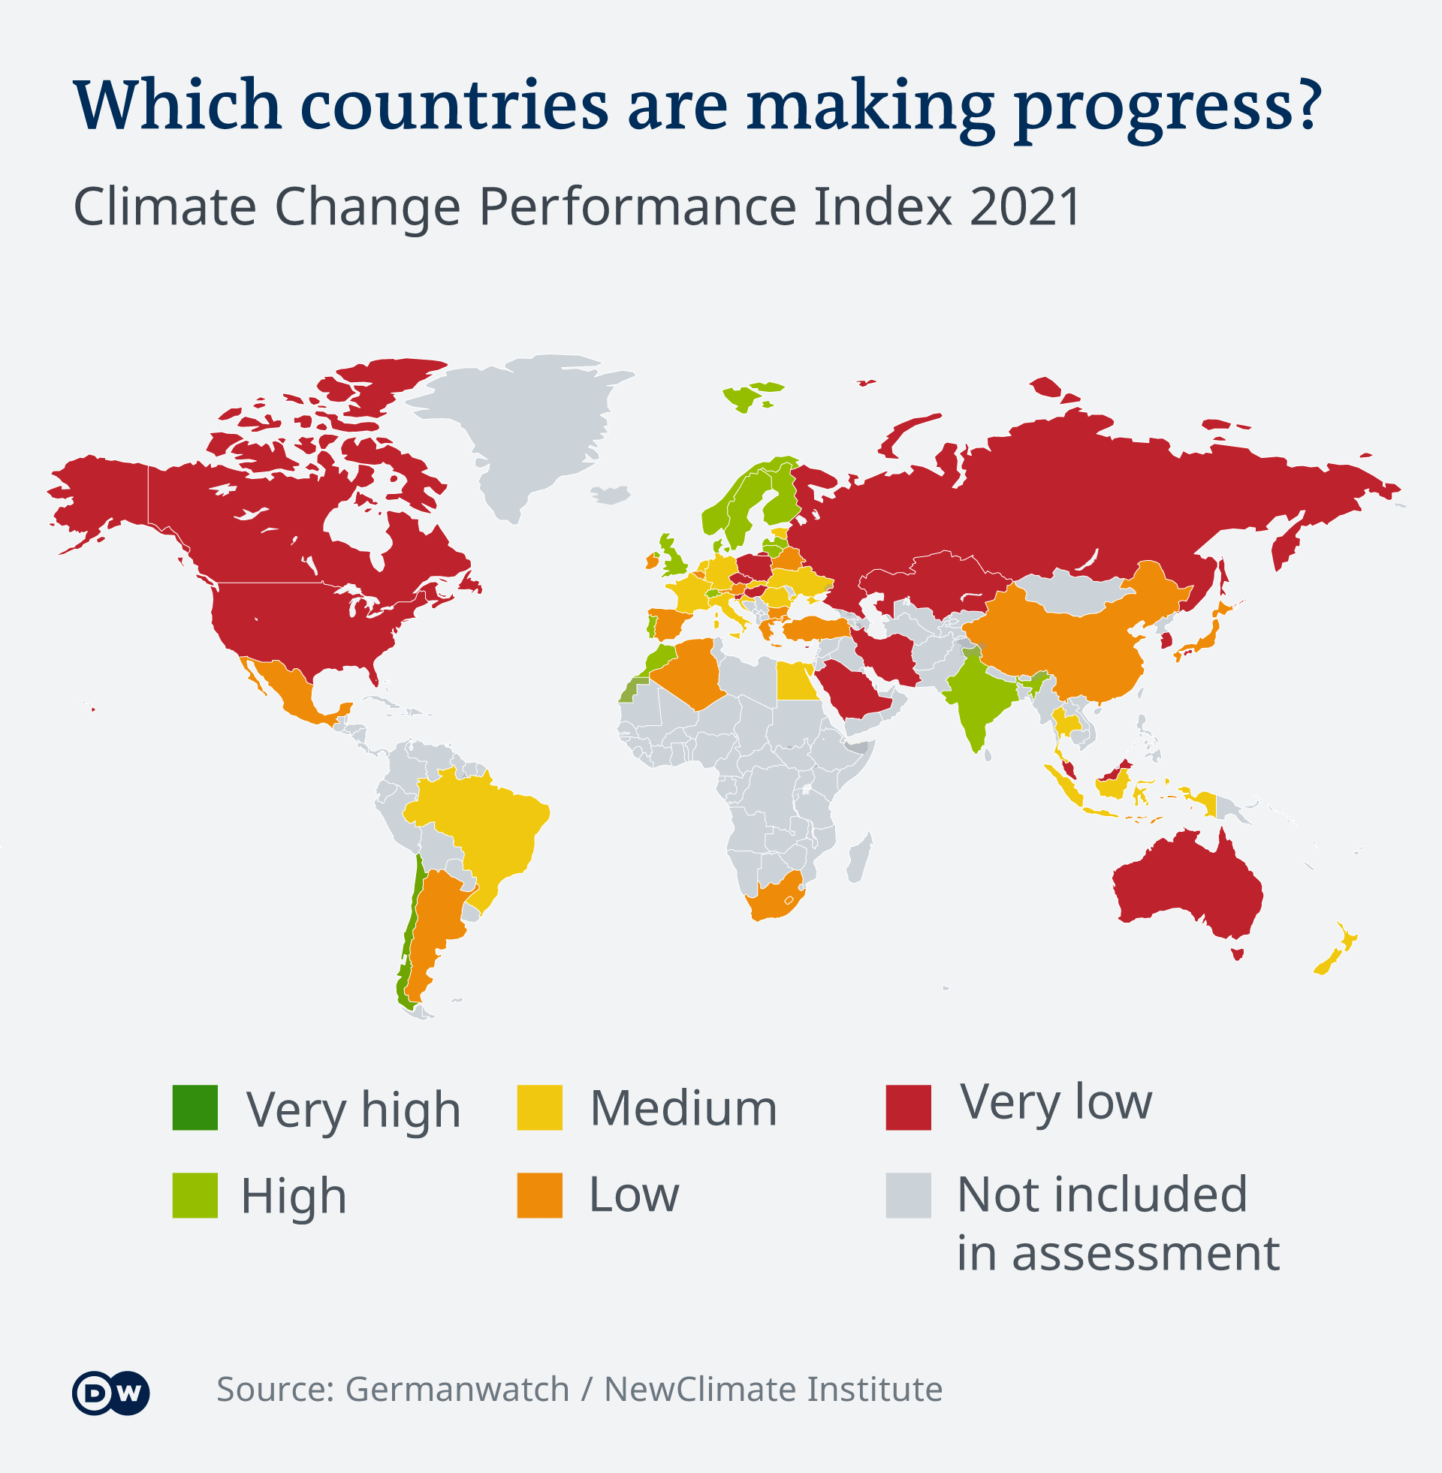
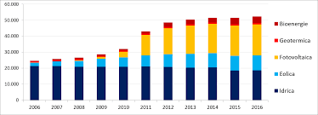
A climate AND ENERGY PLAN FOR A 100% RENEWABLE FUTURE FOR THE PUGLIA REGION for the development of renewables energy efficiency consistent with the National Energy Strategy and with the Paris Agreement. A plan capable of achieving the Region ambitious goals by 2030 and decarbonisation by 2050. A plan that makes adaptation and mitigation to climate change a economic and social development strategy for the territories, capable of enhancing regional resources and beauties. Rule simple and trasparent for the approval of projects from renewable sources. Energy and climate goals can be achieved only by introducing new investment boosting policies. The uncertainty of the procedures and the uncertain times today are one of the main barriers to the spread of renewable sources. The difficulties concern small and large interventions, which add to the bureaucracy, to the limits set by national guidelines and vetoes by the superintendencies (which often highlight a real obsession in wind power counterattacks)

Slide 29
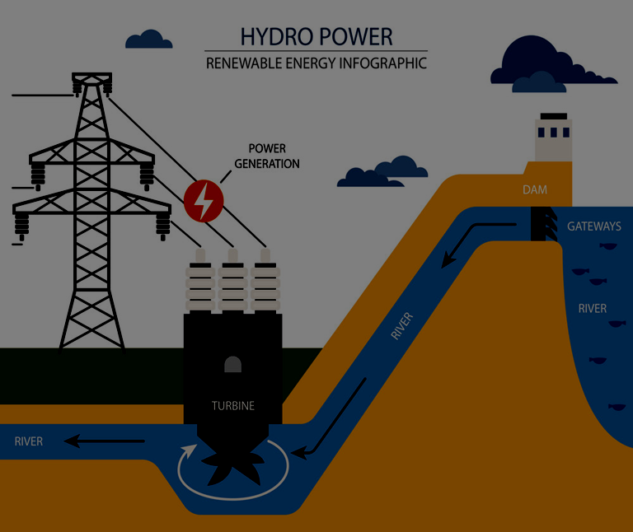
THE TOWNS OF HYDROELECTRIC
There are 9 towns in the Apulia Region that have hydroelectric plants on their territory, all of the mini hydroelectric category, capable of satisfying the electricity needs of approximately 6,200 families. Some are found for example in Corato or Andria

Slide 30
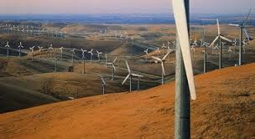
WIND ENERGY
GREEN WIND 2 SRL, a company of the Green Network Group, inaugurated on 27 December 2012 a new on-shore wind farm in Puglia with a total power of approximately 950 kW at the Lame district in Sant'Agata di Puglia (FG), an area between the richest in Italy in terms of wind resources.
The wind farm in Puglia uses the most advanced technologies currently available in the wind generation sector and produces approximately 2,350,000 kWh per year.
This quantity of energy is sufficient to meet the needs of approximately 1,084 domestic users.
Since the wind power plant in Puglia is directly connected to the national electricity grid, all the energy produced will be fed into the grid, encouraged by the GSE through the GRIN (Incentive Recognition Management) method.

Slide 31
Here is the list of six plants in wind farms:
Cerignola Veneta Nord wind farm (Municipality of Cerignola)
Cerignola Veneta Sud wind farm (Municipality of Cerignola)
Wind power plant Municipality of Ascoli Satriano (Foggia)
Wind power in the Municipality of Montemilone (Potenza)
“Banzi la Regina” wind farm (Potenza)
"Lampino" wind power plant (Municipalities of Orta Nova, Stornara -Foggia)
In addition, the Council of Ministers authorized the construction of a new 380/132 kV electricity station and new 380 kV and 132 kV lines. Development of the national electricity network in the Lucca area

Slide 32
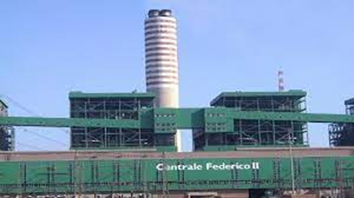
THERMOELECTRIC PLANT
The Enel Federico II plant is a coal-fired thermoelectric plant with a total capacity of 2640 MW. It is located near Cerano, in the Brindisi area. With an extension of about 270 hectares, it is the second largest thermoelectric plant in Italy and one of the largest in Europe.The plant consists of four sections with a steam cycle, with a capacity of 660 MW, which came into operation between 1991 and 1993 and achimney. For the containment of polluting emissions, the plant has systems such as:
a burner system to reduce NOx during the combustion phase;
denitrificators;
desulfurizers;
Electrostatic precipitators to reduce dust.

Slide 33
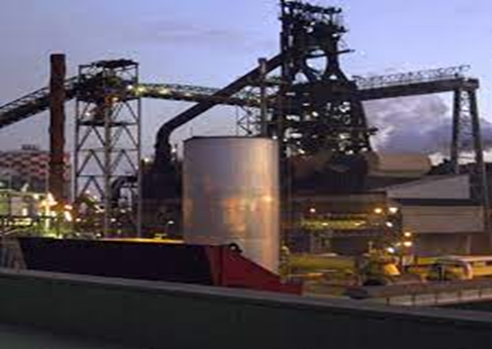
Taranto Energia S.r.l. uses the iron and steel gases of the Ilva plant for the production of electricity. The Taranto plant is equipped with a Safety and Environmental Management System. The results achieved in this sector are disclosed to the public in accordance with the Community eco-management and audit system of EC Regulation 1221/2009.

Slide 34
High school E. Amaldi

