Slide 1
A European green goal: clean energy and environmental sustainability against climate change
LICEO SCIENTIFICO E. AMALDI
BITETTO (BA)

Slide 2
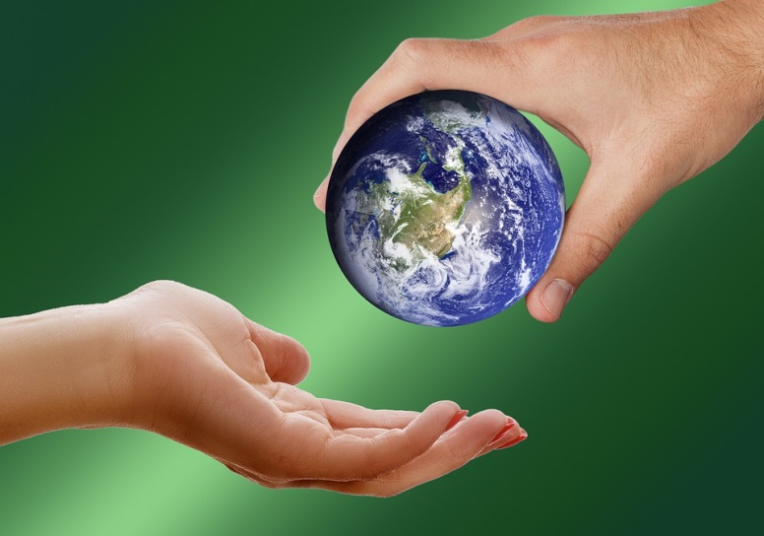
MAN AND ENVIRONMENT: A SINGLE ACTION CAN MAKE THE DIFFERENCE
Environmental degradation is worrying humanity only now because the planet is becoming more and more unlivable.
Unfortunately it was the man who caused all this and is continuing to do so.
In today’s society, waste and the problem of its proper disposal represent a danger for the future of the ecosystem, man's health and the Earth in general.

Slide 3
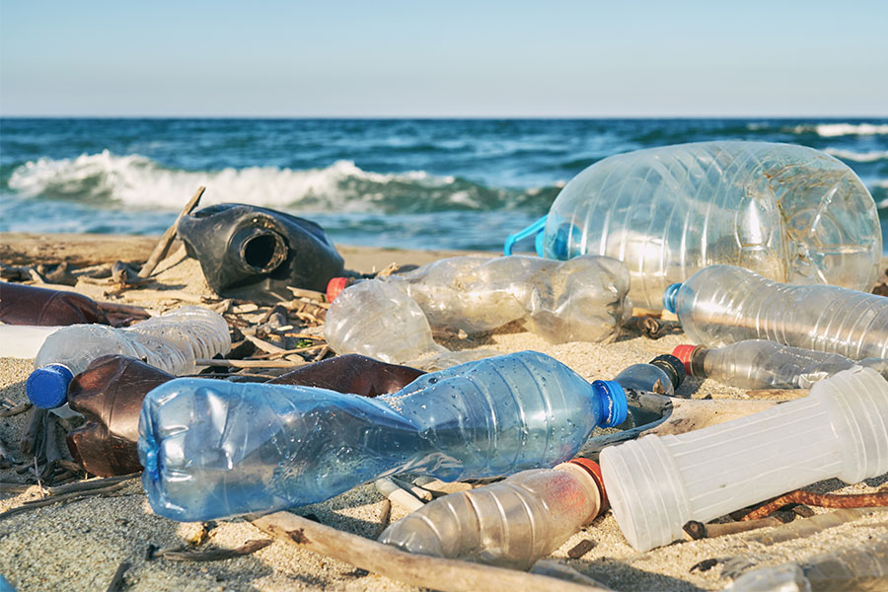
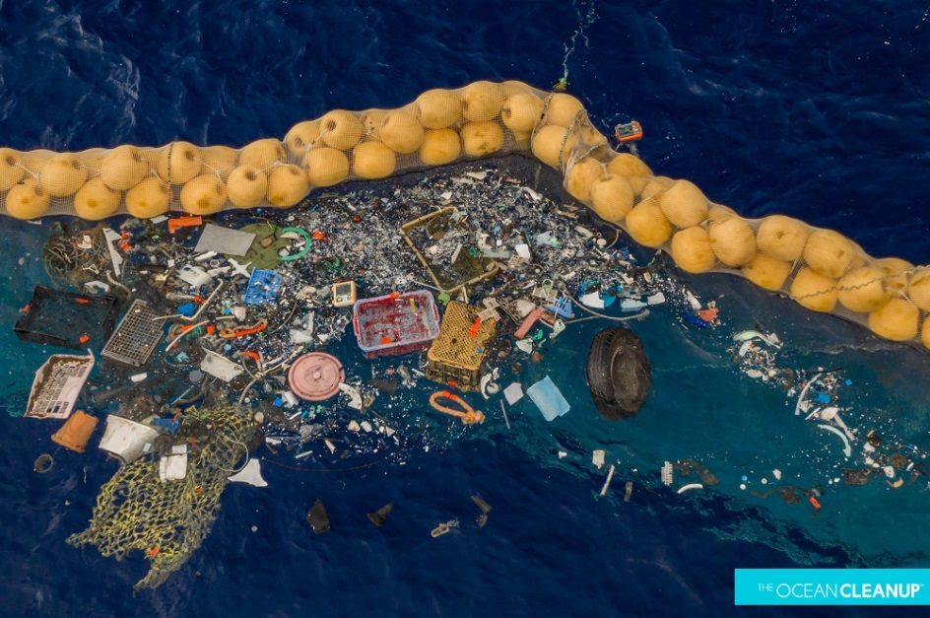
It has been estimated that between 60% and 80% of marine pollution is caused by plastic.
Million tons of plastic bags, bottles and other rubbish produce poisonous substances in our oceans

Slide 4
We are familiar with images of birds and sea creatures being killed by plastic they have swallowed or swum into.

Slide 5
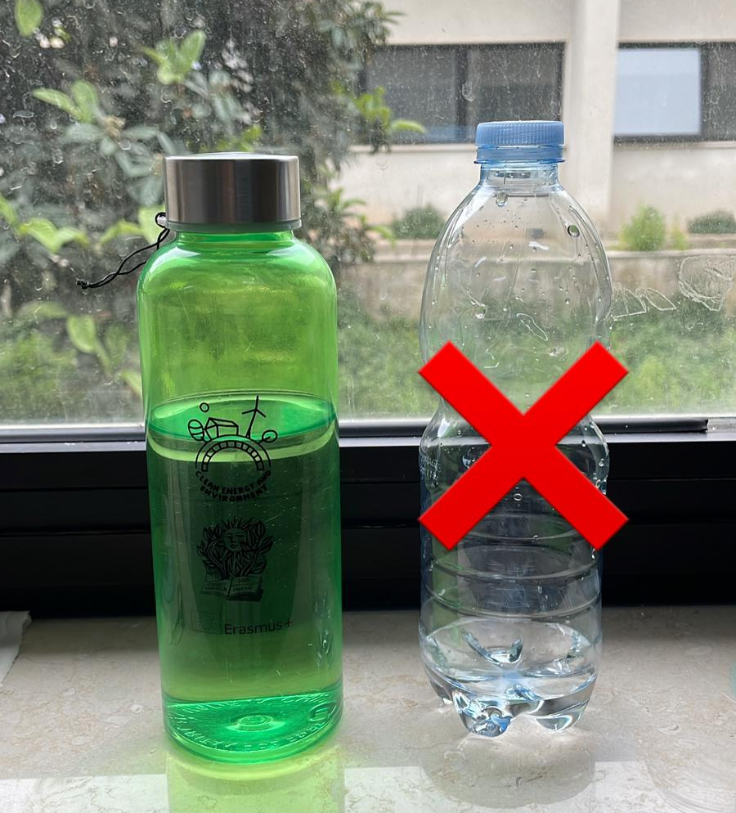
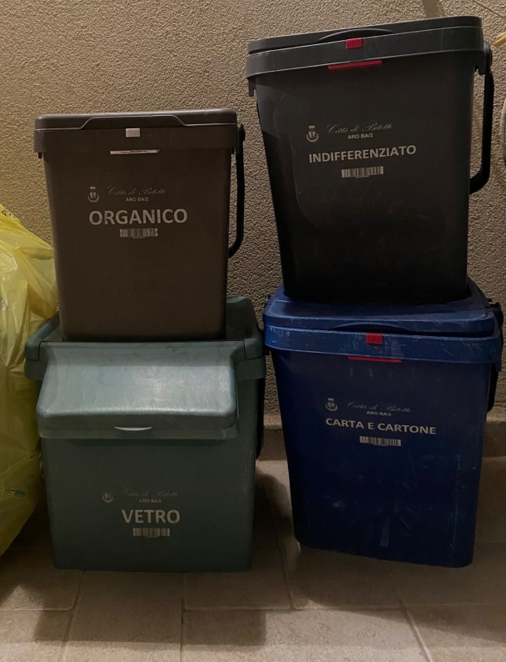
Here are a few actions we can take all to help ease the problem
Use recyclable items
Make separate collection

Slide 6
Buy food without plastic packaging

Slide 7
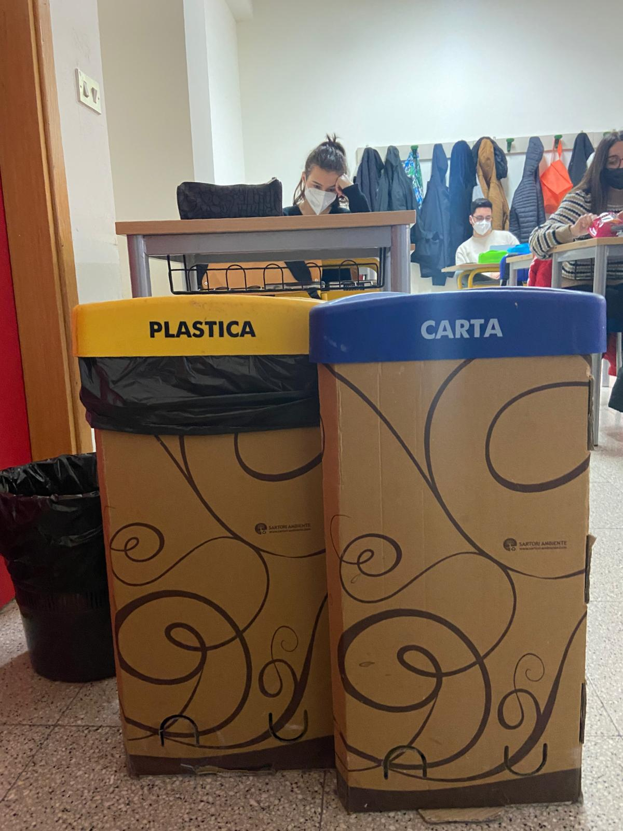
Even at school it is important to separate waste

Slide 8
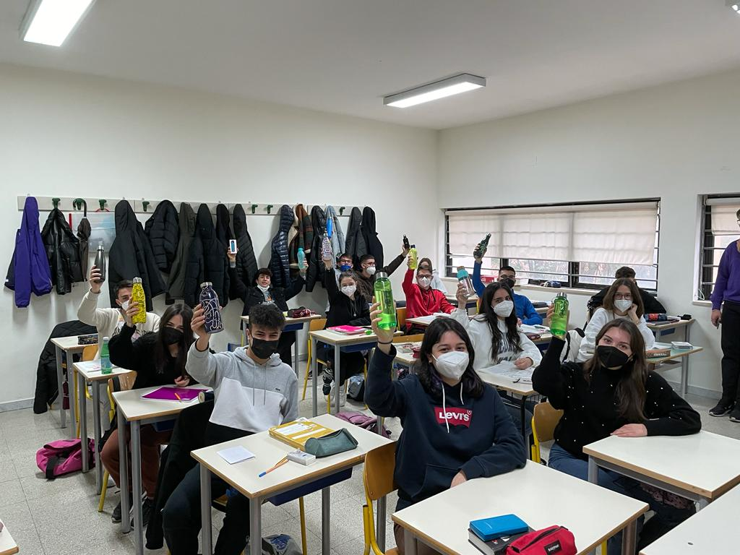
ONLY WITH THE HELP OF EVERYONE WE CAN MAKE THE DIFFERENCE

