Slide 1
Survey Summary
A European green goal: clean energy and environmental sustainability against climate change
Erasmus+ 2019-1-IT02-KA229-062189_4
Lithuanian team from Prienai Žiburys gymnasium
2020

Slide 2
PURPOSE
The goal – to ascertain students‘ opinions on pollution and its causes.
115 students of Prienai „Žiburys“ gymnasium participated in the survey.

Slide 3
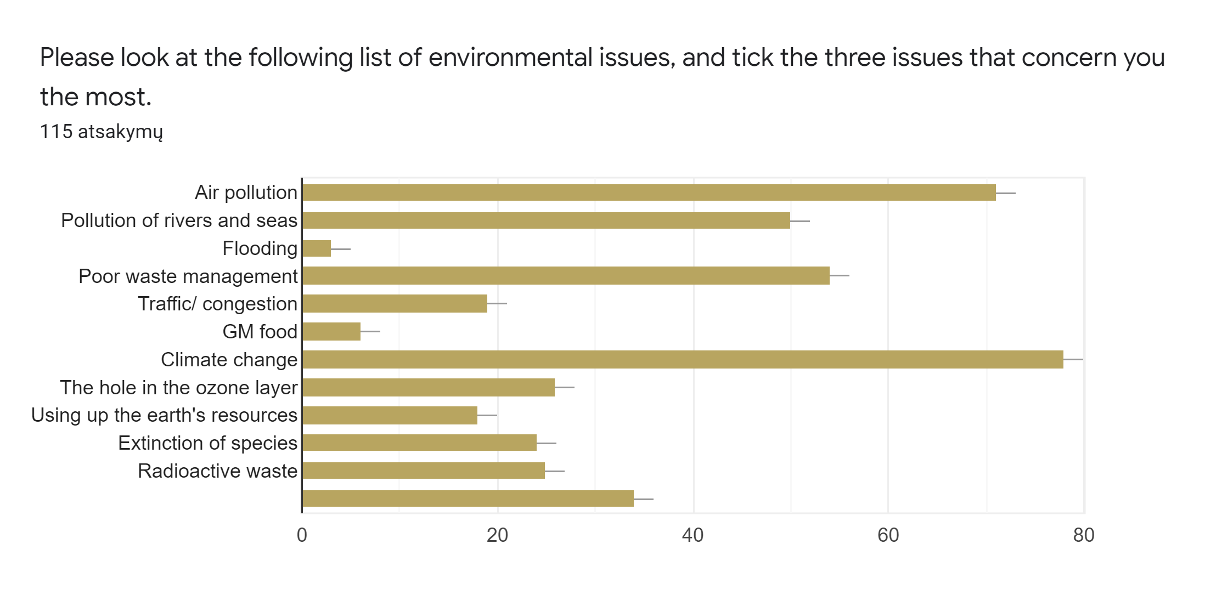
Environmental issues that concern students the most
We asked students to tick three biggest issues. Results showed that climate change, air pollution and poor waste management concerned our students the most.

Slide 4
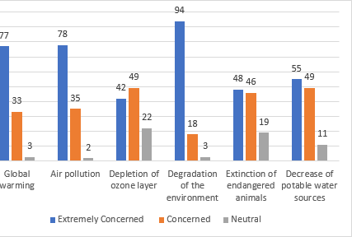
Highest concern level
Degradation of the environment causes the highest level of concern.

Slide 5
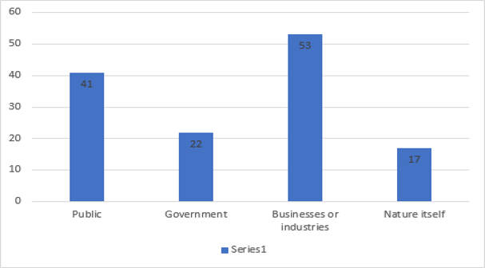
Who is responsible for the climate change?
In our students’ view, the biggest responsibility for climate changes should go to businesses and industries.

Slide 6
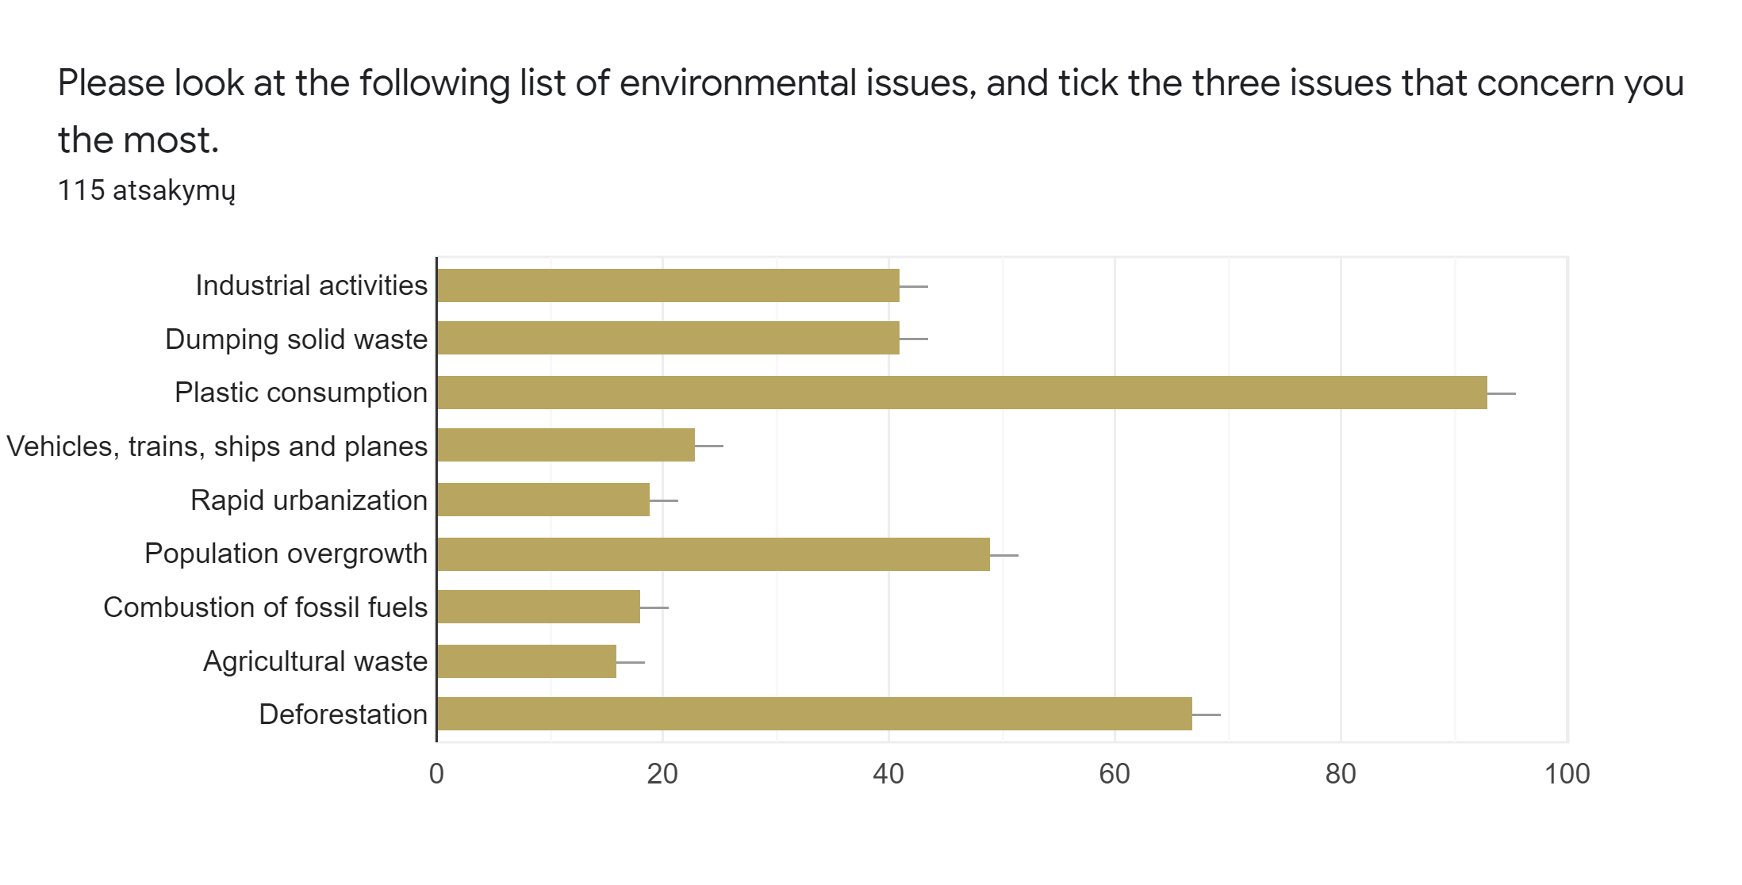
Environmental issues that cause most concern
93 students chose plastic consumption as one of the biggest environmental issues, followed by deforestation and population overgrowth.

Slide 7
We asked survey participants to indicate how much they agree with a few statements about climate change. (from 1 to 5. 1-strongly agree, 5- strongly disagree)
More than half of the participants strongly agreed that we can all do our bit to reduce the effects of climate change (53,5%).
40% marked that climate change isn't just a natural fluctuation in earth’s temperatures, only 3,5% agreed with this statement.
34,2% strongly agreed, 32,5% agreed and only 4,4% disagreed with proposition that climate change is something that frightens students.
43% agreed that society needs radical changes in order to tackle climate change.

Slide 8
We asked survey participants to indicate how much they agreed with a few statements about climate change. (from 1 to 5. 1-strongly agree, 5- strongly disagree)
46% strongly agreed that humans are severely abusing the planet.
Almost 53% strongly agreed that plants and animals have the same rights as humans to exist.
33% strongly disagreed and 40% disagreed that nature is strong enough to cope with the impact of modern industrial nations.

Slide 9
According to survey the most effective way to make sure that the environment is healthy for the future generations is for people learn to live with less and be more efficient users of energy and materials and to invent new technologies that could solve our enviromental problems.

Slide 10
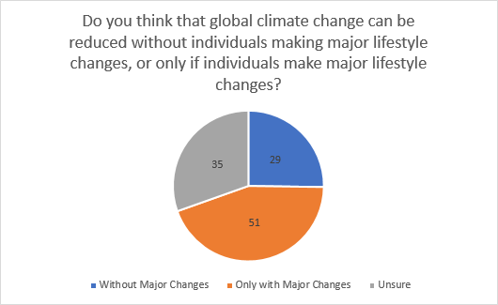

Slide 11
We asked participants to indicate how they contribute to nature conservation
72% walk or cycle to work for their own health.
Students use public transport because of convenience and in order to protect environment.
76% recycle glass and other items in order to protect the environment.
Turn off the light when leaving a room. It's an easy habit to take up which helps you save a lot of money and at the same time to protect the environment.

Slide 12
48% of the participants describe themselves as environmentally friendly.
63% are likely to change lifestyle to better suit the environment.

Slide 13
Conclusions
The students of Prienai „Žiburys“ gymnasium think that the biggest enviromental problems in their area are:
climate change,
air pollution,
inability to recycle.

