Slide 1
Electricity- saving campaign by students from Albert Camus

Slide 2


Slide 4
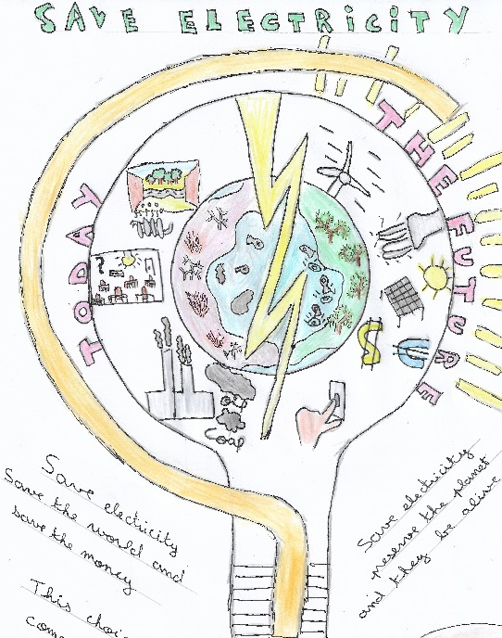

Slide 5


Slide 6


Slide 7
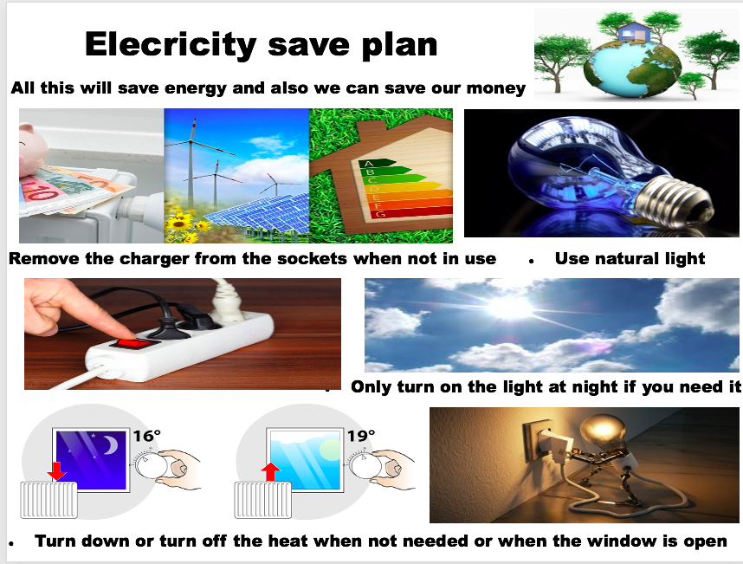

Slide 8


Slide 9
