Slide 1

AIR POLLUTION STUDY IN “LAS FUENTES HIGH SCHOOL” OF VILLENA
INDEX
WHAT IS URBAN AIR POLLUTION?
WHAT ARE THE MAIN HEALTH RISKS?
MAIN AIR POLLUTANTS
ATMOSPHERIC POLLUTION IN OUR CITY
ANALYSIS OF RESULTS
CONCLUSIONS AND MEASURES

Slide 2
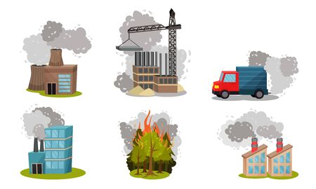
1. WHAT IS URBAN AIR POLLUTION?
Air pollution is the presence in the atmosphere of substances or forms of energy which represent a danger or damage to human being or the environment.
The current high levels of air pollution, in addition to affect people, animals, plants and goods, give rise to other problems related to changes in their composition, such as: climate change, acid rain and destruction of the ozone layer, phenomena that affect the entire planet globally.
The main sources of anthropogenic air pollution are:
Mining operations
Farms
The burging of fossil fuels
Deforestation

Slide 3
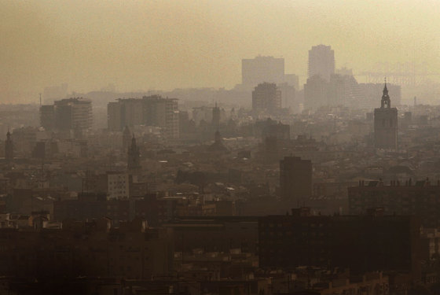
Air pollution in the city of Valencia
In this study we are going to focus on air pollution in large cities, the health problem. Urban air pollution is a serious problem in many large cities around the world. Intense and incessant traffic, joined to factories and emissions from domestic heating, turns the air of cities around the world into veritable smog clouds. Particulate pollutant levels often exceed the WHO safety limit for human health.

Slide 4
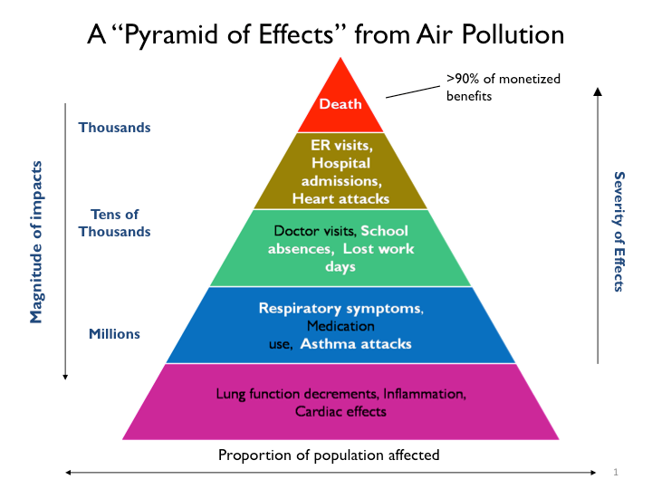
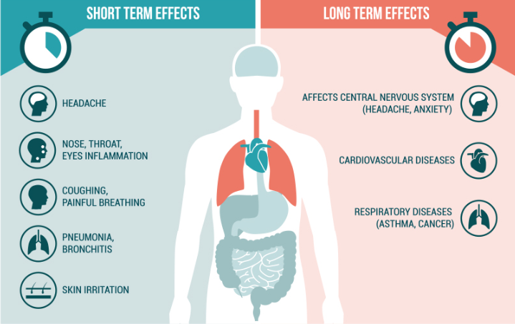
2. WHAT ARE THE MAIN HEALTH RISKS?
The main health effects of air pollution range from impaired lung function, heart problems and other symptoms and discomfort to an increase in the number of deaths, hospital admissions and emergency visits, especially for respiratory and cardiovascular causes.
The effect of air pollution maintains a gradation both in the severity of its consequences and in the population at risk affected. Thus, as the effects are less severe, the percentage of the population affected is higher.

Slide 5
3. MAIN AIR POLLUTANTS
As to the origin of the air pollutants, they can be classified as:
Primary pollutants: are those emitted directly from a source, which may be natural (volcanic eruptions or fires, for example) or anthropogenic (carbon monoxide from vehicles).
Secondary contaminants: they are not emitted directly. Its origin lies in the interactions between primary pollutants in the atmosphere. One of the most well-known secondary pollutants is tropospheric ozone.
The main air pollutants to be discussed below are:
Carbon dioxide CO₂
Nitrogen dioxide NO₂
Sulphur dioxide SO₂
Tropospheric ozone O₃
Particulate matter in suspension PM

Slide 6
Carbon dioxide (cO₂)
Emission sources
The main man-made CO₂ emissions are derived from the use of fossils fuels (such as airplanes, cars, trucks, motorcycles, etc.), there are alsoderived from large industries and factories, although it is estimated that the air pollution produced by vehicles is higher
Health and environmental effects
Carbon dioxide is a colorless, odorless gas whose origin may be both in natural sources and in human activity itself. Its consequences are very important both in the quality of the indoor air we breathe and in air pollution and the emission of greenhouse gases.
The concentration of CO₂ has increased by more than 30%, that is, it is the most influential gas, responsible for 70% of global warming.
This greenhouse effect generates large environmental impacts, such as sea level rise, more intense storms, increased droughts, among others.
CO₂ also reaches the ocean, increasing water acidification.

Slide 7
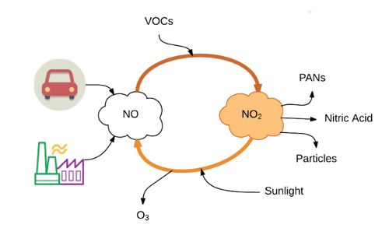
Nitrogen dioxide (NO₂)
Values set out in the Guidelines
40 µg/m³ annual average - 200 µg/m3 average in 1h
The main sources of anthropogenic emissions of NO2 are combustion processes (heating, electricity generation and motor vehicles and ships).
Health and environmental effects
Studies have shown that the symptoms of bronchitis in asthmatic children increase in relation to prolonged exposure to this contaminant, as well as a decrease in the development of lung function.
As for the environment, nitrogen dioxide (NO₂) is one of the causes of the famous acid rain, since reacting with water vapor would produce nitric acid.

Slide 8
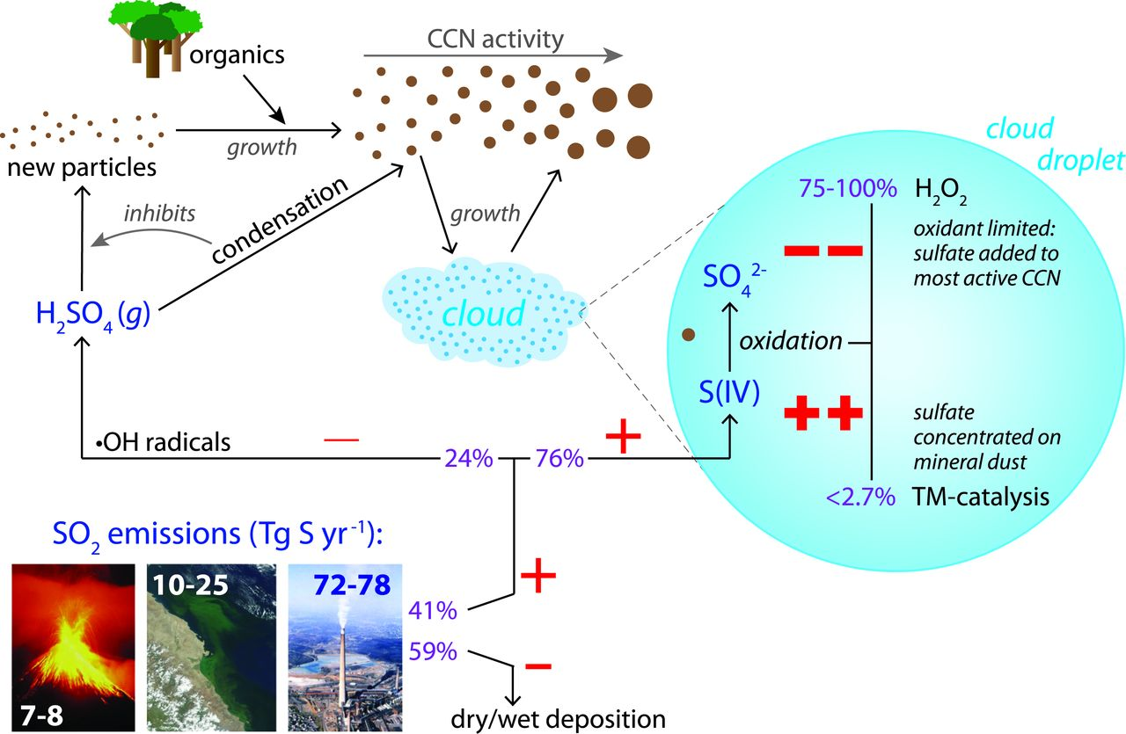
SULPHUR DIOXIDE(SO₂)
Values set out in the Guidelines
20 µg/m3 on average in 24h - 500 µg/m3 on average in 10 min.
The main anthropogenic source of SO₂ is the combustion of sulphur-containing fossils used for domestic heating, electricity generation and motor vehicles.
Health and environmental effects
SO₂ can affect the respiratory system and lung functions, and cause eye irritation. Hospital admissions for heart disease and mortality increase on days when SO₂ levels are highest.
In combination with water, SO₂ is converted to sulfuric acid, which is the main component of acid rain that causes deforestation.

Slide 9
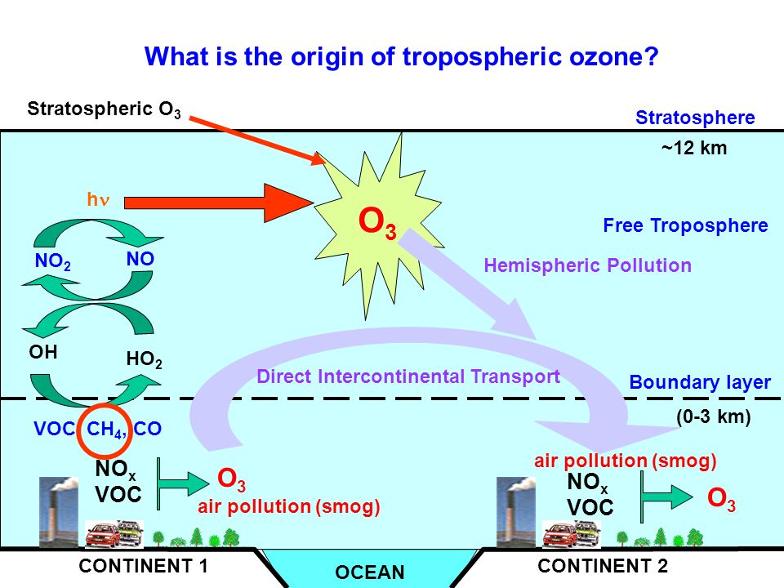
Tropospheric ozone (O3)
Values set out in the Guidelines
100 µg/m3 on average in 8h
Ground-level ozone (not to be confused with the ozone layer in the upper atmosphere) is one of the main components of smog.
This is formed by the reaction with sunlight of pollutants such as nitrogen oxides (NOx)
The highest ozone levels are recorded during periods of sunny weather.
Health effects
It can cause respiratory problems and asthma, reduce lung function, and cause lung disease. It is currently one of the most worrying air pollutants in Europe.

Slide 10
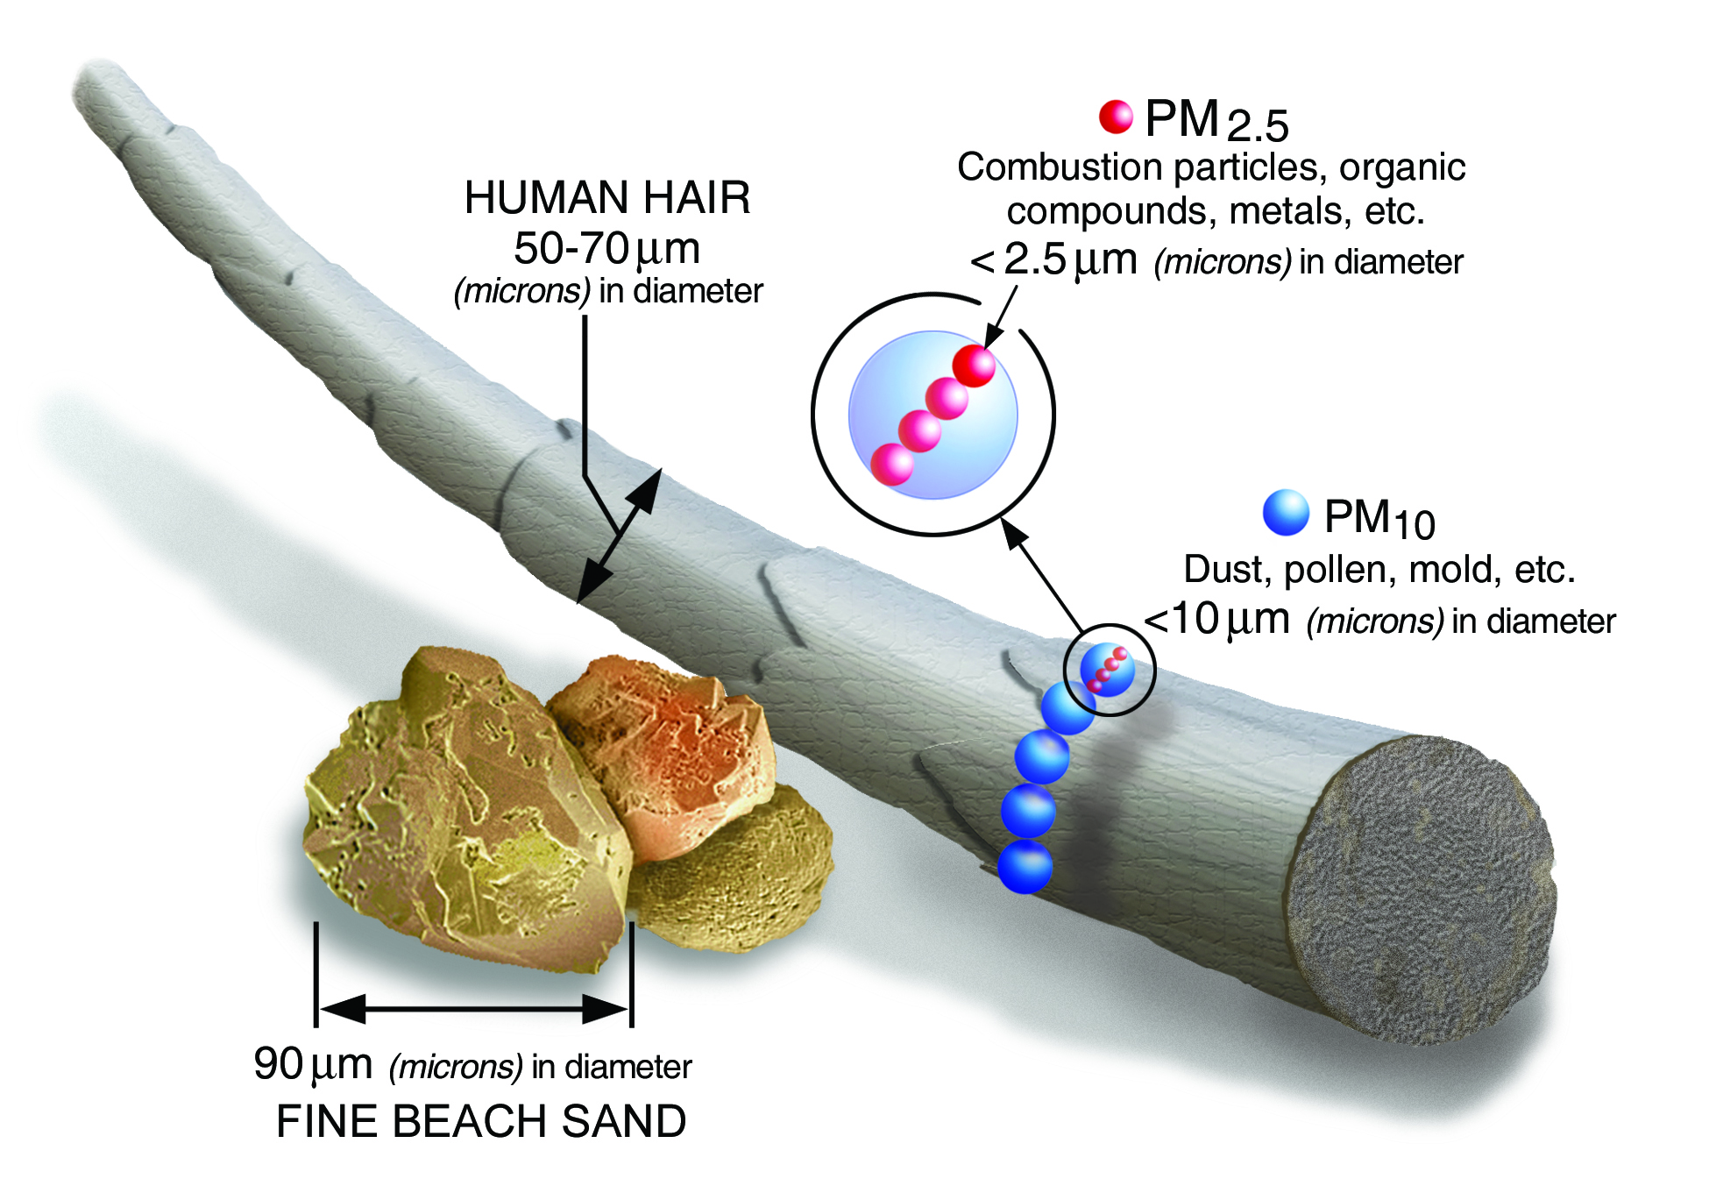
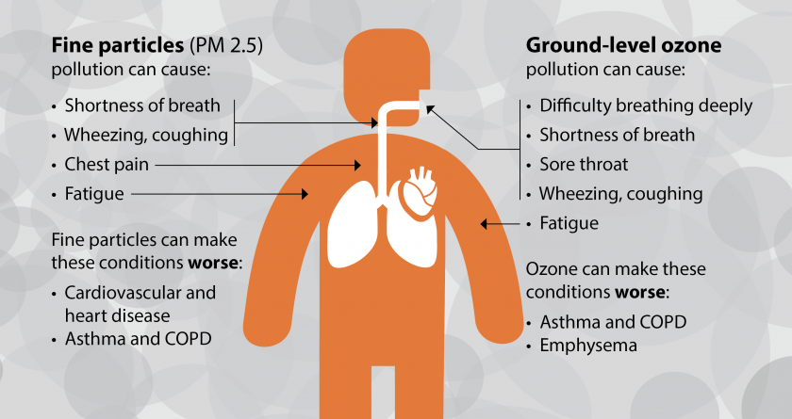
PARTICULATE MATTER IN SUSPENSION (pm)
Values set out in the Guidelines
PM2.5: 10 µg/m3 annual average - 25 µg/m3 24h average
PM10: 20 µg/m3 annual average - 50 µg/m3 24h average
PM affects more people than any other contaminant
They are very small solid particles in the air
They include a mixture of substances that may come from cars, factories, burning wood, etc.
There are two types of PM:
PM10 (particles with an aerodynamic diameter of less than 10 µm)
PM2.5 (aerodynamic diameter less than 2.5 µm)
Health effects
Chronic exposure to particulates increases the risk of cardiovascular and respiratory diseases, as well as lung cancer.
Mortality in cities with high levels of pollution is between 15% and 20% higher than in cleaner cities.
PM2.5 are more dangerous because, by inhaling them, they can reach the peripheral areas of the bronchioles and alter the pulmonary exchange of gases.

Slide 11
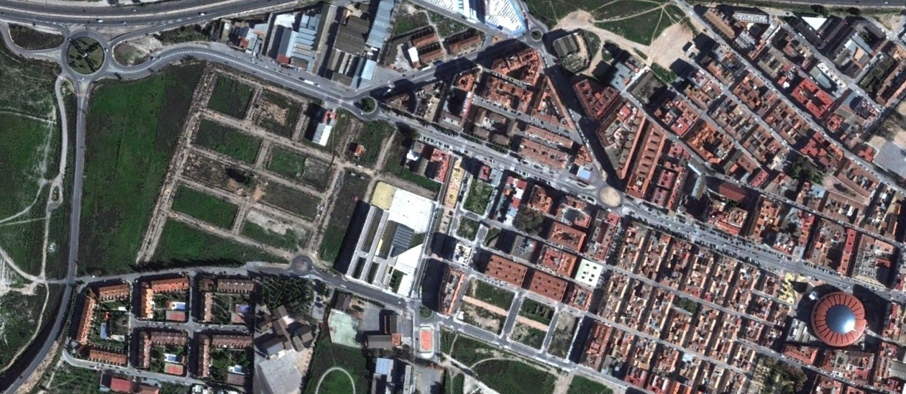
4. ATMOSPHERIC POLLUTION IN OUR CITY
Villena is a medium sized city (35,000 inhabitants) with not too much industrial fabric, so we believe that it does not have a very high urban air pollution. Even so, in the area where our educational center is located (las Fuentes High School) coincides with three other educational centers and there are significant traffic problems in the peak hours in addition to the heating emissions of all centers. Our interest was focused on knowing the levels of pollution in our area as well as whether these traffic peaks affected the quality of the air that students breathe.
IES LAS FUENTES

Slide 12
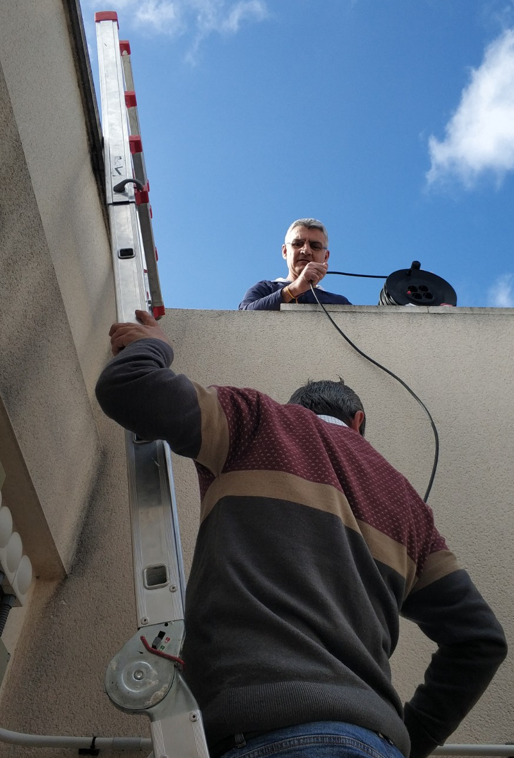
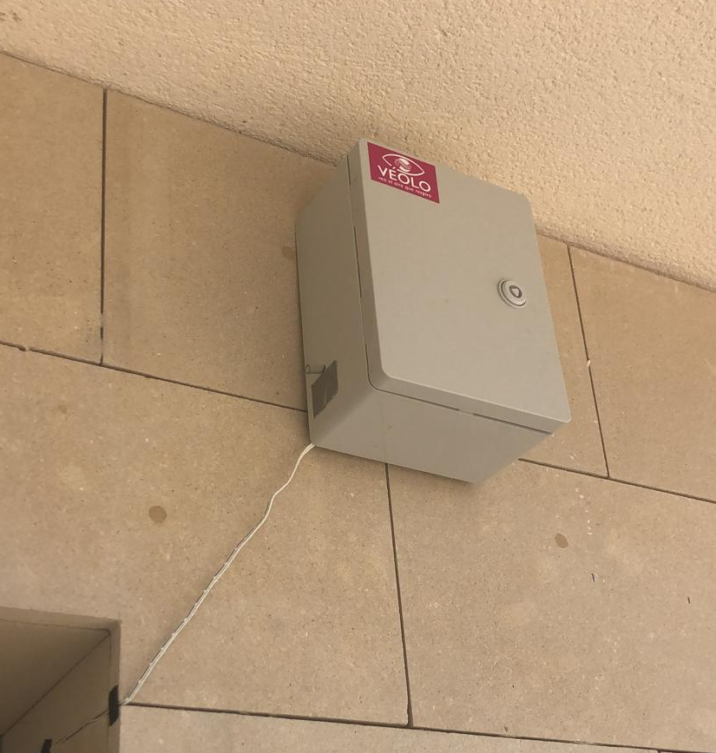
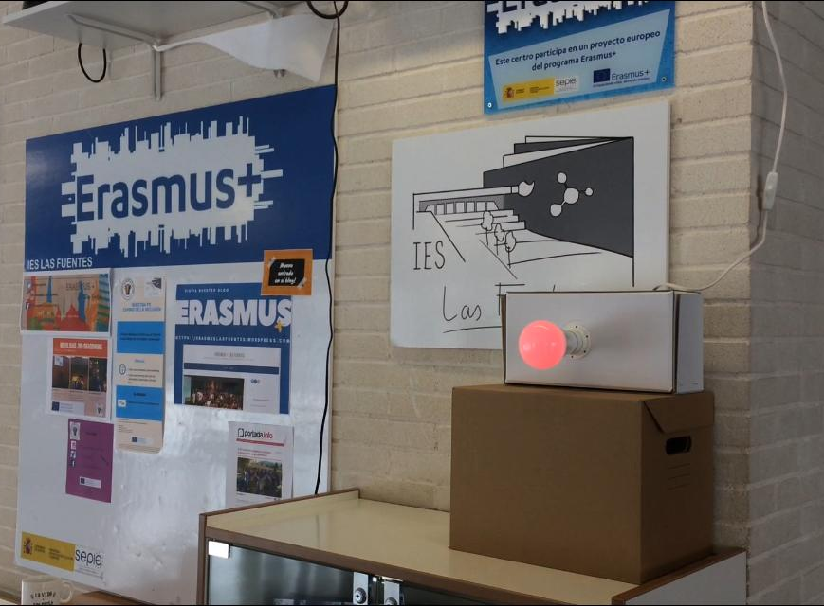

As discussed before, the most harmful contaminants, which cause the most health problems, are particulate matter (PM).
We were therefore interested in doing a study of this pollutant in the vicinity of our center. For this reason we contacted with VÉOLO programme.
VÉOLO is a social innovation project that stimulates society’s commitment to improving air quality in cities.
With the participation in this project we obtained the transfer for a few months of a PM10 and PM2.5 particle measurement kit.

Slide 13
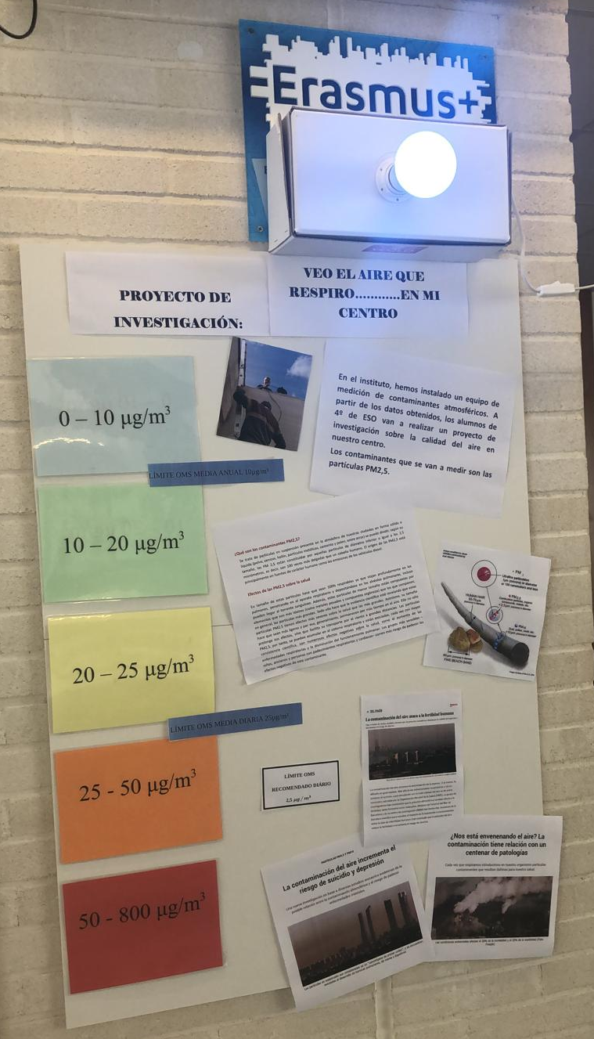
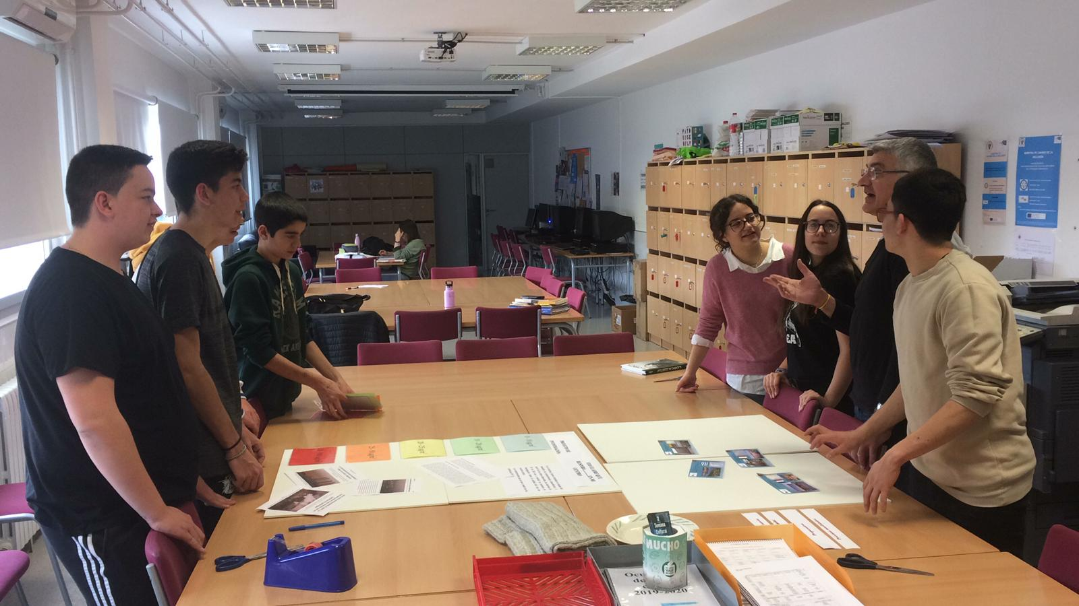
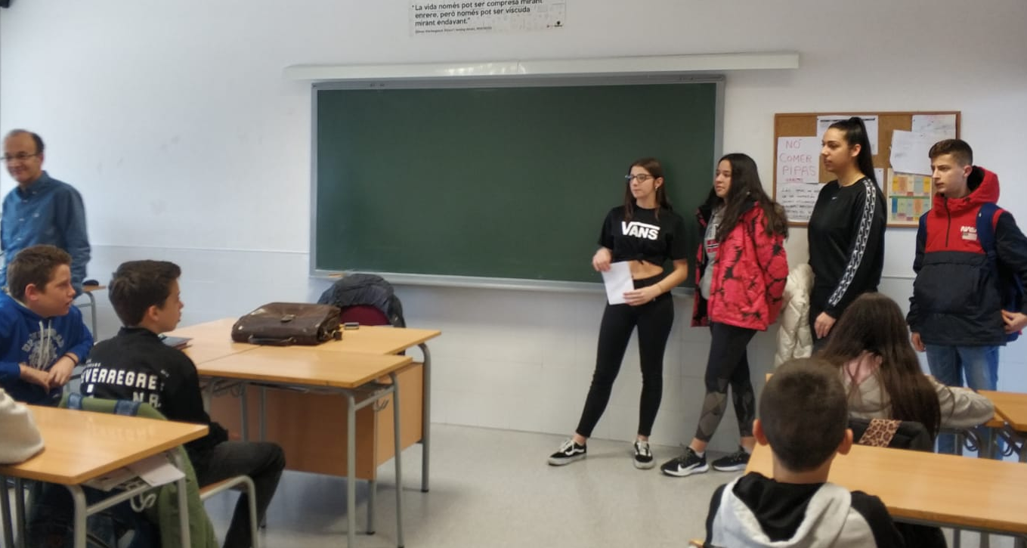
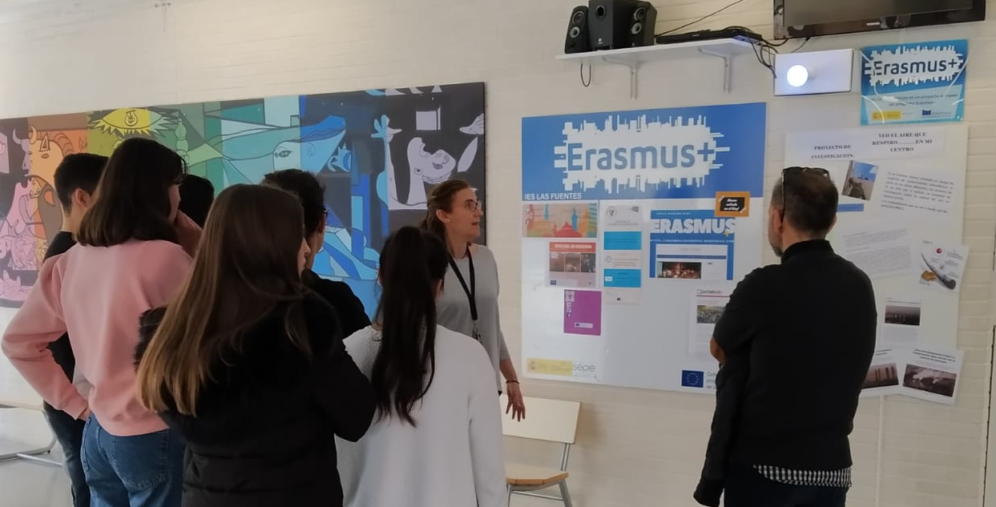
The kit, installed in February 2020, had a light bulb that was located at the entrance of the high school and that changed color according to the concentration of outdoor PM.
The students of the ERASMUS+ project made an information panel so that the rest of the students of the school knew the meaning of the bulb. Outreach activities were also carried out at all the centres. The students explained to the rest of the students the problem of air pollution and the characteristics of the project.

Slide 14

5. ANALYSIS OF RESULTS
The analysis of the results obtained by the kit for PM2.5 particles showed clearly an increase in concentration values with a delay of 1 hour after the entry of students to the educational centres of the area (one hour after peak traffic in the morning). In the following graphs we can see the evolution of these data (concentration in microg/m3) for a full day (1/2/2020).
During the month of February, similar results were obtained every working day, with a peak of concentration in the middle of the morning. At these peaks, the maximum WHO recommended value of 25 mg/m3 is normally exceeded.
Logically the study would have required a longer analysis time, but due to the situation generated by the COVID pandemic-19, on March 13, the suspension of classes and the house confinement of the population took place, which lasted until the end of the academic year.

Slide 15
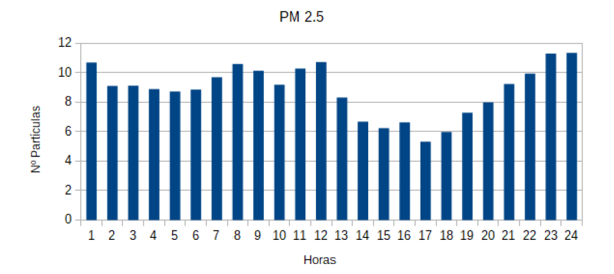

During the confinement period, the kit continued to take data, and this has allowed us to make a comparison of the values before and during the suspension of classes. In the following graph we can see the evolution of the concentration of PM2.5 in a day during confinement (18/3/2020).
This graph shows lower values than those recorded before confinement, and no peak concentration is observed due to traffic at the entrance of schools.
Due to the containment situation the air quality of our city improved.

Slide 16
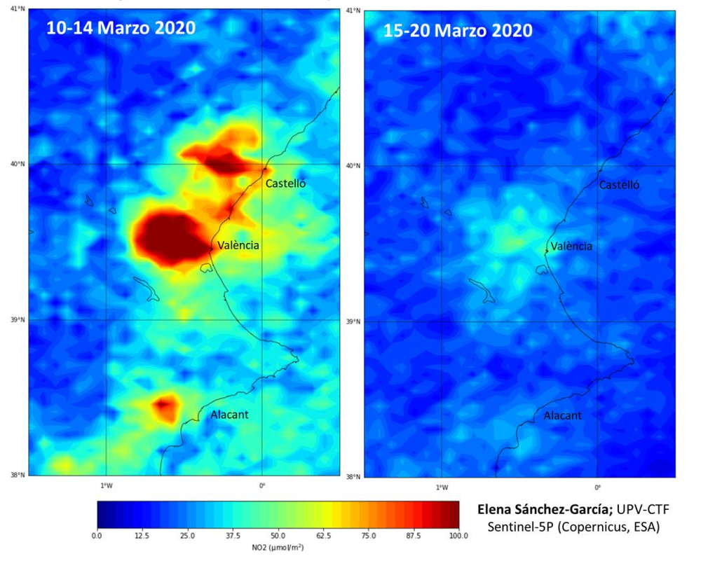
This improvement in air pollution was logically due to the decrease in traffic and industrial activity and took place in all the cities of the world.
In the following images we can see the decrease in NO₂ concentrations in our region (Valencian Community) before and after the declaration of soul state by the COVID-19 pandemic.
In this image we see that the most important problems of air pollution in our region are mainly located in the capital, Valencia. It is a city of 2.5 million inhabitants (3rd most populated city in Spain), very industrialized and with serious traffic problems.
There are also significant concentrations of pollution in the other two provincial capitals, Castellón and Alicante.
We see how the pollution decreases were drastic during confinement. These values have, of course, increased again after the end of confinement, although they have not reverted to the previous values since the situation is not fully normalized and there are currently restrictions on mobility between regions.

Slide 17
6. CONCLUSIONS AND MEASURES
As we have seen, the traffic in our city causes concentrations of PM2.5 particles higher than the recommended limits at certain times of the day.
To improve this situation, environmental policies would be needed to reduce pollution. These policies must come from local, regional and national administrations and should include:
Restrictions on traffic
Promote the use of public transport and make it less polluting: Transport vehicles and utilities, hybrid or electric.
Reduced speed on roads, especially on peripheral belts.
Encourage walking and cycling in the city center by adapting the city to cyclists.
More pedestrian streets or restricted access to residents.
Meters in the areas with the highest concentration of pollution that provide reliable data on which to base.
Encourage initiatives to share private vehicles or car-sharing companies.
Aid for the purchase of electric vehicles
Raising public awareness of the importance of reducing pollution in cities and related health problems.

Slide 18
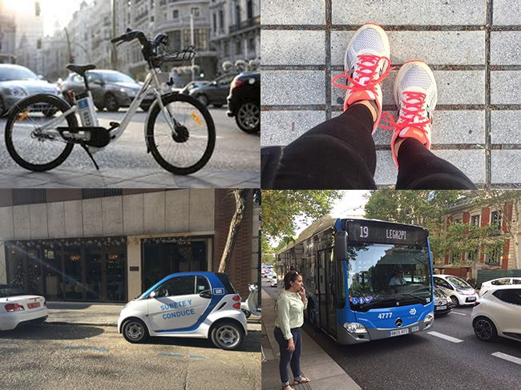
Without more ambitious policies and city awareness to combat urban pollution, by 2050:
Air pollution will become the leading environmental cause of premature mortality in the world. It is estimated that by 2050 the number of premature deaths from exposure to suspended particles will more than double to 3.6 million per year on the planet.
In addition to health problems, a large increase in global warming is expected with all the implications it entails, as global greenhouse gas (GHG) emissions are projected increase by 50%, mainly due to the 70% increase in CO₂ emissions related to power generation.

