Slide 1
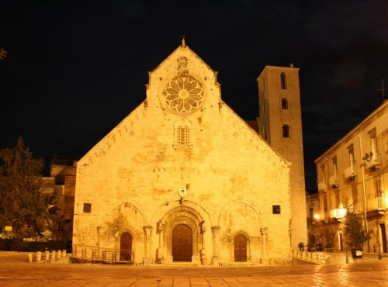
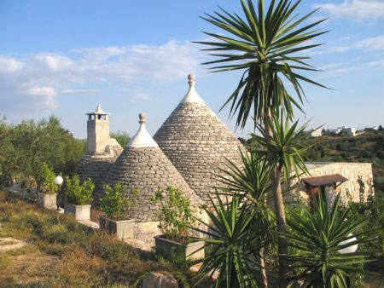
Our
Region:Puglia

Slide 2
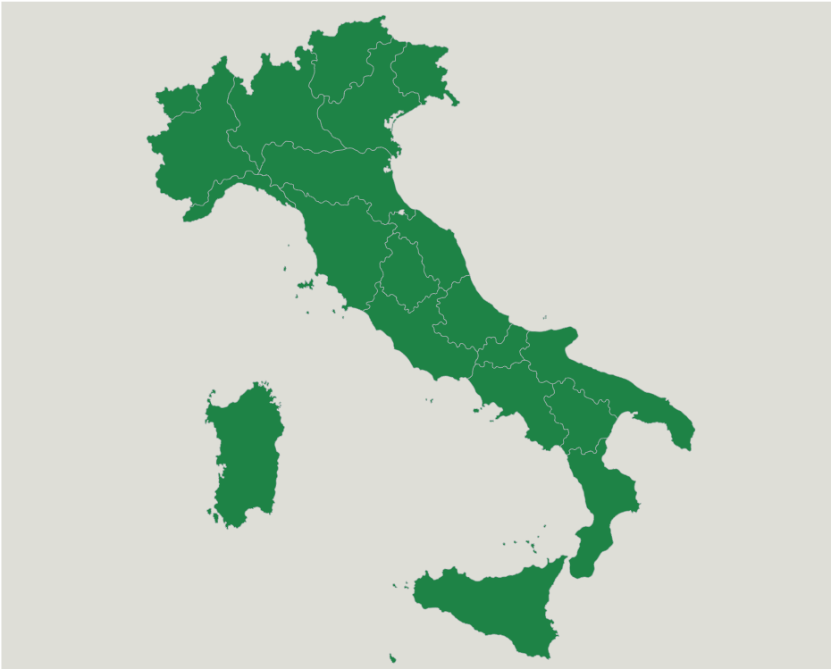
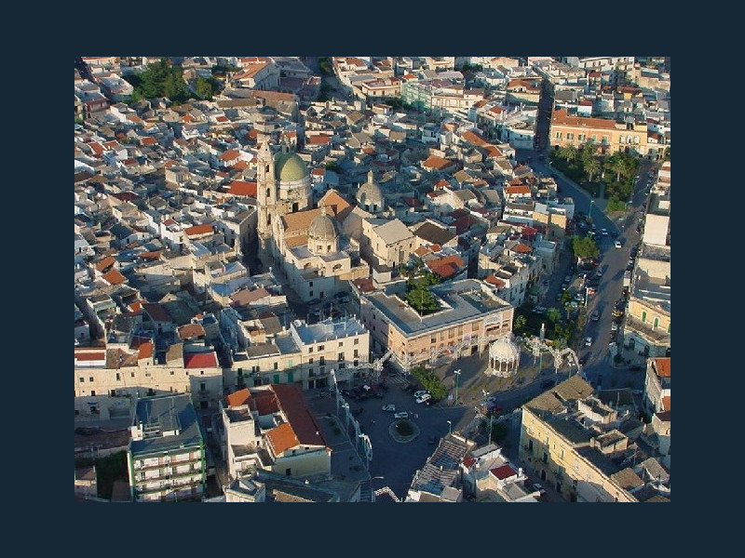
Geographic location
BITETTO
Bitetto is situated in Puglia in the south of Italy.
This city is about 12 kms from the sea.

Slide 3
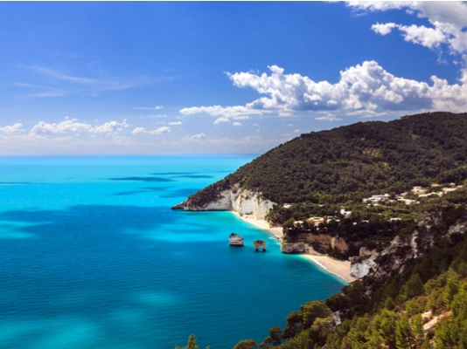
In our territory there are many natural areas, churches and museums to visit.
In the north of Puglia, there is the Gargano, an imposing promontory situated on the sea coast.

Slide 4
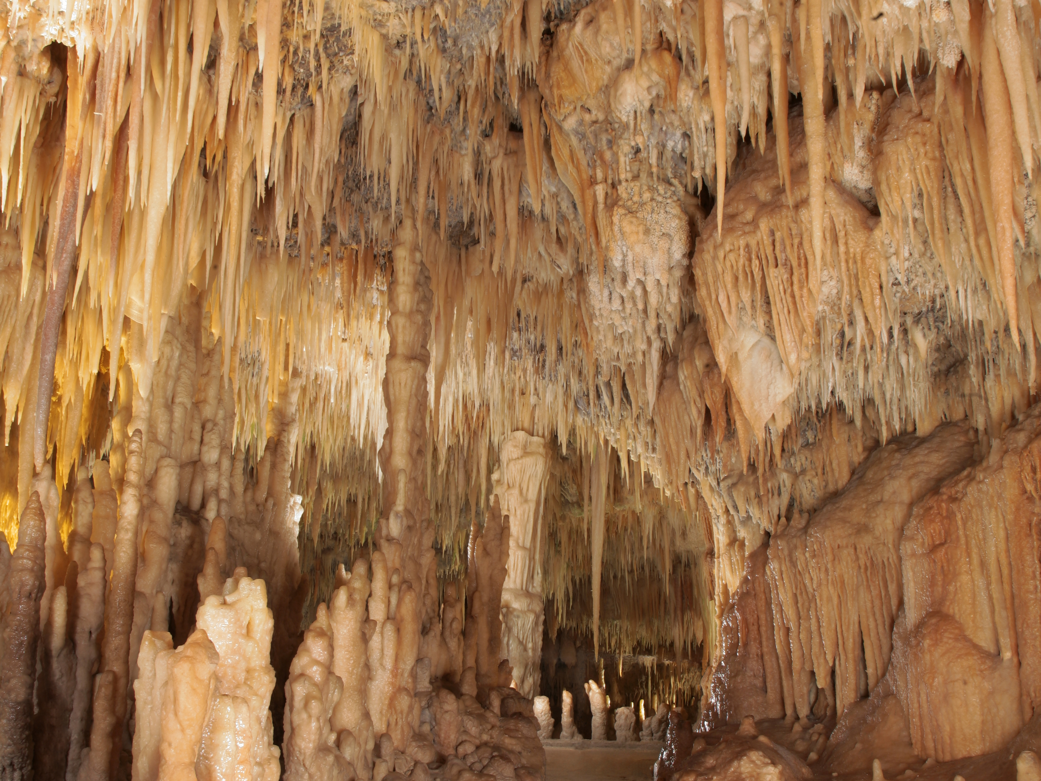
……you can visit the caves of Castellana,
a complex of underground caverns of carsic origin, it
is a big abyss, its depth is 60 meters.

Slide 5
……or you can visit the Trulli of Alberobello,
those stone buildings of prehistoric origins.
The trullo was a typical farm construction, where the workers who cultivated the land, could have a bed to sleep and keep the tools of the field.

Slide 6
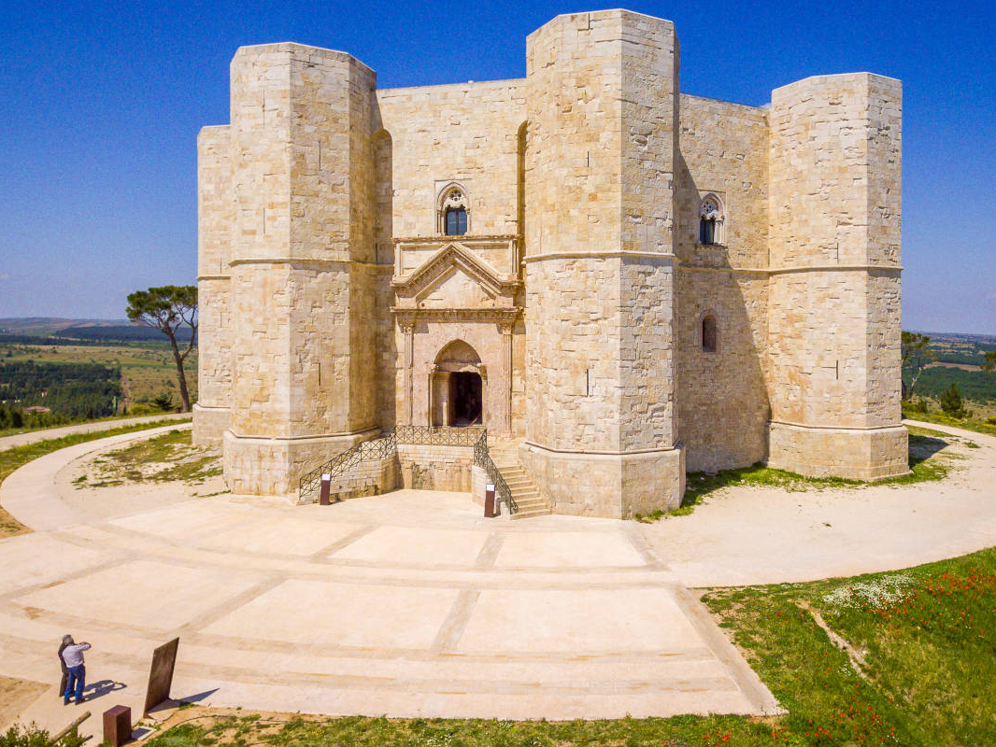
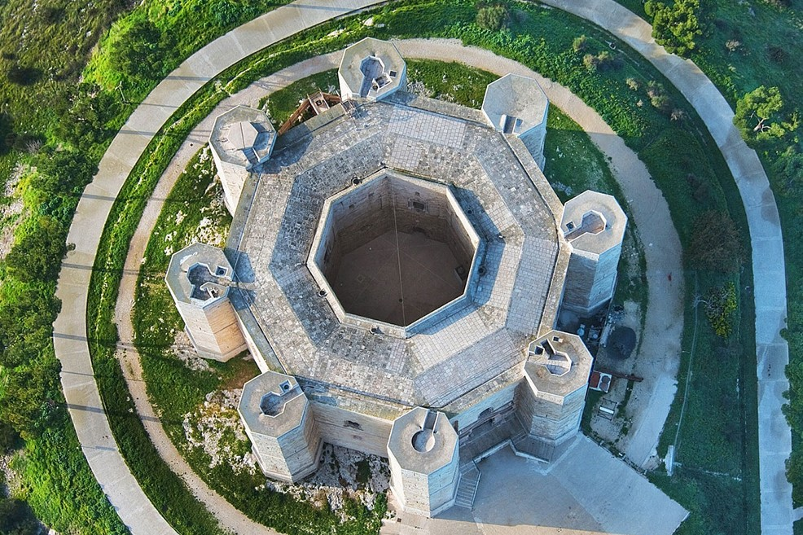
The del monte Castle: built in the territory of Andria, in the first half of the eleventh century by Frederick II of Svevia.
The building has an octagonal plan and every angle is an octagonal
tower.

Slide 7
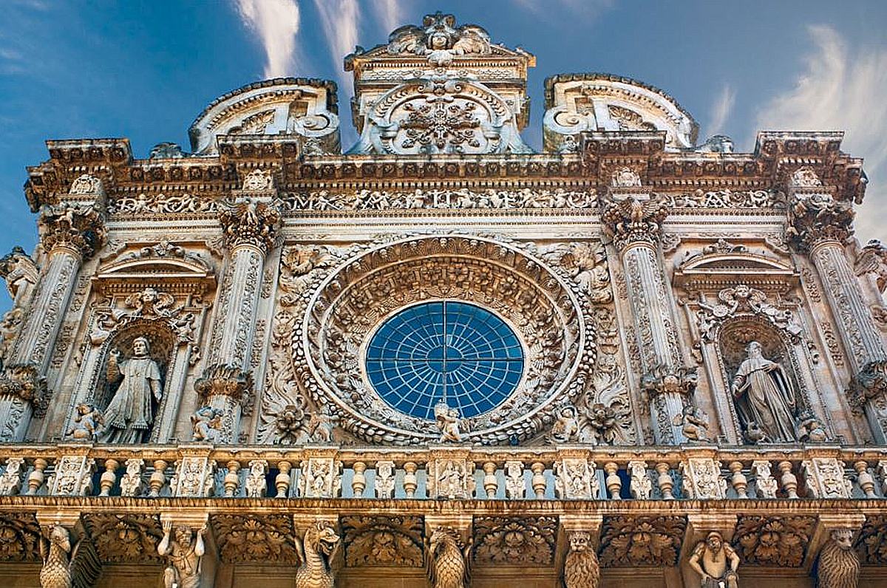
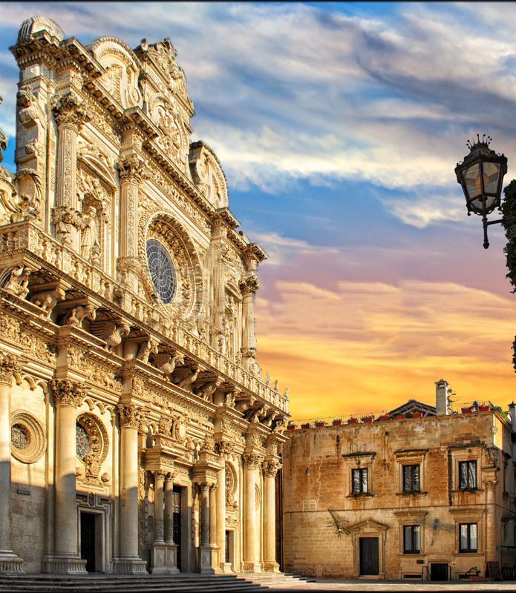
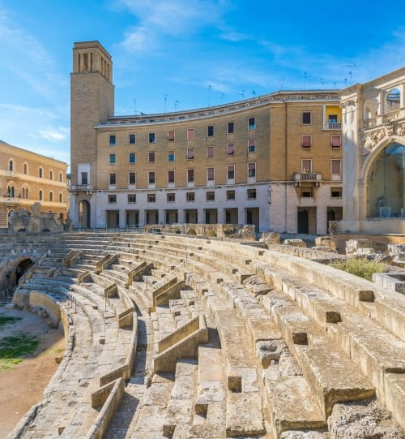
Il Salento
Lecce, the Florence of the south,represents the best example of baroque art.
The Piazza del Duomo, is one of the most beautiful squares in Italy

Slide 8
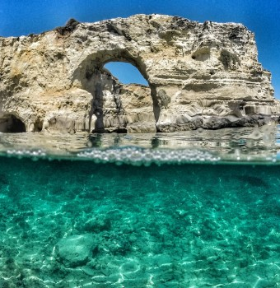
OUR SEA🌴🐚🦈🏖️
Our sea is one of the most beautiful in Italy
We have both sandy and rocky coasts.
The sea of Puglia is one of the favourite destinations for travellers from northern Italy and also from other nations: Germany, Poland, Switzerland, Austria etc.

Slide 9
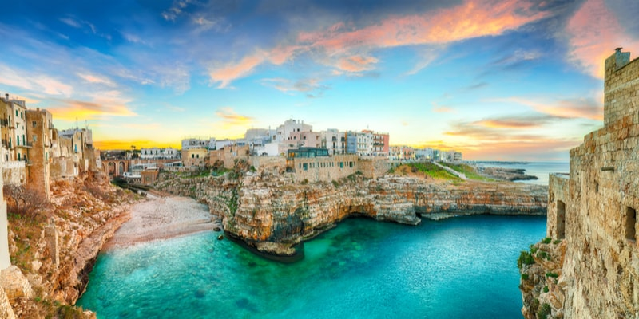
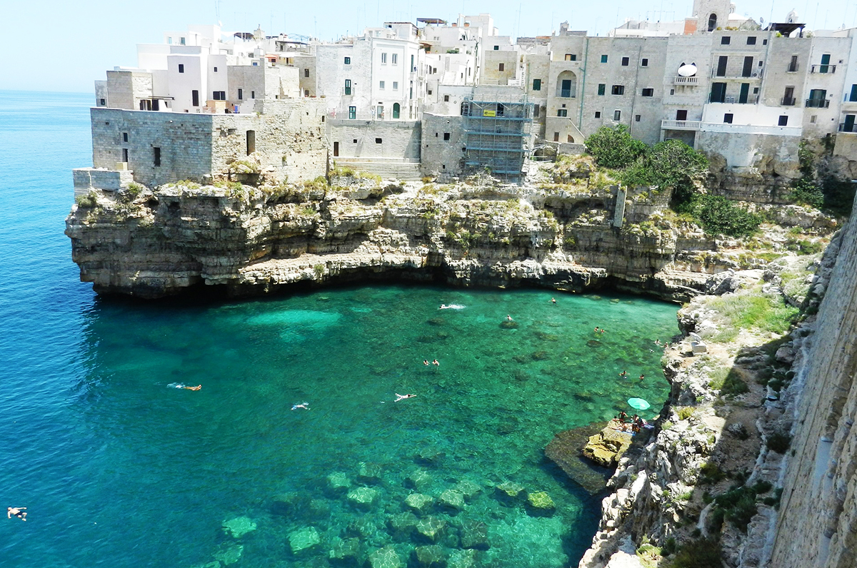
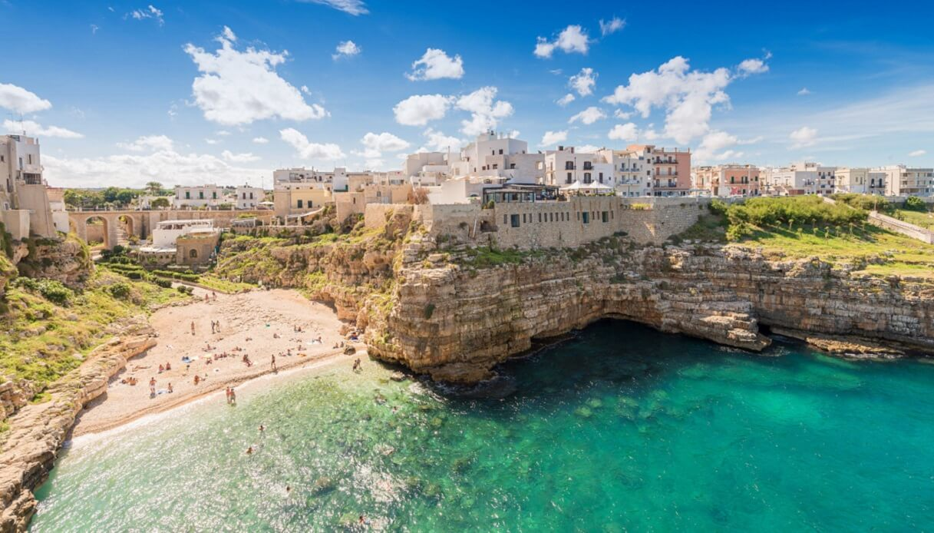
POLIGNANO
Known as the “Pearl of the Adriatic”, Polignano a Mare is the ideal place to plunge into uncontaminated waters and explore a picturesque historic centre by the sea.

Slide 10
Our Little Town : BITETTO

Slide 11
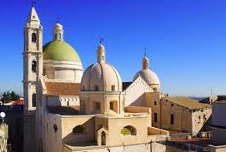
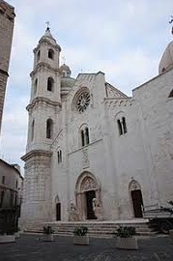
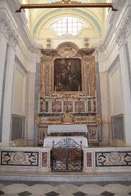
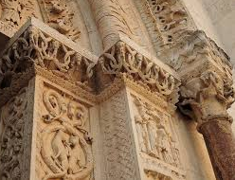
Bitetto is a town in the Metropolitan City Of Bari , Apulia , Italy. The main attraction of Bitetto is the cathedral, dedicated to Saint Michael , one of the main examples of Apulian Romanesque architecture , built in 1335
The laces of the cathedral

Slide 12
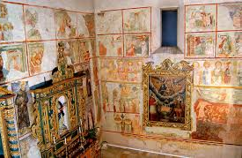
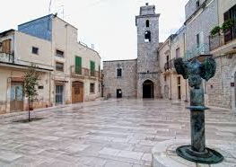
The ancient historical centre
At the end of Corso Garibaldi there is the Church of Santa Maria la Veterana, this was one of the churches of Bitetto built outside the city walls and had annexed a convent of which, however, today there is no trace.

Slide 13
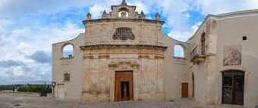
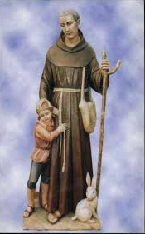
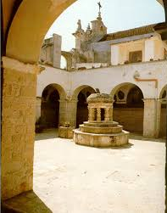
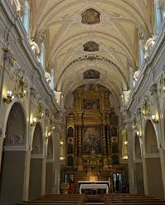
BITETTO preserves the remains in the homonymous
convent of the Blessed Giacomo, a lay friar who during
the period of the plague in the 15th century did a great
deal for the sick and was proclaimed blessed in 1700
the Blessed Giacomo

Slide 14
Polo Liceale Statale
“Edoardo Amaldi”

Slide 19
Our previous Erasmus
Erasmus is also friendship and fun
Erasmus 2018/2019 with Spanish, Czech Republic and Irish partners

