Slide 1
LICHENS

Slide 2
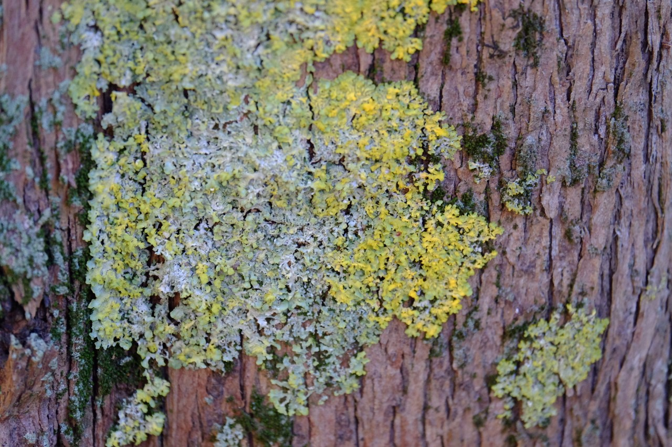
LICHENS AS BIOINDICATORS

Slide 3
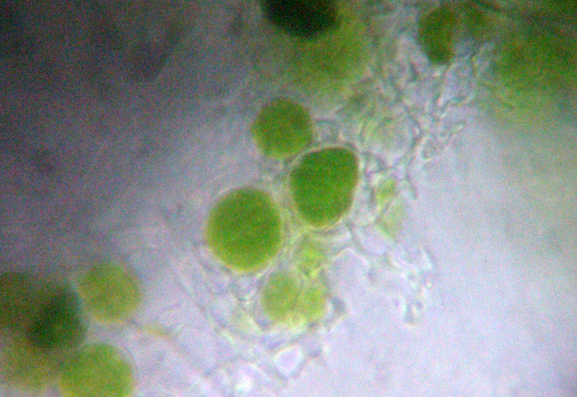
WHAT IS A LICHEN?
A lichen is an organism formed by the symbiosis between a fungus and an algae that live among filaments of multiple fungi species in a mutualistic relationship. (Simon Schwender, 1867).
Symbiosis means the relationship of alliance and collaboration between two or more species that live together and derive the greatest possible benefit from this situation. The algae, through photosynthesis, produces the nourishment for the fungus. The fungus uses this nourishment and provides the alga with water and mineral salts, necessary for its survival, also protects it from the bad weather.
Lichen on microscope

Slide 4
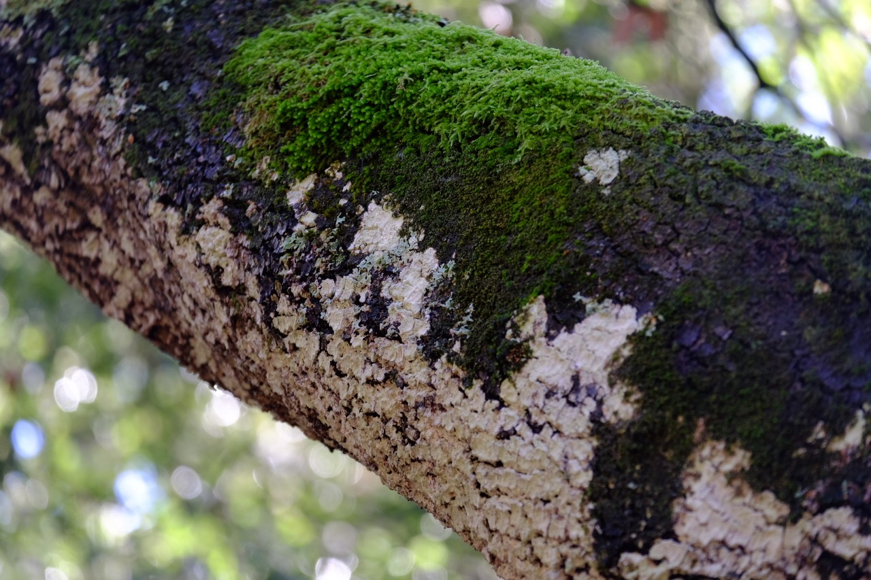
LICHEN STRUCTURE
The body of the lichen is called THALLUS.
In the fruticose lichens the more elongated branches are called LACINIE.
In the leafy lichens it can be recognized the LOBI, which have forms and different sizes.

Slide 5
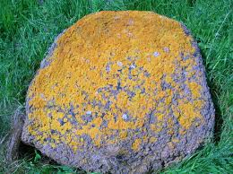
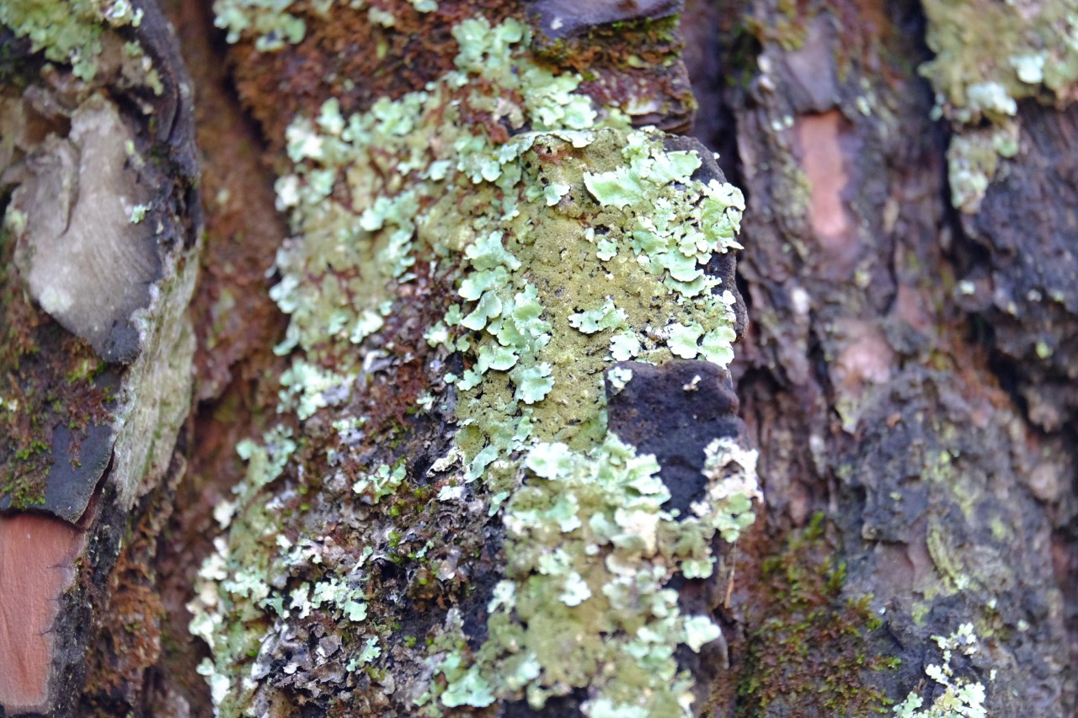
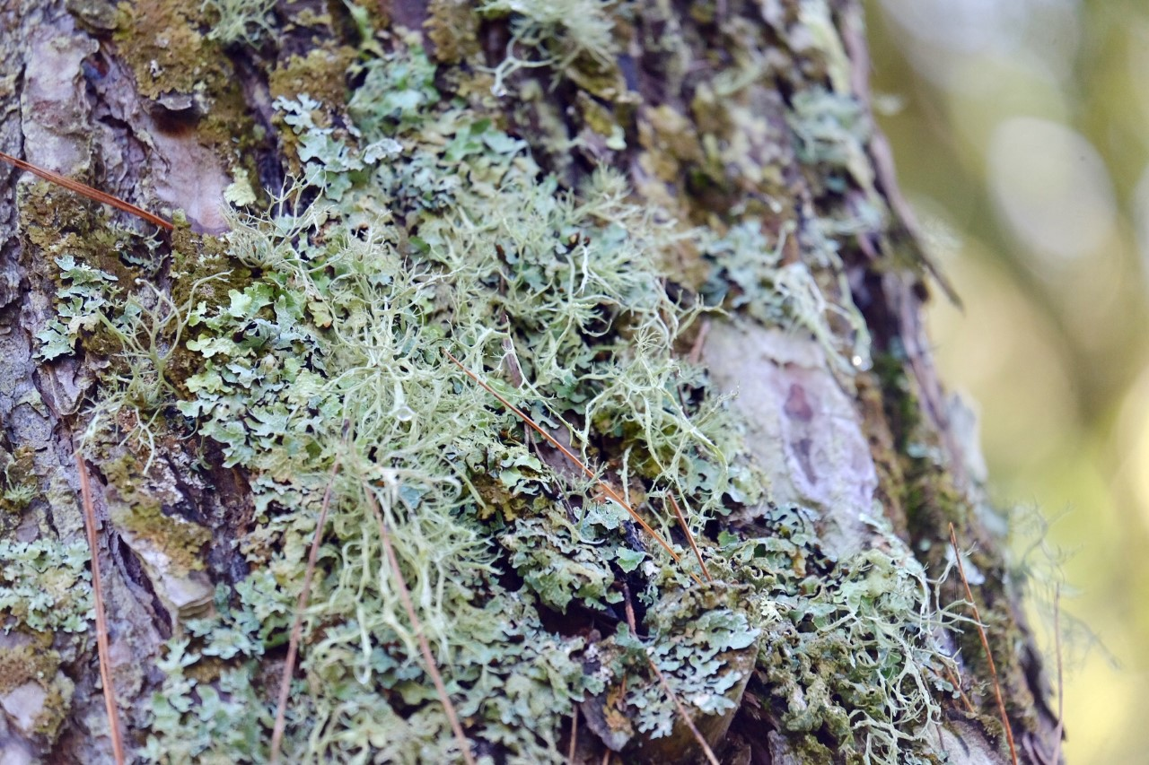
THE SHAPE OF THALLIUM
CRUSTOSE: very adherent to substrate
FOLIOSE: the lobes are flattened and they grow parallel to the substrate;
FRUTICOSE: Thalluses branch
in various directions. The look is bushy.

Slide 6
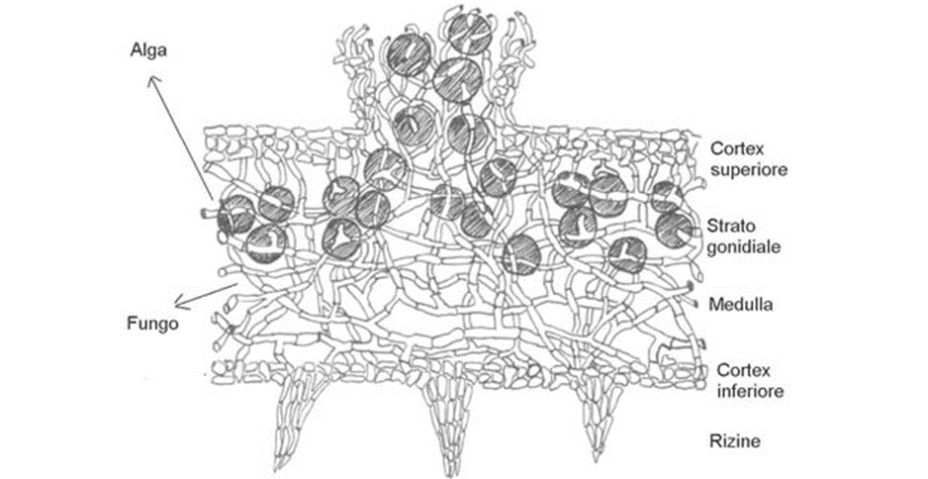
Perhaps few will know instead that lichens can be used as bioindicators of atmospheric pollution and this thanks to their particular sensitivity, against toxic substances.
Since the 1980s, in other parts of Europe it has been shown that these organisms respond relatively quickly to the decline in air quality and can return to colonise, in a few years, in urban and industrial contexts if there is an improvement.

Slide 7
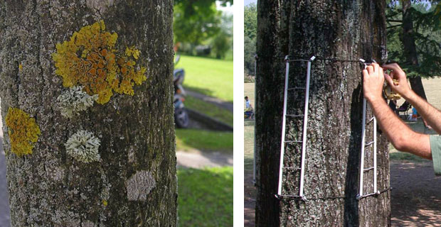
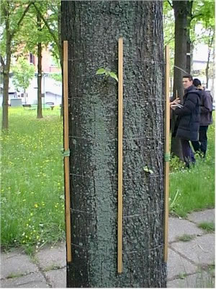
They in fact:
are sensitive to pollutants because they lack
surface cuticle and stomatic openings and therefore indiscriminately absorb gases and pollutants;
have a slow growth and a great longevity

Slide 8
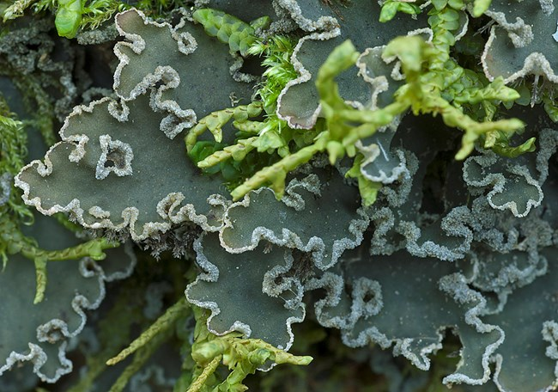
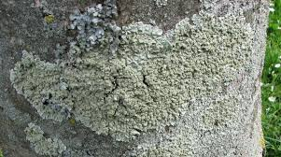
WHY ARE LICHENS GOOD BIOINDICATORS?
Their metabolism depends essentially by the atmospheric weather conditions.
Their metabolic activity is continuous throughout the year.
They grow very slowly and are long-lived.
They don’t eliminate the intoxicated parts.
They are sensitive to pollutants (anhydride sulphur, hydrocarbons, nitrogen oxides, heavy metals, substances radioactive ...)

Slide 9
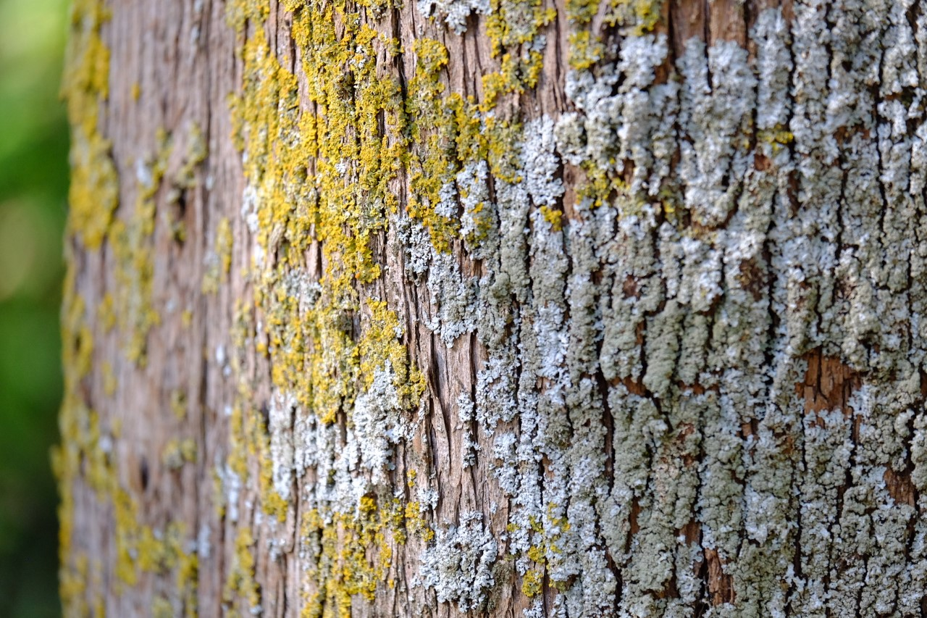
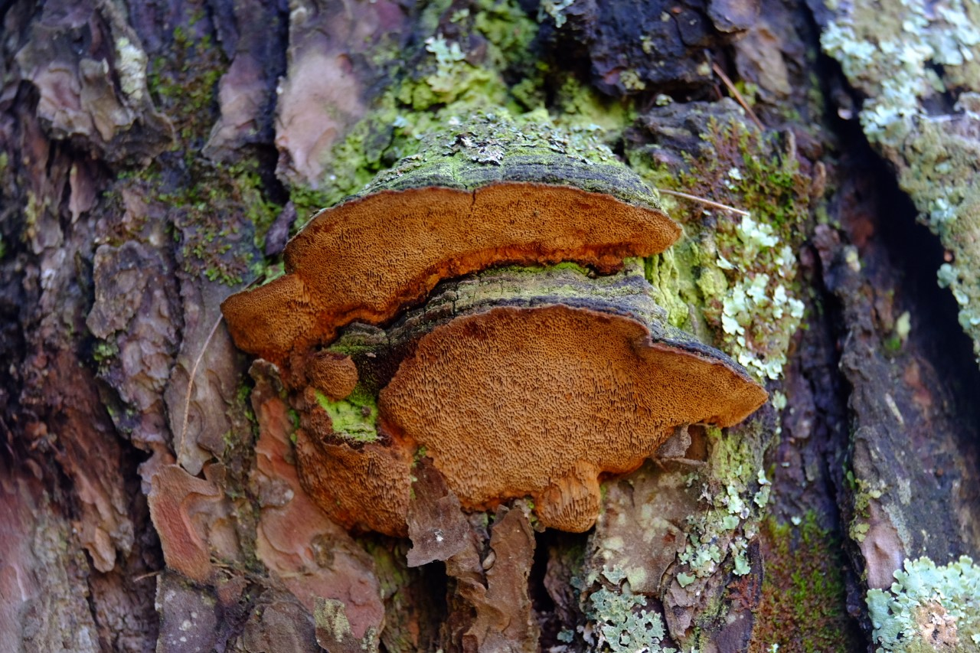
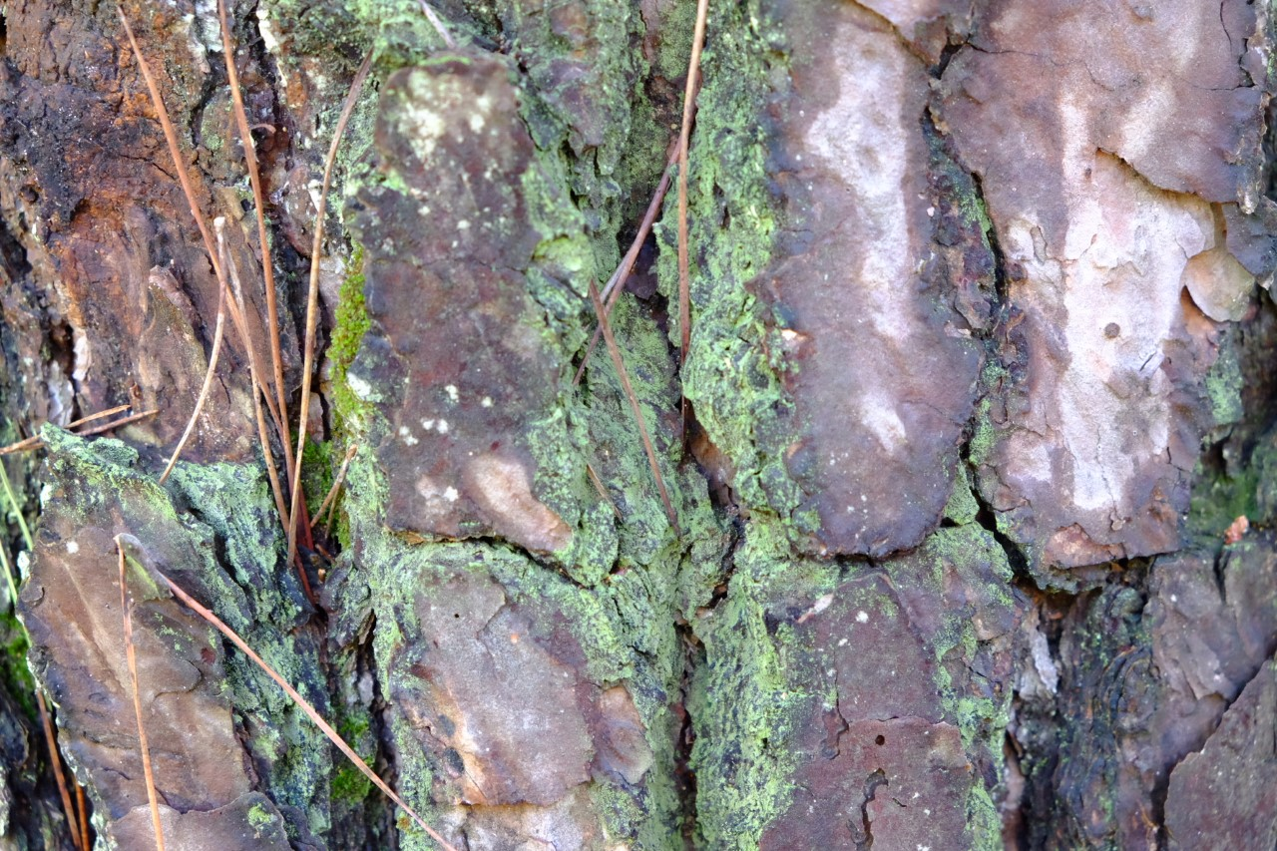
These are some pictures taken by us in Mercadante Forest. This means that it is still an area, fortunately, free of pollution.

Slide 10
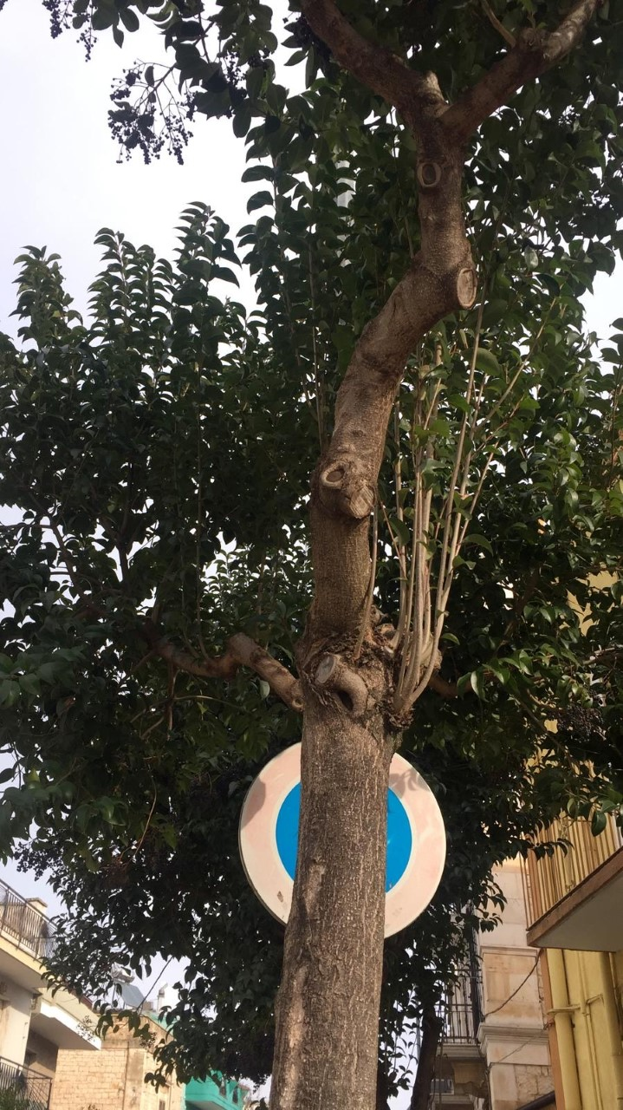
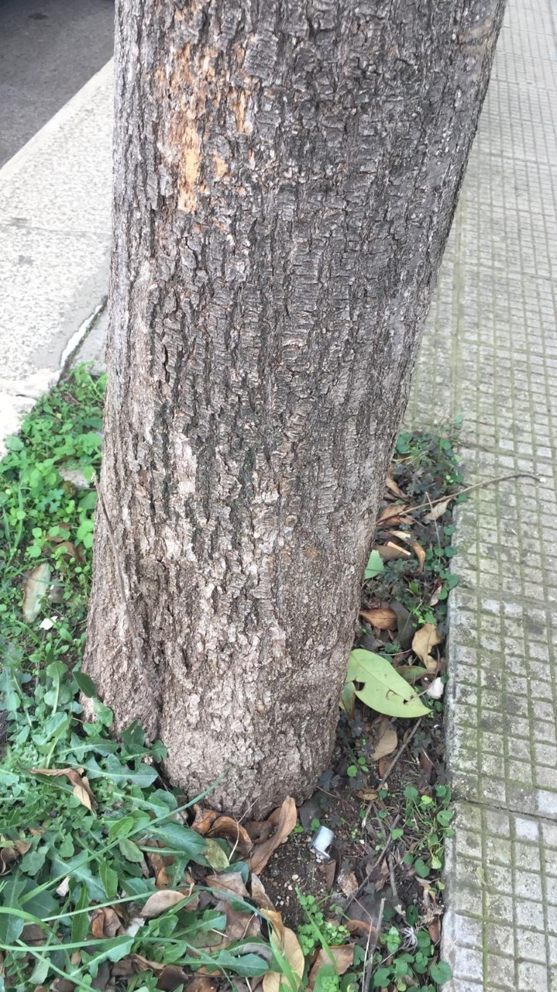
These are some pictures taken by us in Bari. We can see that there are not lichens. That means that is a polluted area.

Slide 11
CURIOSITY
The Egyptians used lichens for the preparation of mummies.
Before the invention of synthetic coloring, lichens were used as colorants.
Their average life is very long: crusty lichens live about 300 years, while foliose and fruticose lichens live about 70/80 years.
For some animals, like the reindeer lichens represent food.
even men in the past used them as food and for other purposes.

Slide 12
THE END
MADE BY
DI MAGGIO VITO
VITUCCI STEFANIA

