Slide 1
Temperatures and precipitation in Lithuania in November, 2019
A European green goal: clean energy and environmental sustainability against climate change
Erasmus+ 2019-1-IT02-KA229-062189_4
Lithuanian team from Prienai Žiburys gymnasium
2020

Slide 2
Compared to the 20th century the average annual temperature in Lithuania rose by 0.7-0.9 ° C :
Summer droughts are increasingly frequent (1992, 1994, 2002, 2006);
Precipitation changes in the territory of Lithuania vary;
Liquid precipitation is increasingly responsible for the cold period.

Slide 3
Work objective:
To determine the temperature and rainfall in Lithuania in November 2019.
To compare the average temperature of November 2019 and the rainfall with statistical data from 2014 to 2018.

Slide 4
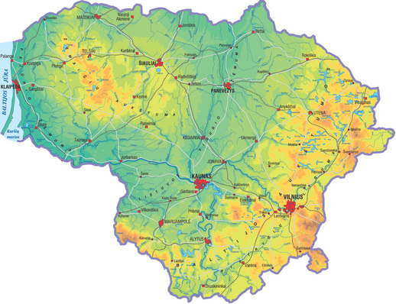
Statistics were collected using measurements provided by the Lithuanian Hydrometeorological Service from Kaunas Meteorological Station.
Kaunas
Prienai

Slide 8
Conclusions
The average temperature in November 2019 is 5.4 degrees. And that is 1.5 times the normal November temperature;
2019 November's precipitation was 23.2 mm. (2 times less than average in November)

Slide 9
sources
http://www.meteo.lt/lt/home

