Slide 1
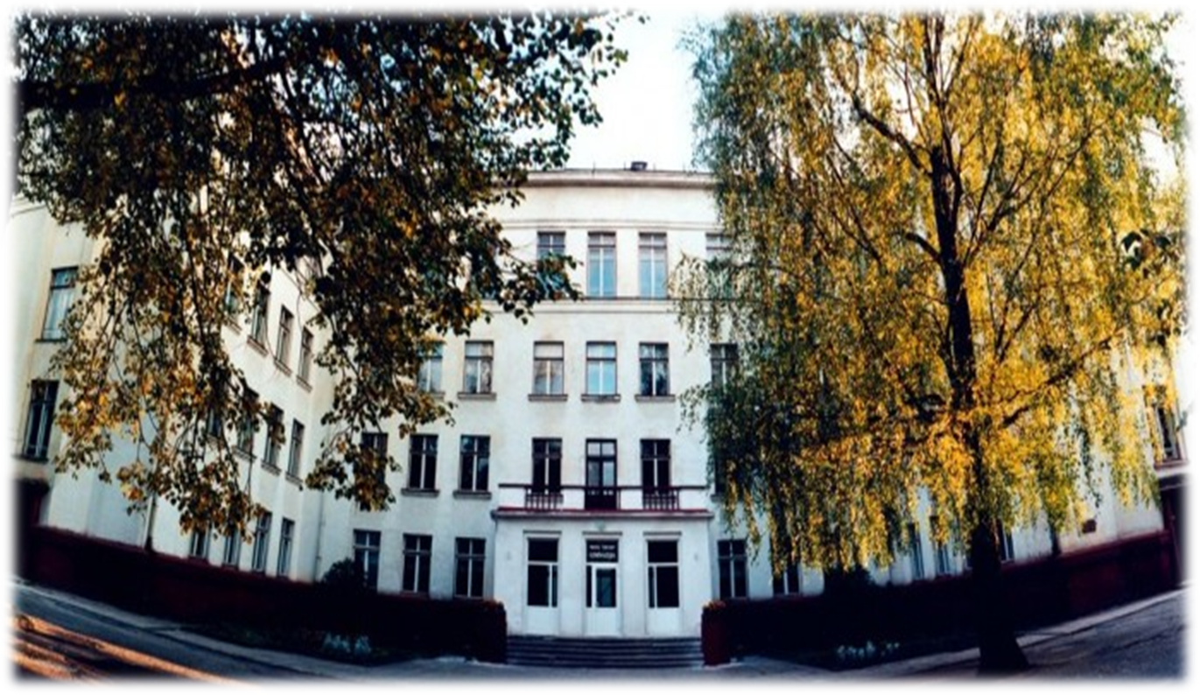
PRIENAI ,,ŽIBURYS” GYMNASIUM

Slide 2
LITHUANIAN CLIMATE CHANGE
A European green goal: clean energy and environmental sustainability against climate change
Erasmus+ 2019-1-IT02-KA229-062189_4
Ignas Malinauskas

Slide 3
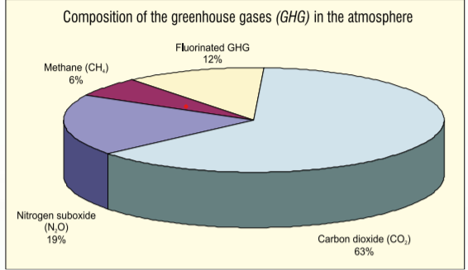
Consequences of climate change :
Climate change has a negative impact on natural systems and will only increase in the future;
Hurricanes, storms, whirlwinds, floods, droughts will gradually increase each year;
Drinking water may deteriorate and water scarcity in the dry regions may increase.
The increase of global temperature above 2.5 0 C might put as many as 20— 30% of plant and animal species at risk of extinction.

Slide 4
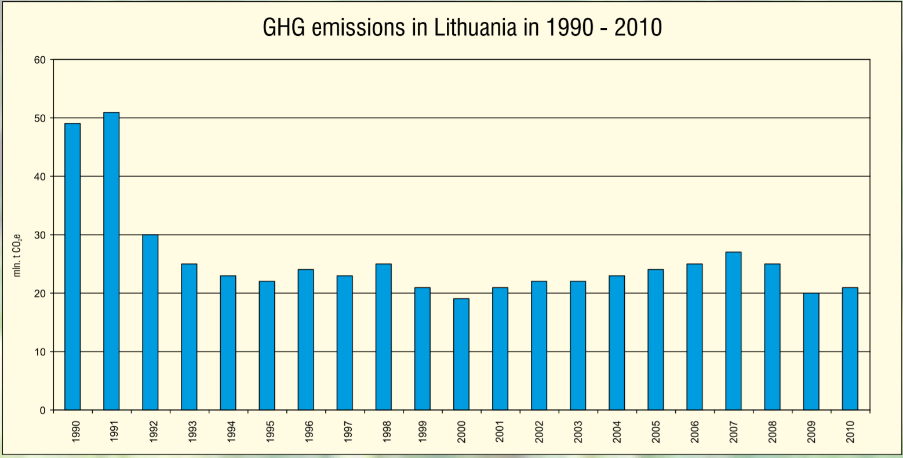
The GHG emissions in Lithuania
Kyoto protocol — to reduce the emissions of GHG by 8 % below 1990 level during the period of 2008 — 2012.
By 2010, the GHG emissions in Lithuania have been reduced by 58 % compared to 1990.

Slide 5
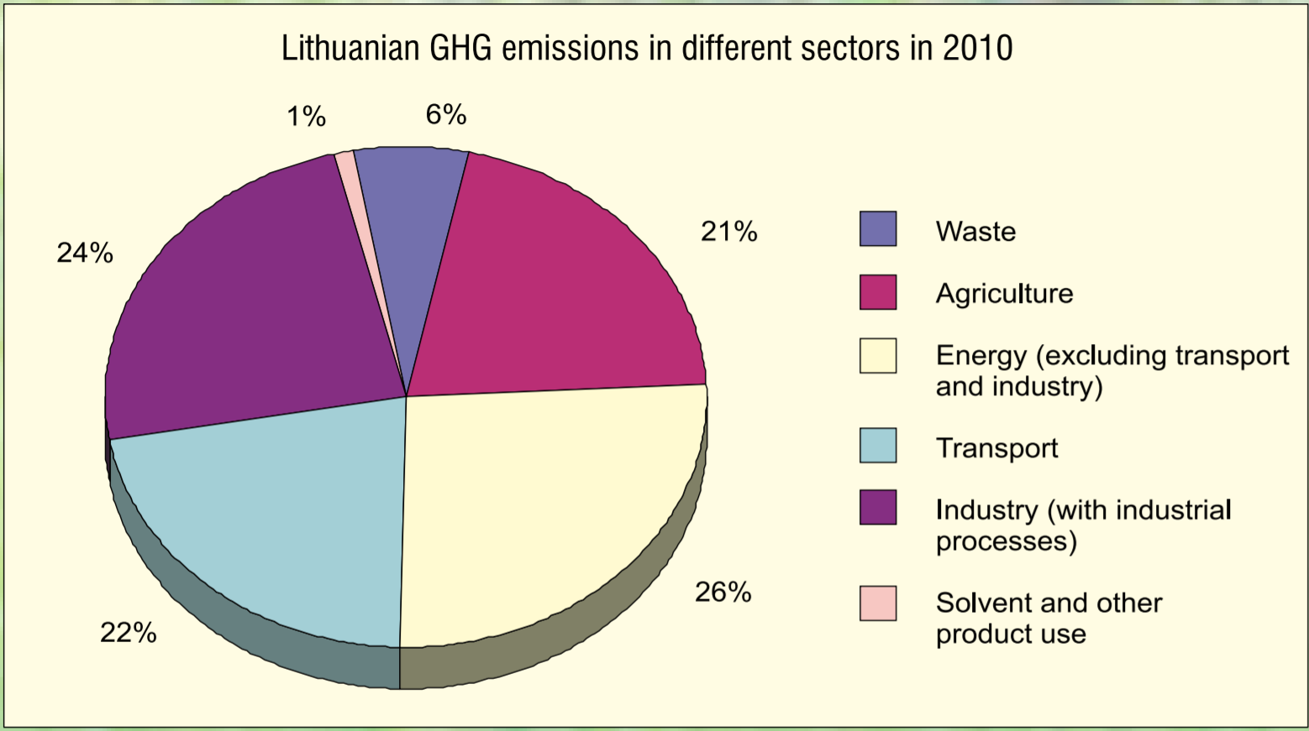
The implementation of climate change mitigation measures in Lithuania is particularly important in the sectors of energy, transport, industry, and agriculture.
The main measures towards climate change mitigation must be taken into account between practices of industrial processes, land use, agricultural and forestry, food, feed and fiber production, and consumption, as well as the conservation of key ecosystems.

Slide 6
Dividing sectors according to their influence on development of the Lithuanian climate change management policy

Slide 7
Based on the results of the studies the Baltic Sea Region is the most vulnerable to the climate change consequences;
Reduction of GHG emissions have the highest contribution to the GHG emissions into the atmosphere during the performed activities (energy, transport, industry, ect.).
The forestry sector is significant for its role in absorption and sequestration of the CO₂.

Slide 8
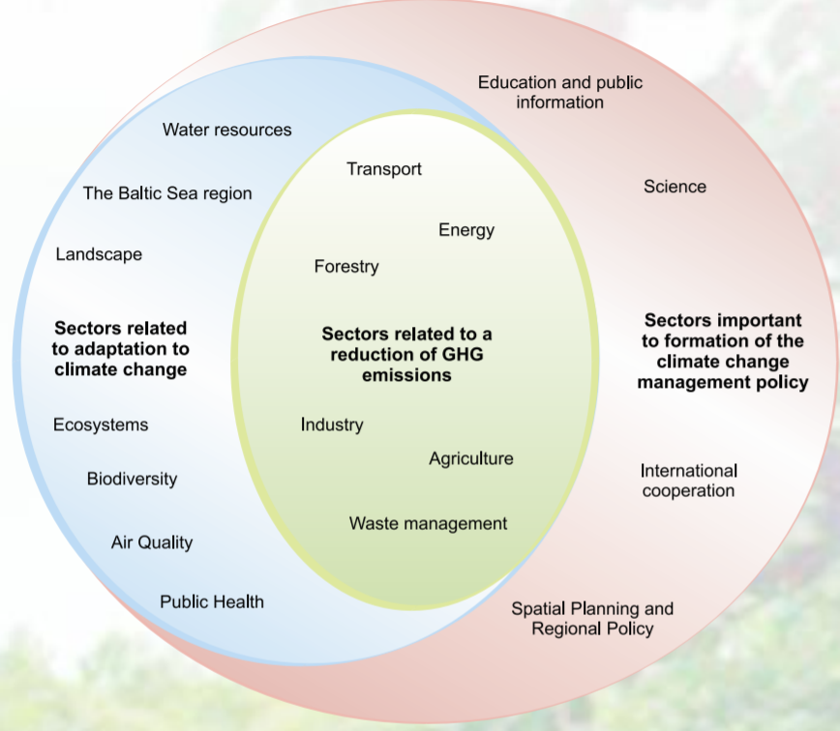

Slide 9
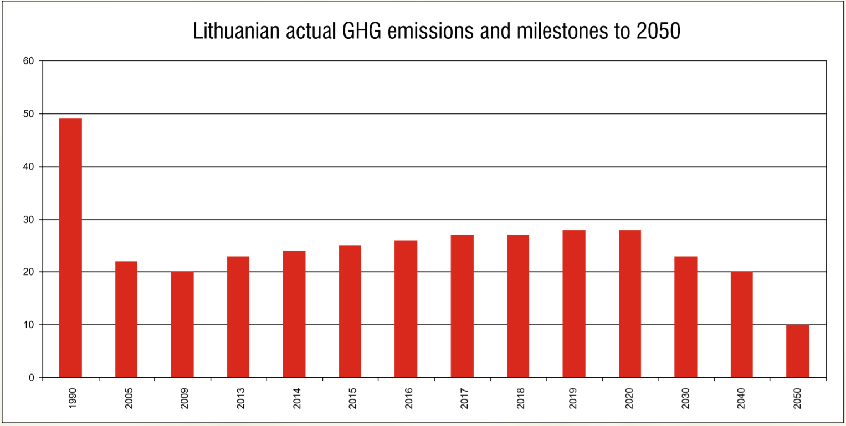
The strategic goal of the Lithuanian climate change mitigation policy
to reduce vulnerability of the natural ecosystems and national economy sectors by implementing measures that preserve and increase the resistance to climate change, and maintain beneficial conditions of social life and economic activity.

Slide 10
The strategic goal of the Lithuanian adaptation to climate change policy
The strategic goal will be implemented according to these main directions:
The integrated approach to the climate change impact on the particular territories at the regional level.
The chosen climate change adaptation measures should not oppose the climate change mitigation efforts but should contribute to them.
Adaptation to climate change should become a separate component of the climate scientific research.
Mutually beneficial cooperation between governmental, municipal and financial institutions, funds, universities, with other countries and the EU projects should be encouraged.

Slide 11
Implementation of the climate change management policy strategic goals in Lithuania will benefit for:

Slide 12
Modernisation of the most important economy sectors of Lithuania (energy, industry, transport, agriculture, ect.).
The use of fossil fuels will be gradually reduced in transport and heating sectors.
Higher use of RES in electricity and heat energy production, transport.
Reduction of energy consumption in the existing buildings and construction of new intelligent low- or zero-energy buildings.
Energy performance of the existing buildings will be improved by renovating them.
Modernisation of electricity grids.

Slide 13
Reduction of air pollution:
Decrease of negative health effects induced by air pollution.
The society will become healthier and the health care costs will be reduced.
Efficiency of passenger cars will be constantly improved, after the adoption of legal acts setting the requirements for reductions in C02 emissions;
moreover, a gradual transition to the use of electric and hybrid car technologies is predicted.

Slide 14
Conservation of biological diversity:
The purposeful use of biomass and agriculture resources increases better agriculture and forestry practice;
Promoting healthy and organic food will help reduce methane and nitrous oxide emissions.
Climate change mitigation measures will have a positive influence on the preservation of Lithuania's ecosystems and biodiversity.

