Slide 1
Lesson plan 2 SANTO ANGEL DE LA GUARDA SCHOOL
ERASMUS + MONEY MATTERS Project
List of countries that use euro currency
Similarities and differences of these currencies

Slide 2
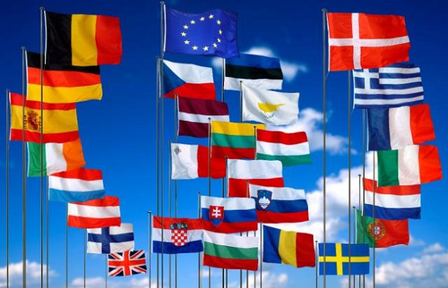
List of EU members
Austria, Belgium, Bulgaria, Croatia, Cyprus, Czech Republic,Denmark, Estonia, Finland, France, Germany, Greece, Hungary, Ireland, Italy, Latvia, Lithuania, Luxembourg, Malta, Netherlands, Poland, Portugal, Romania, Slovakia, Slovenia, Spain, Sweden and United Kingdom.

Slide 3
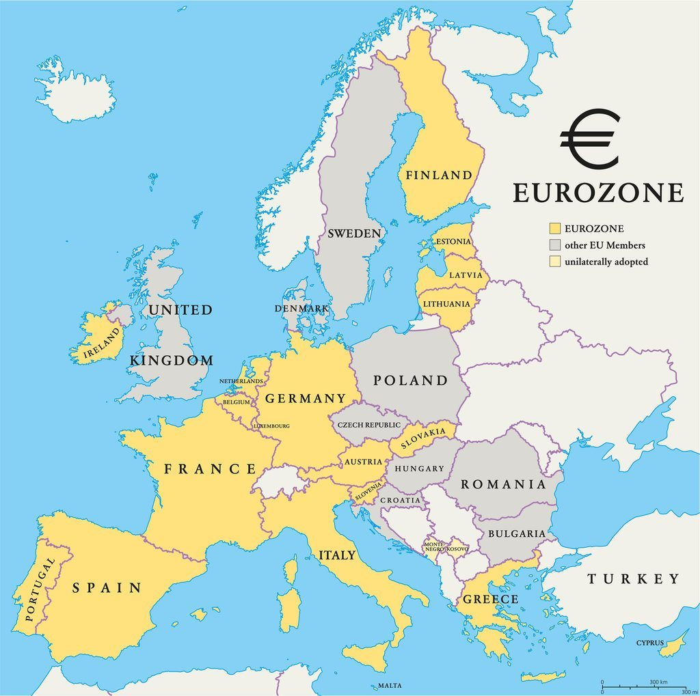
List of countries that use euro currency
Andorra , Austria, Belgium, Cyprus, Estonia, Finland, France, Germany, Greece, Ireland, Italy, Latvia, Lithuania, Luxembourg, Malta, Monaco, Netherlands, Portugal, San Marino, Slovakia, Slovenia, Spain, Vatican city
Andorra, Monaco , San Marino and the Vatican city do not belong to The European Union

Slide 4
What are the similarities and differences of these currencies
The euro coin series comprises eight different denominations: 1, 2, 5, 10, 20 and 50 cent, €1 and €2. You can use any euro coin anywhere in the euro area.
The euro coins have a common side and a national side.
A.-The national side indicates the issuing country.
B.-The common sides of the coins were designed by Mr Luc Luycx of the Royal Belgian Mint.
They show images of the European Union or of Europe and symbolise the unity of the EU.
The 5, 2 and 1 cent coins show Europe in relation to Africa and Asia on a globe.

