Slide 1
Lesson plan SANTO ANGEL DE LA GUARDA SCHOOL
ERASMUS + MONEY MATTERS Project
Technical information about coins.
Security measures

Slide 2
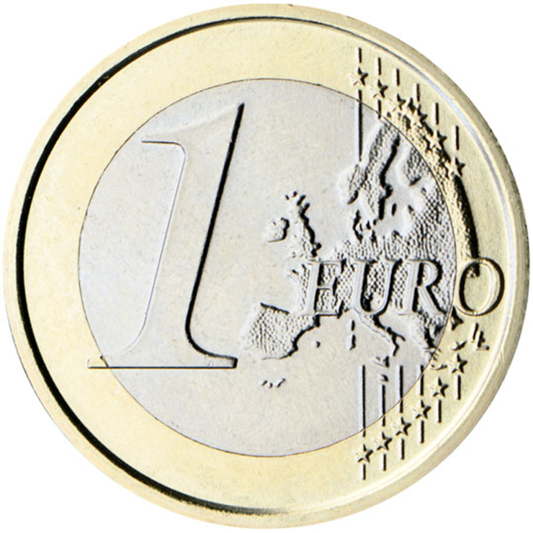
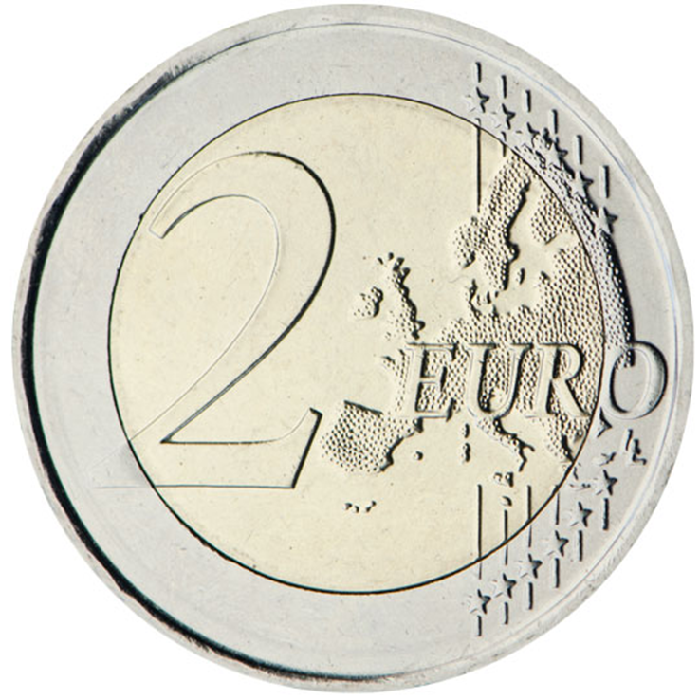
Bi-color coins
What are they ?
They are made up of several metal alloys.
These materials consist of a core of a certain metal and a ring of another metal, both with a different coloration.
Coins of this composition are called 'bi-colour coins'.
The production of bi-colour coins are a technical innovation of the last decades.

Slide 3
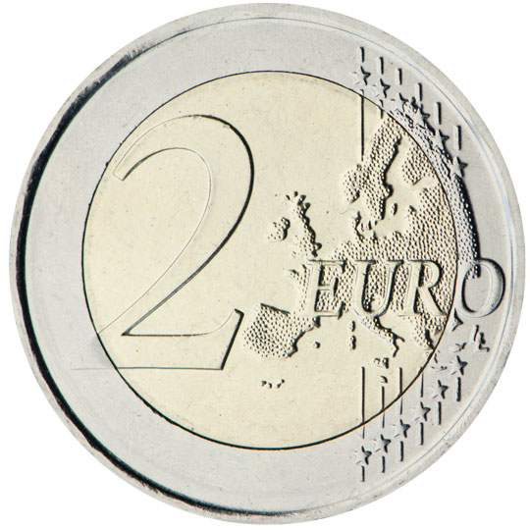
2 euro coin
Diameter (mm): 25.75
Thickness (mm): 2.20
Weight (g): 8.50
Shape: Round
Colour: Outer part: silver; inner part: gold
Composition: Outer part: copper-nickel; inner part: three layers: nickel brass, nickel, nickel brass
Edge: Edge lettering, fine milled

Slide 4
1 euro coin
Diameter (mm): 23.25
Thickness (mm): 2.33
Weight (g): 7.50
Shape: Round
Colour: Outer part: gold; inner part: silver
Composition: Outer part: nickel brass; inner part: three layers: copper-nickel, nickel, copper-nickel
Edge: Interrupted milled

Slide 5
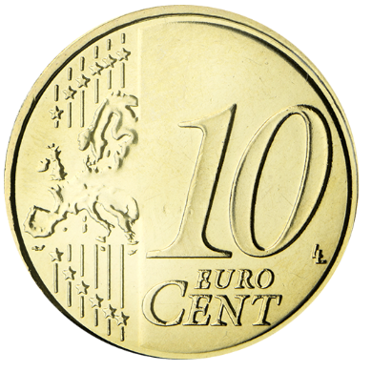
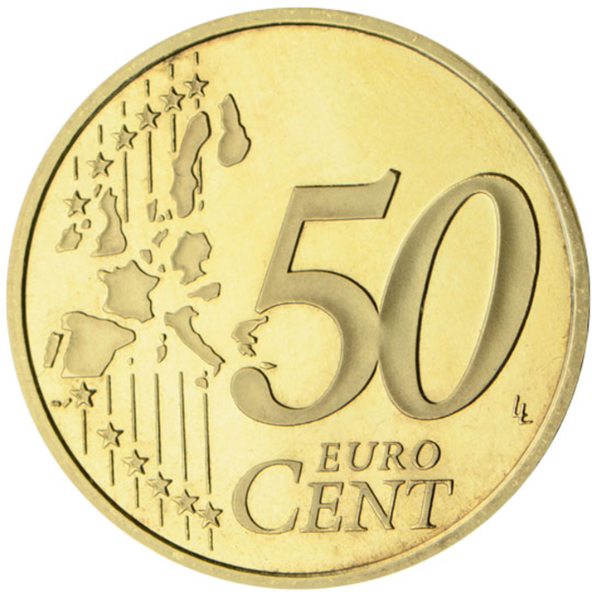
Nordic gold
What is it?
It is a brass alloy, made up from more than 89% of copper, 5% aluminium and 1% zinc.
Why Nordic gold?
By adding aluminium the material gets its pretty golden shine.
For normal daily use the shine remains and the coins do not become mat.
In contrast to brass or bronze Nordic Gold is difficult to produce, meaning that the risk of counterfeit is reduced.
Moreover there is great skill and technical knowledge required to make Nordic Gold into a coin.
Because of the difficult processability the alloy is not used for industrial applications.

Slide 6
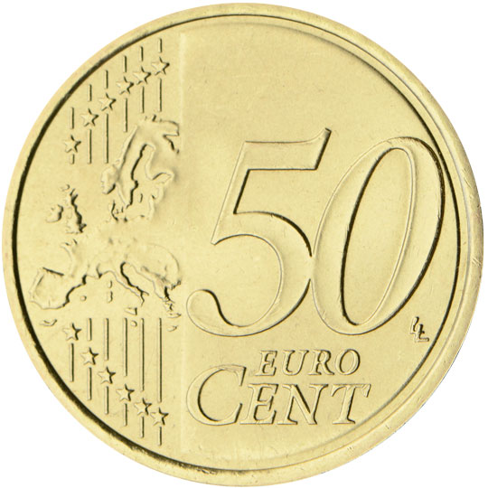
50 euro cent coin
Diameter (mm): 24.25
Thickness (mm): 2.38
Weight (g): 7.80
Shape: Round
Colour: Gold
Composition: Nordic gold
Edge: Shaped edge with fine scallops

Slide 7
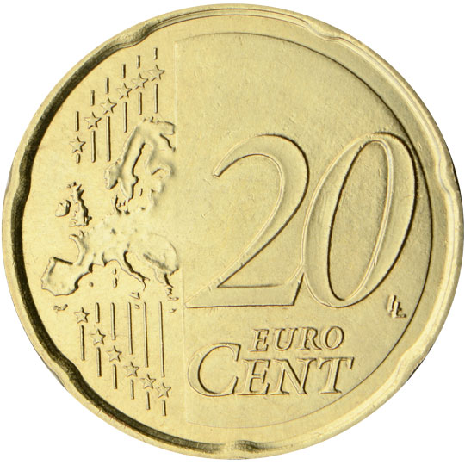
20 euro cent coin
Diameter (mm): 22.25
Thickness (mm): 2.14
Weight (g): 5.74
Shape: Spanish flower shape
Colour: Gold
Composition: Nordic gold
Edge: Plain

Slide 8
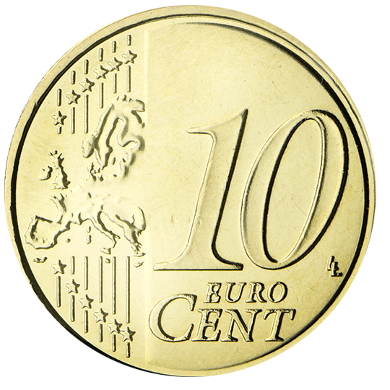
10 euro cent coin
Diameter (mm): 19.75
Thickness (mm): 1.93
Weight (g): 4.10
Shape: Round
Colour: Gold
Composition: Nordic gold
Edge: Shaped edge with fine scallops

Slide 9
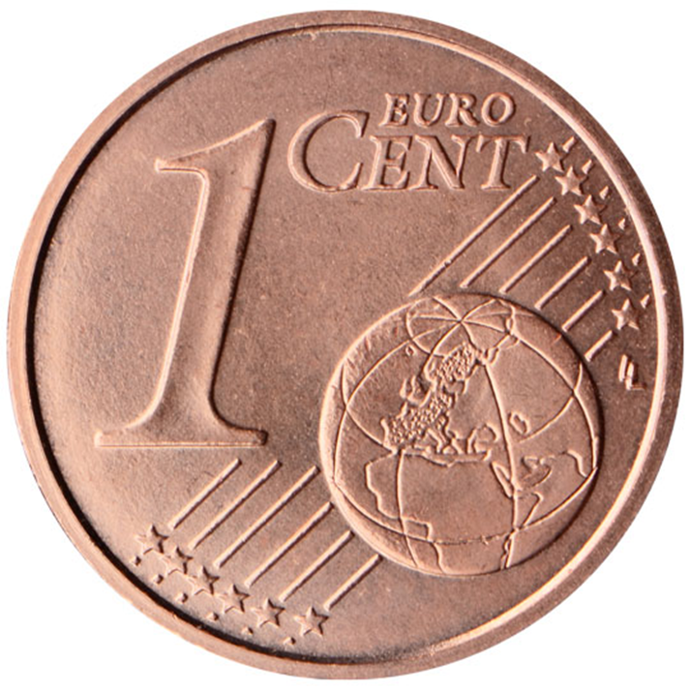
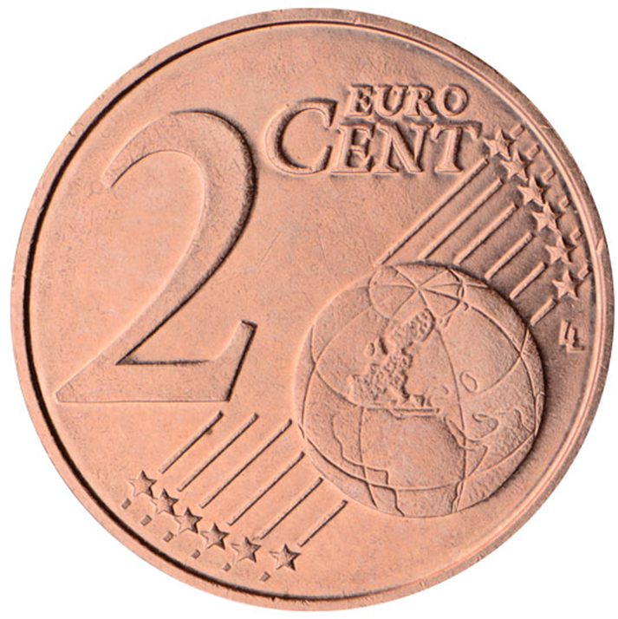
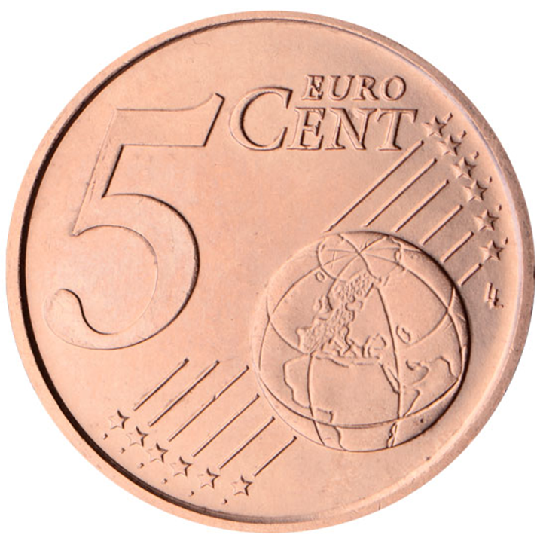
Red coloured coppered steel
Why ?
It is relatively cheap to produce and protects against oxidation.
Its appearance changes greatly during use due to contact with fingers.
Copper is a naturally antibacterial material, fully recyclable,

Slide 10
5 euro cent coin
Diameter (mm): 21.25
Thickness (mm): 1.67
Weight (g): 3.92
Shape: Round
Colour: Copper
Composition: Copper-covered steel
Edge: Smooth

Slide 11
2 euro cent coin
Diameter (mm): 18.75
Thickness (mm): 1.67
Weight (g): 3.06
Shape: Round
Colour: Copper
Composition: Copper-covered steel
Edge: Smooth with a groove

Slide 12
1 euro cent coin
Diameter (mm): 16.25
Thickness (mm): 1.67
Weight (g): 2.30
Shape: Round
Colour: Copper
Composition: Copper-covered steel
Edge: Smooth

Slide 13
Safety measures
Advanced technical specifications
Difficult to counterfeit
Incorporated electromagnetic and automated reading characteristics
They can be used in vending machines throughout the euro zone

Slide 14
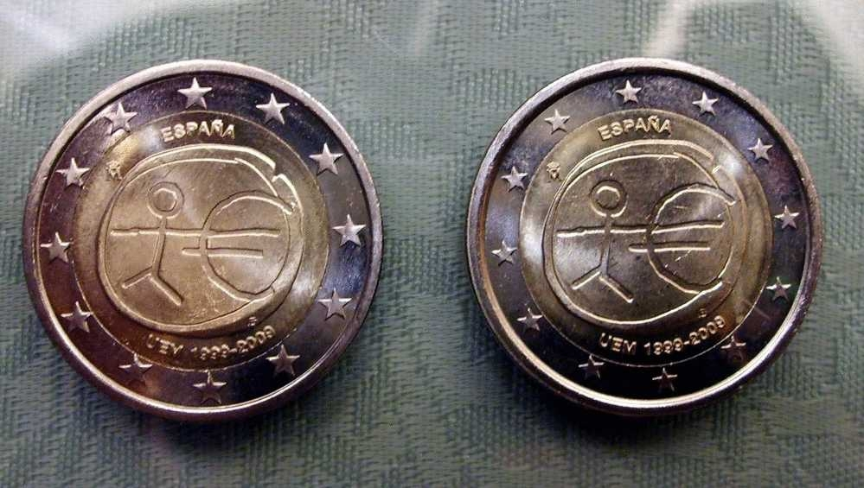
Minting errors ( 1 )
It is a coin dedicated to the 10th Anniversary of the Economic Monetary Union by the Spanish mint FNMT during last 2009
The error consists in an expansion of the little star surrounding the coin

Slide 15
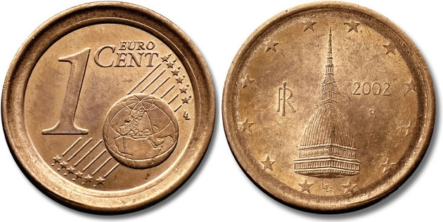
Minting errors ( 2 )
This Italian coin of 1 Euro cent sold for more than 6.600 Euro
It has the same diameter and drawing of the two cents coin but a face value of one cent

Slide 16
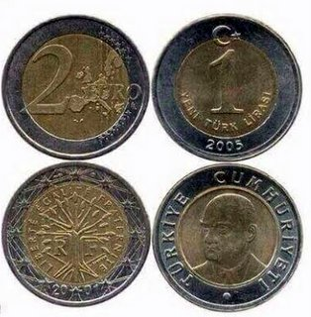
WATCH OUT ¡
Yeni Turk Lirasi Turkish coin versus 2 euro coin
Similarities
Appearence
Big difference
1 Yeni Turk Lirasi is worth 0,4 €

