Slide 1
The national side of euro coins
Spain, Slovakia and Greece

Slide 2
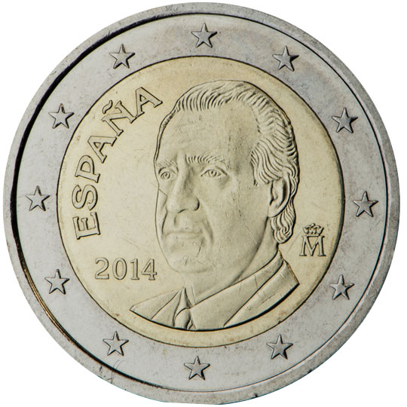
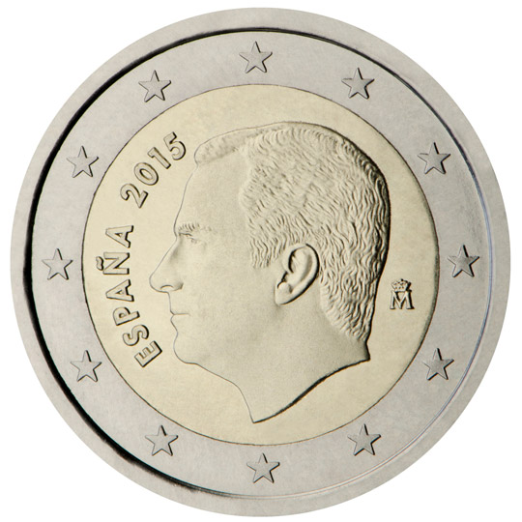
Spain
There are three series of coins in circulation. In 2015, Spain introduced the third series of €1 and €2 coins showing the new King Felipe VI, the name of the issuing country and the year of issuance. The mint mark appears to the right of the effigy
2-euro coins , national side

Slide 3
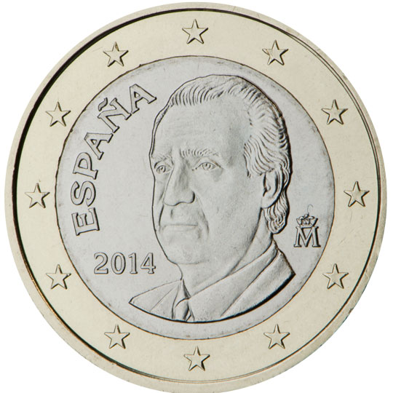
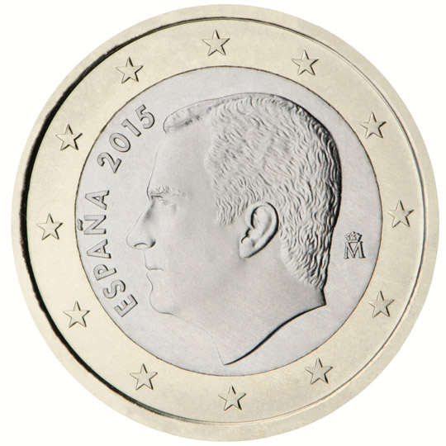
Spain
1-euro coins, national side

Slide 4
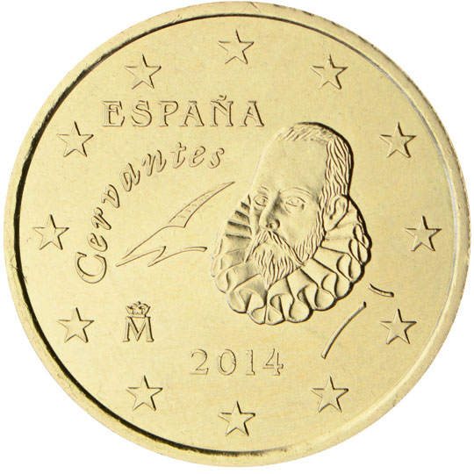
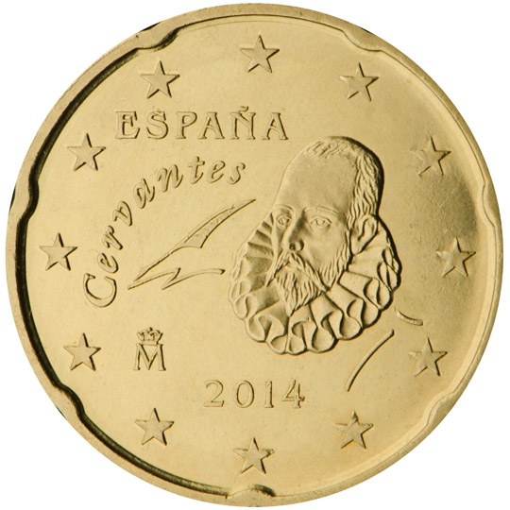
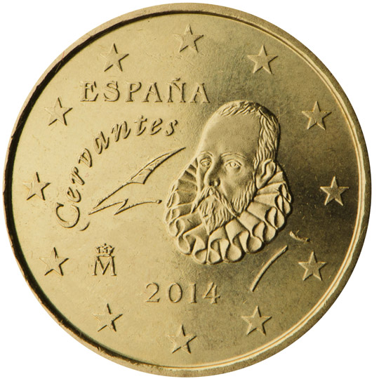
Spain
50, 20 and 10-cent coins: Miguel de Cervantes, the father of Spanish literature, is shown on these coins, reflecting "the universality of the man and his work".
50, 20 and 10-cent coins, national side

Slide 5
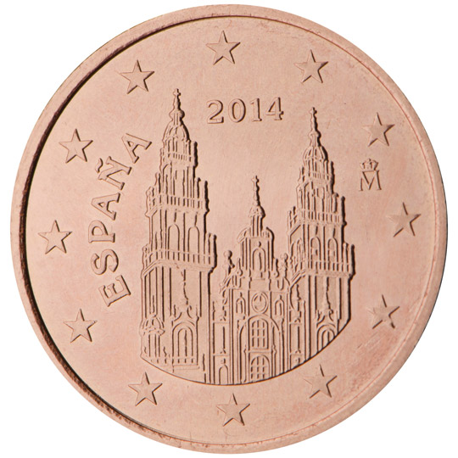
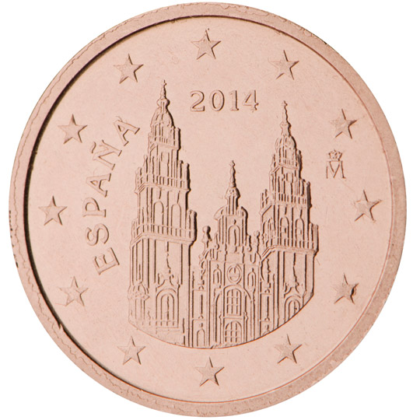
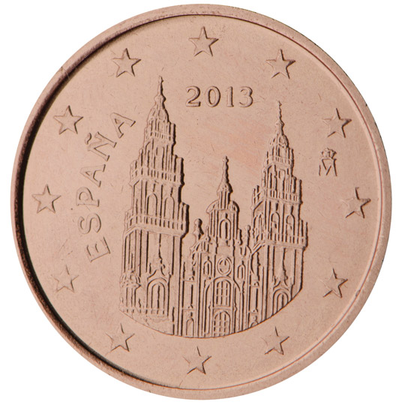
Spain
5, 2 and 1-cent coins: the cathedral of Santiago de Compostela, a jewel of Spanish Romanesque architecture and one of the most famous pilgrimage destinations in the world, is pictured on these coins. They show the monumental facade of the Obradoiro, a splendid example of Spanish baroque construction, started in 1667 by Jose del Toro and Domingo de Andrade. It was finished in the 18th century by Fernando Casas y Novoa
5, 2 and 1-cent coin, national side

Slide 6
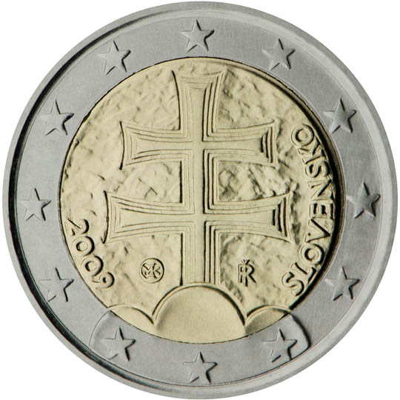
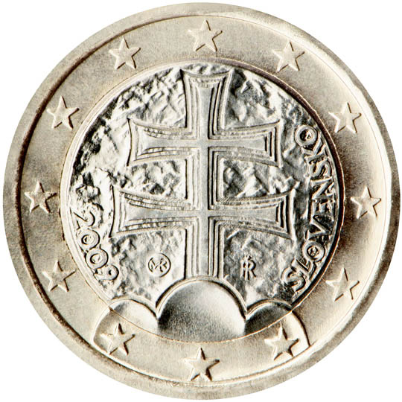
Slovakia
The €1 and €2 coins depict a double cross on three hills, as featured in the national emblem of Slovakia.
2 and 1-euro coins , national side

Slide 7
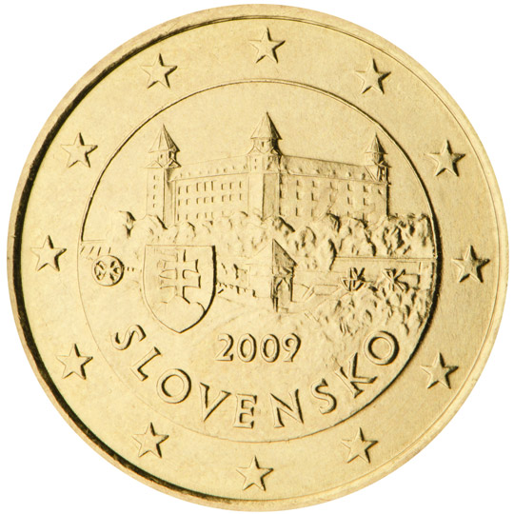
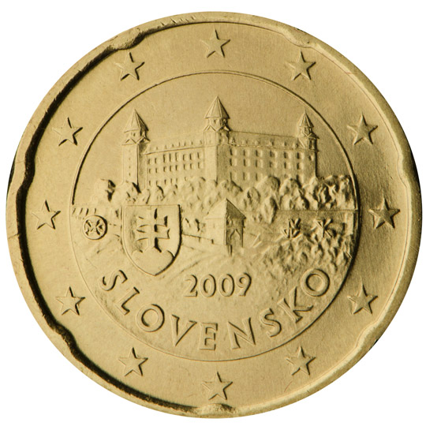
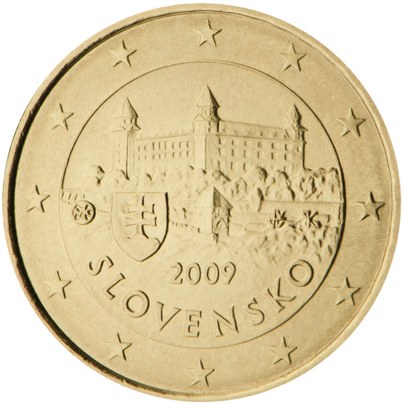
Slovakia
The 10, 20 and 50 cent coins show Bratislava castle and the national emblem of Slovakia.
50, 20 and 10-cent coins, national side

Slide 8
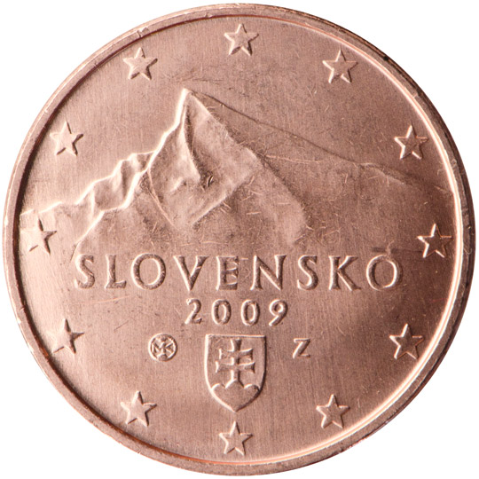
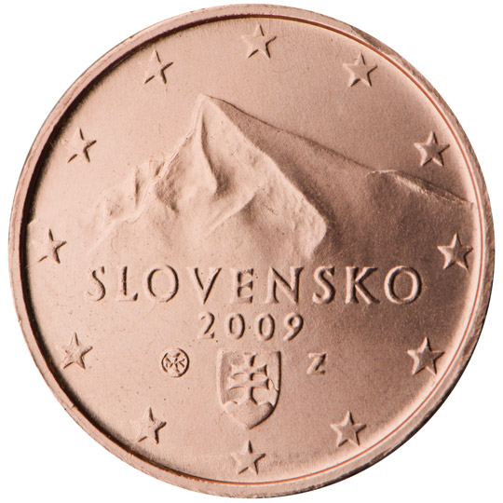
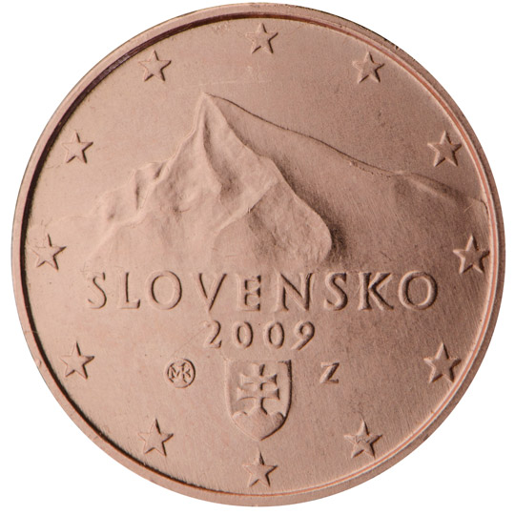
Slovakia
The 1, 2 and 5 cent coins feature the Tatra Mountains’ peak, Kriváň, a symbol of the sovereignty of the Slovak nation, and the national emblem of Slovakia.
5, 2 and 1-cent coins, national side

Slide 9
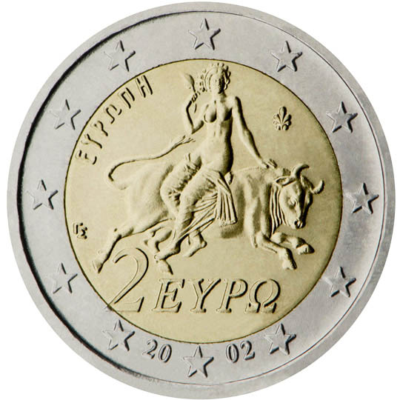
Greece
This coin depicts a scene from a mosaic in Sparta (third century AD), showing Europa being abducted by Zeus, who has taken the form of a bull. Europa is a figure from Greek mythology after whom Europe was named. Edge lettering of the €2 coin: EΛΛHNIKH ΔHMOKPATIA * (Hellenic Republic).
2 -euro coin , national side

Slide 10
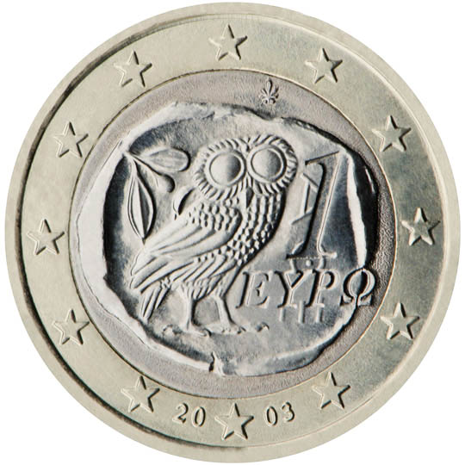
Greece
The image of the owl featured in this design was copied from an ancient Athenian 4-drachma coin (fifth century BC).
1 -euro coin , national side

Slide 11
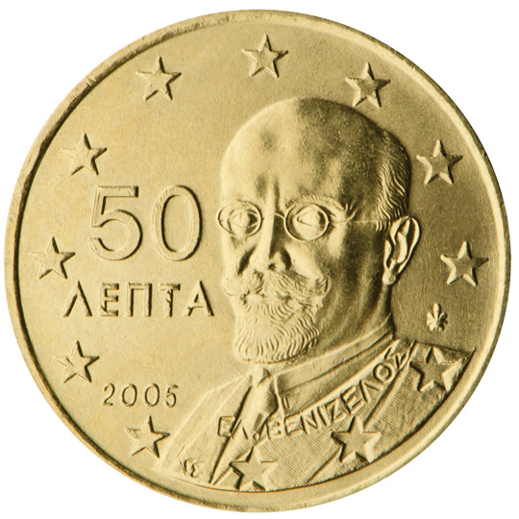
Greece
Eleftherios Venizelos (1864-1936), one of Greece's most prominent political figures, is shown on this coin. He was a pioneer in social reform, a renowned diplomat and played a key role in modernising the Greek state and liberating Northern Greece and the Aegean islands.
50-cent coin, national side

Slide 12
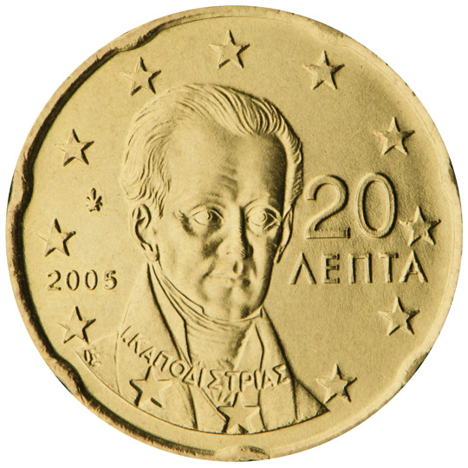
Greece
This coin commemorates Ioannis Capodistrias (1776-1831), a leading national and European politician and diplomat who became the first Governor of Greece (1830-31) following the Greek War of Independence (1821-27).
20-cent coin, national side

Slide 13
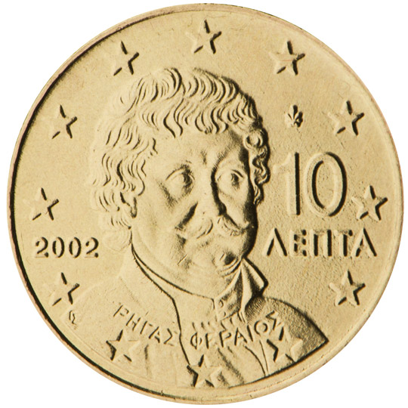
Greece
Rigas Fereos (Velestinlis) (1757-98) is featured on this coin. He was a forerunner and leading figure of the Greek enlightenment, as well as a visionary and herald of Balkan liberation from Ottoman rule.
10-cent coin, national side

Slide 14
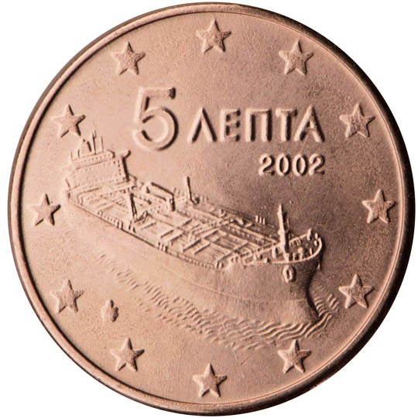
Greece
This coin shows a modern sea-going tanker, reflecting the innovative spirit of Greek shipping
5-cent coin, national side

Slide 15
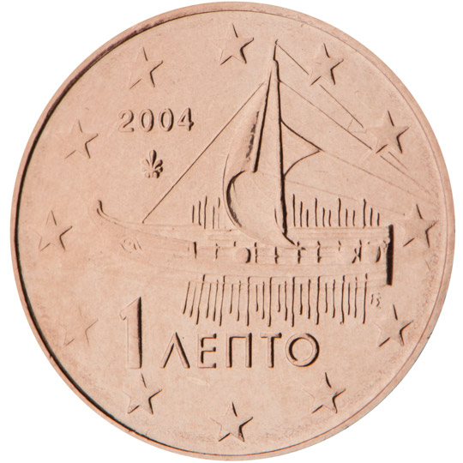
Greece
This design features an advanced model of an Athenian trireme, the largest warship afloat for more than 200 years, dating from the time of the Athenian democracy (fifth century BC).
1-cent coin, national side

