Slide 1
The common side of euro coins

Slide 2
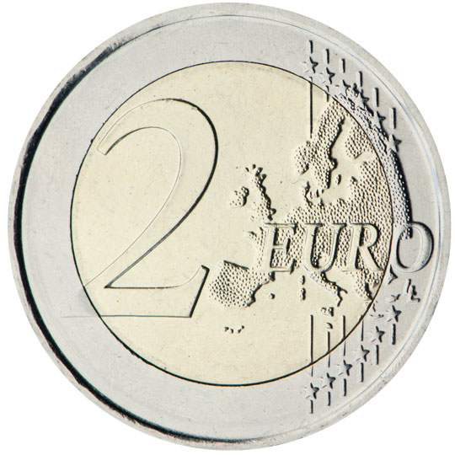
2 euro coin

Slide 3
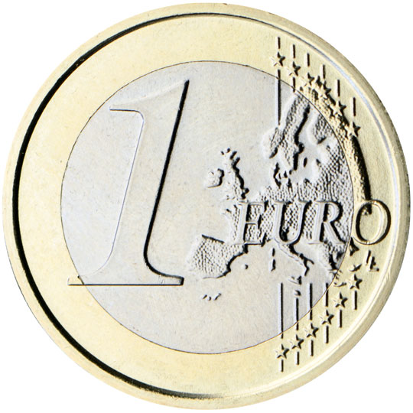
1 euro coin

Slide 4
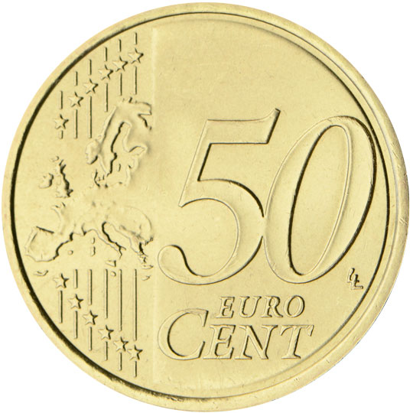
50 euro cent coin

Slide 5
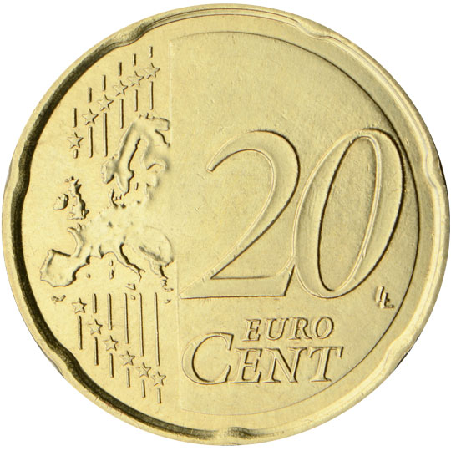
20 euro cent coin

Slide 6
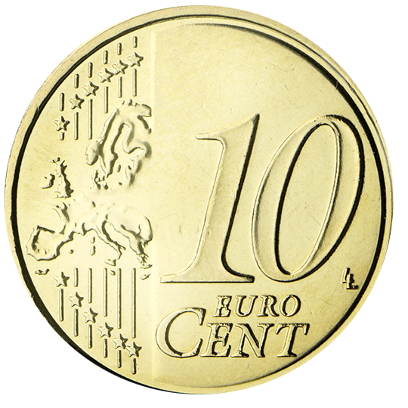
10 euro cent coin

Slide 7
5 euro cent coin

Slide 8
2 euro cent coin

Slide 9
1 euro cent coin

