Slide 1
Study 3 commemorative coins of Spain related to Europe, historical events, a short description of them
Tuesday,28th February 2018.

Slide 2
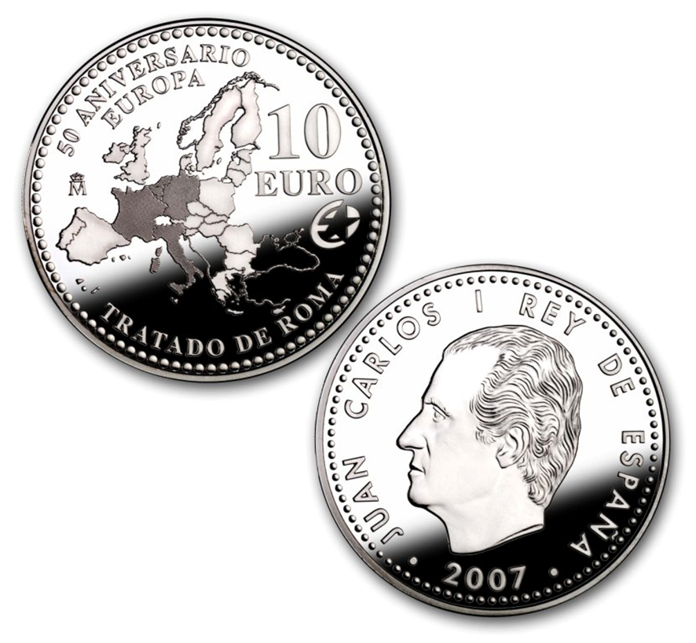
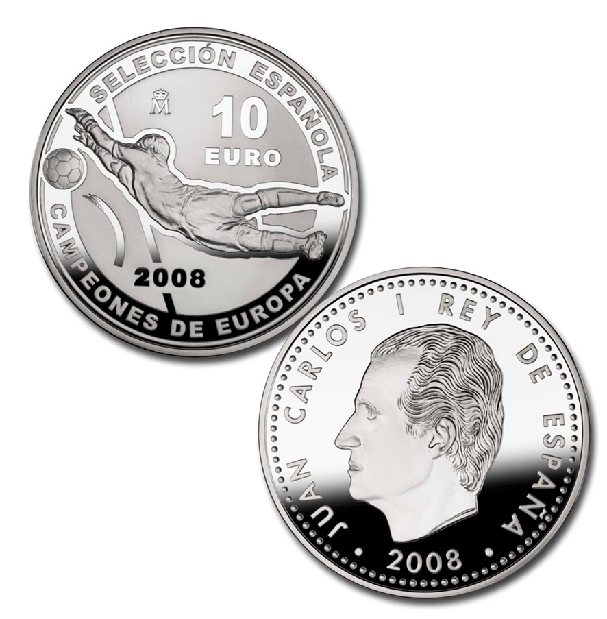
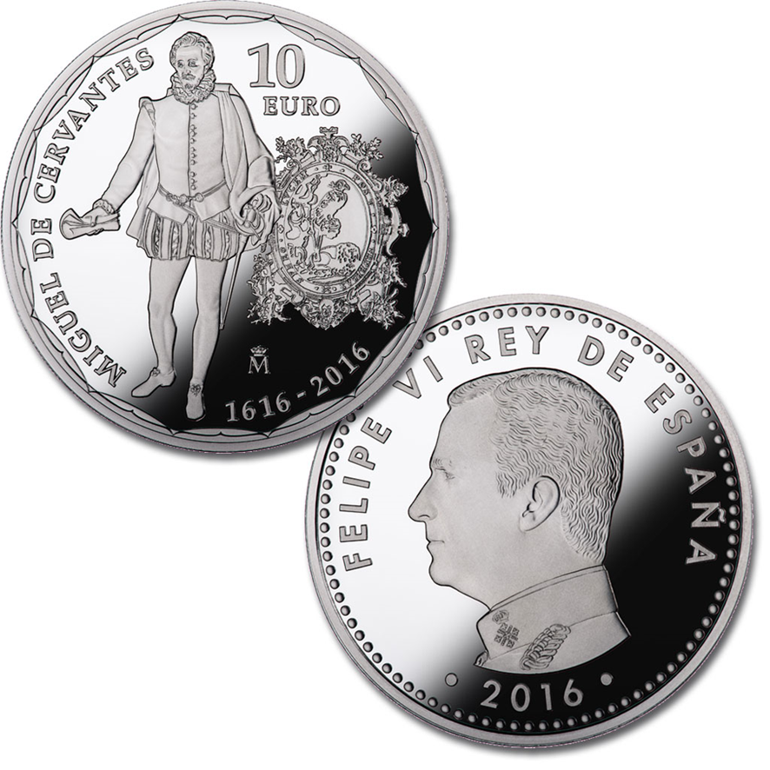
Guess what are these three Spanish commemorative euro coins about?

Slide 3
Should you need some help…
Coin 1
Coin 2
Coin 3

