Slide 1
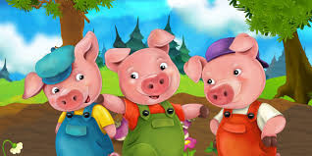
tHE THREE LITTLE PIGS

Slide 2
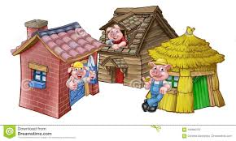
Once upon a time there were three little pigs and the time came for them to leave home and seek their fortunes. Before they left, their mother told them " Whatever you do , do it the best that you can because that's the way to get along in the world.
The first little pig built his house out of slama because it was the easiest thing to do. The second little pig built his house out of klonki. This was a little bit stronger than a straw house. The third little pig built his house out of tuhli.

Slide 3
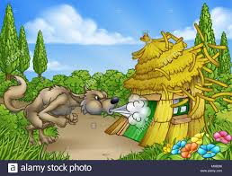
One night the big bad wolf, who dearly loved to eat fat little piggies, came along and saw the first little pig in his house of slama. He said "Let me in, Let me in, little pig or I'll huff and I'll puff and I'll blow your house in!" "Not by the hair of my chinny chin chin", said the little pig. But of course the wolf did blow the house in and the first little pig ran to his brother’s house of klonki.

Slide 4
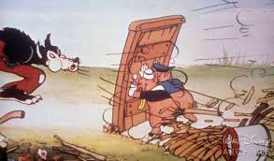
The wolf then came to the house of klonki. "Let me in ,Let me in little pig or I'll huff and I'll puff and I'll blow your house in" "Not by the hair of my chinny chin chin", said the little pigs. But the wolf blew that house in too, and the two little pigs ran to their brother’s house of tuhli.
The wolf then came to the house of tuhli. " Let me in , let me in" cried the wolf "Or I'll huff and I'll puff till I blow your house in" "Not by the hair of my chinny chin chin" said the pigs. Well, the wolf huffed and puffed but he could not blow down that brick house.

Slide 5
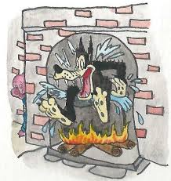
When the wolf finally found the hole in the chimney he crawled down and KERSPLASH right into that kettle of water and that was the end of his troubles with the big bad wolf.
But the wolf was a sly old wolf and he climbed up on the roof to look for a way into the brick house.
The little pig saw the wolf climb up on the roof and lit a roaring fire in the fireplace and placed on it a large kettle of water.

Slide 6
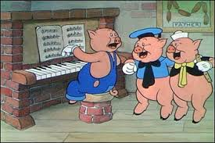
The next day the three little pigs invited their mother over . She said "You see it is just as I told you. The way to get along in the world is to do things as well as you can." Fortunately for these little pigs,they learned that lesson. And they just lived happily ever after!

Slide 7
straw tuhli
sticks slama
bricks klonki

Slide 8
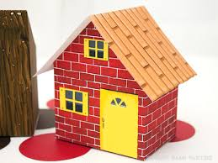
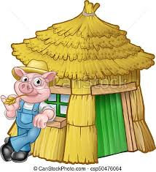
Well done!
tuhli
bricks
sticks
Try again!
straw

Slide 9
Well done!
klonki
bricks
sticks
Try again!
straw

Slide 10
Well done!
slama
bricks
sticks
Try again!
straw

