Slide 1
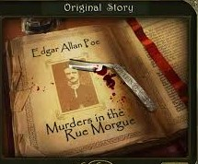

Slide 2
CSI(Crime Story Investigation)
The Plot Investigator : Antonia Georgitsou
The Character Investigator :Thodoris Diakonarakis
The Passage Investigator : Nelli Pasat
The Word Investigator : Damianos Karabelas
The Clue Investigator : Panayotis Kontogiorgis

Slide 3
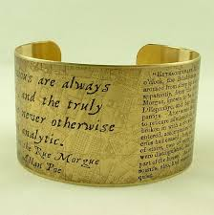
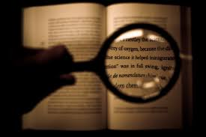
PLOT
Our story begins when terrific shrieks where heard at three o' clock in the morning, from the fourth story of a house in the Rue Morgue. The apartment, which belonged to one Madame L‘ Espanaye and her daughter, Mademoiselle Camille L‘ Espanaye, was found in the wildest disorder. The corpse of the daughter was found in the chimney head downward. It was quite warm, with many scratches upon the face and upon the throat dark bruises and deep indentations of finger nails, as if the deceased had been throttled to death. The corpse of Madame L‘ Espanaye was found into a small paved yard in the near of the building, with her throat entirely cut that, upon an attempt to raise her, the head fell off. The body, as well as the head, was fearfully mutilated.
Two voices were heard from the apartment. The one definitely belonged to a Frenchman, while the other was described as a shrill, or harsh voice, that while an Italian, an Englishman, a Spaniard, a Hollander and a Frenchman attempted to describe it, each one spoke of it as that of a foreigner. That lead to the conclusion that the second voice was not one of a human.
Also, the assassin did not take the money that were found in the apartment, a fact that leads to the conclusion that they did not have a motive to kill and the condition of the apartment shows us that the person was either a really strong man or an animal.

Slide 4
Character
The most important character is Dupin,a young man from an illustrious family.For some untoward events,he has reduced to poverty.He appears to be the main character of the story,because the narrator spends a lot of time with him and admires his amazing –although strange- imagination.A very unique imagination,about loving the night and believing in a sable divinity,the Advent of Darkness.

Slide 5
Passage
The reason why I picked these paragraphs is because they show us the crime scene and we can learn many things about the assassin, we have clues for the murderer. We know that there were more people in the apartment than just the two ladies. Moreover, we learn that the murderer was really strong and he hat a very bizarre way of talking that an Italian, an Englishman, a Spaniard, a Hollander and a Frenchman could not identify a word. Lastly the murderer did not cares about the money that were found under mattress in the apartment.

Slide 6
Words
The fruiterer: The last thing Dupin and the narrator talked about before Dupin made his remark was horses. So Dupin traces his observations back to that point, when the two cross the street and the narrator runs into a fruiterer (i.e., a guy who sells fruit). The fruit-seller knocks the narrator into a stack of paving stones, which makes the narrator look angry and slightly pained.
Chimneys: Of "ordinary width" for the first eight to ten feet, they then narrow to the point that nothing bigger than a cat could get through.
The street stones: Having had this accident, Dupin observes that the narrator begins staring at the ground, watching his step. The road under repair is uneven and full of holes, so when they get to a freshly paved alley called Lamartine, the narrator starts to look more cheerful. He's visibly glad that the street stones underfoot are more even for
Doors: The killer(s) must have been still in the apartment where they found the daughter's body when the rescue party broke into the house (because of the sounds of scuffle/argument/etc.). But the doors were locked.

Slide 7
The first clue is that the neighbors who heard the murderer they each claimedthat they heard him speaking a different language. Second clue is the fact that If the neighbors cant agree for the murderers language maybe it is not a human that murder the two women, as concluded by Dupin. Third Clue is the hair Dupin found at the crime scene, This hair was unusual. So Dupin put an ad in the Paper asking if anyone lost an “Ourang-Outang” and the ad was answered by a sailor. Dupin asked for all the information sailor has to give and he revealed that he had been keeping an oragutan obtained by his trip in Borneo. He explained that the animal escaped with his straight razor. So the oragutan entered in the apartment in Rue Morgue through the window, once in the room the animal tried to shave Madame Espanaye in imitation of the sailor’s daily routine and in doing so accidentally slits the woman’s throat. The bloody deed incited it fury and it squeezed the daughter’s throat until she died.

Slide 8
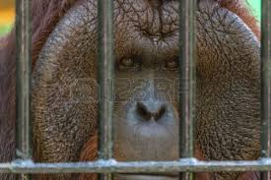
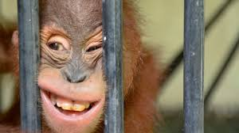
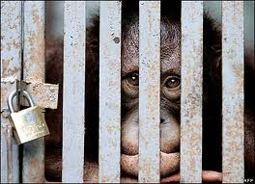
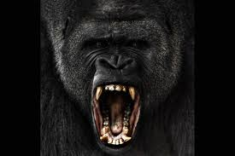
After a long time investigating , we concluded that the killer must have been very strong and smart . But because of lack of evidence , we had to believe that the killer was what we suspected . But after analyzing better the scant proof we had , we concluded that the killer was what we thought . Thus the murder has been solved and the killer is behind bars life long!!!

Slide 9
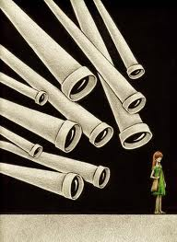
You are under surveillance
Whenever and Whatever will be criminal cases the JUNIOR DETECTIVES will be there to solve them!!!

Slide 10
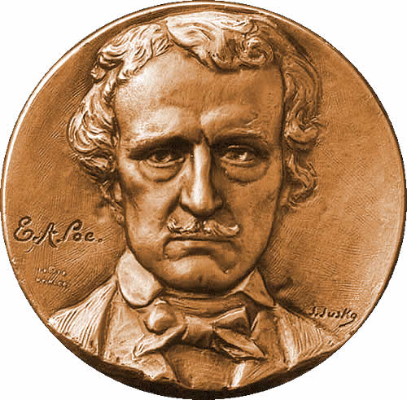
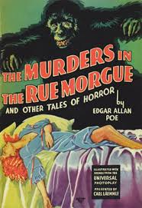
The End!!!
Thank you for watching
Junior Detectives

