Slide 1
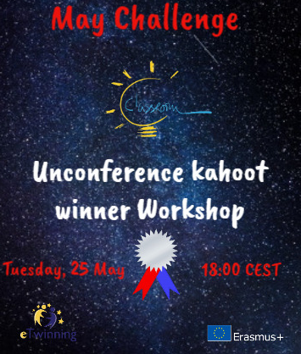
Deceiving
Life
Freestyle activities
Athanasia Zafeiropoulou
ICT & Physics teacher in Lower Secondary Greek Schools

Slide 2
How do you start a project?
How do you decide about the topic?
Where your inspiration comes from?
Menti.com https://www.menti.com/qauindzt8d

Slide 3
What if for our next project the starting point was only the tittle?
Deceiving
Life

Slide 4
Deceiving: an adjective or a verb?
Deceiving Life: What is the subject? What is the object? Life deceiving us? Something that is deceiving life (“reality”)?
Our (false) interpretation of “life”?
Life: what about?

Slide 5
A matter of definitions?

Slide 6
“Deceiving”?

Slide 7
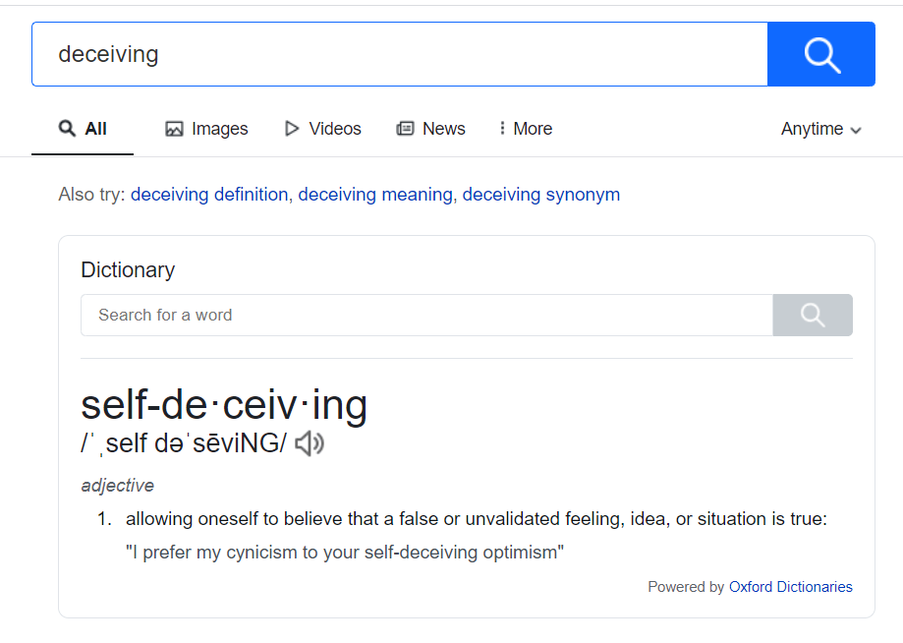
Wow! The search engine knows something about me!

Slide 9
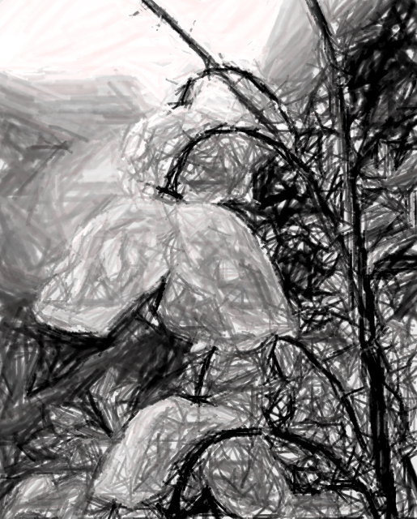
“Life”?

Slide 10
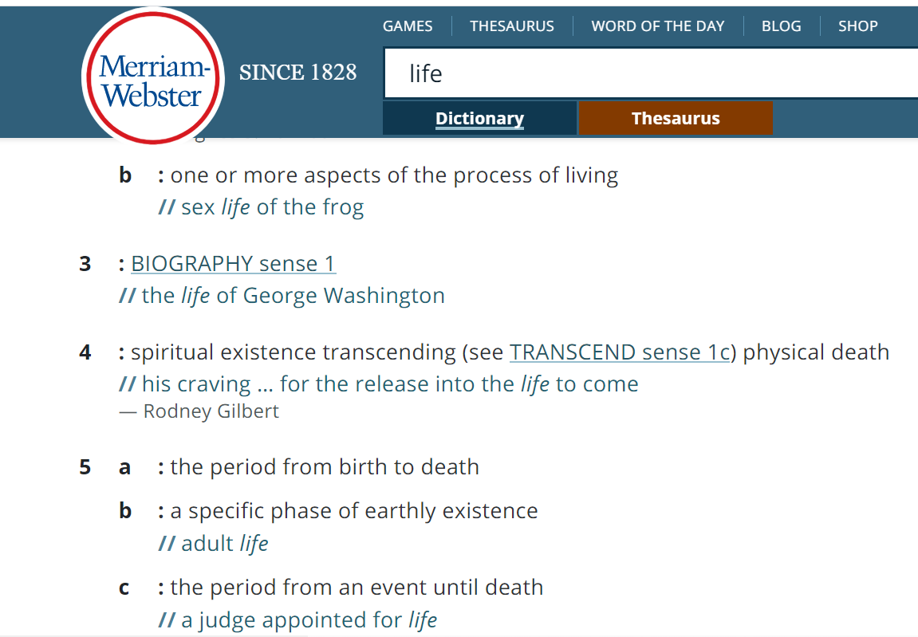

Slide 11
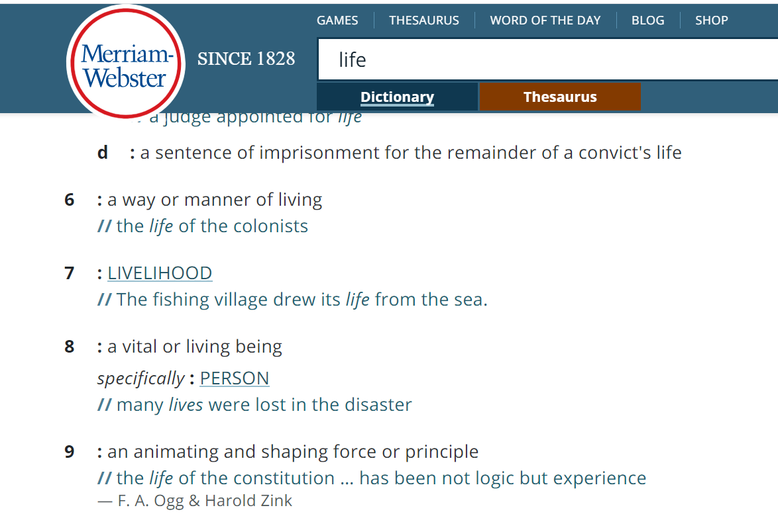

Slide 13
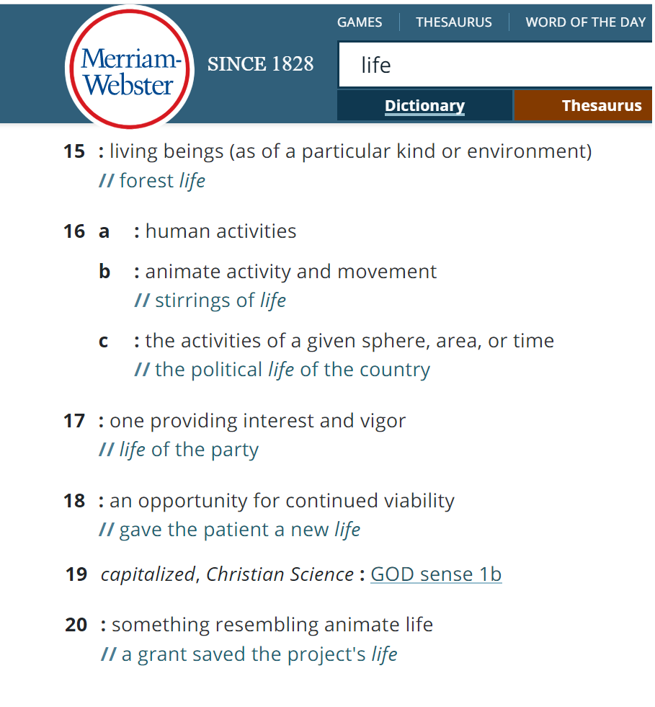

Slide 14
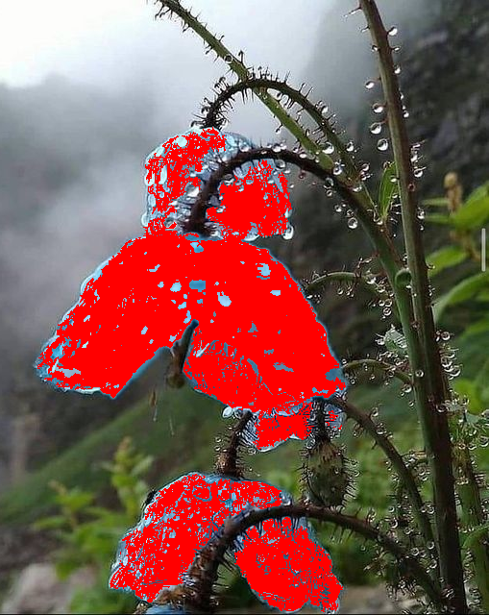

Slide 15
Our scientific age demands that we provide definitions, measurements, and statistics
in order to be taken seriously.
Yet most of the important things in life
cannot be precisely defined or measured.
Can we define or measure
life, love, beauty, friendship, or decency?

Slide 16
“In the sky, there is no distinction of east and west;
people create distinctions out of their own minds
and then believe them to be true.”
― Buddha

Slide 17
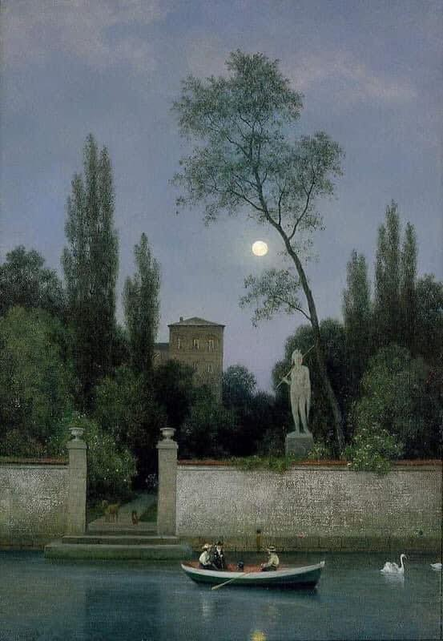
“Life is not a series of gig lamps symmetrically arranged;
life is a luminous halo,
a semi-transparent envelope surrounding us
from the beginning of consciousness to the end.”
Virginia Woolf
Georg Emil Libert - Italian Villa in Moonlight, 1868

Slide 18
People ask for a reason, for a purpose in everything we do.
“This is not the case in music and dancing.
When we make music we don't do it in order to reach a certain point, such as the end of the composition. If that were the purpose of music then obviously the fastest players would be the best.
Also, when we are dancing we are not aiming to arrive at a particular place on the floor as in a journey.
When we dance, the journey itself is the point, as when we play music the playing itself is the point…

Slide 19
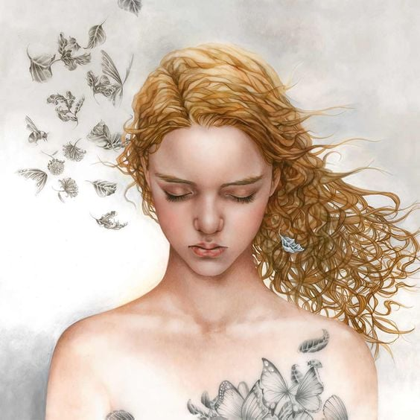
“…And exactly the same thing is true in meditation.
Meditation is the discovery that the point of life is always arrived at in the immediate moment.”
― Alan Watts

Slide 20
Take time to sit back and observe life.
And ask questions after.
Take time to think about “your (?) answers” (your way of thinking)
Think about your(?) interpretations of the “inputs” you have
and be aware that “your way” is not the only (valid) way.

Slide 21
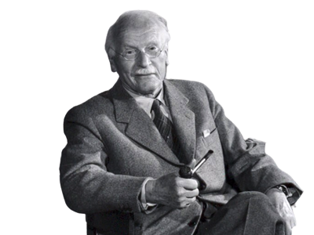
“Until you turn
the unconscious into conscious,
it will direct your life
and you will call it fate”
(mis/dis-information
is based on self-deceiving)
Carl Jung

Slide 22
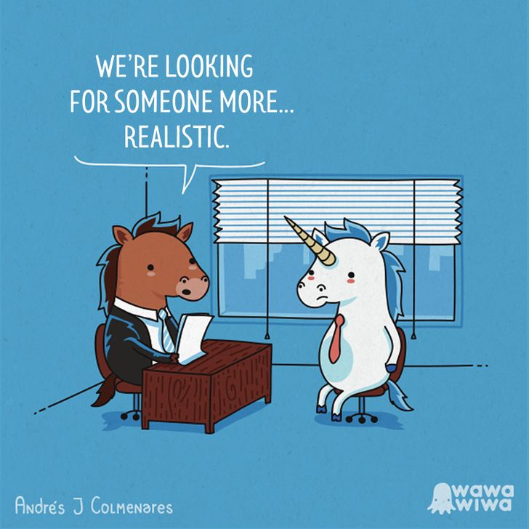
Would we dare
to be a unicorn
in a society
made of/for horses?

Slide 23
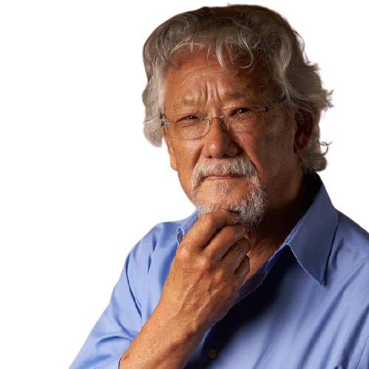
The way we see the world shapes
the way we treat it.
If a mountain is a deity, not a pile of ore;
if a river is one of the veins of the land, not potential irrigation water;
if a forest is a sacred grove, not timber;
if other species are biological kin, not resources;
or if the planet is our mother, not an opportunity –
then we will treat each other with greater respect.
Thus is the challenge,
to look at the world
from a different perspective.

Slide 24
Life is the answers to all our questions
But what is true in life?

Slide 26
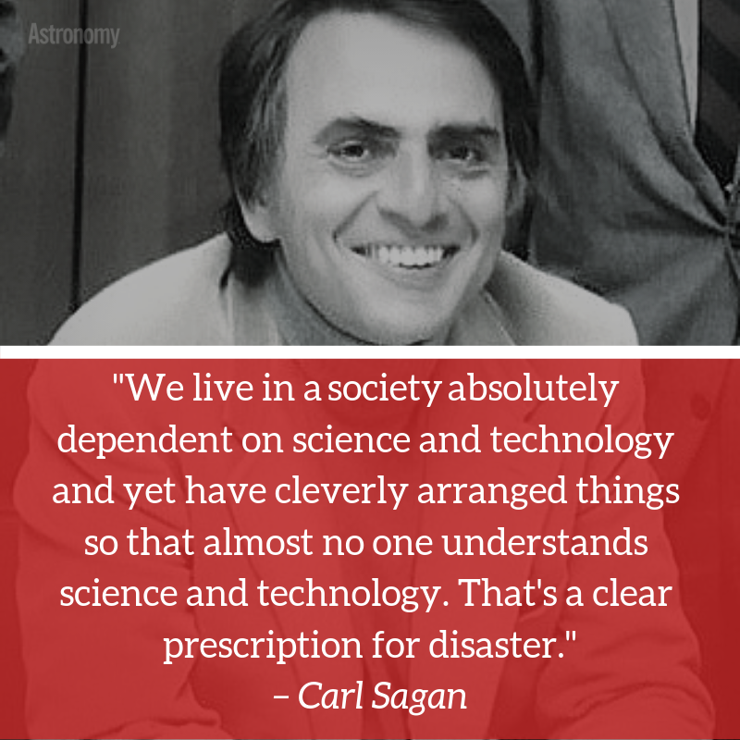

Slide 28
Ecology?
Perception, Science, AI?
?
So… what “our project” is about?
https://www.menti.com/mvacnw7cbq
Well-being and meditation?
Misinformation of our bias?

Slide 29
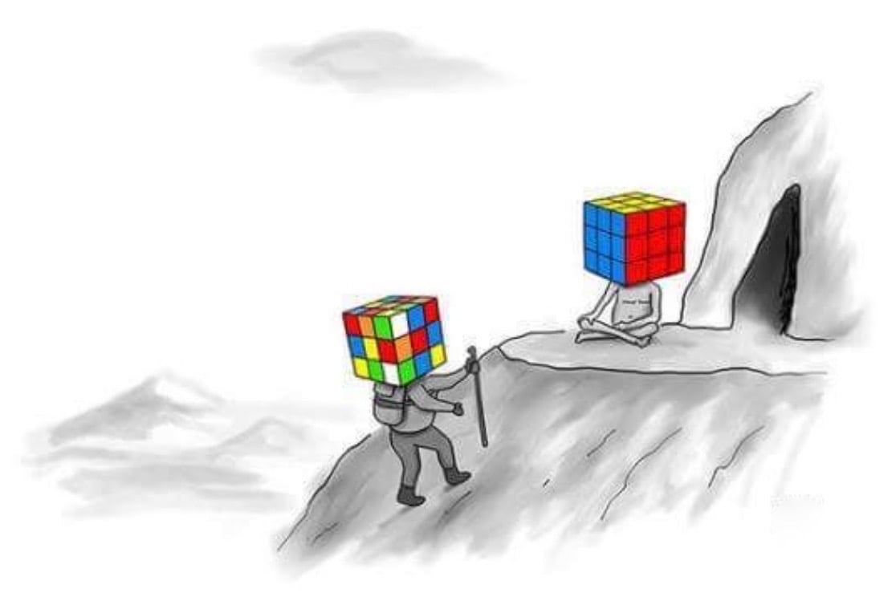
Activities that fit to “our project”…
…whatever the topic is,
based on its title!

Slide 30
A haiku
Write a haiku using in your own way the words “life” and “deceiving” -together or separated in the verses of the poem.
An example:
Afternoon decrease
Her own, deceiving life trots
Her expectations
Use a poem generator and “correct” the poem to make “a meaningful” one

Slide 31
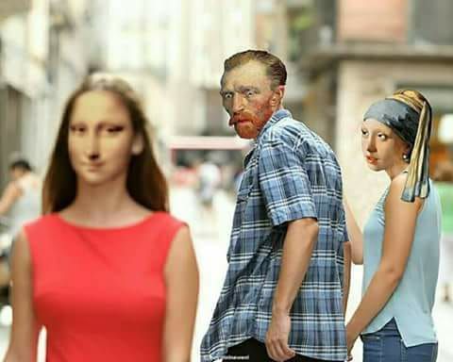
A photo (or photo collage) that could have that tittle (it can be yours or web-search based)
An example:

Slide 32
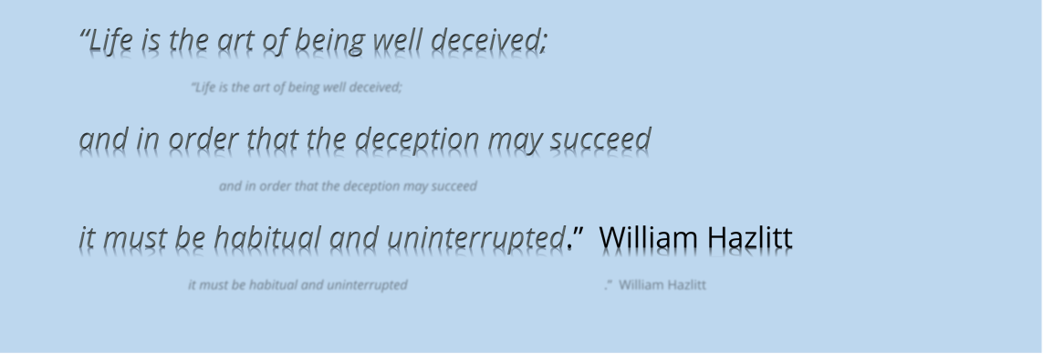
A Quote with that phrase that is presented in your own way (eg as a poster or edited textbox etc)
An example:

Slide 33
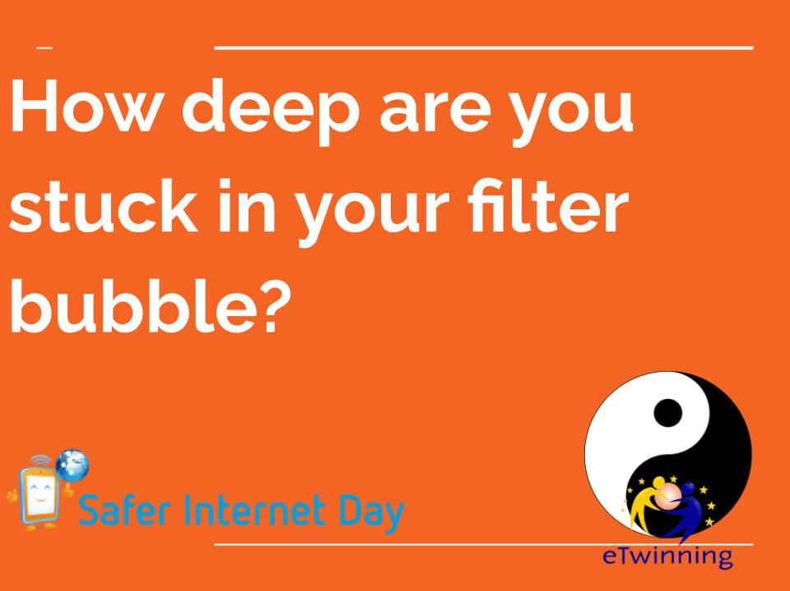
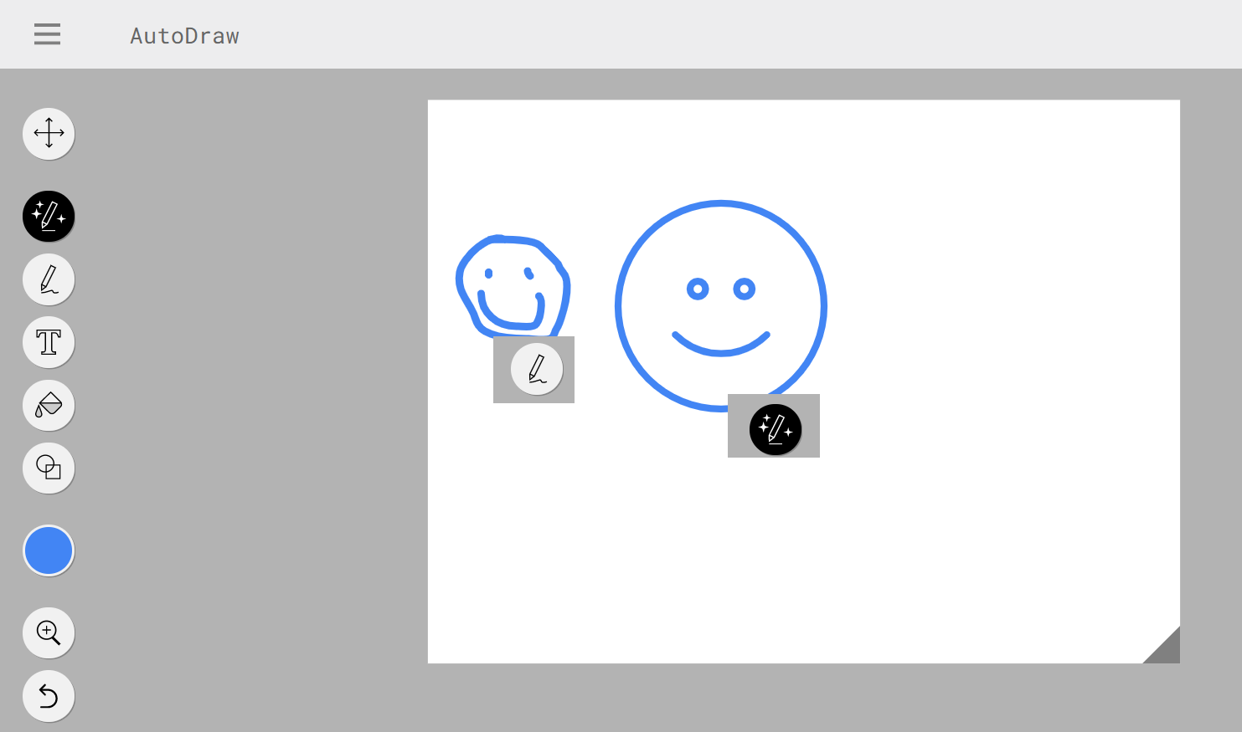
Some more ideas…
Link to project’s slide
https://www.autodraw.com/
https://www.filterbubble.lu/

Slide 34
Breaking rooms?
Padlet for your creations: https://padlet.com/etwpetroupoli/dl

Slide 35
“Education has failed in a very serious way
to convey the most important lesson
science can teach: skepticism.”
David Suzuki

Slide 36
https://www.goodreads.com/quote
https://www.merriam-webster.com/dictionary/deceiving
https://www.poem-generator.org.uk/
https://www.poemofquotes.com/tools/poetry-generator/
Examples of freestyle projects that had started from a phrase, an image a character
https://twinspace.etwinning.net/124048/
https://twinspace.etwinning.net/91431/home
https://twinspace.etwinning.net/43751

