Slide 1
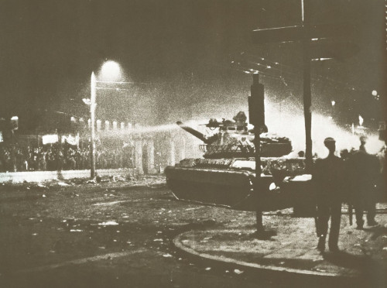

Slide 11
With SafePass, lives wouldn’t have been lost at this incident.
Choose the safe path. Stay alive.
Choose SafePass.

