Slide 1
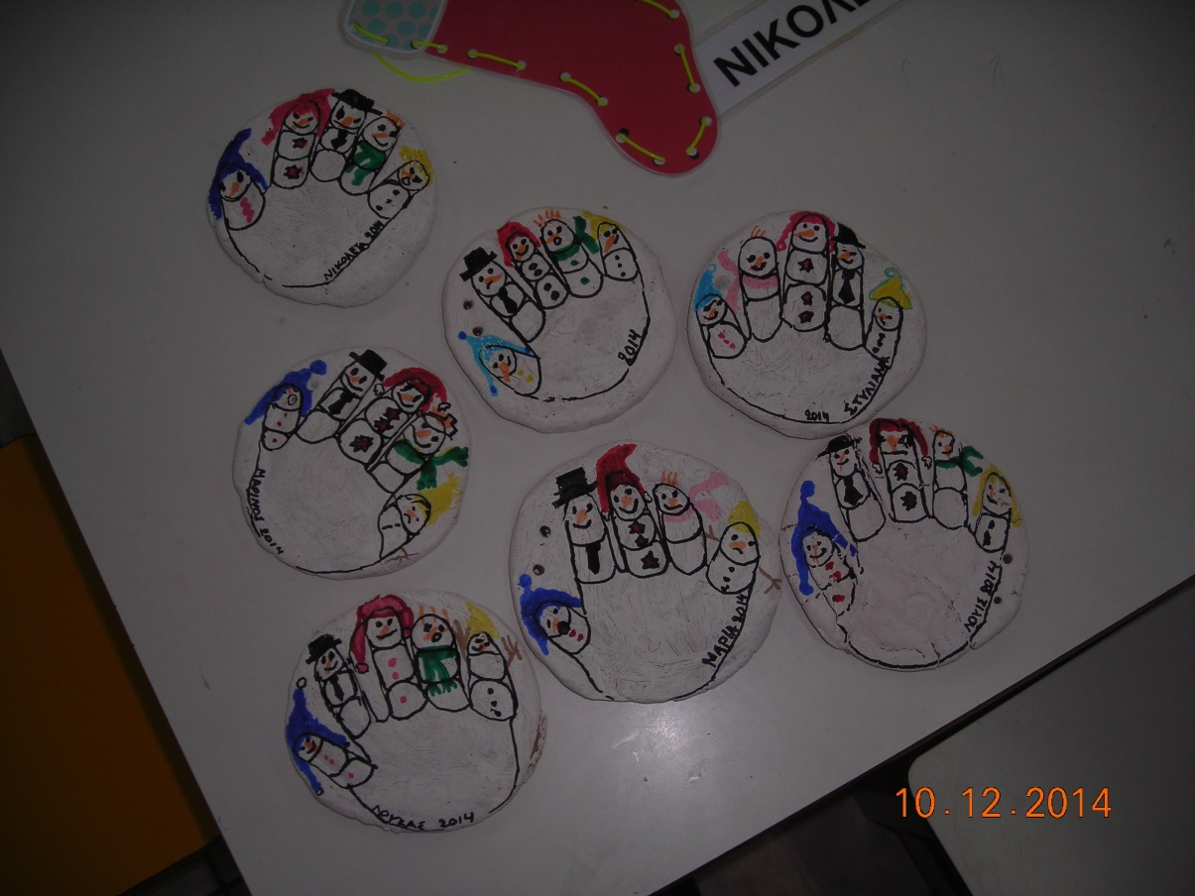
CHRISTMAS DECORATIONS (with homemade playdo) 10/12/2014
Kindergarten of Paranesti

Slide 13
