Slide 1
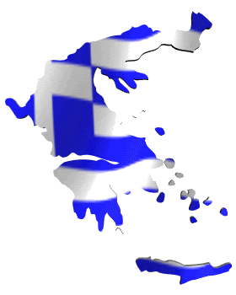
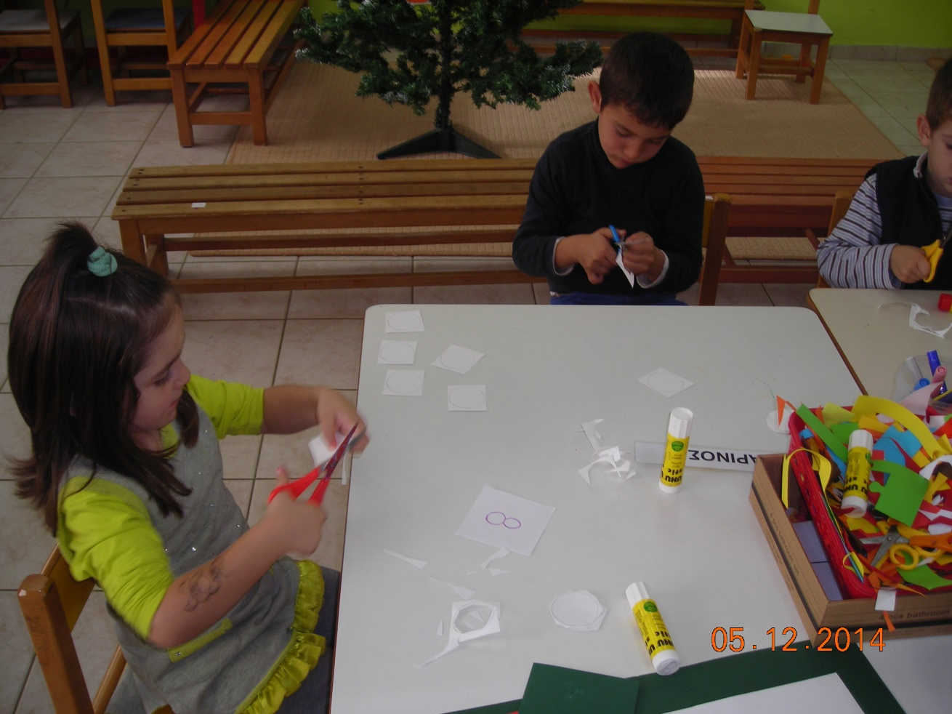
Snowballs & letters 5/12/2014
Kindergarten of Paranesti

Slide 5
