Slide 1
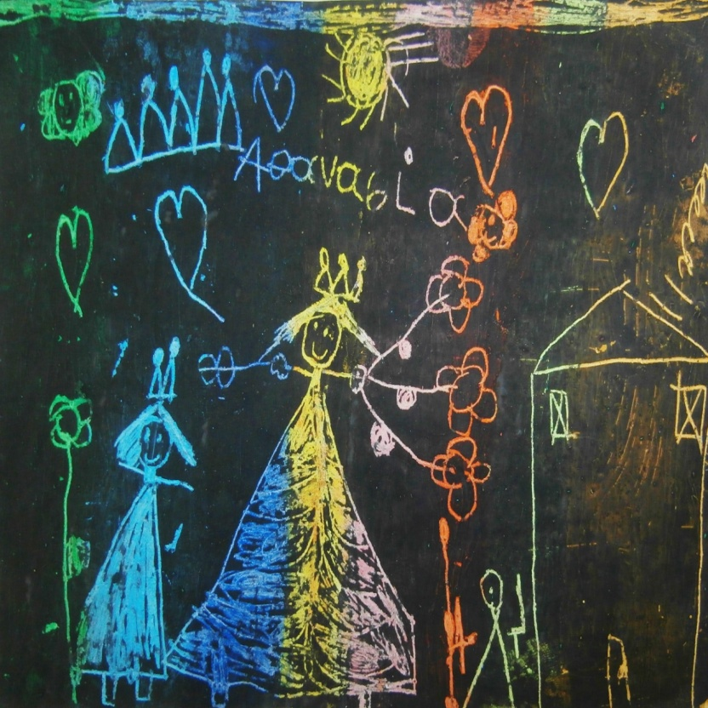
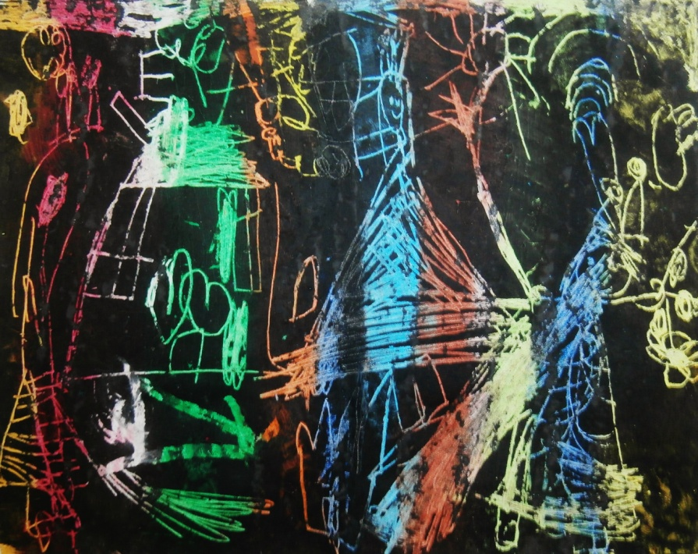
eTwinning program “Magic Children’s Crafts” Activity: ENGRAVING IN KINDERGARDEN
Styliani Argyrouli 37o Kindergarden of Larissa, Greece

Slide 2
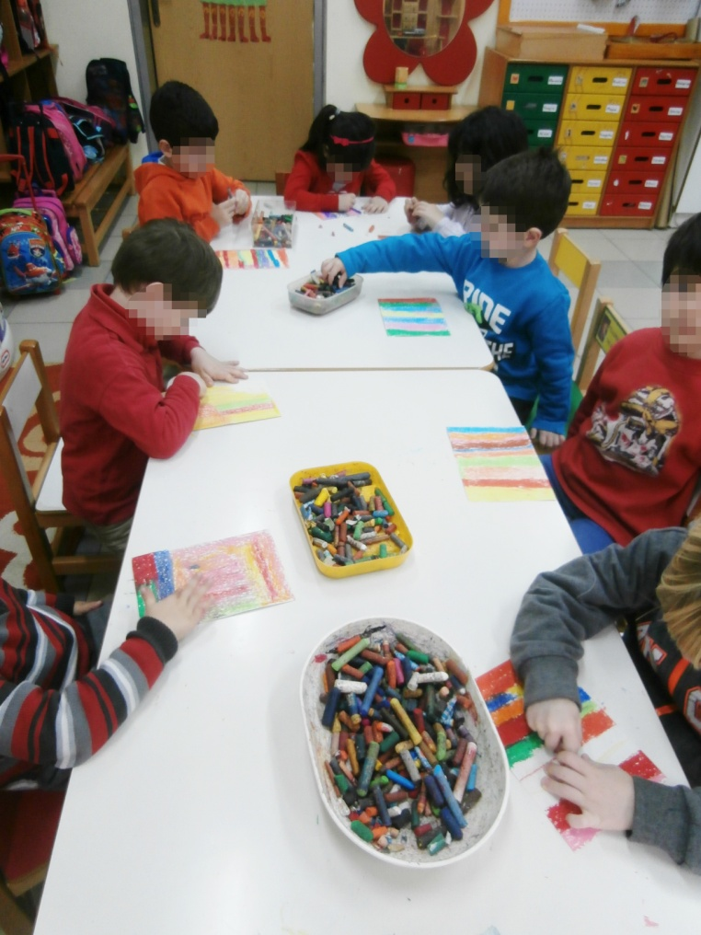
We invited an engraver to teach us the art of engraving with oil pastels .
Thanasis Faliagkas

Slide 3
We paint the entire surface of the cardboard making stripes…

Slide 4
We use light colours.

Slide 5
Painting looks like a rainbow!

Slide 6
We put some black tempera in the boll.

Slide 7
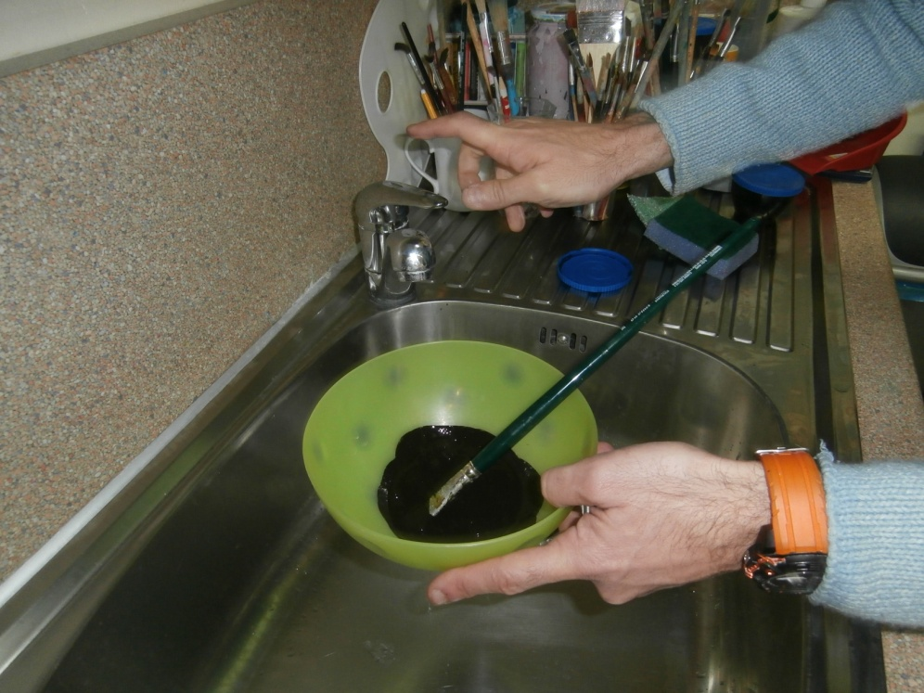
We add some soap and water. Then we mix them.

Slide 8
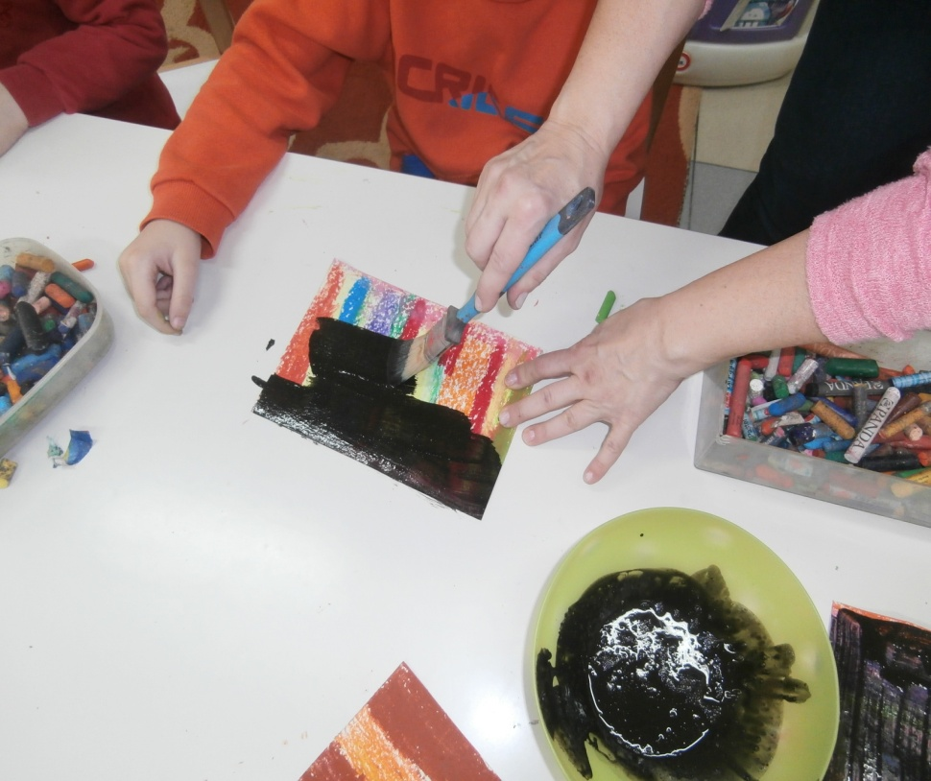
We cover the entire surface of the cardboard.

Slide 9
We expect our painting to be dry.

Slide 10
We begin engraving using a wooden tool.

Slide 11
We make any shape we like.

Slide 12
Bright colours jump out!

Slide 13
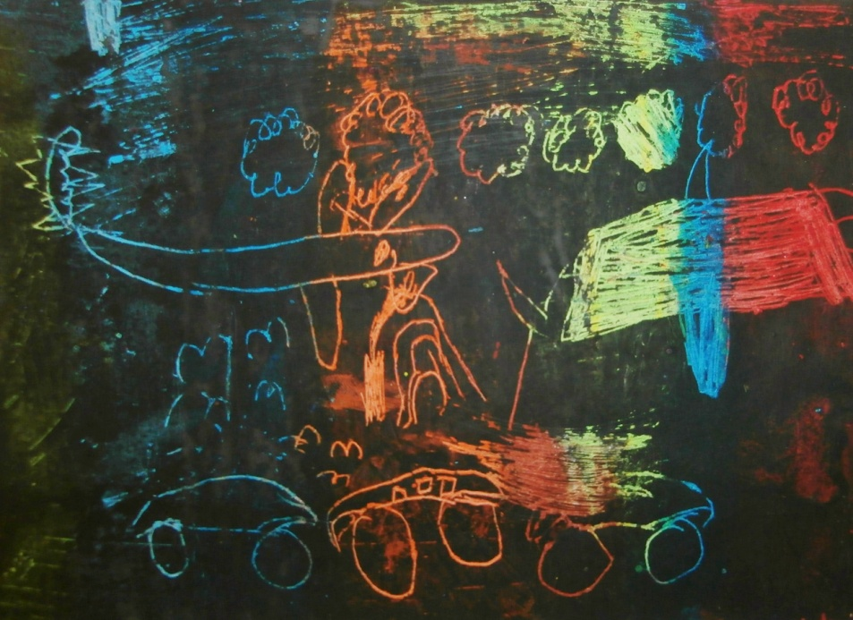
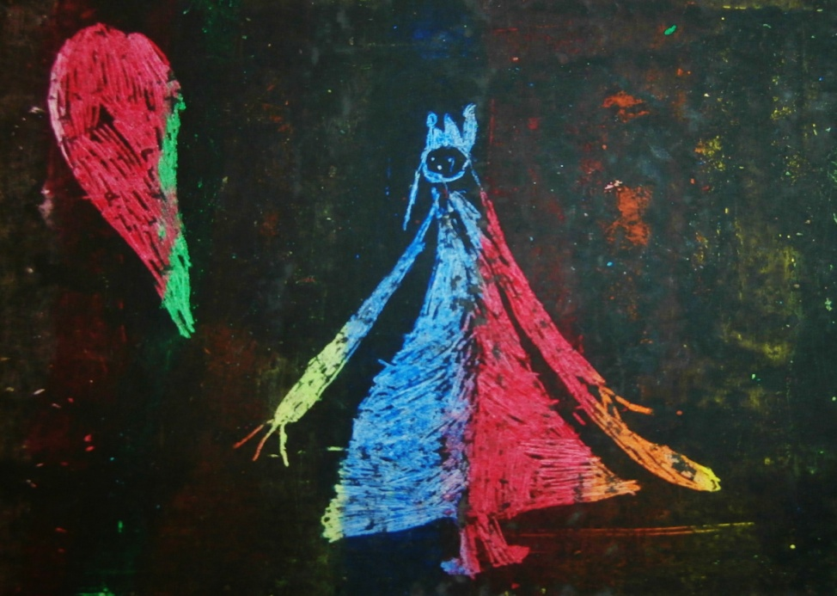
Our creations are ready.

Slide 14
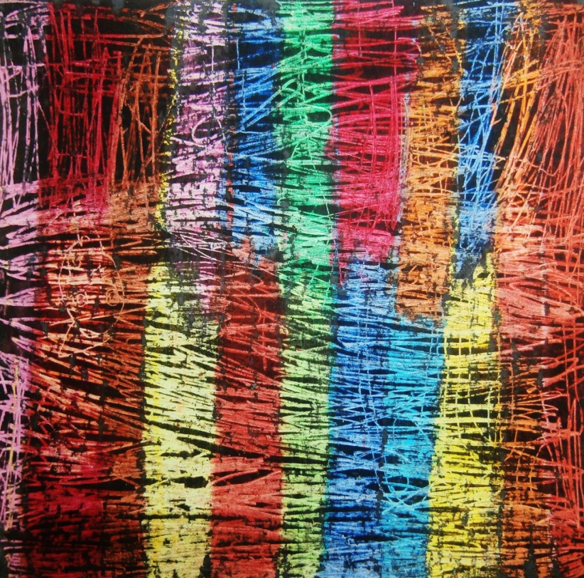
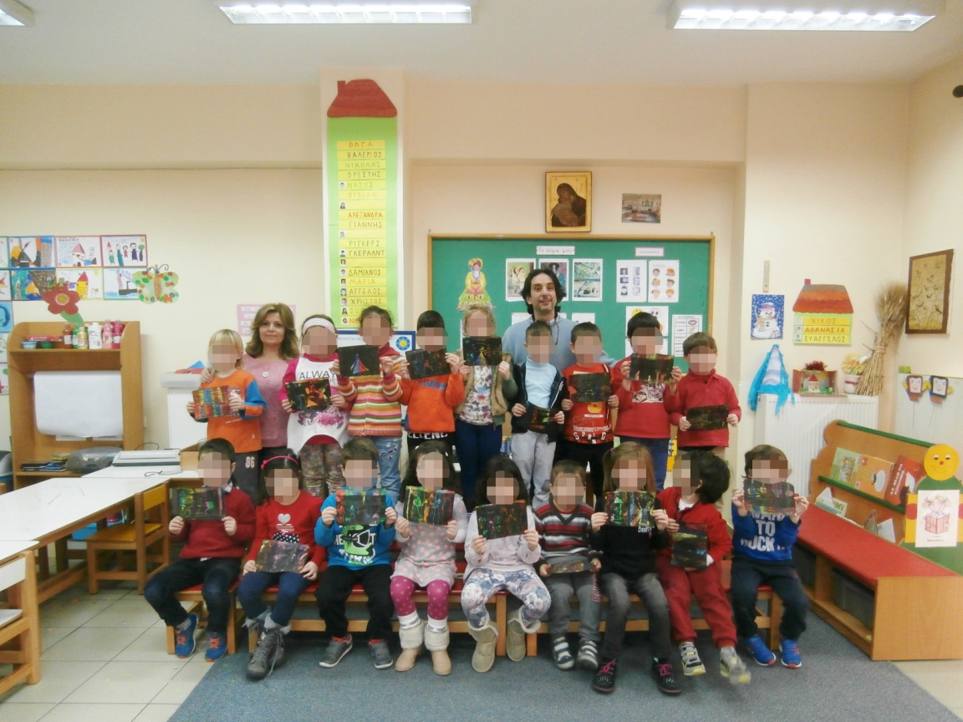
Enjoy our art work. We had a great time!

