Slide 1
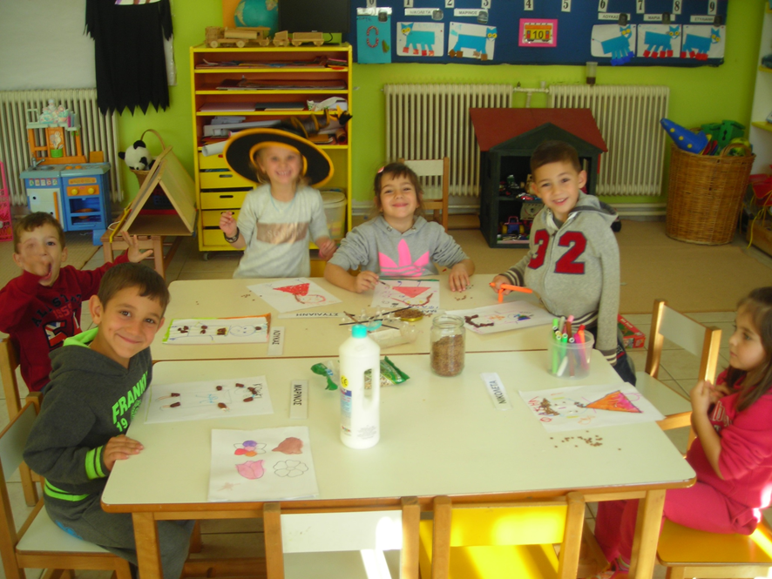
There is a Greek song that is usually sang before every fairytale begins. It is called “The Bean and the Chickpea”. In this assignment the kids animate the two heroes of the song. 25/11/2014

Slide 3
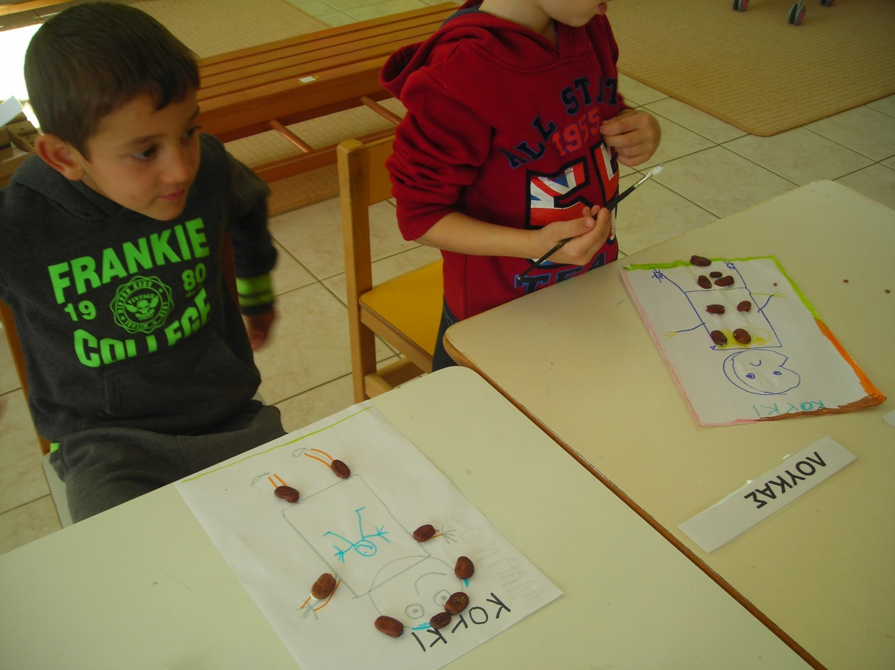

Slide 4
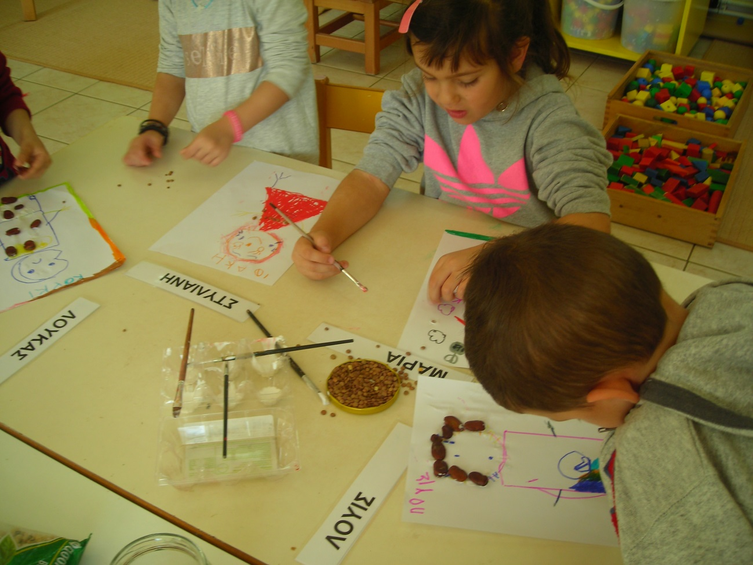

Slide 5
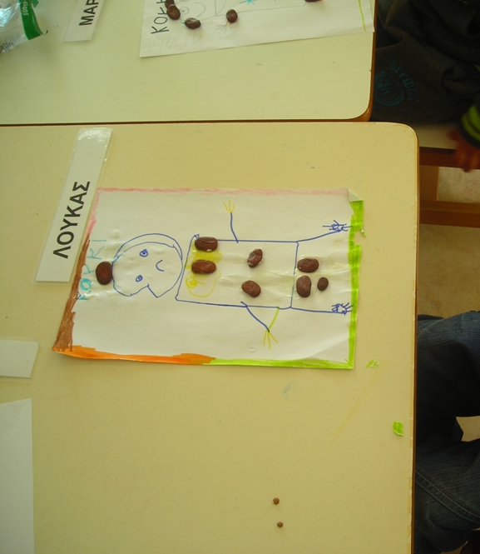

Slide 13
