Slide 1
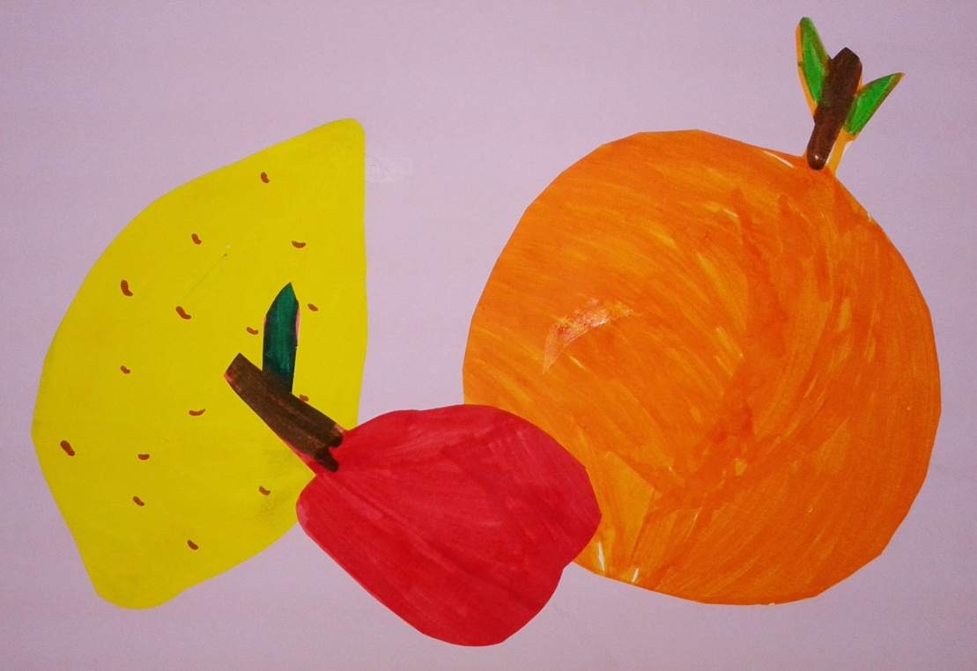
FRUITS’PARTY
Summer holiday-Lets start acting!

Slide 2
Here is our fruits’ market
It's show time!

Slide 3
The grocers are carrying crates with fruits to their shop.

Slide 4
Girls go to the shop and do not know what to choose!

Slide 5
Then, fruits present themselves and express how important they are…

Slide 6
Children welcome Summer in a ship.
The sailor made the flag of the ship using his friend’s clothes!

Slide 7
Here is fig, pear and watermelon!

Slide 8
Here is banana, grape and apricot!

Slide 9
Here is bananas, strawberries and cherries!

Slide 10
Children draw fruits because they love them!

