Slide 1
Making crafts using educational material We sometimes use educational material by witch children can draw shapes of crafts. Then, they can fulfill their painting and decorate as they wish. This is a pre-writing activity.

Slide 7
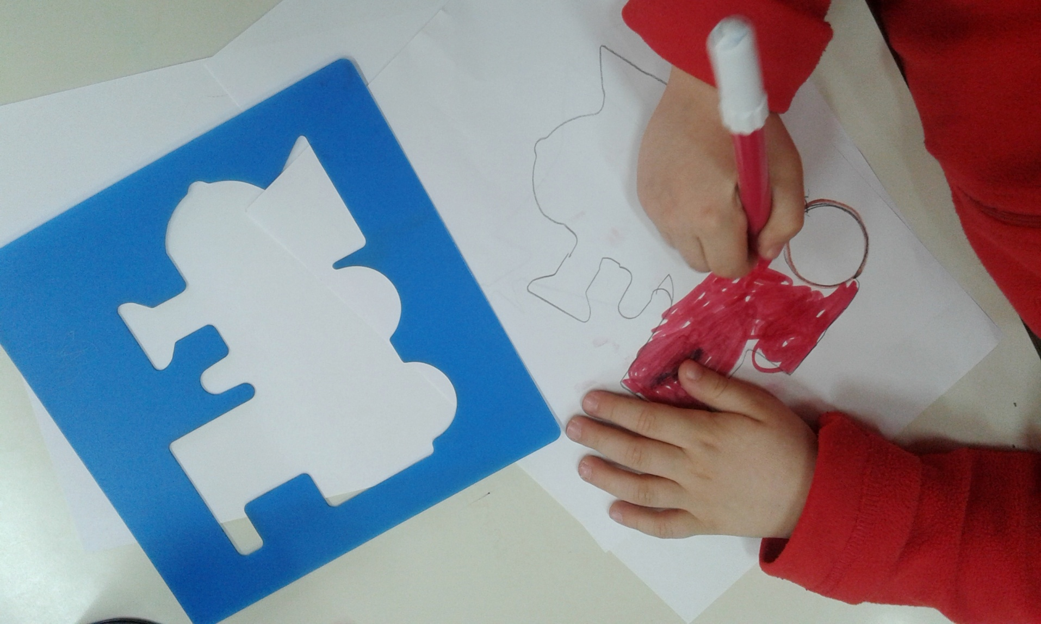

Slide 10
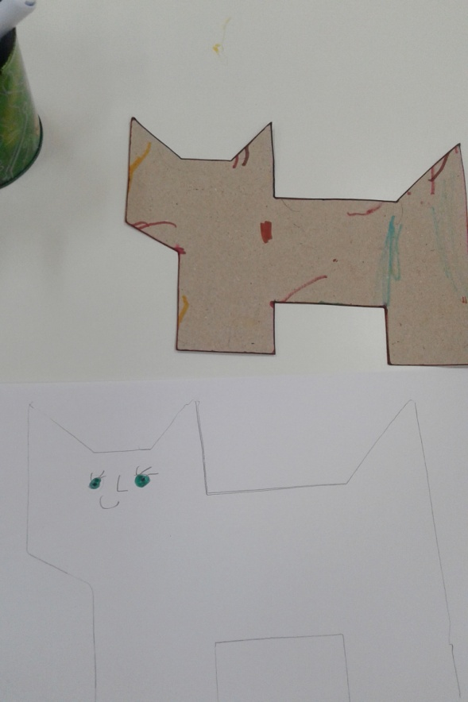
If you wish, you can create your own material using cardboard.

