Slide 1
Making candlesticks
By mud

Slide 2
We knead the mud

Slide 3
We use water to make the mud soft

Slide 4
We put a candle in the center of the mud

Slide 5
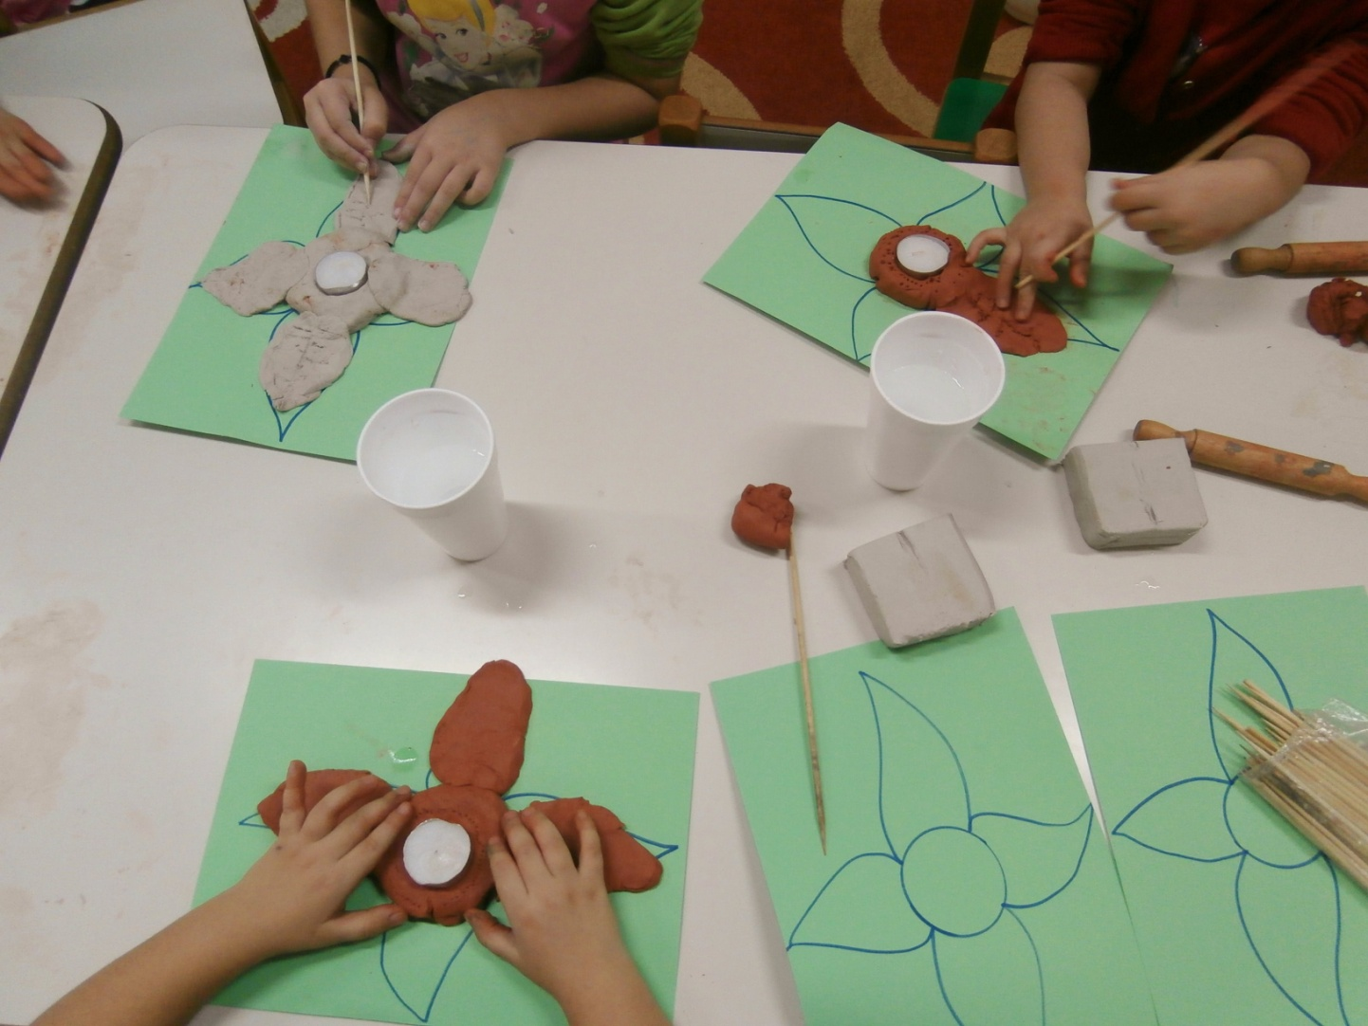
We cut in using a wooden tool

Slide 6
Shaping the mud like a flower

Slide 7
You can either use red mud or…

Slide 8
white mud !

Slide 9
We put the candlesticks on a cardboard

Slide 10
They must get dry!

Slide 11
We paint them and we put on golden powder

Slide 12
We propose the red color!

Slide 13
You can make them colorful instead!

Slide 14
Children will take them home on a tough cardboard

Slide 15
They are ready!

