Slide 1
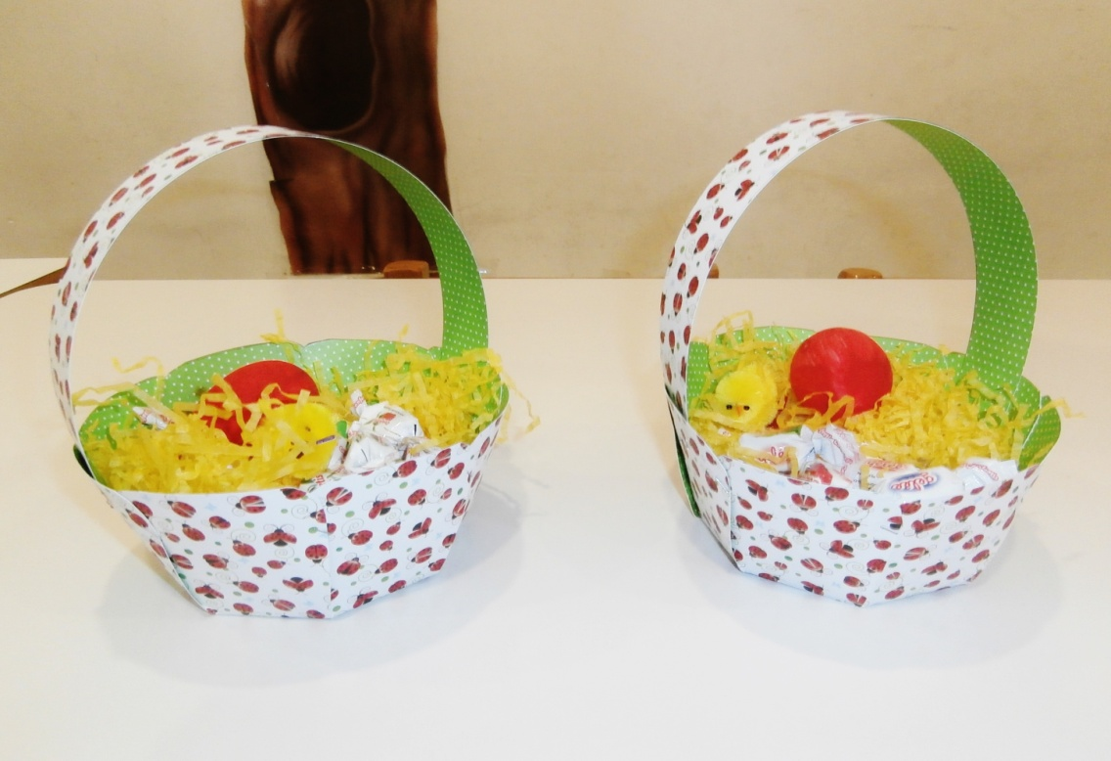
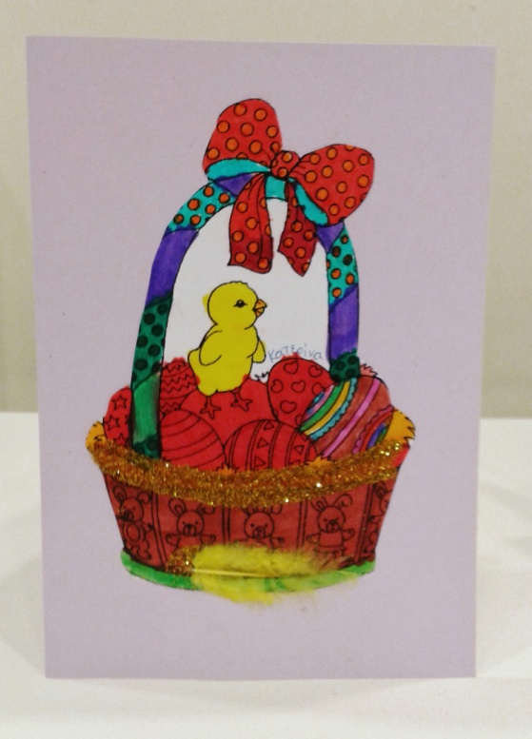
EASTER CRAFTS

Slide 2
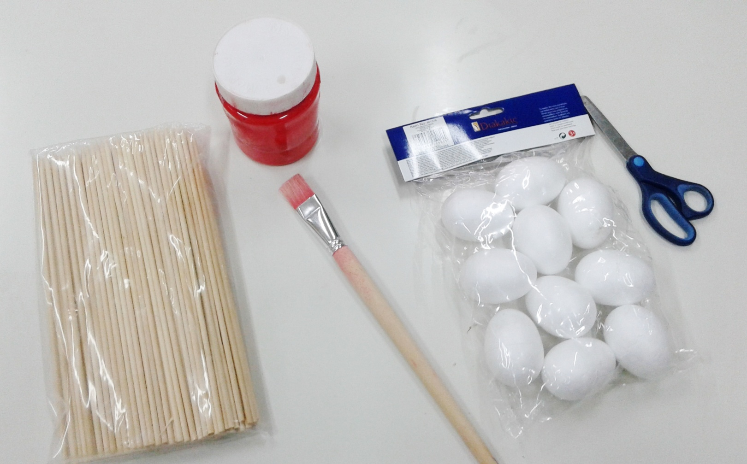
Here are our tools!

Slide 3
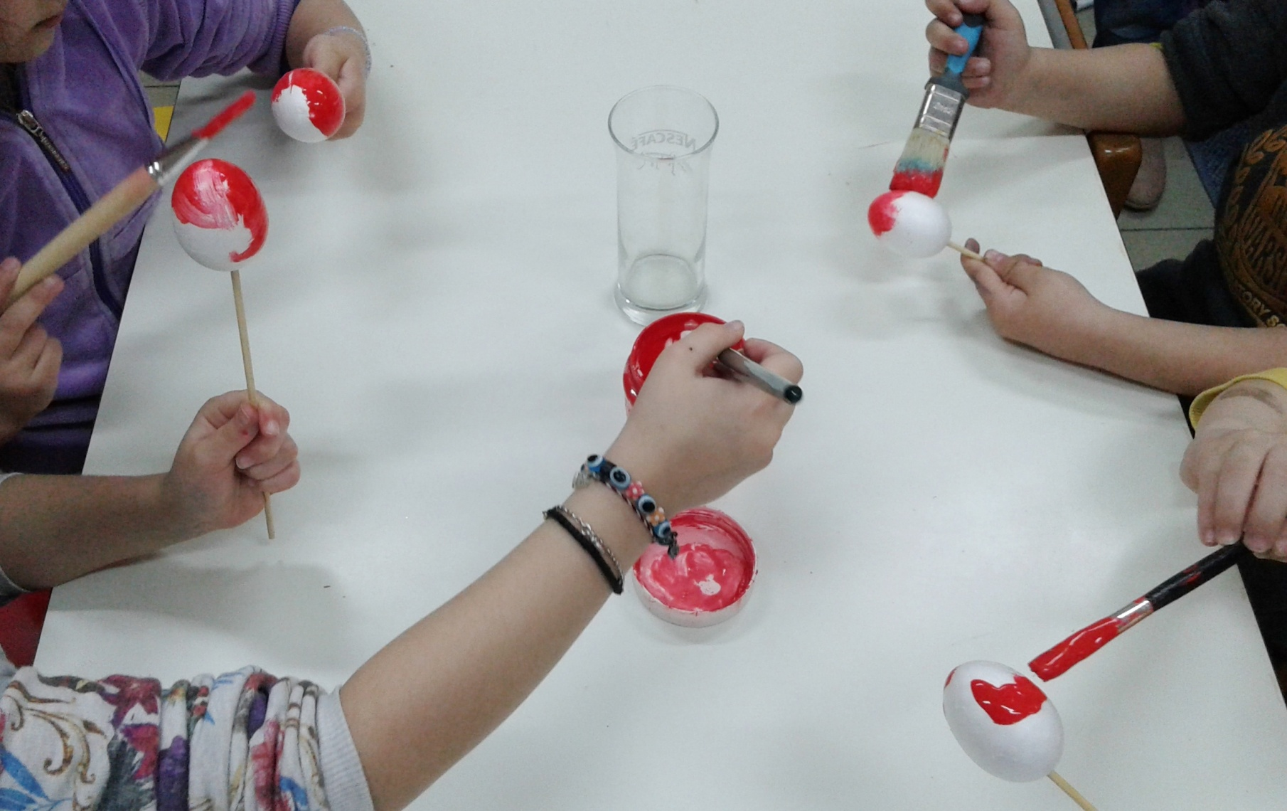
We are painting the eggs red.

Slide 4
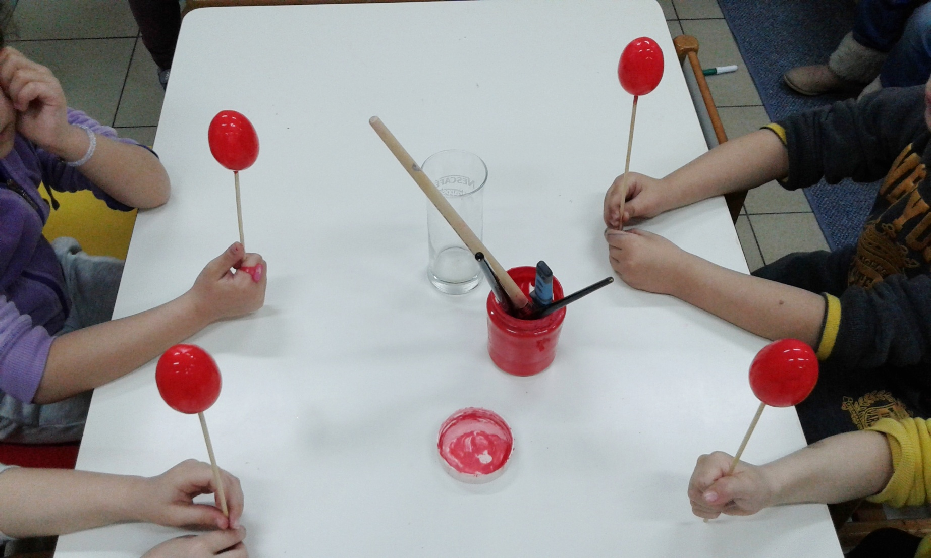
We use tempera colours.

Slide 5
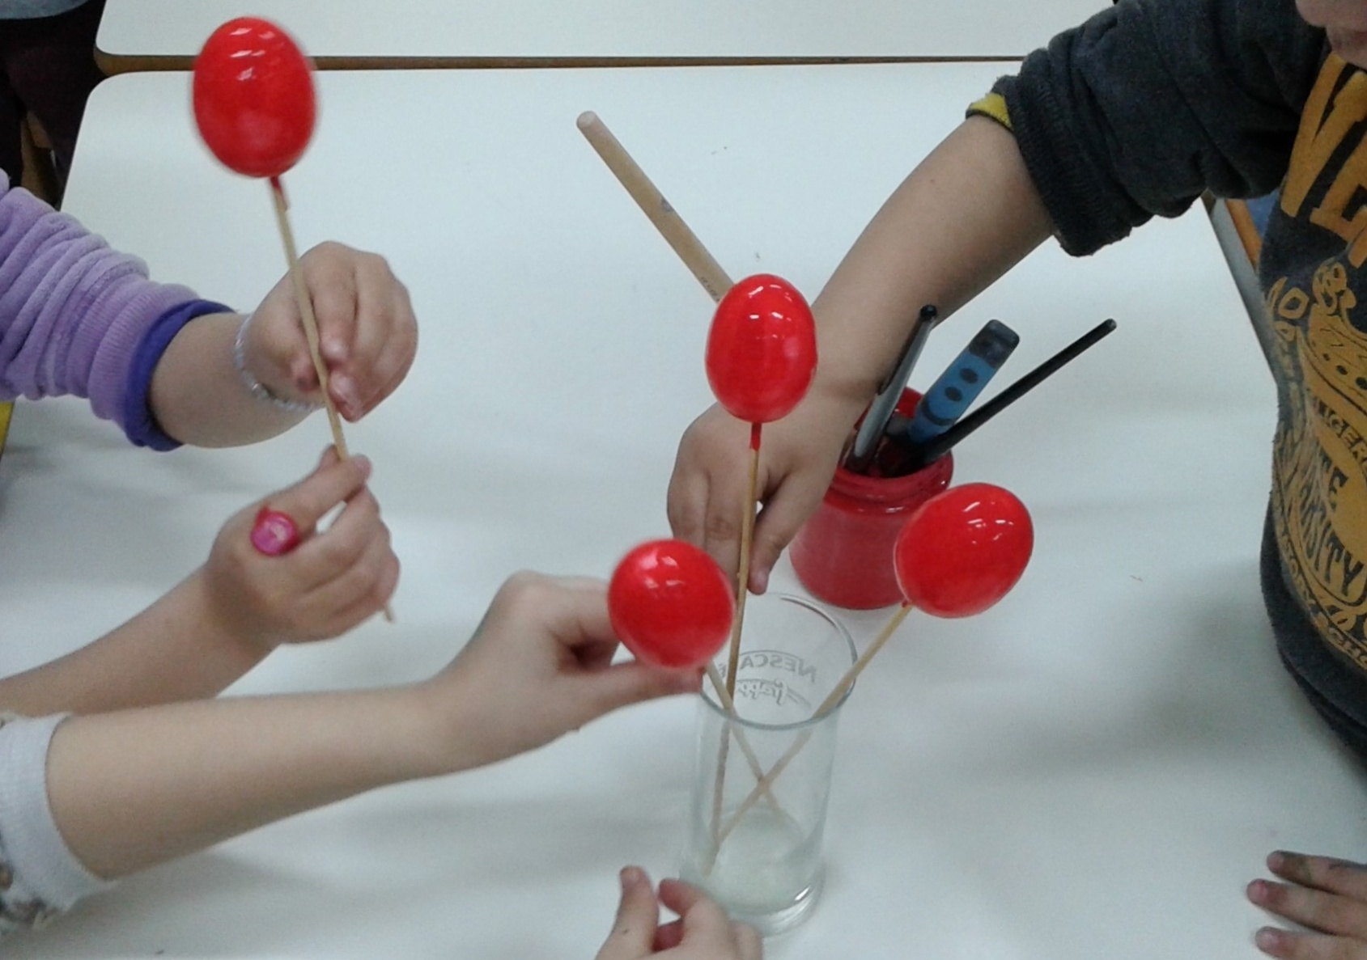
We put them in a glass.

Slide 6
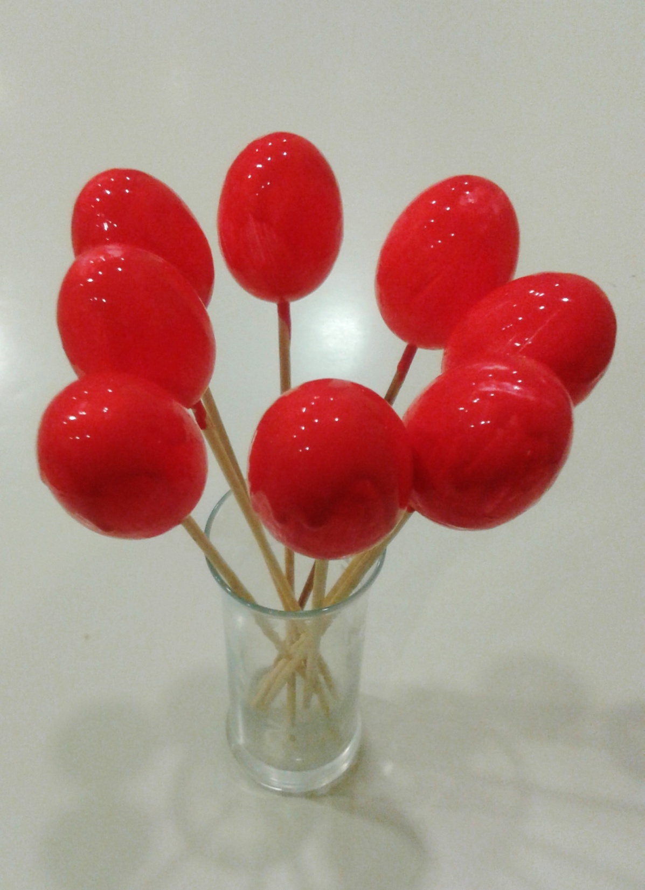
Eggs must get dry!

Slide 7
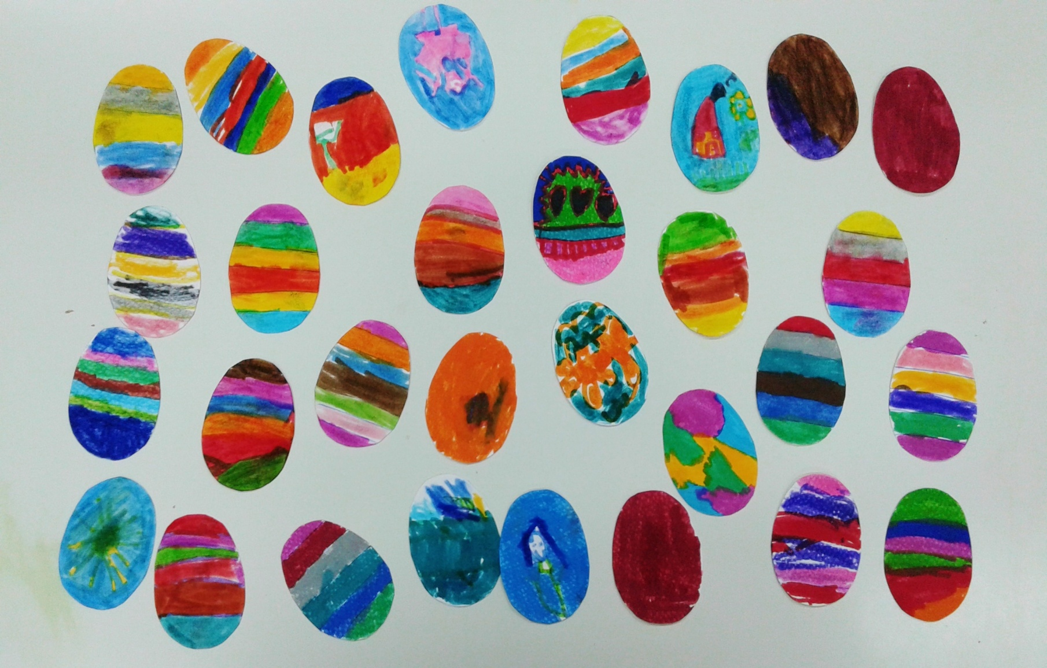
Children paint eggs as they like.

Slide 8
We put the red and the coloured eggs in the basket. We add a little bird and candies.

Slide 9
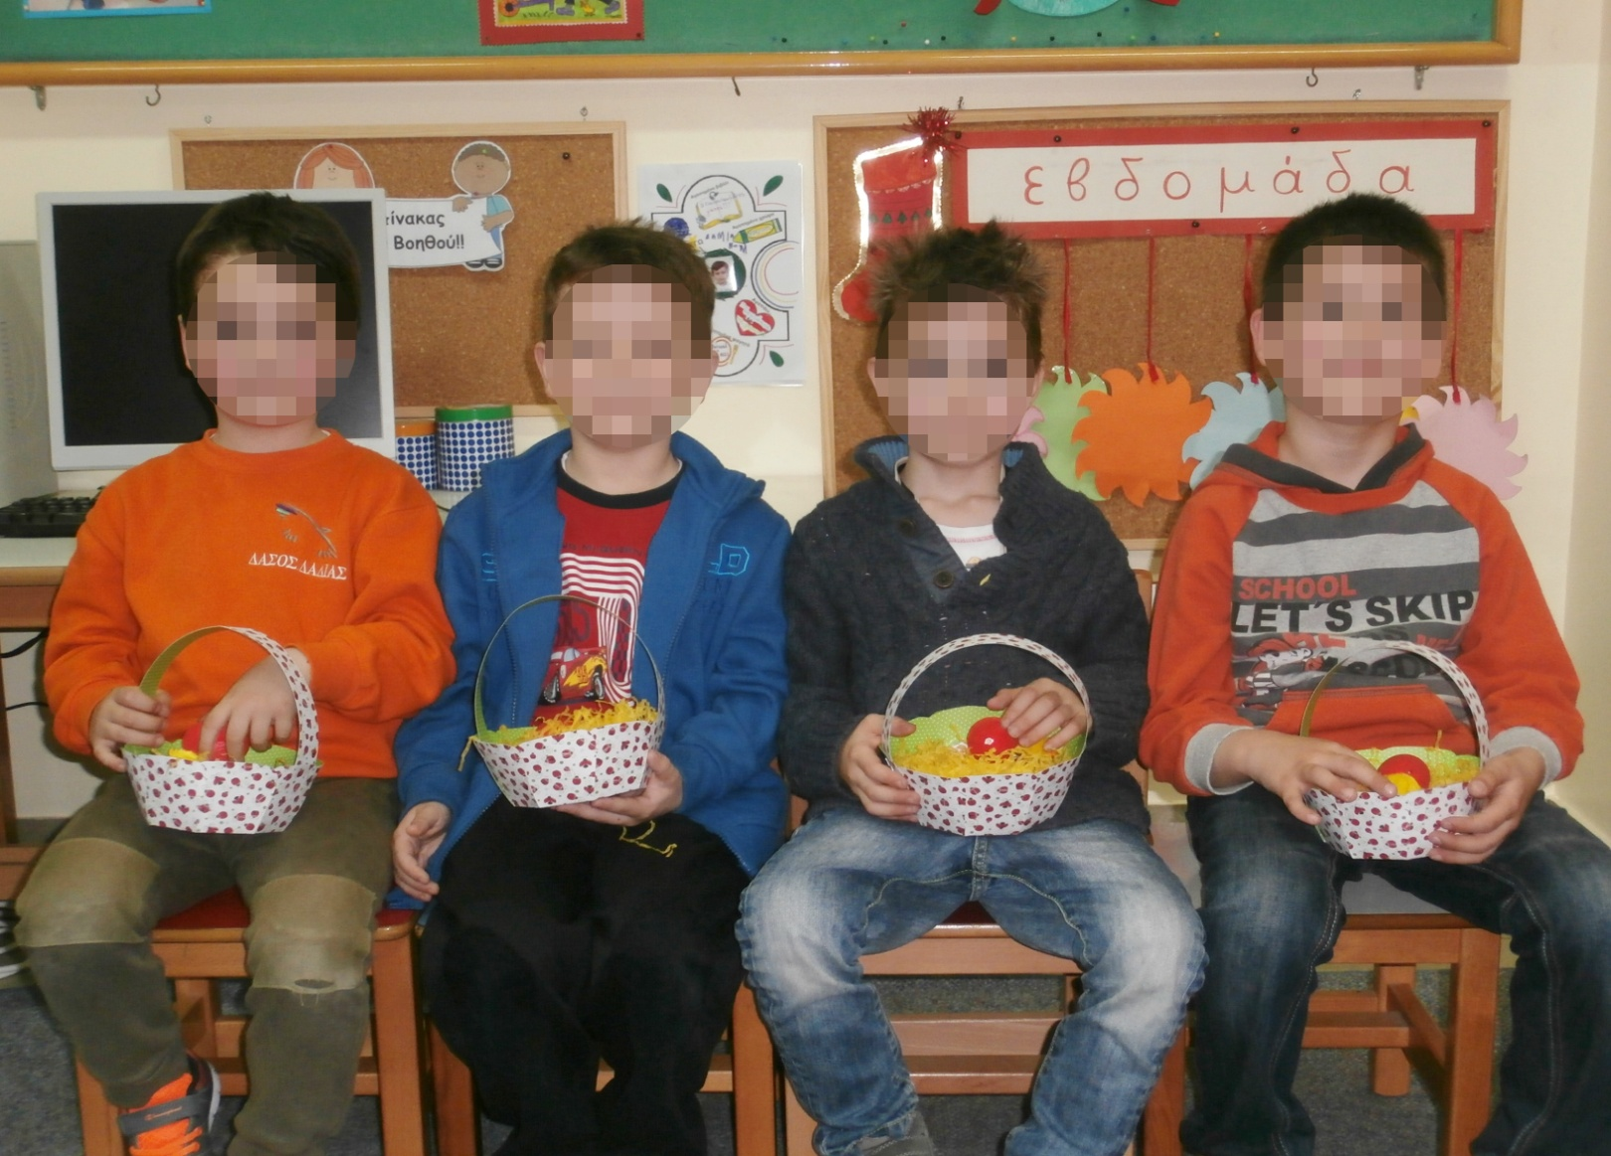
Boys loved the basket!

Slide 10
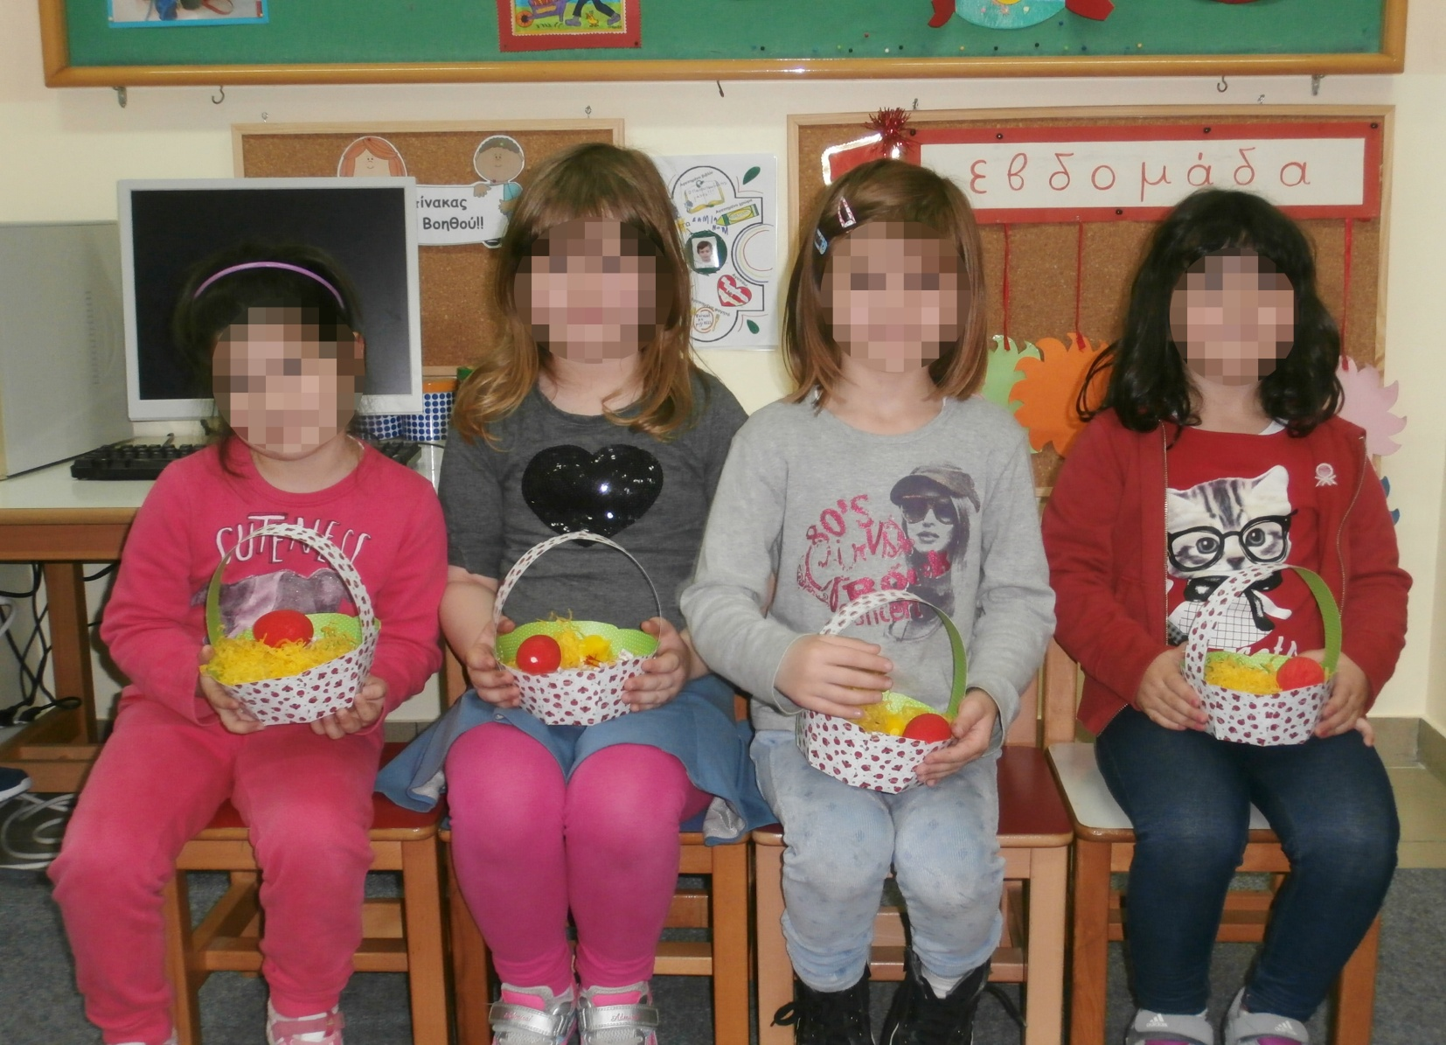
Girls were excited with the basket!

Slide 11
We also made an Easter card

Slide 12
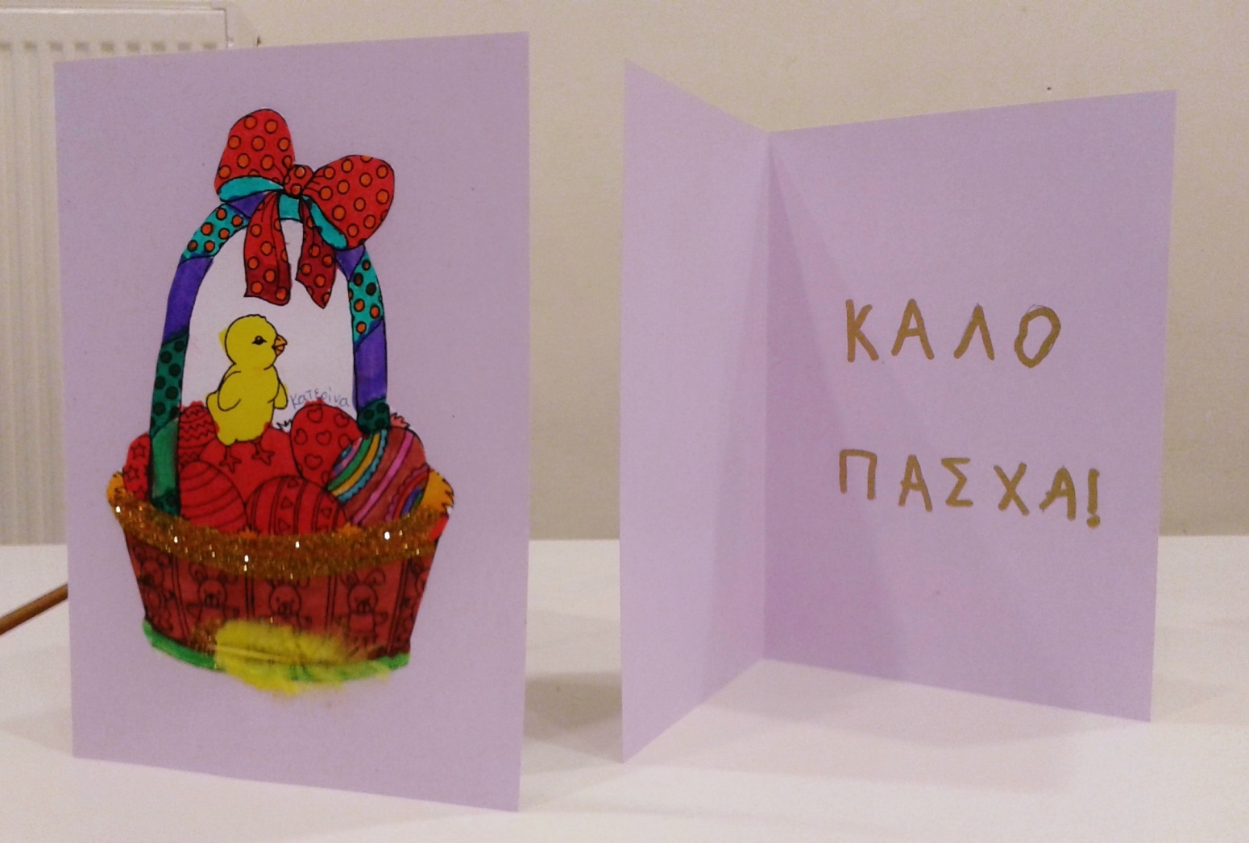
Have a nice Easter!

Slide 13
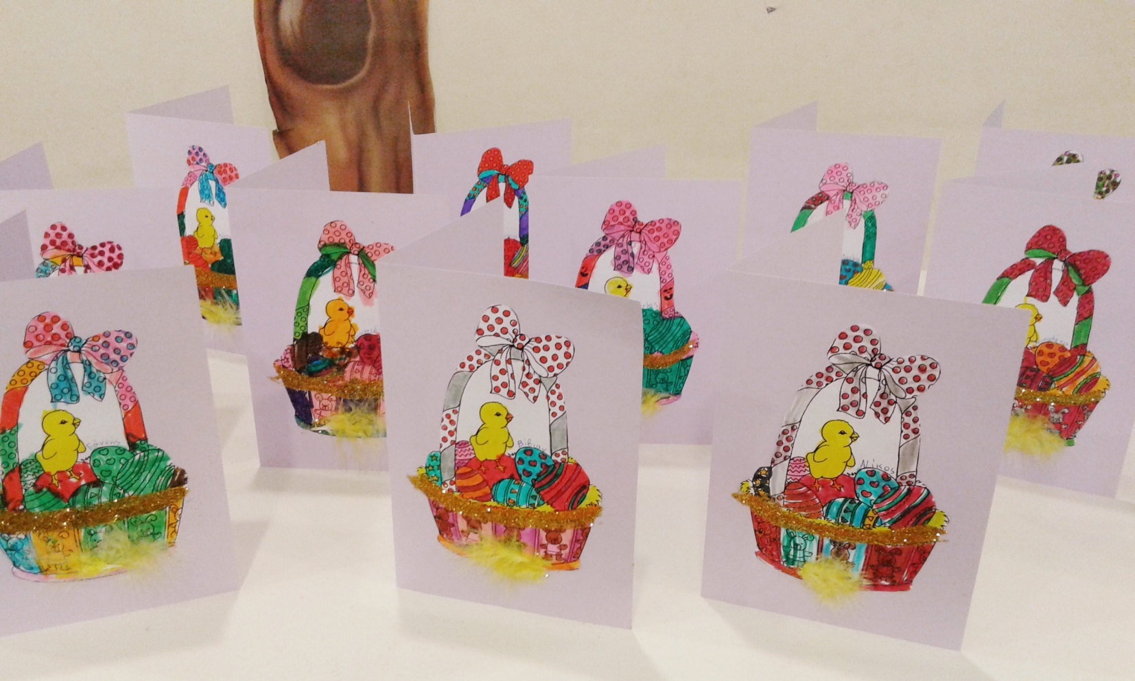
May your Easter basket be full of joy, happiness and Peace. Happy Easter to all!

