Slide 1
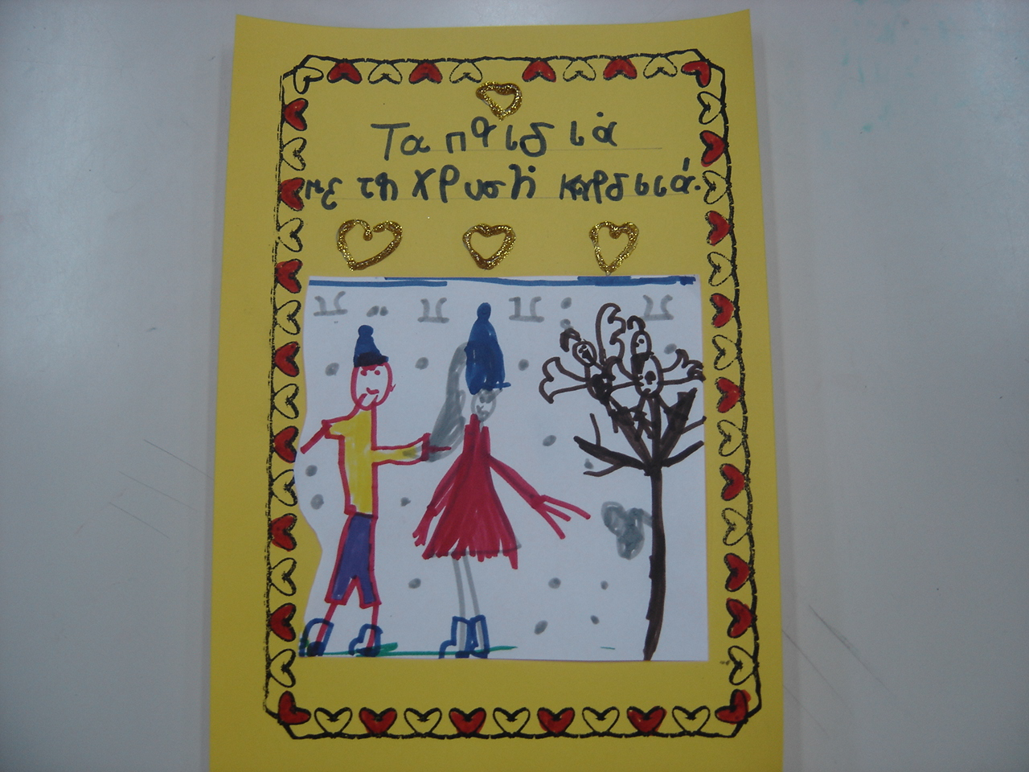
THE CHILDREN WITH THE GOLDEN HEART.

Slide 2
It was winter .It was very cold. Everything was frozen.

Slide 3
The trees were bare. The birds were looking for food but the could not find anything to eat. They were anxious and very sad.

Slide 4
Suddenly an owl appeared and told them : ‘’ Don’t worry, I heard that the children who know that we are very useful will come very soon and they will bring us food.’’

Slide 5
The children came the next day holding bags with seeds, crumbs and orange peels in order to feed the birds.

Slide 6
A girl hung the orange peels on the trees because she knew that the birds adored them. She also put bowls filled with water next to the trees.

Slide 7
The children were throwing the seeds and the crumbs and the birds flew quickly close to them. They were hungry and began to eat.

Slide 8
The birds were tweeting happily .’’ We have food !! We aren't hungry anymore!! ‘’ they shouted full of enthusiasm.

Slide 9
The birds were singing loudly : ‘’ Cheers to the children with the golden heart !! ‘’

Slide 10
This story was created by the children of 56 Kindergarten Larisa, Greece

