Slide 1
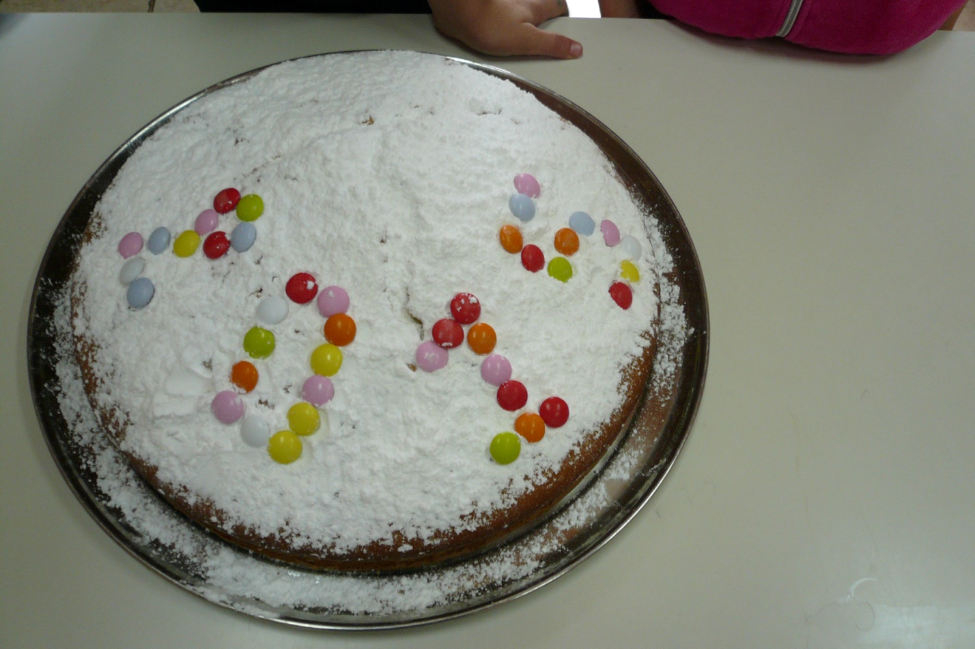
THE NEW YEAR`S CAKE
In the Kindergarten of Anavra GREECE
Petkou Styliani

Slide 2
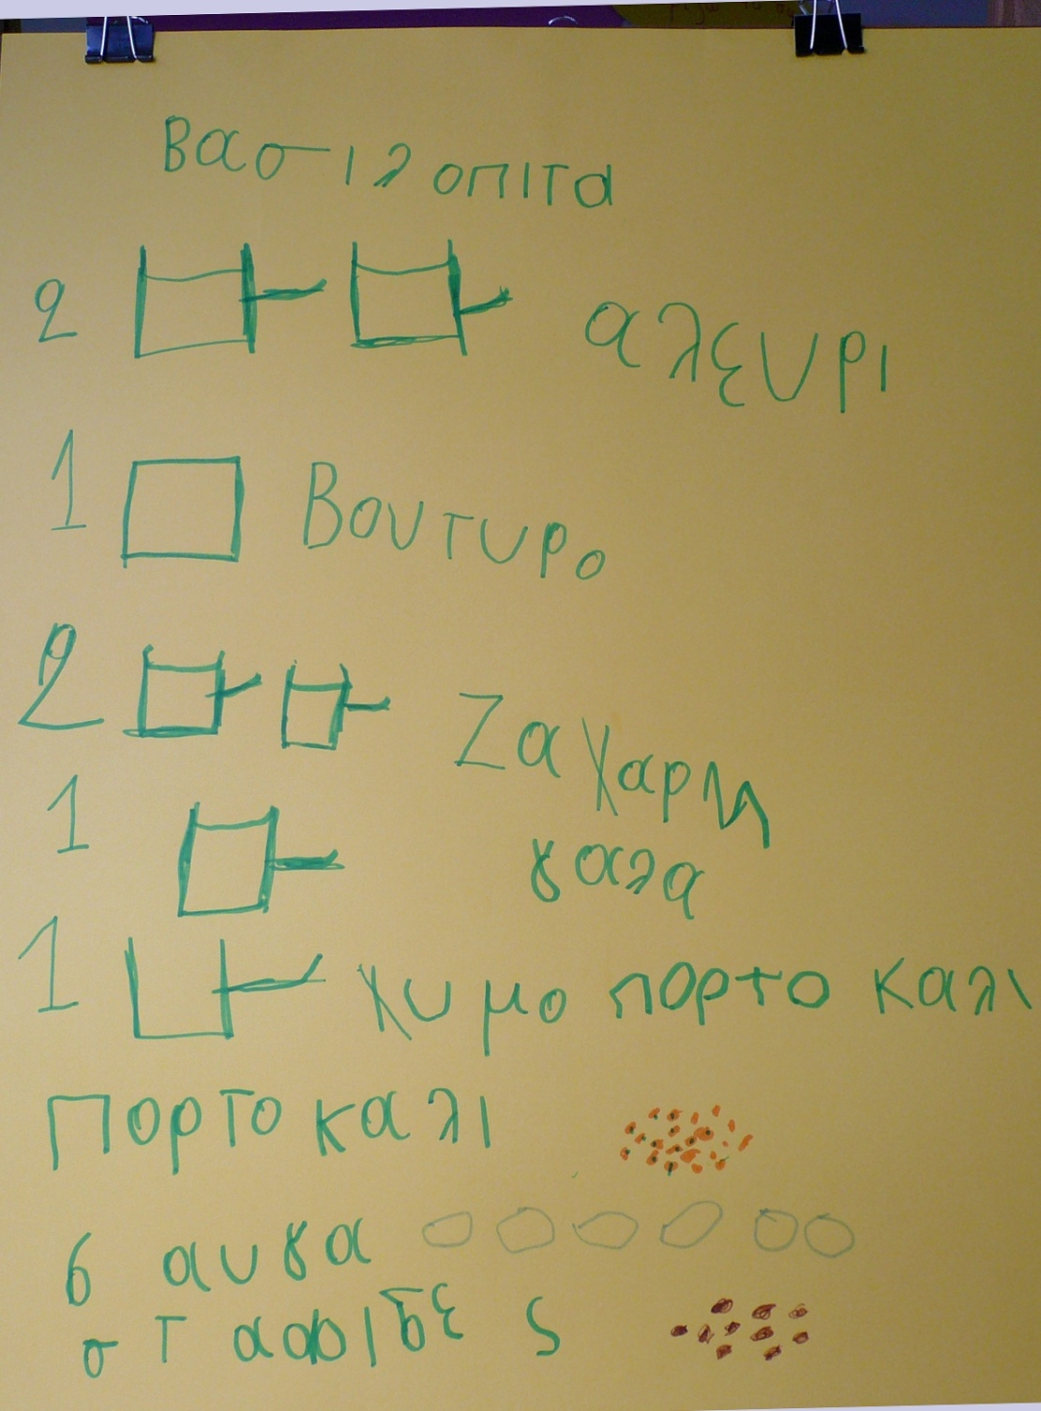
Our recipe was written by Spiros

Slide 3
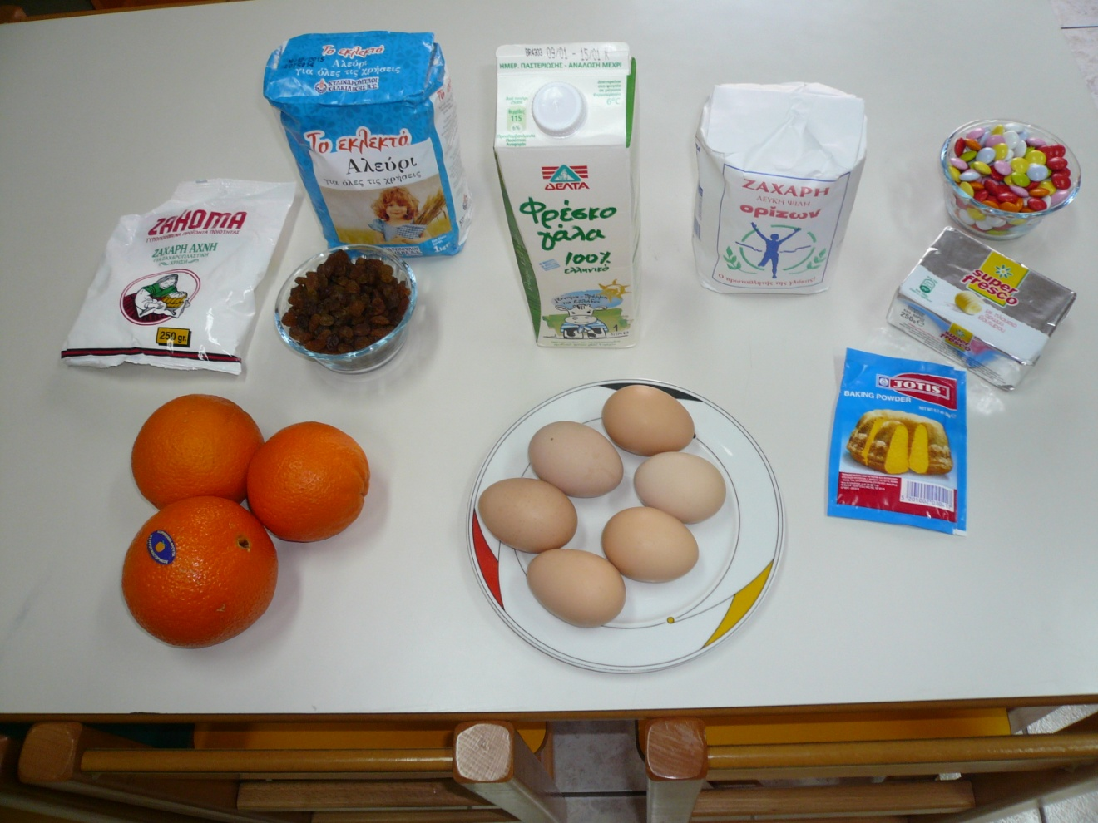
The ingredients of the recipe

Slide 4
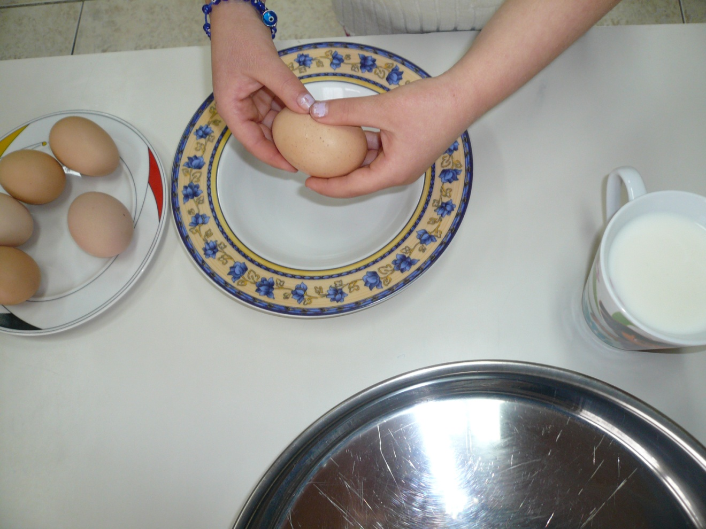
All of us start working to make the
New Year`s Cake as fast as we can.
We break the eggs

Slide 5
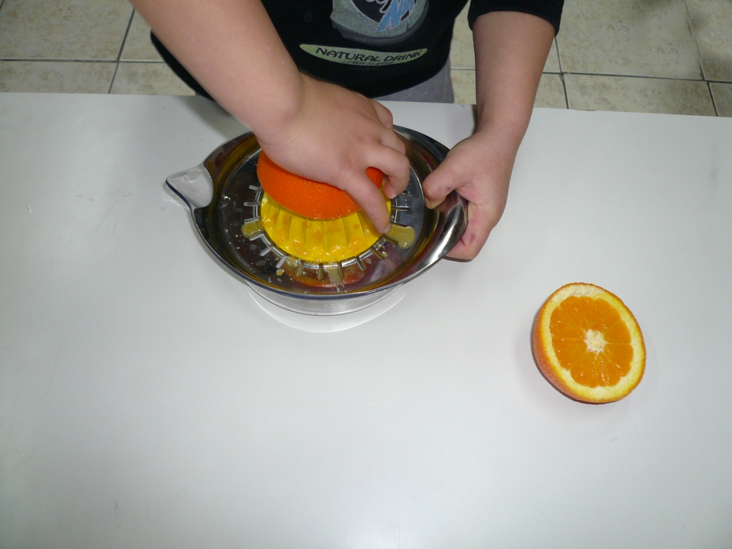
We squeeze the orange.
Don`t forget to use orange peel.

Slide 6
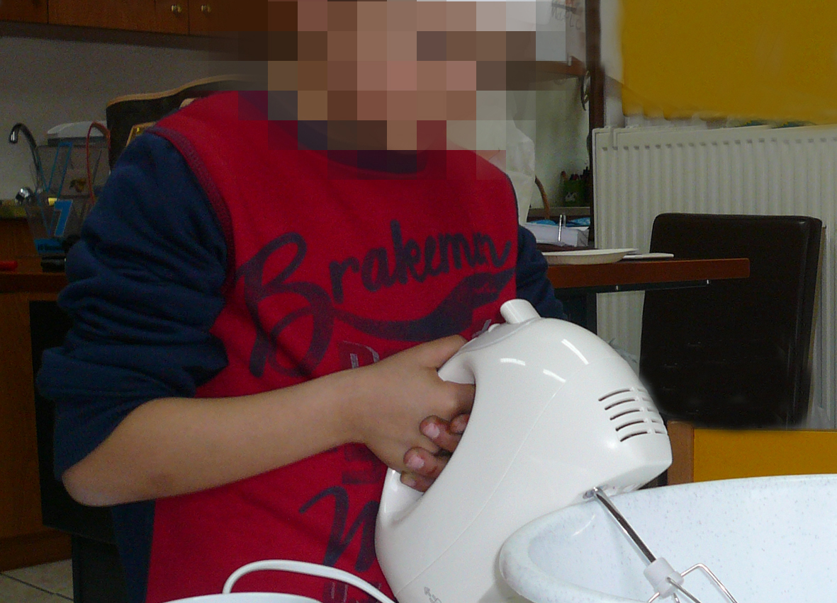
Aris prepares the dough.

Slide 7
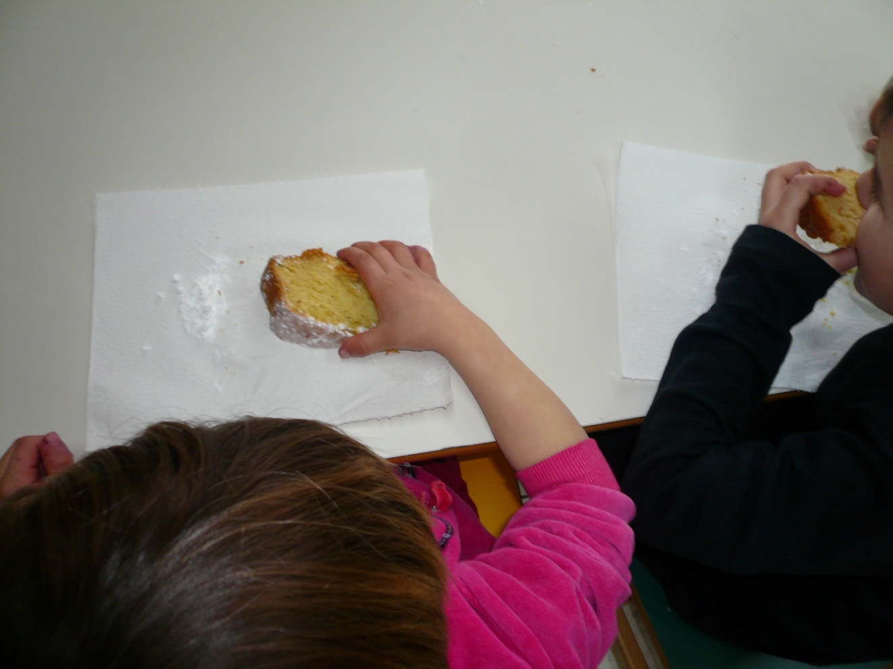
delicious!!!

Slide 8
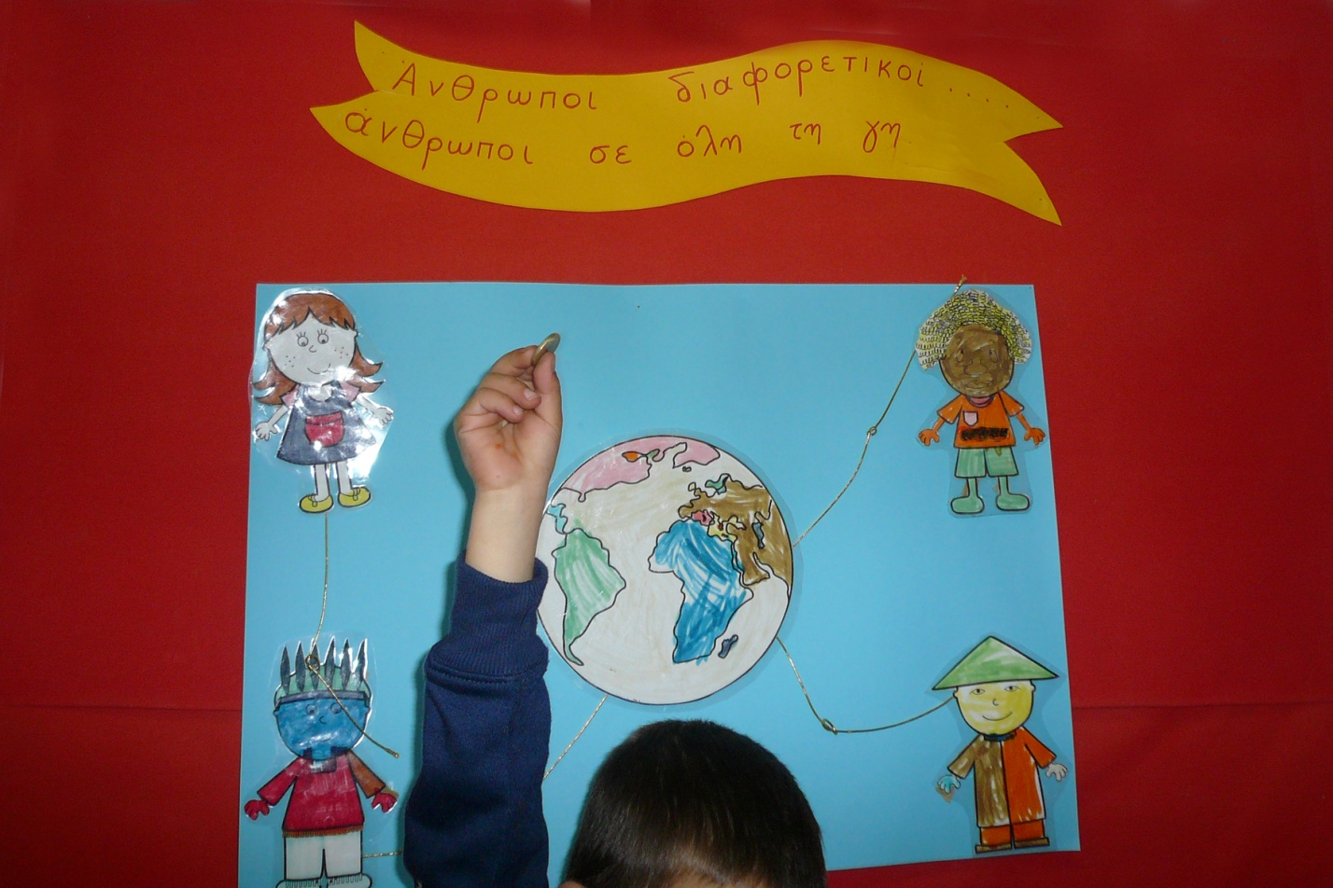
Aris finds the lucky coin!!!
People different,
People all over the world

Slide 9
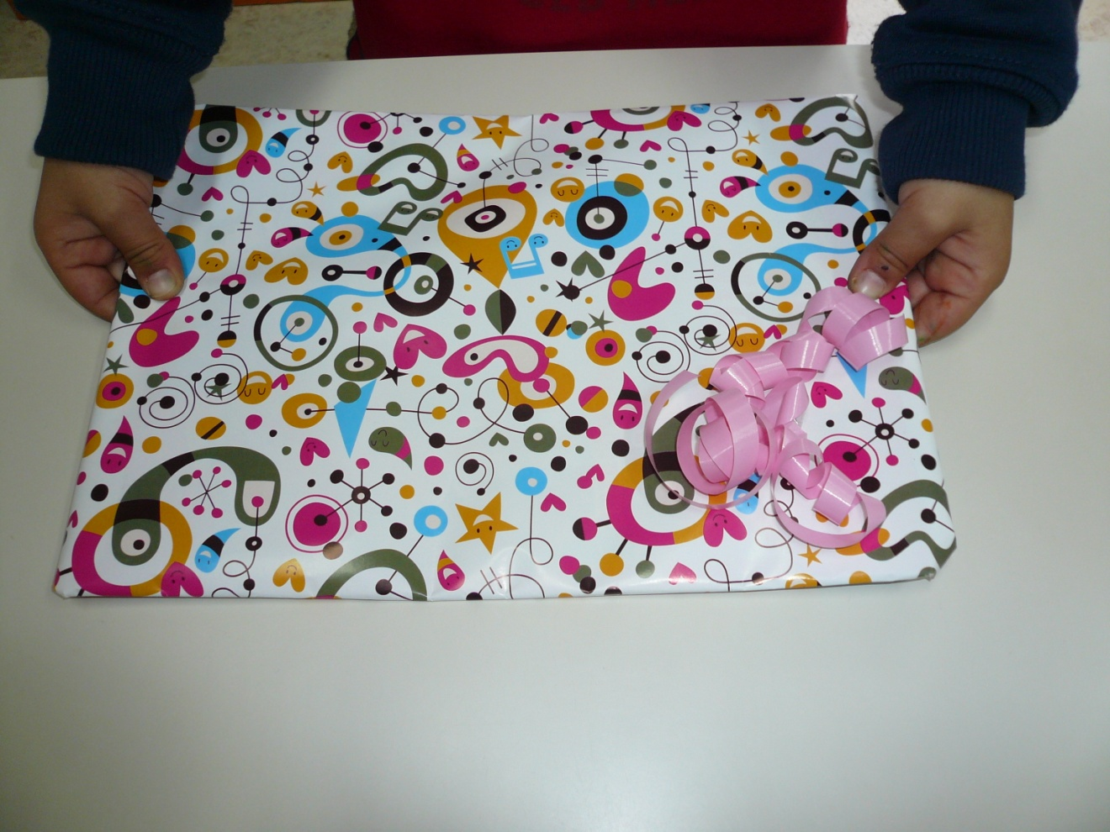
Aris gets a new book as a present.

Slide 10
Wishing you
2015+ wishes for the NEW YEAR
From our Kindergarten
Petkou Styliani

