Slide 1
23^{ο} Νηπιαγωγείο ΛΑρισαΣ
Ειρήνη-Δημοκρατία- Ελευθερία
Peace- Democracy-Freedom

Slide 2
Ειρήνη-Δημοκρατία-Ελευθερία Peace- Democracy-Freedom

Slide 3
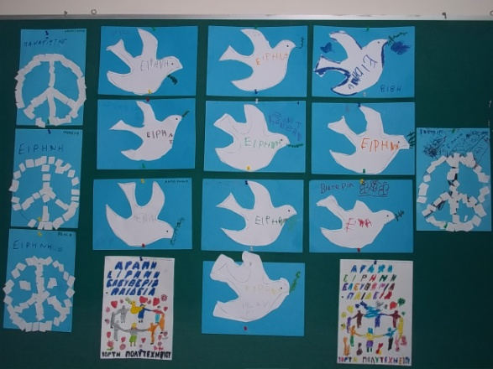
The Dove of Peace

Slide 4
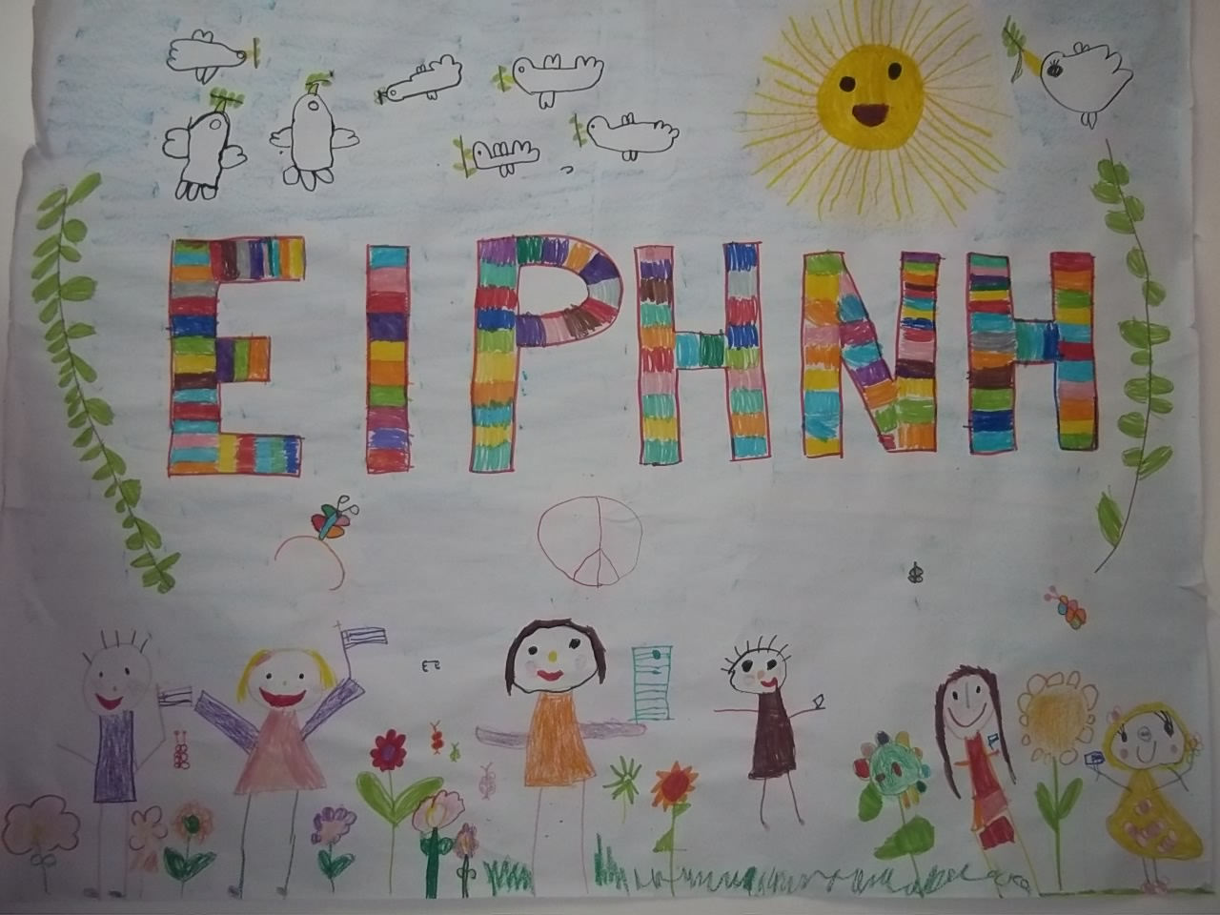
Children ask for peace

Slide 5
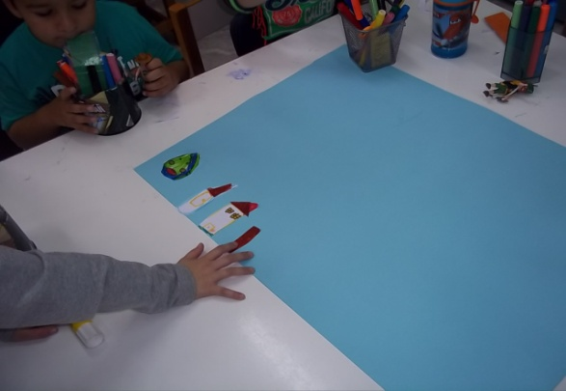
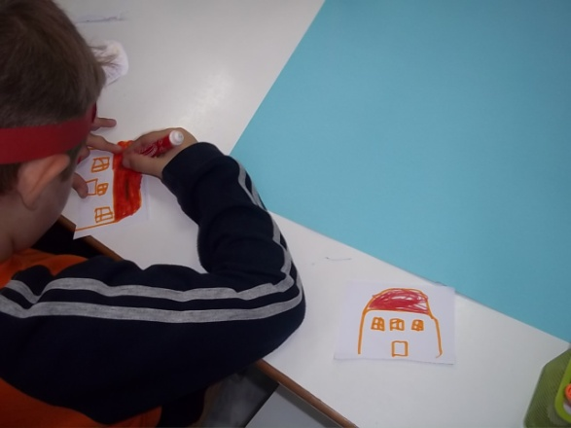
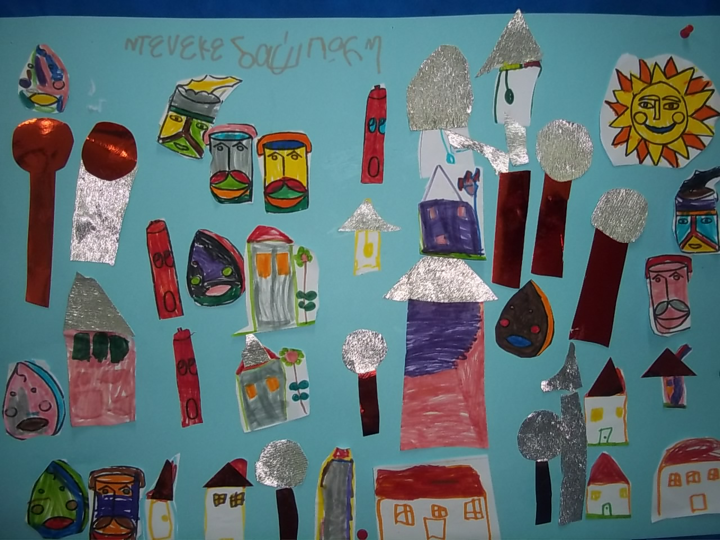
The cans ask for freedom and democracy

Slide 6
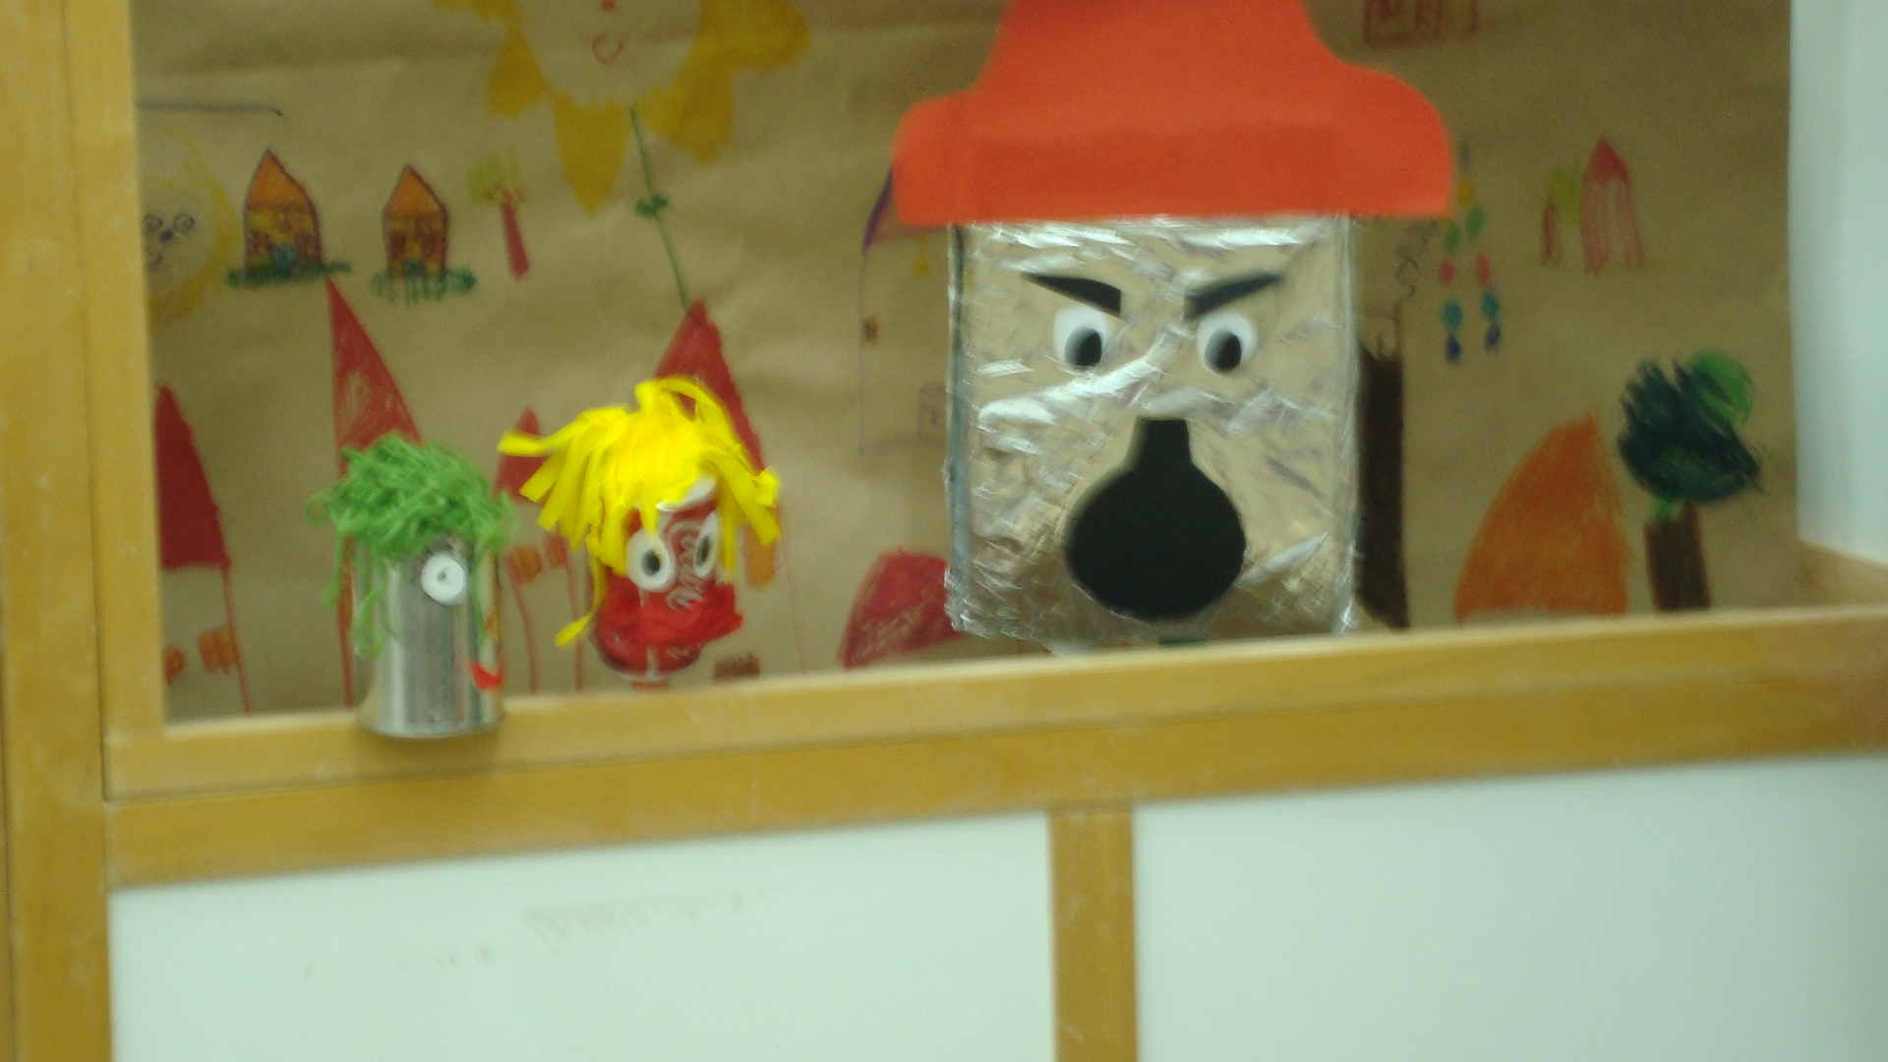

Slide 7
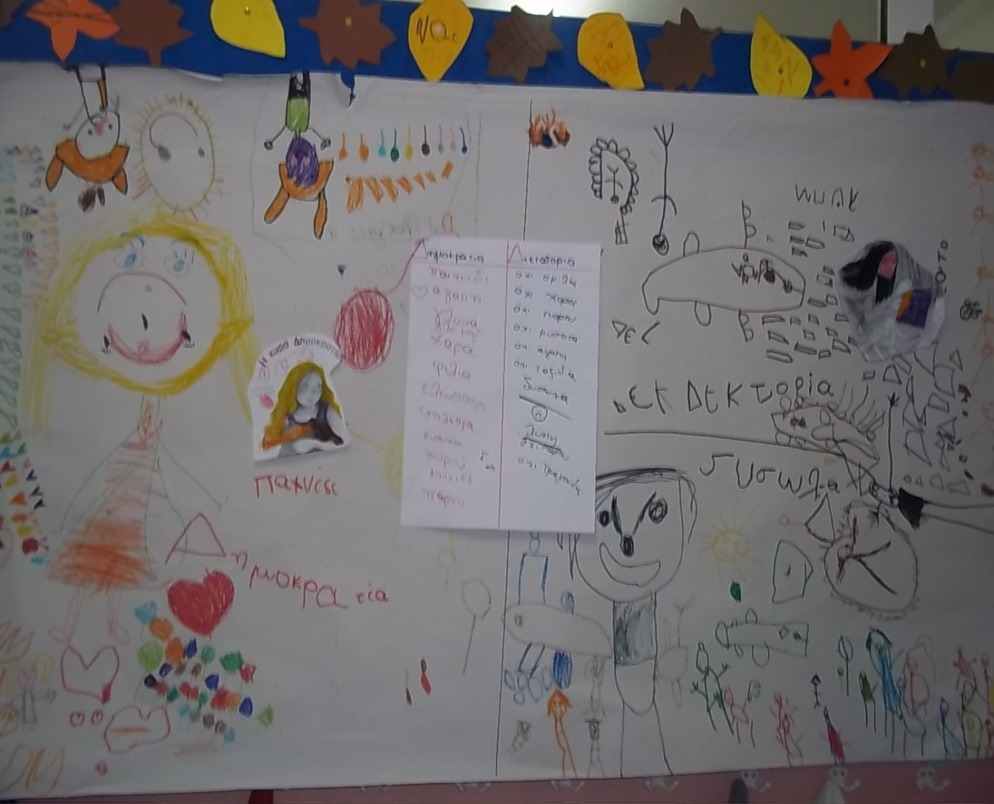
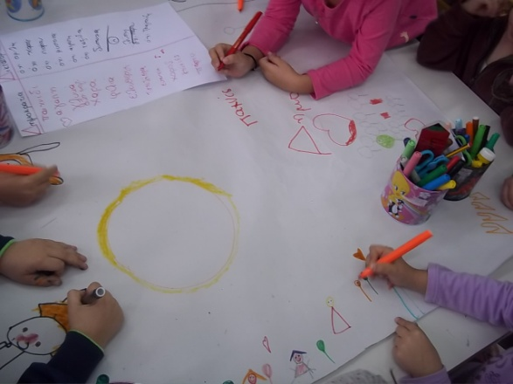
Miss Democracy and Miss Dictatorship.

Slide 8
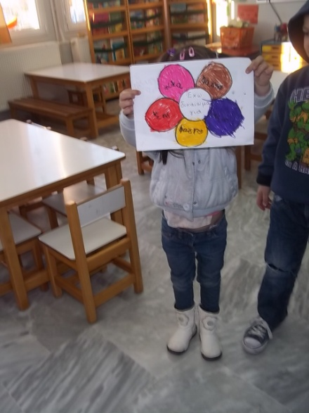
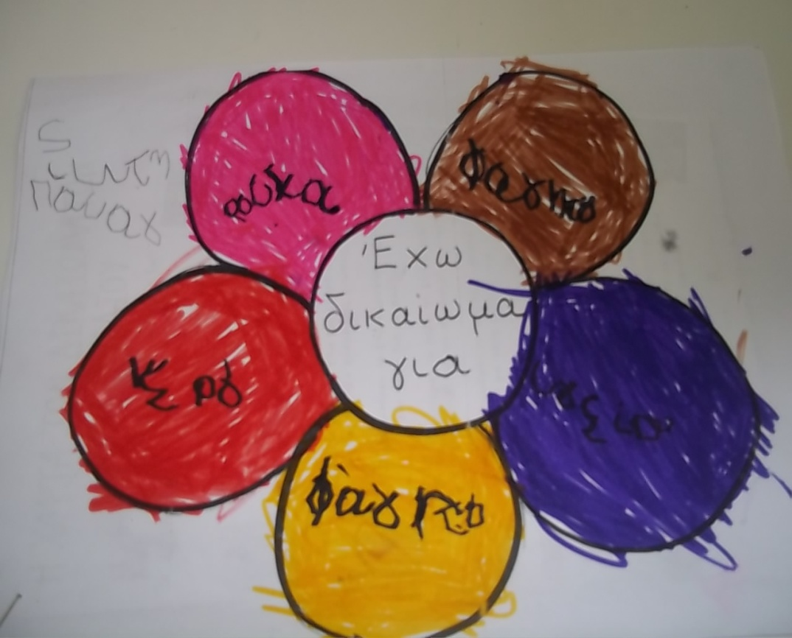
I have a right to health, food, water, clothes and love.

Slide 9
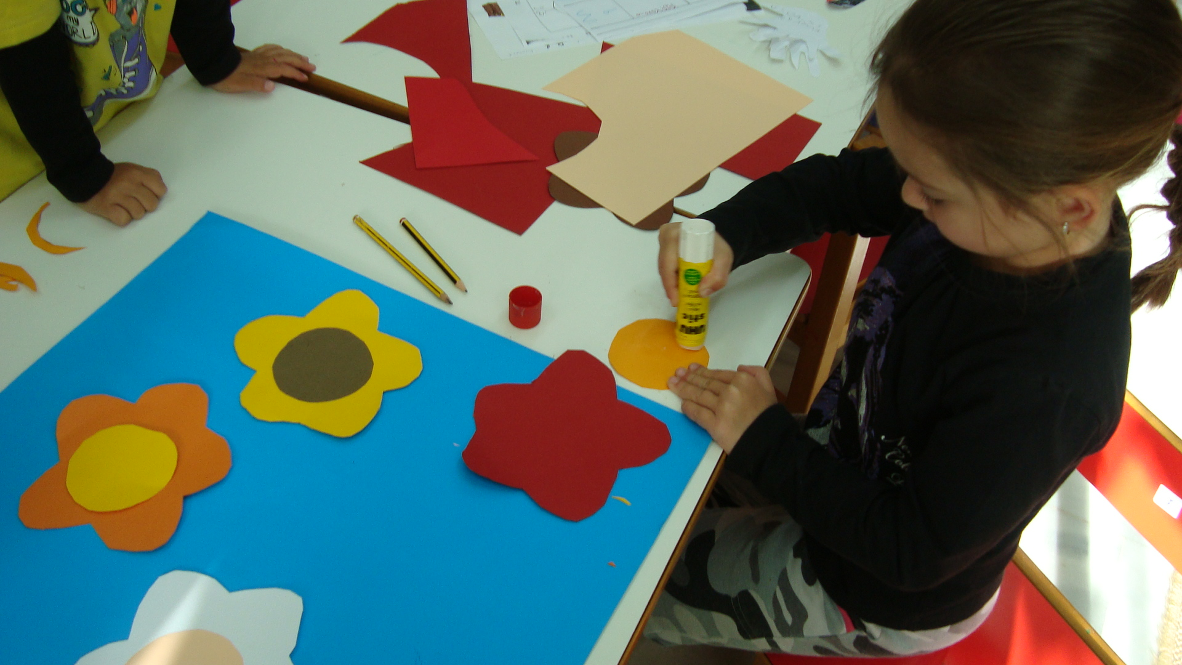

Slide 10
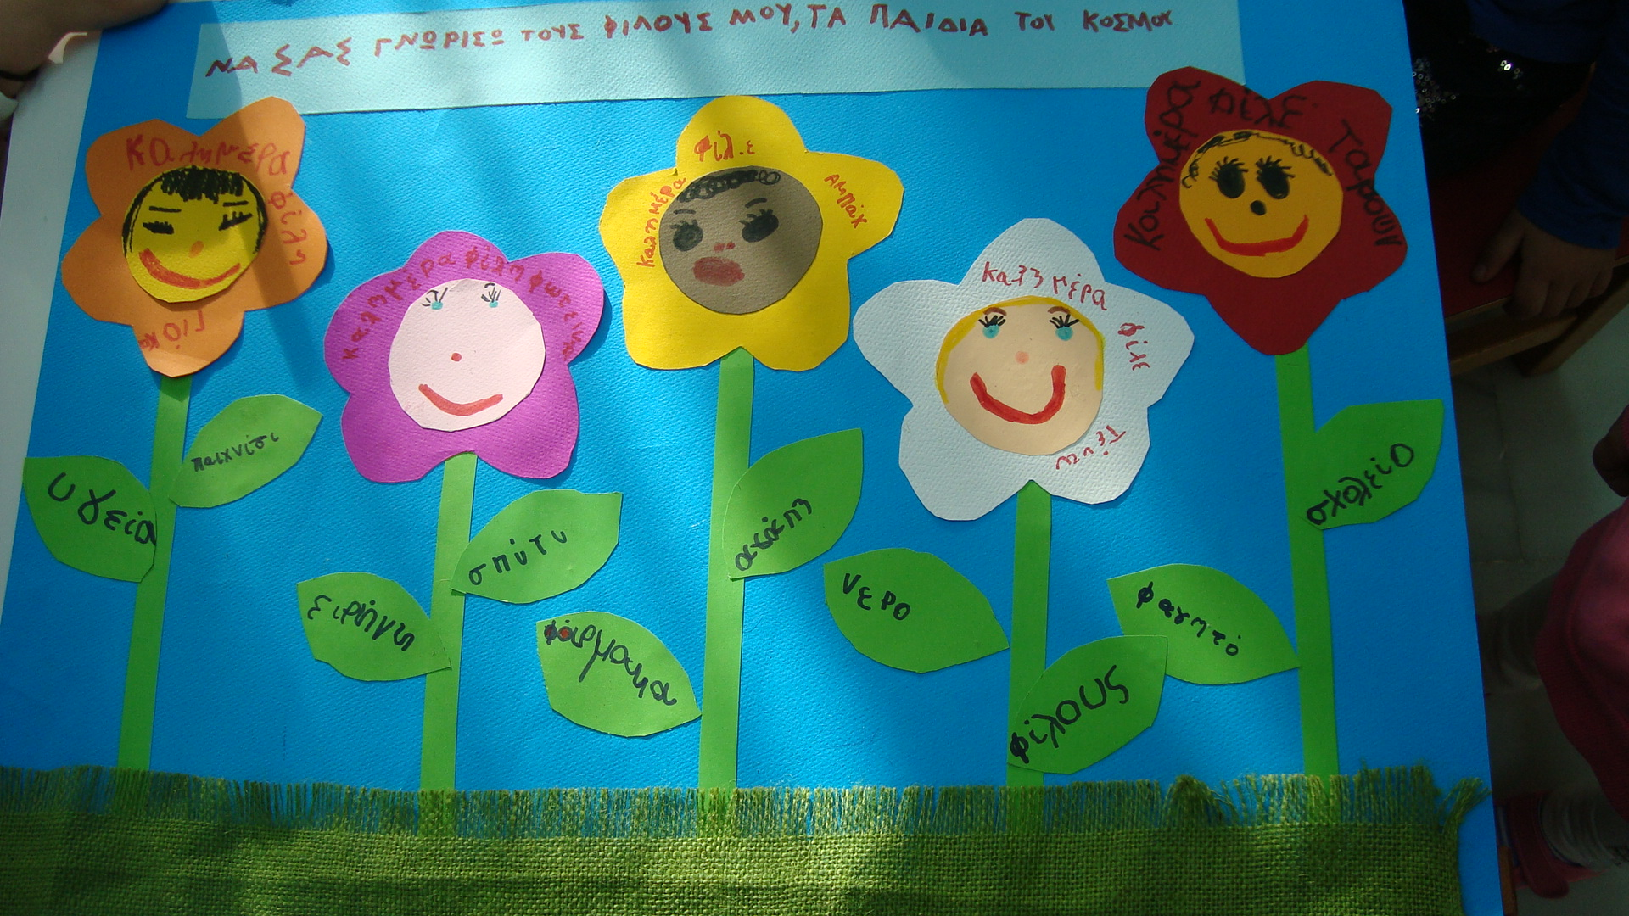
Children of the world ask for food, home, love, friendship, health.

