Slide 1
The myth of Athena Ο μύθος της Αθηνάς
23 Kindergarten Larissa-Greece
November 2014

Slide 2
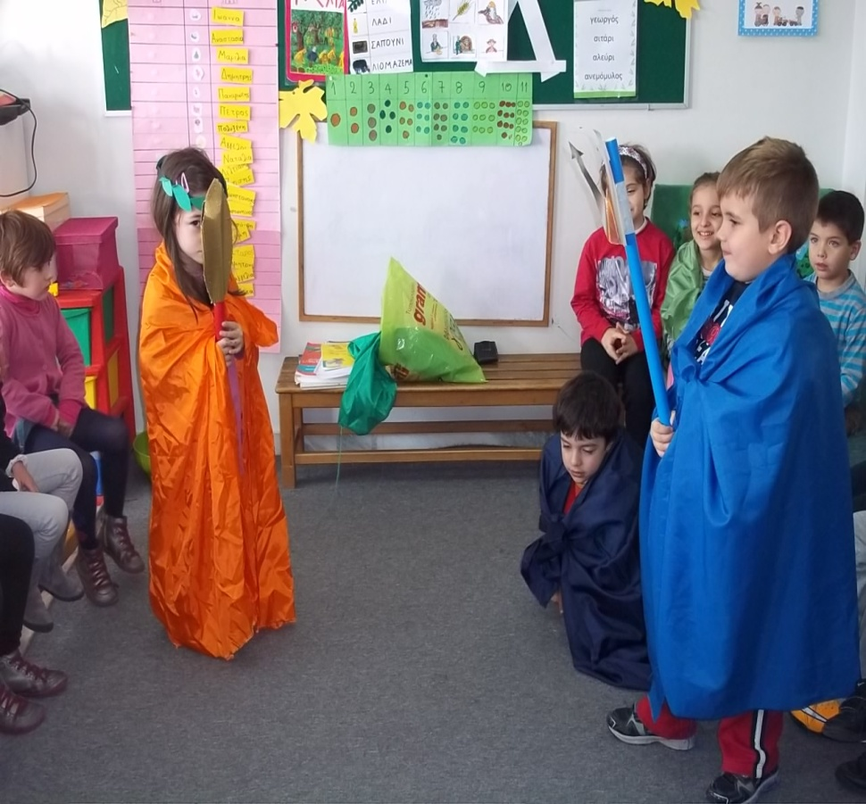
Athena and Poseidon are fighting who would protect the city of Athens.

Slide 3
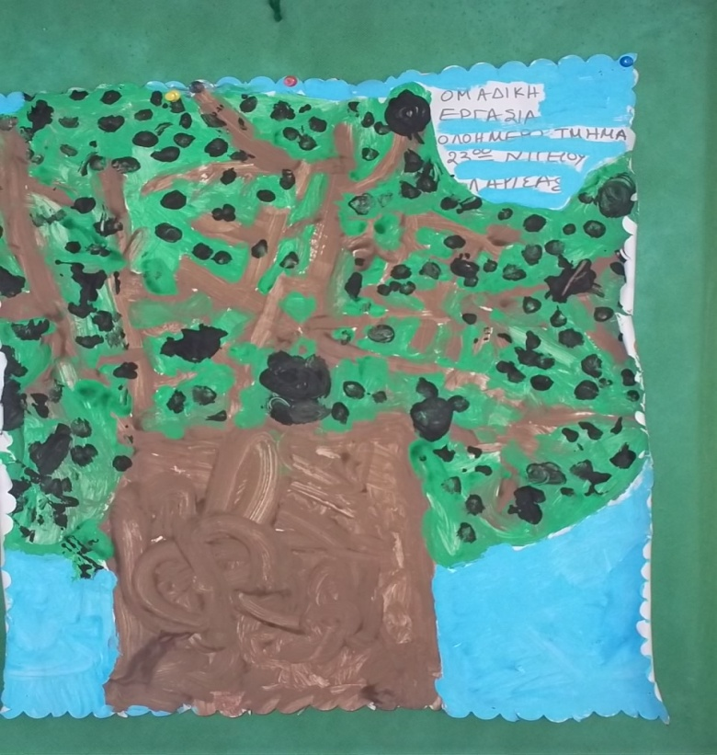
Athena gave an olive tree to the city and Poseidon a horse.

Slide 4
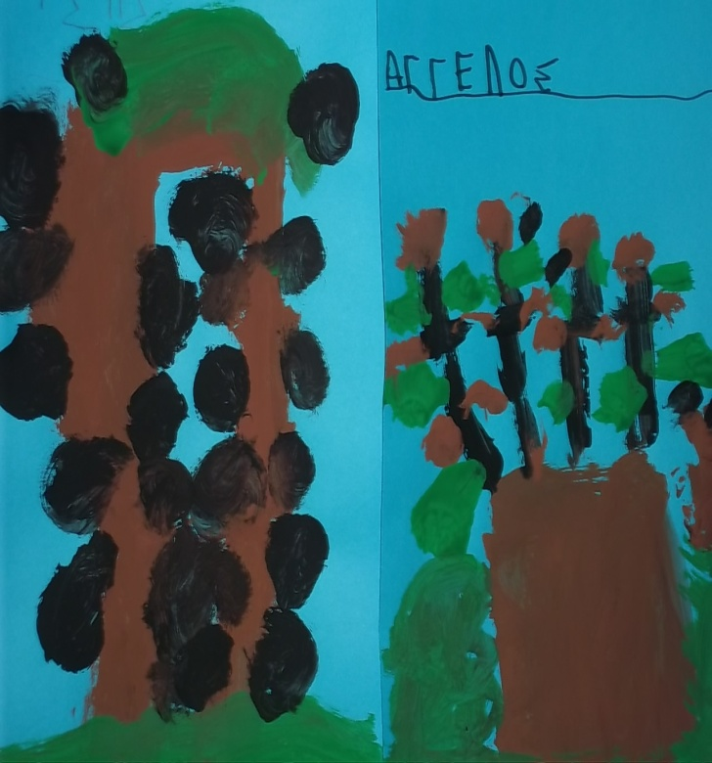
Dias decided that olive was most useful gift, so Athena would protect the city. Goodness gave her name at the city.

Slide 5
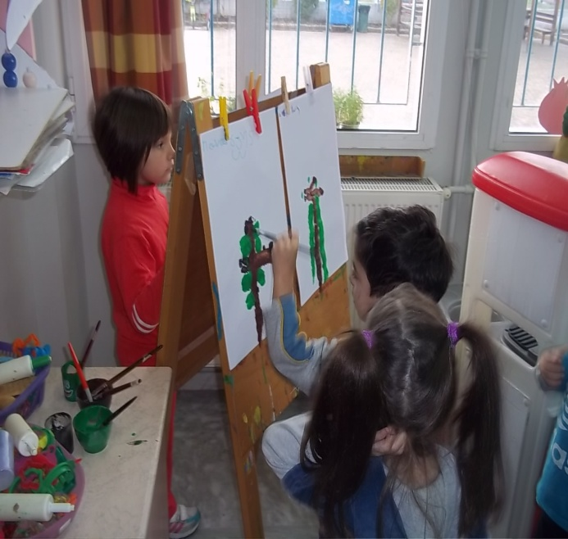
Olive, a valuable commodity

Slide 6
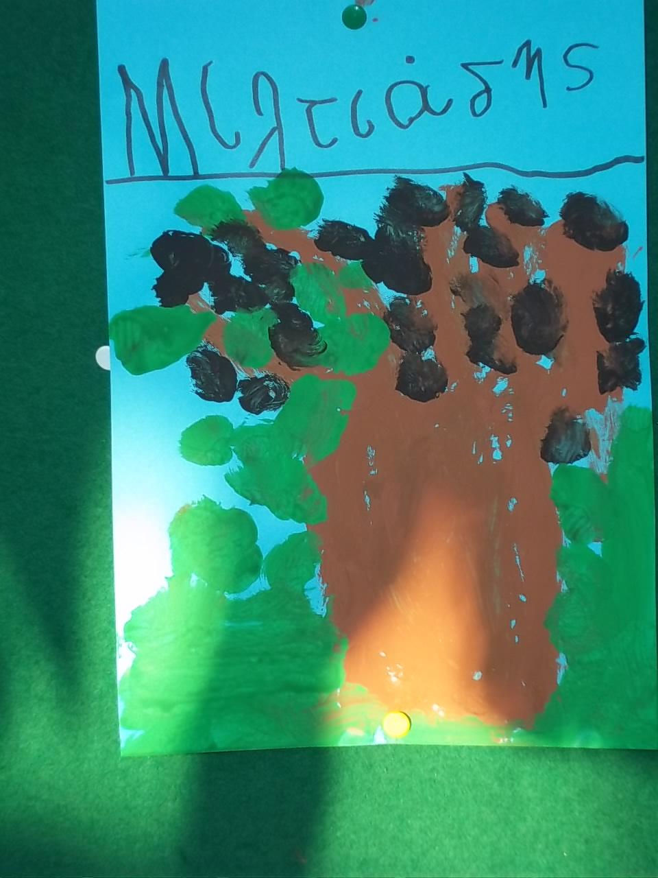
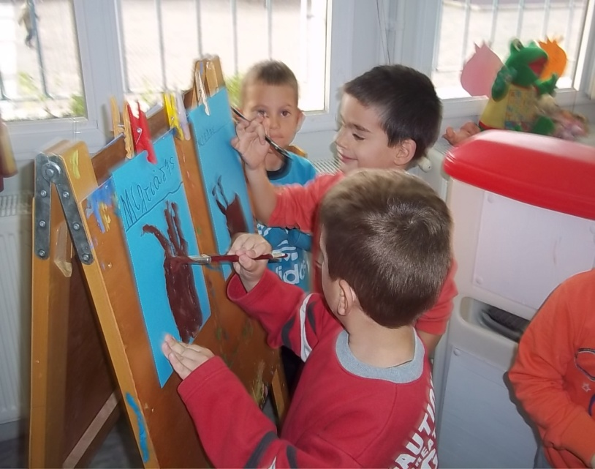

Slide 7
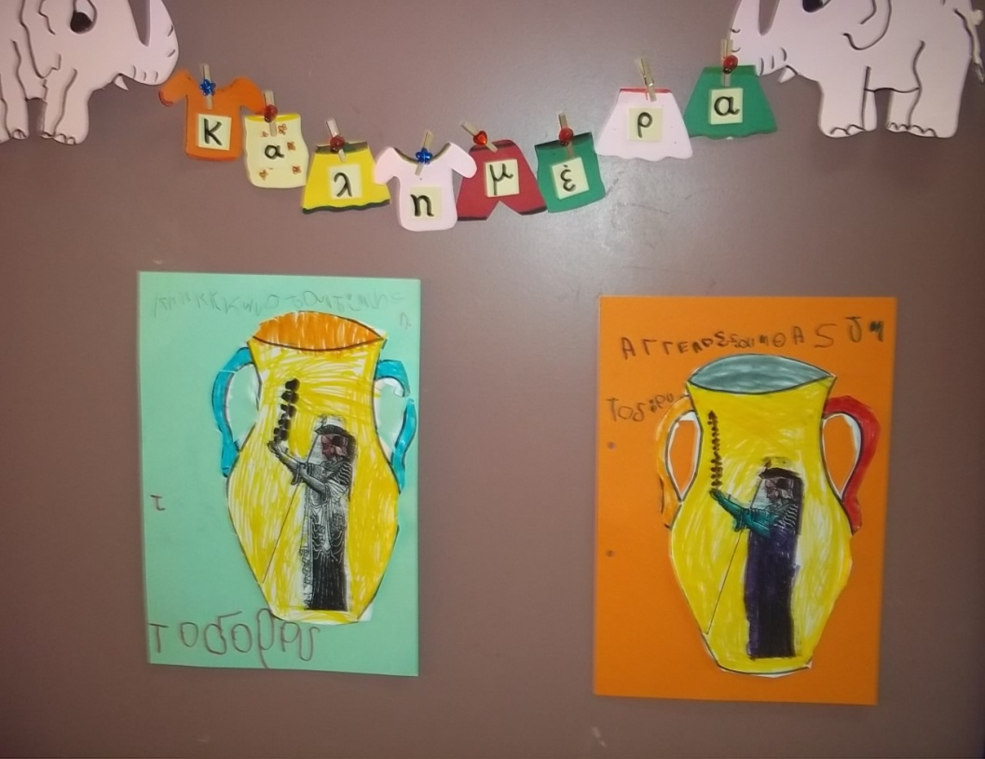
Clay vessels

Slide 8
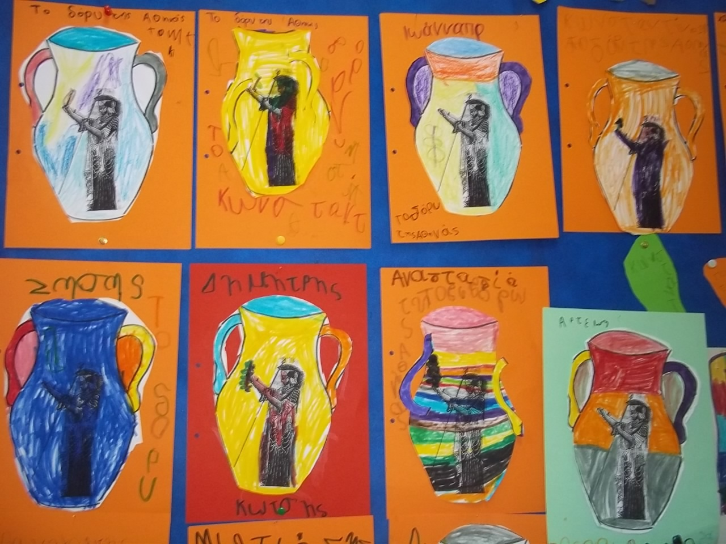
Goddess Athena and her spear.

Slide 9
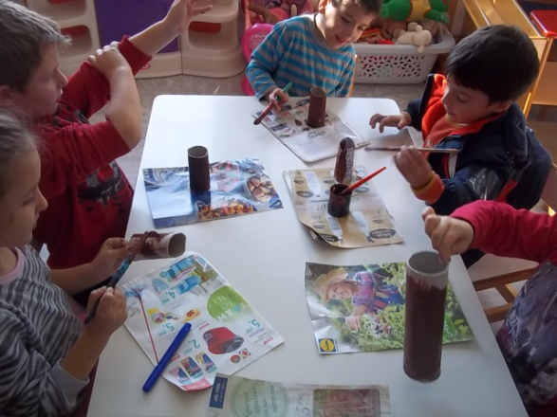
The olive grove.

