Slide 1
25th of March 1821 Greek National festival Kindergarten of Anavra Larisa Greece Styliani Petkou

Slide 2
Students` paintings

Slide 6
Evzone with geometrical shapes

Slide 7
Making “tsarouhia” traditional leather shoes with pompons

Slide 8
The leather shoes are ready

Slide 9
Drawing the school with flags

Slide 10
They are decorating the traditional apron

Slide 12
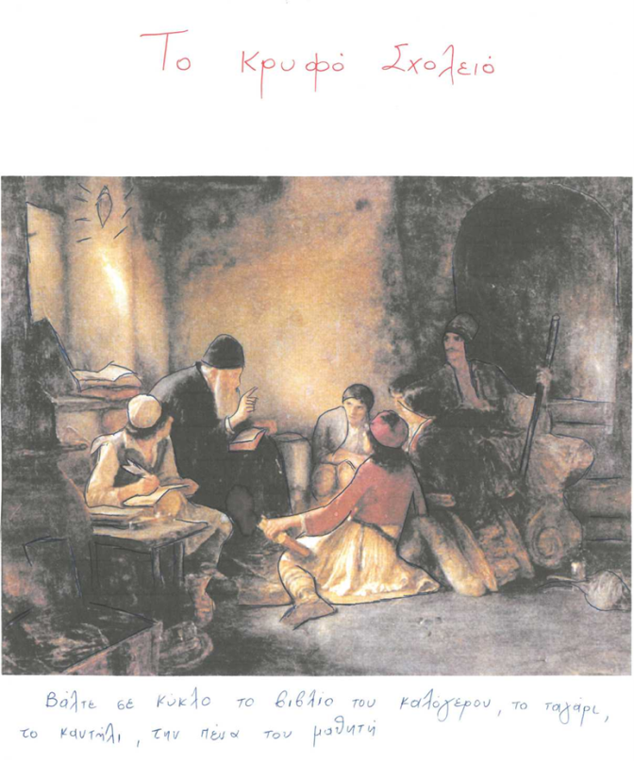
The “secret school”

