Slide 1
Kindergarten of Anavra Larisa GREECE
Styliani Petkou
EASTER CRAFTS

Slide 2
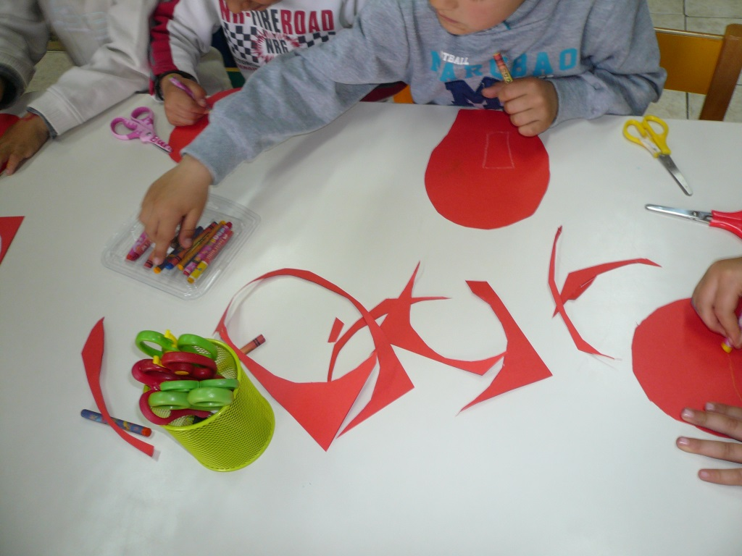

Slide 3
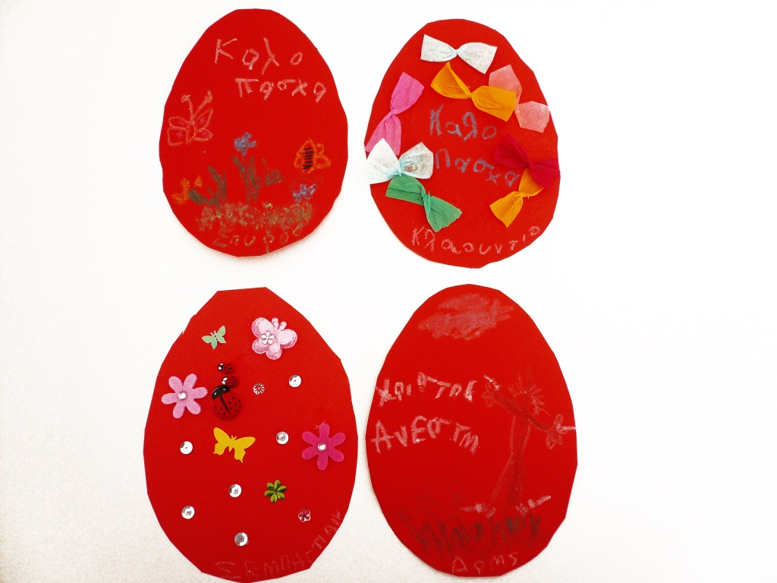

Slide 4
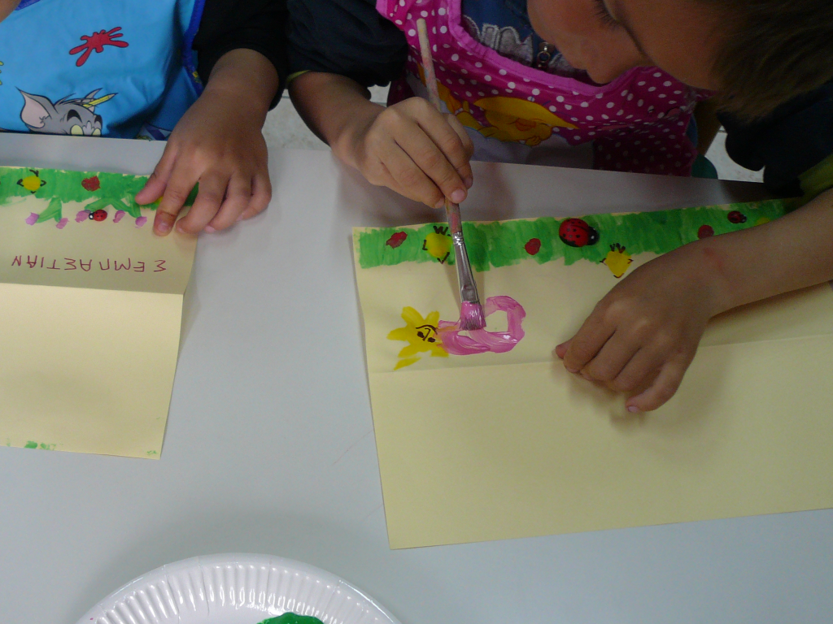
Painting the Easter cards

Slide 5
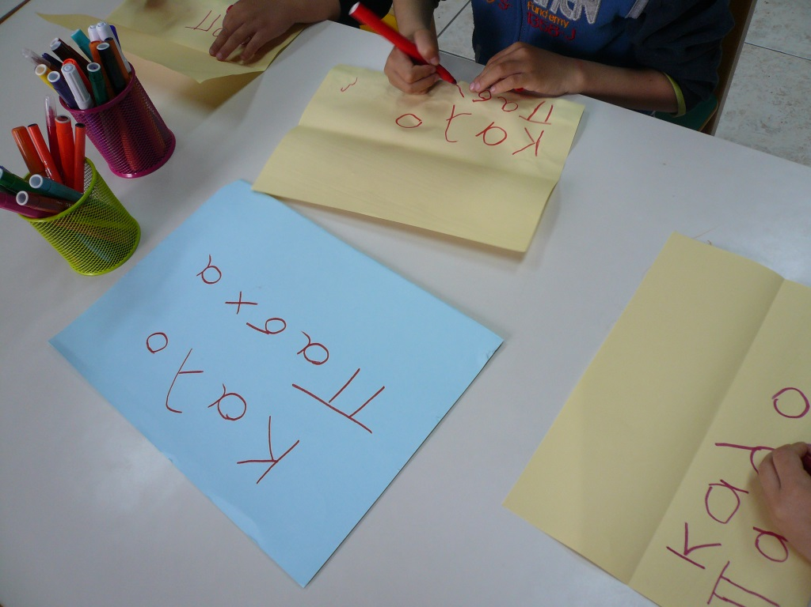
HAPPY EASTER TO ALL OF YOU!!!

Slide 6
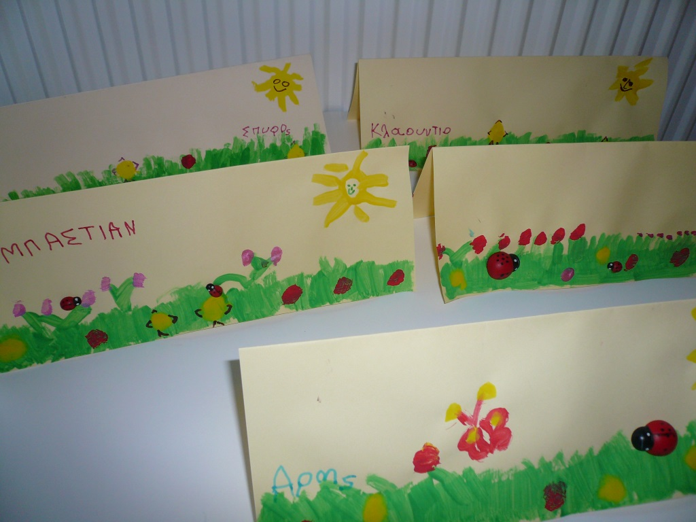

Slide 7
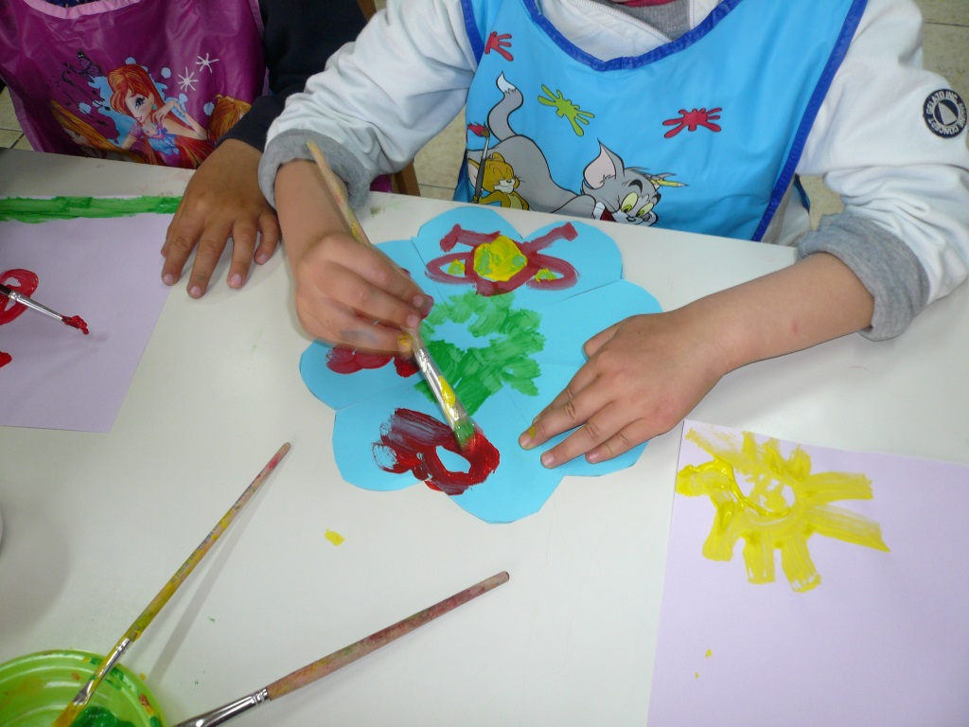
Painting the baskets

Slide 8
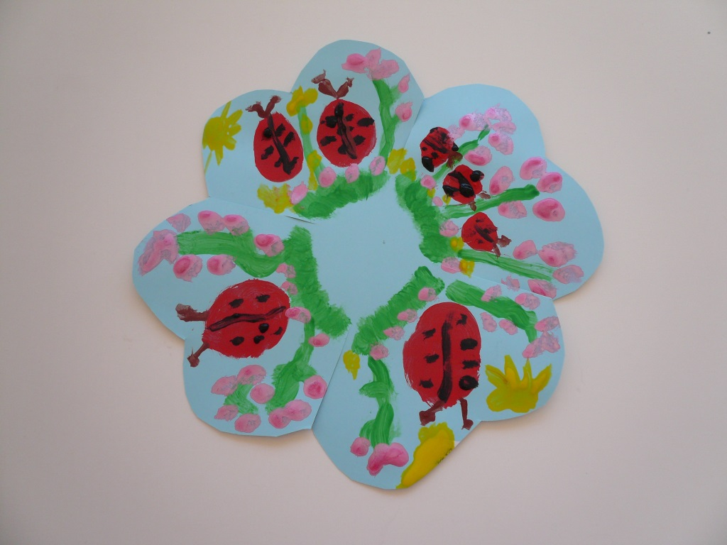

Slide 9
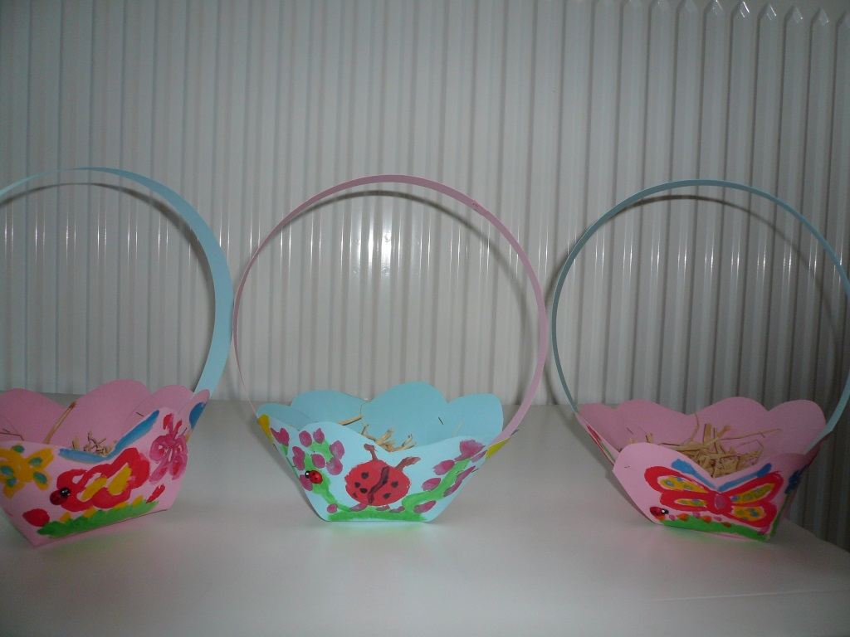

Slide 10
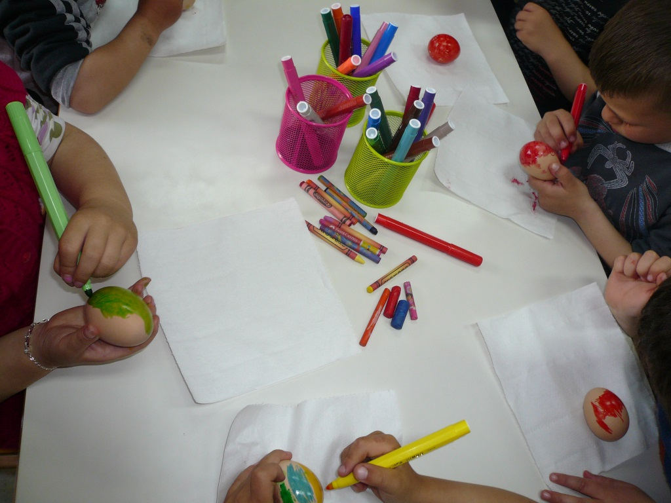
Painting the eggs

Slide 11
