Slide 1
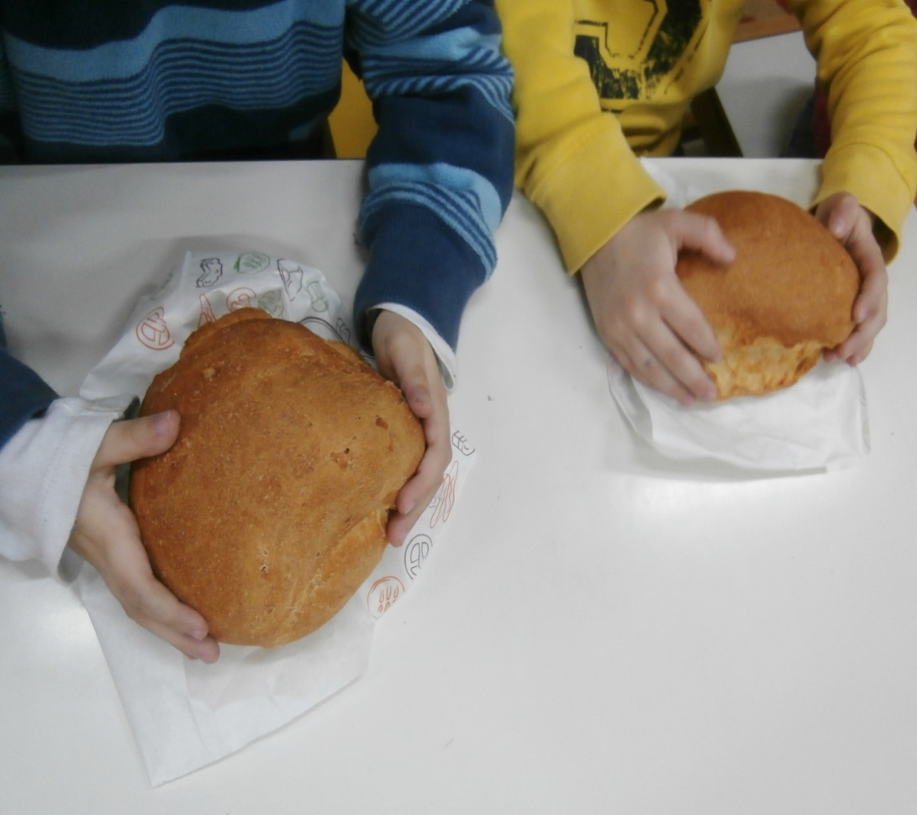
THE SWEETEST BREAD
Kneading our own bread

Slide 2
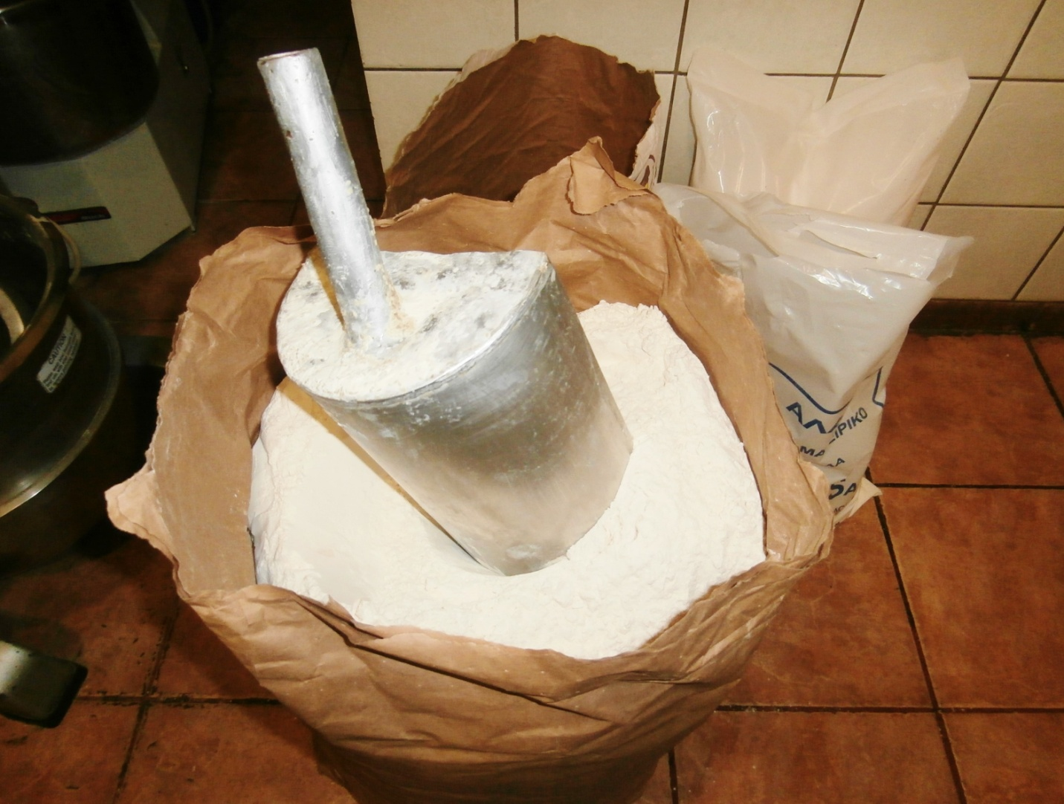
In the oven of our neighborhood, we make bread out of our hands.

Slide 3
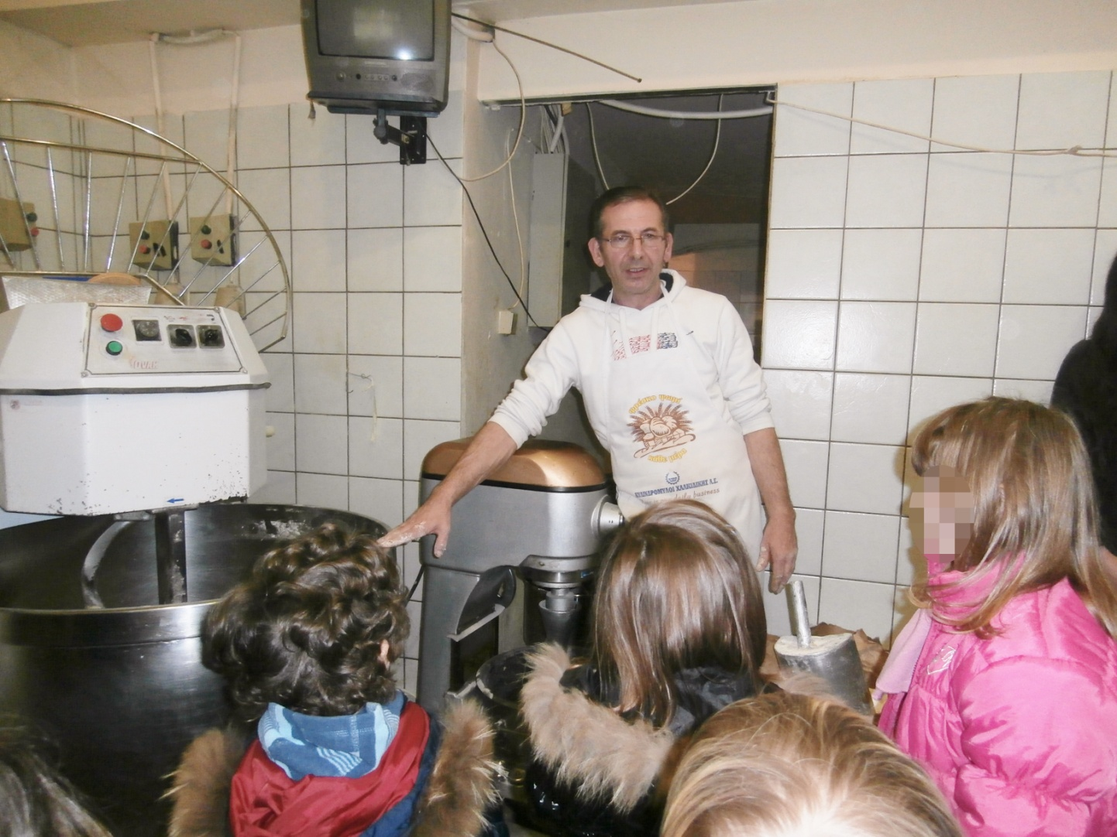
The baker explains us where is kneaded the dough.

Slide 4
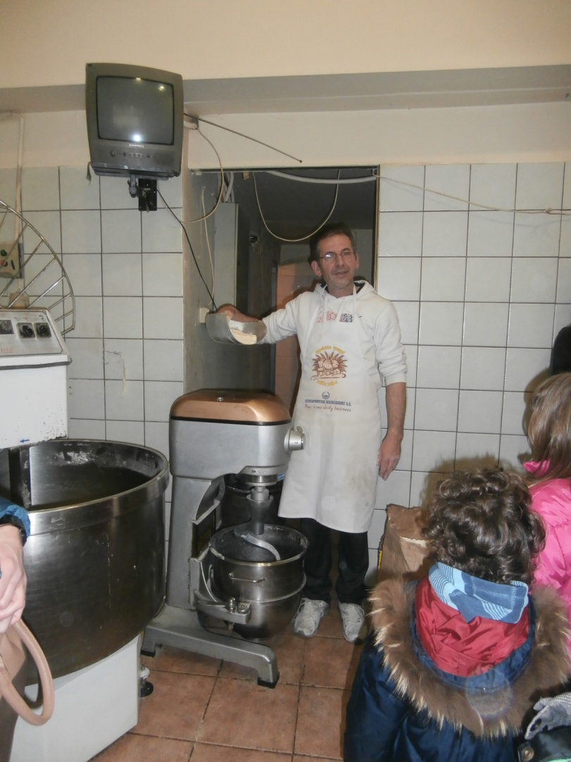
We will use flour and water.

Slide 5
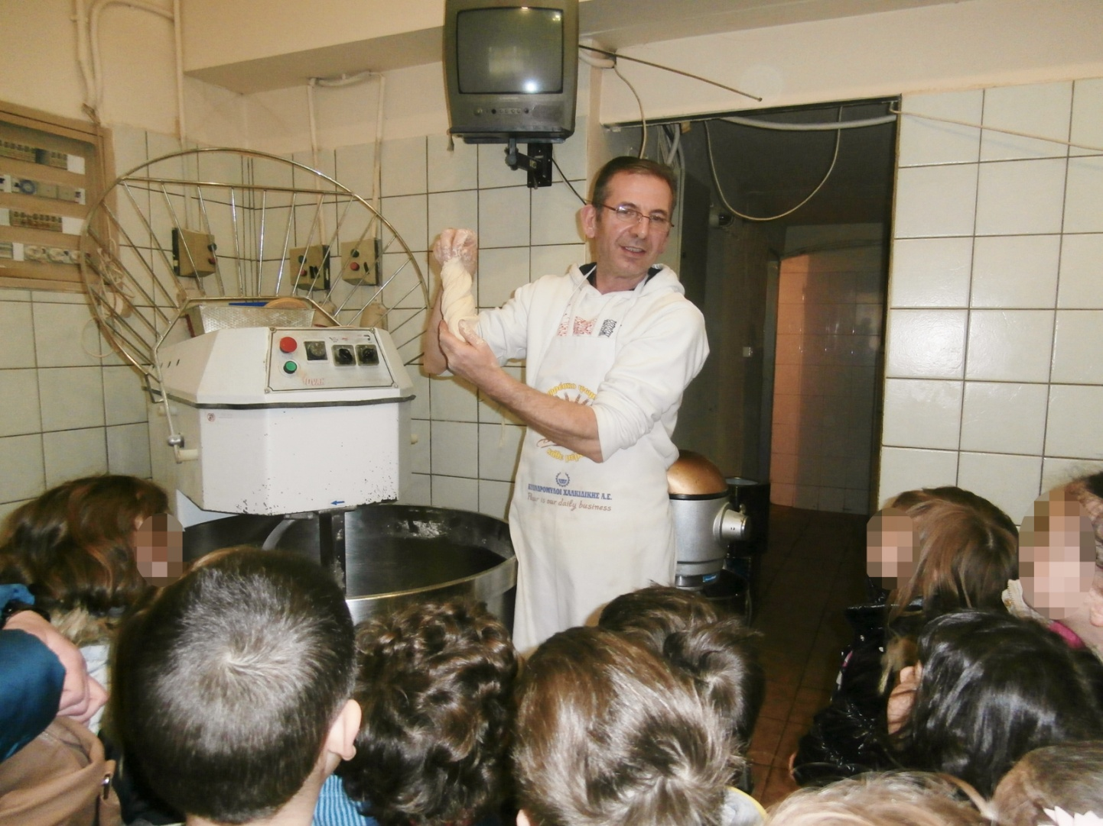
We can give various shapes in dough.

Slide 6
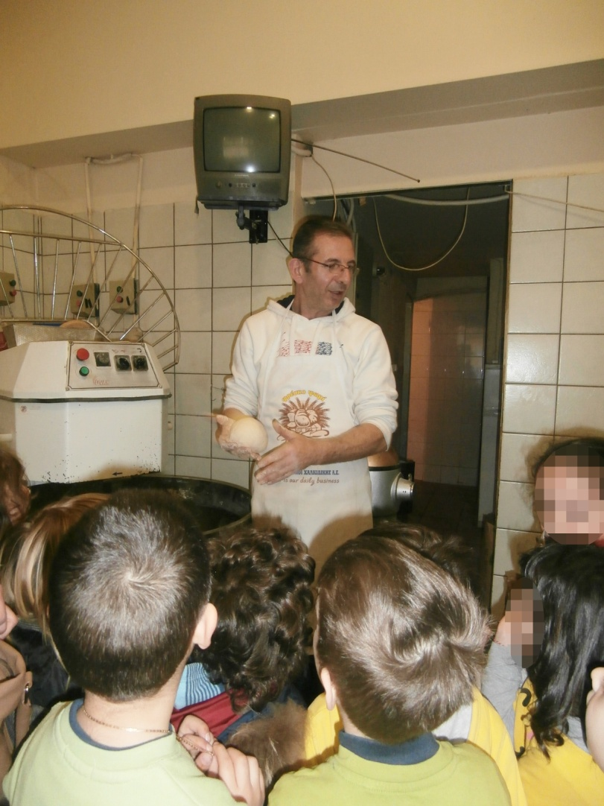
This one looks like a ball.

Slide 7
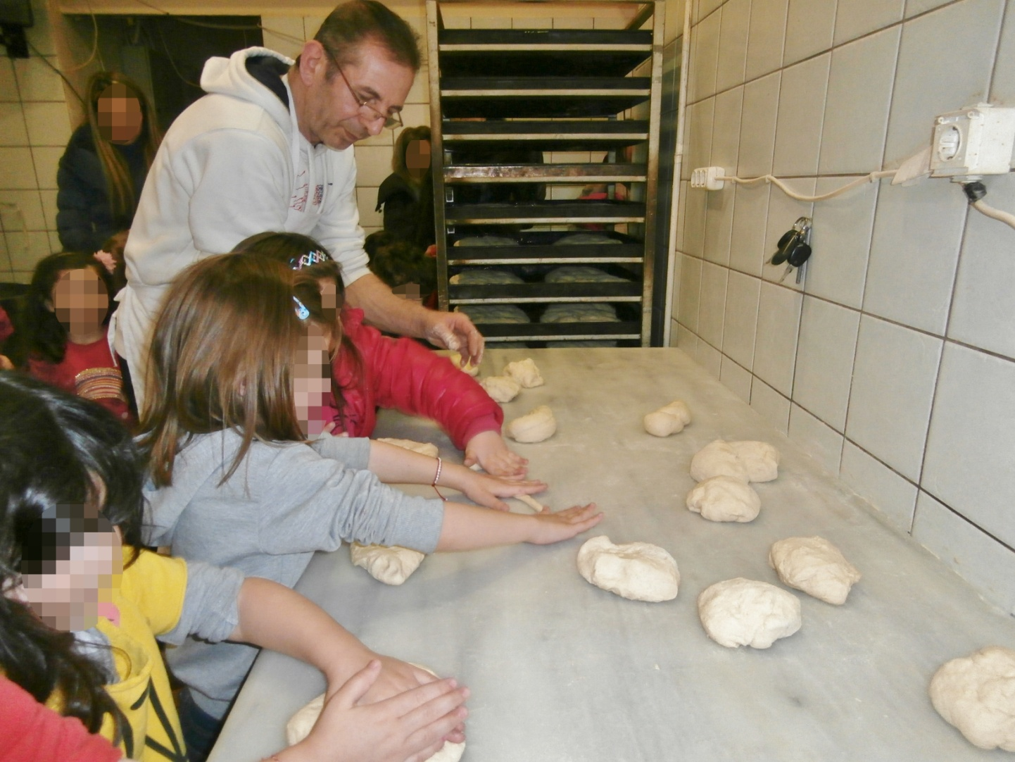
It's time for kneading.

Slide 8
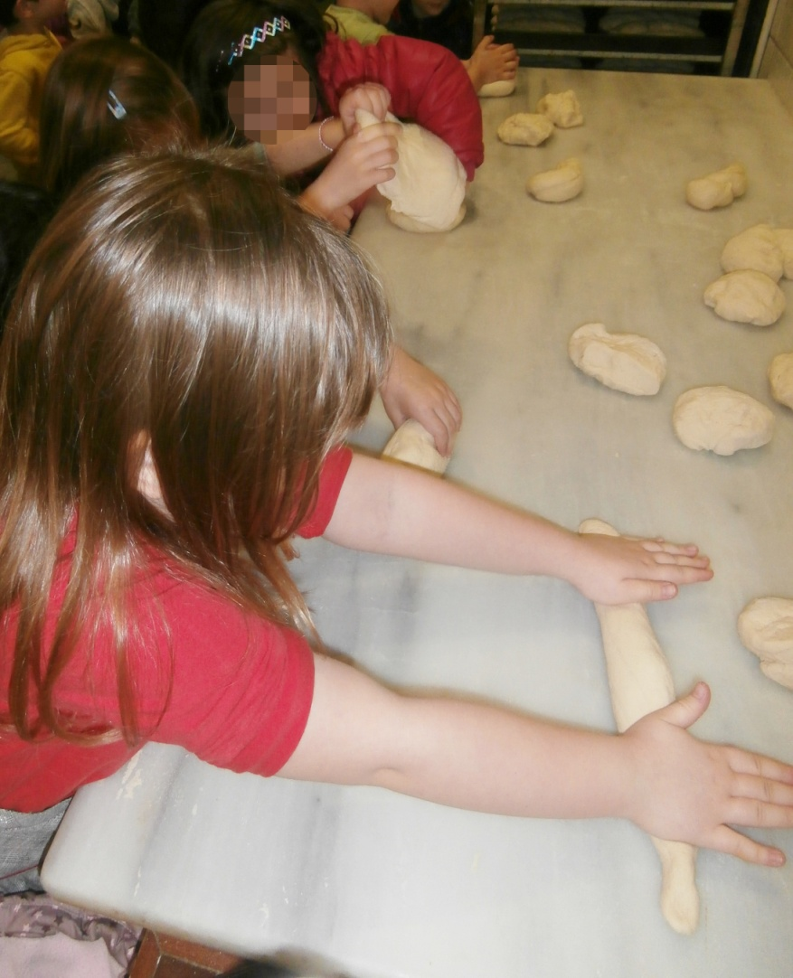
How soft is the dough !

Slide 9
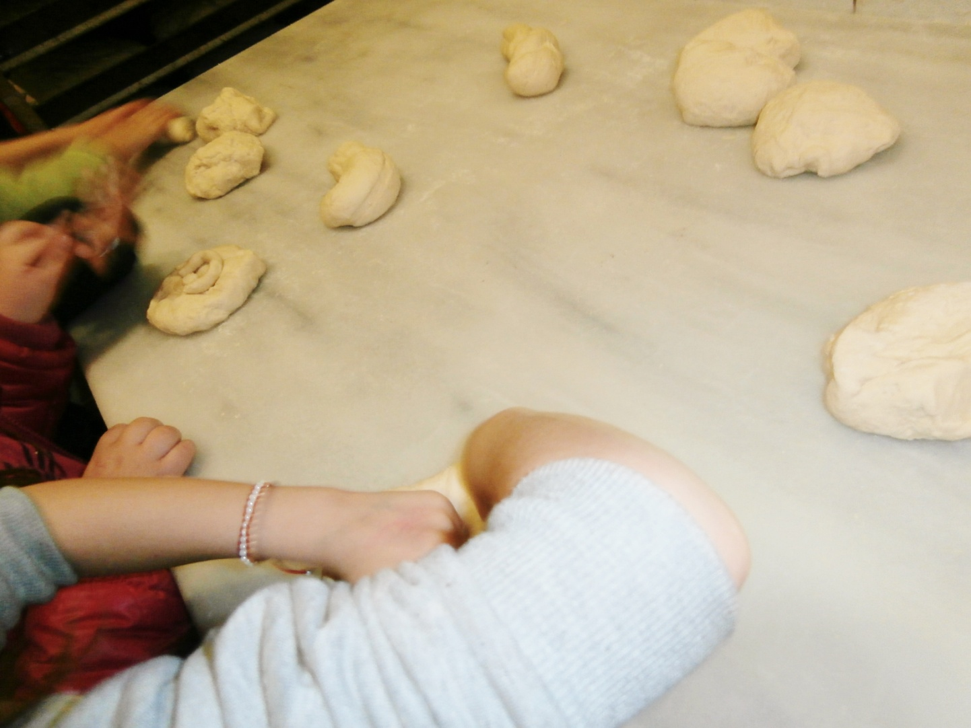
We enjoy kneading!

Slide 10
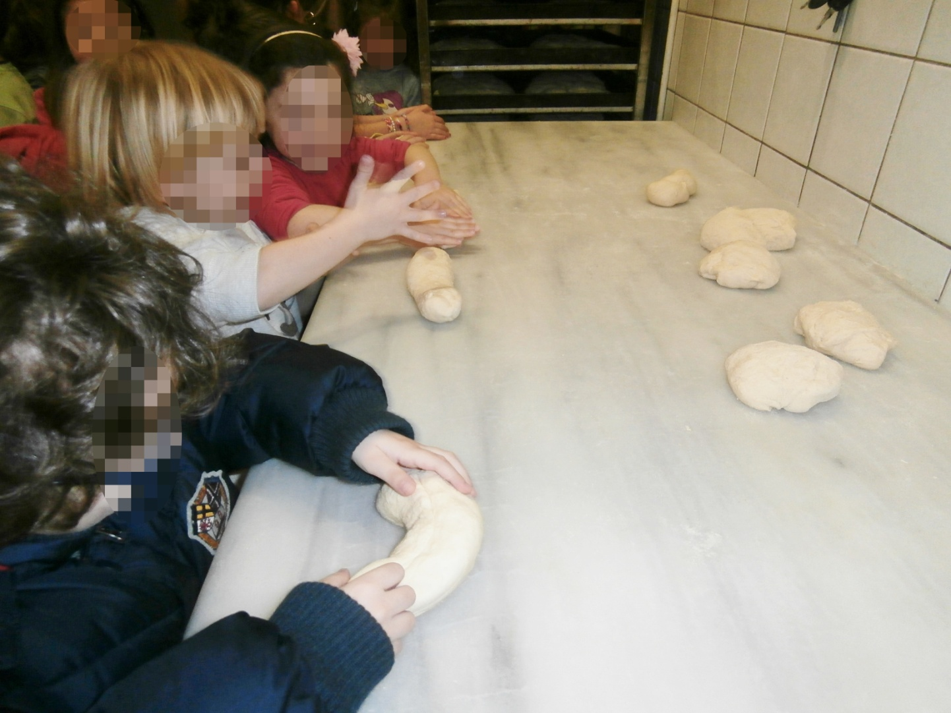
We like to mold the dough.

Slide 11
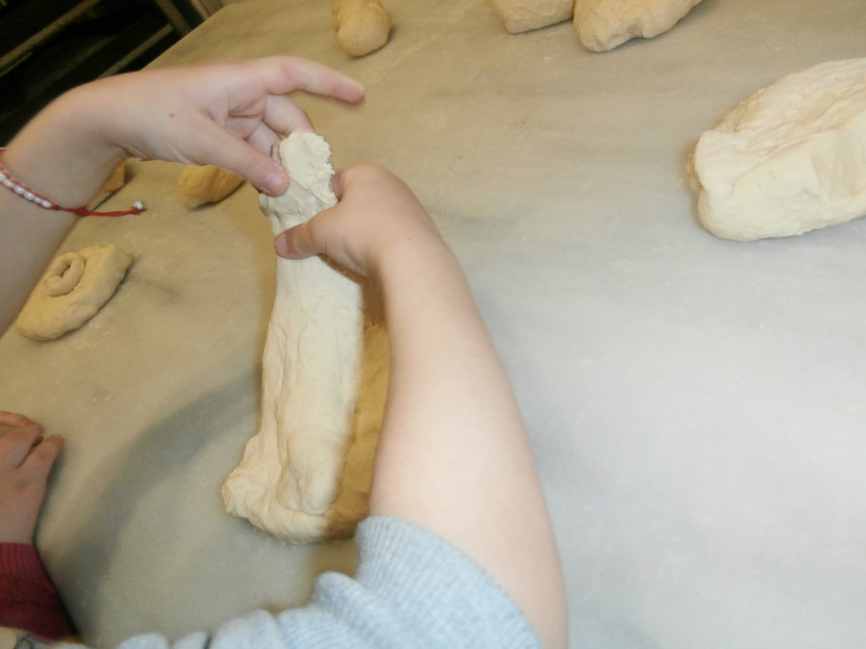
We really enjoy it!

Slide 12
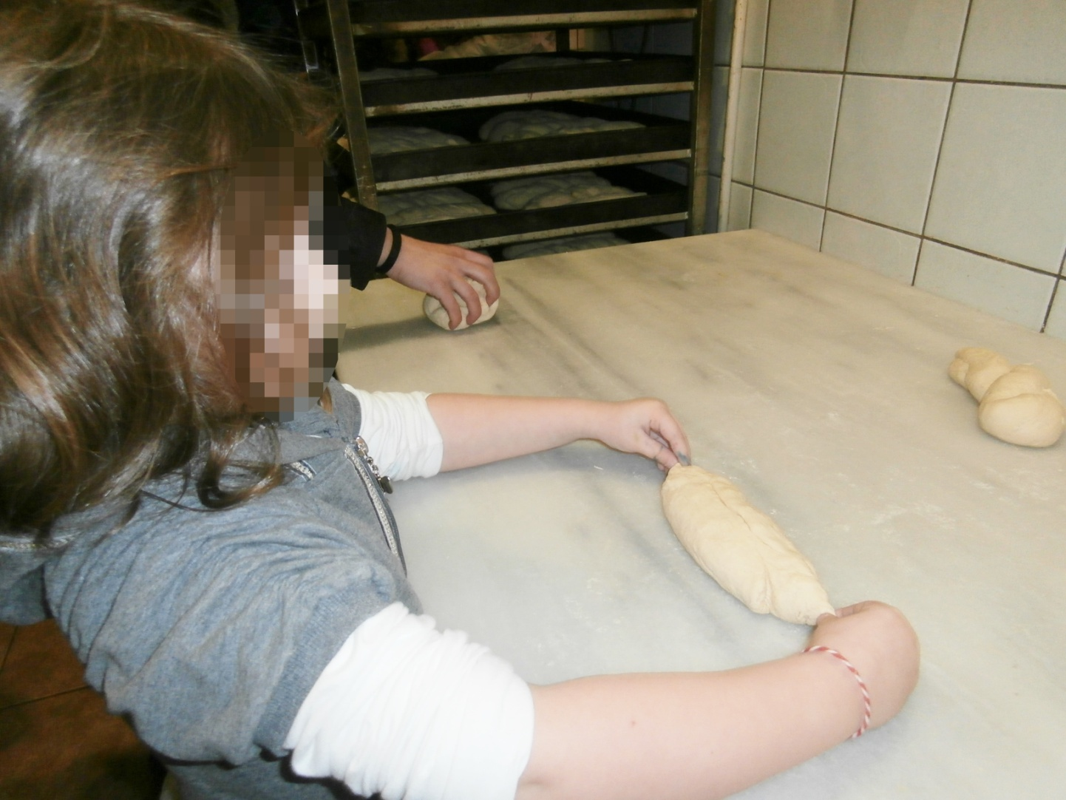
I think we finished

Slide 13
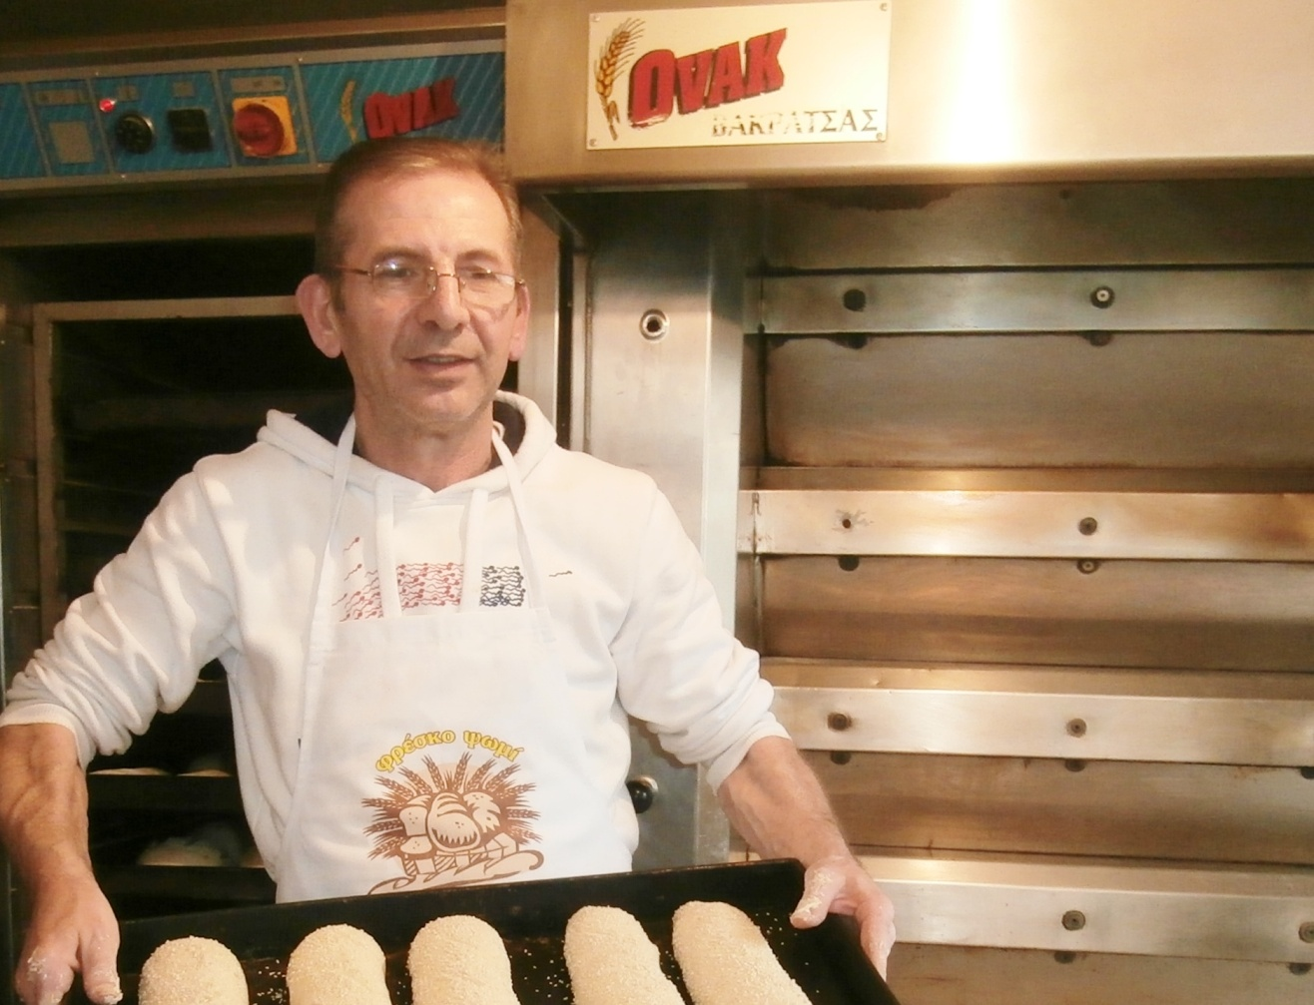
Ready to bake them in the oven.

Slide 14
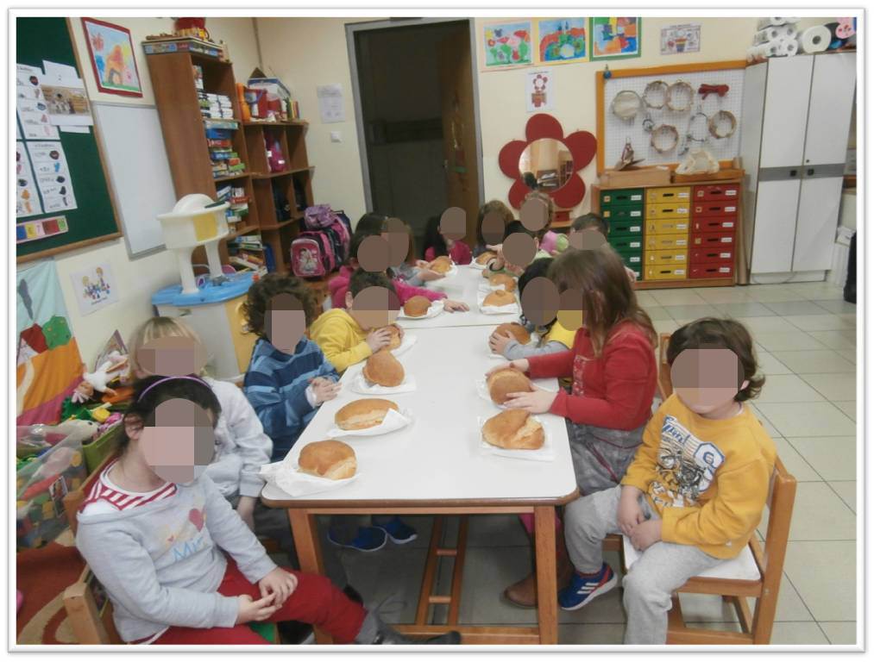
Bread was taken to school.

Slide 15

It’s the sweetest bread!

