Slide 1
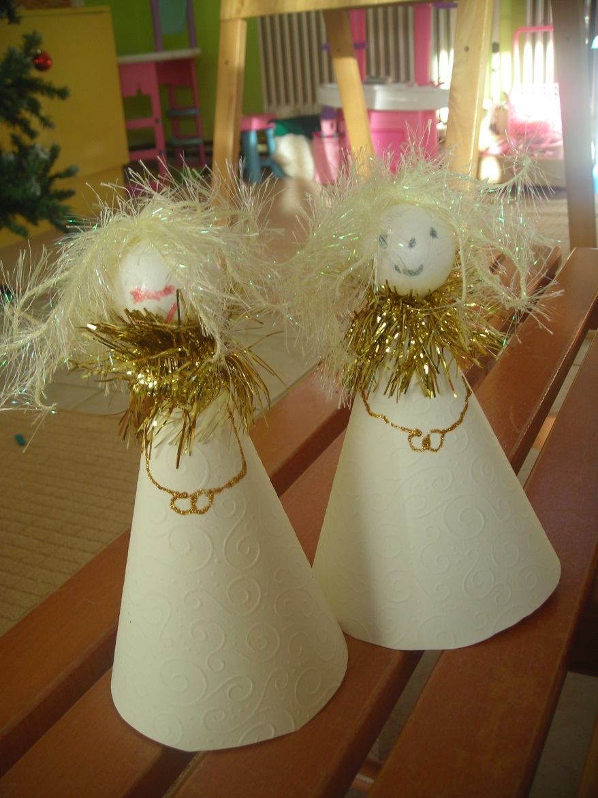
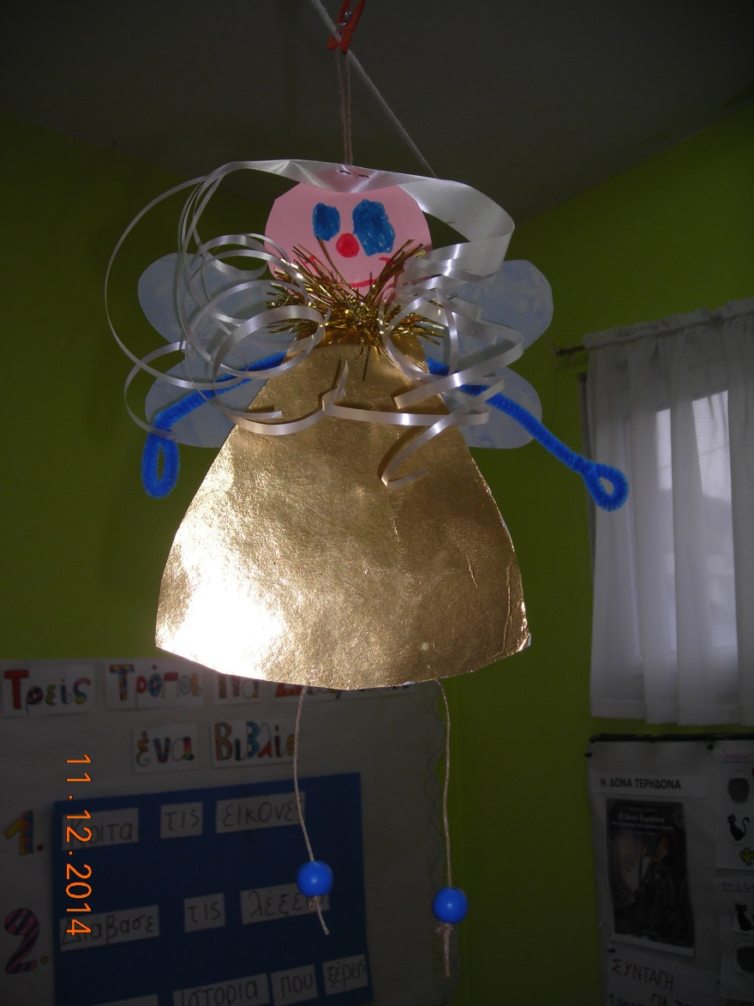
Golden Angels
Kindergarten of Paranesti

Slide 9
