Slide 1
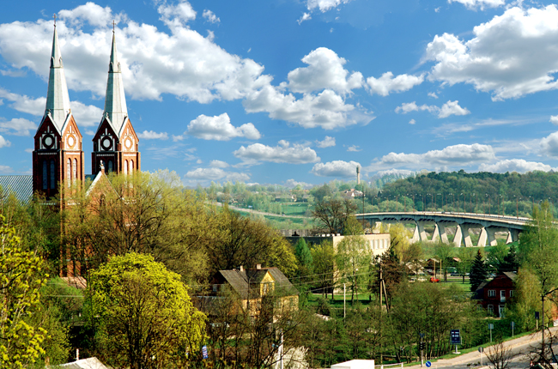
TOWN JURBARKAS
LITHUANIA

Slide 2
Country - Lithuania
County - Tauragė
Municipality - Jurbarkas
Date of Incorporation - 1259
About 13 thousands inhabitants
Area - 13,28 km²

Slide 3
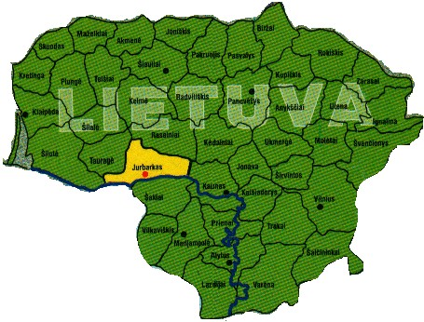
Jurbarkas is in this place of Lithuania
Jurbarkas Coat of Arms

Slide 4
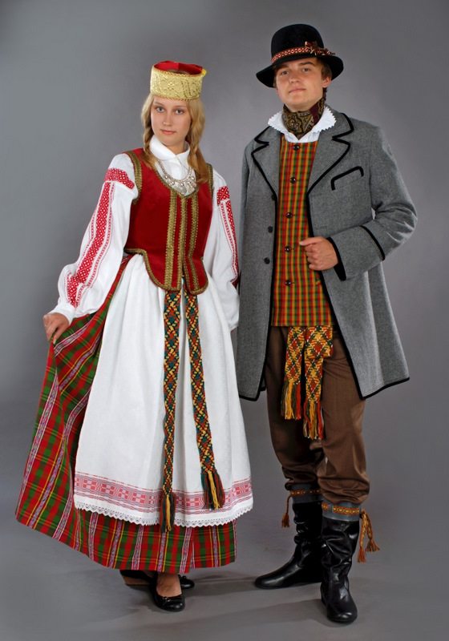
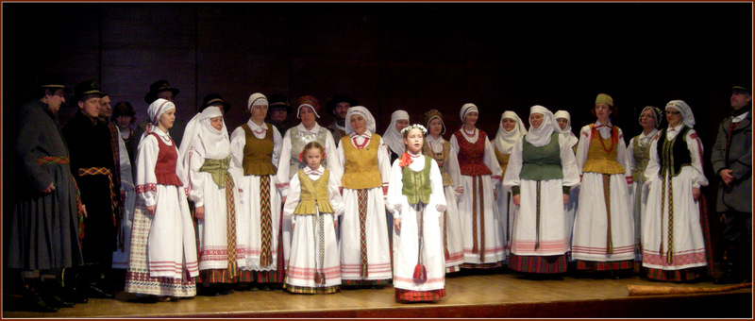
Lithuanian folk costumes

Slide 5
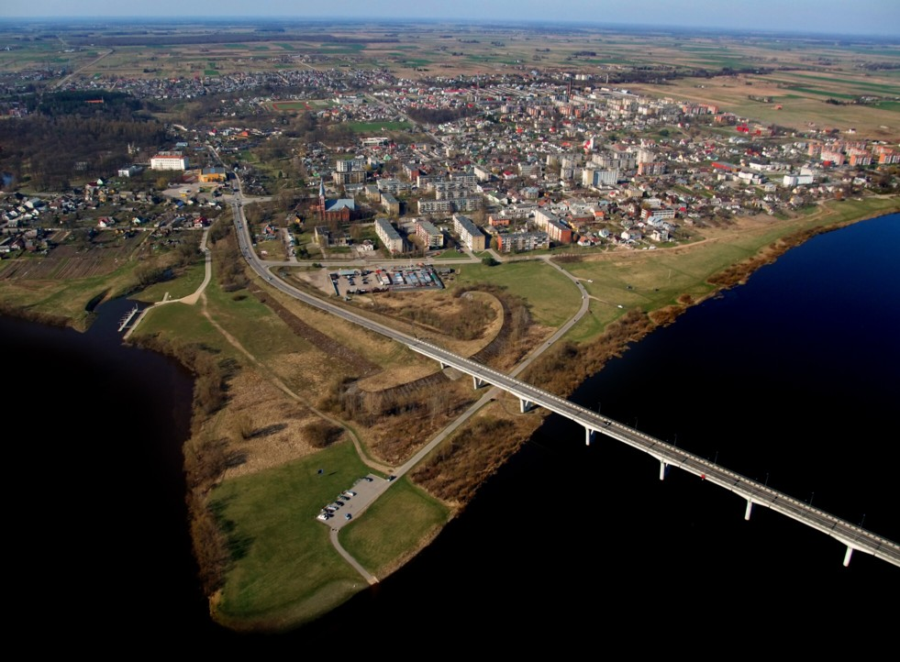
JURBARKAS from the bird flight

Slide 6
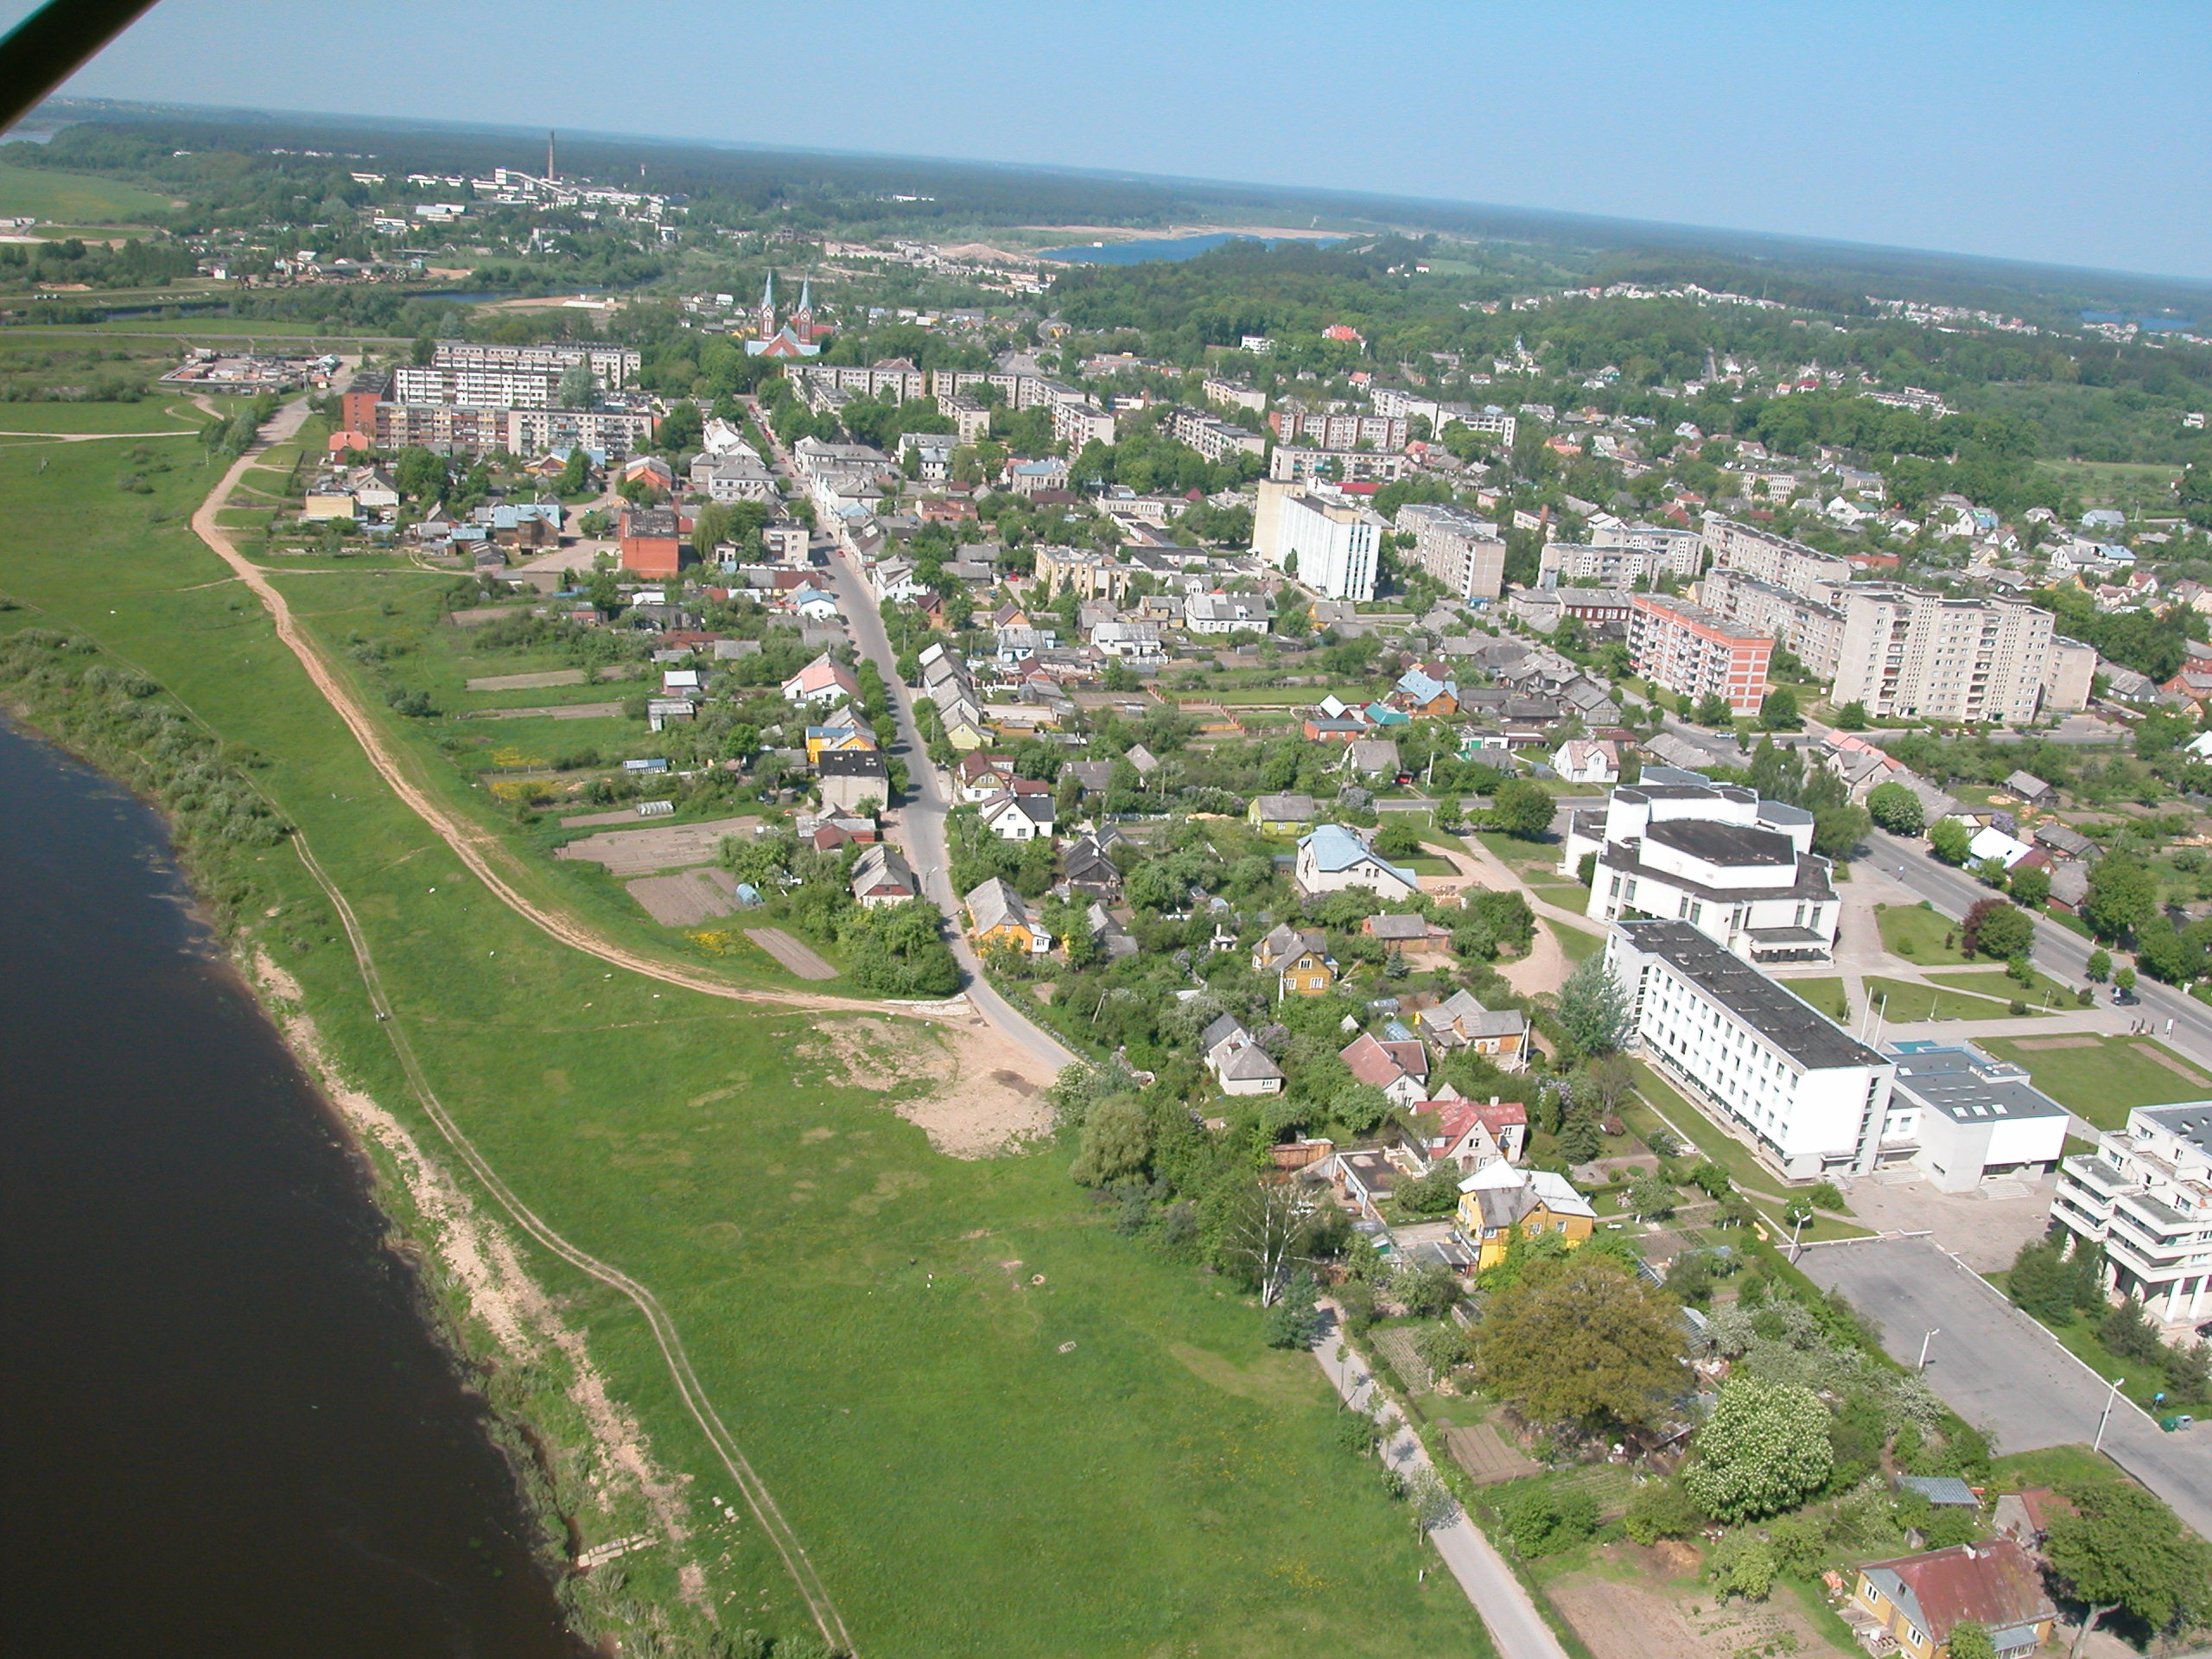

Slide 7
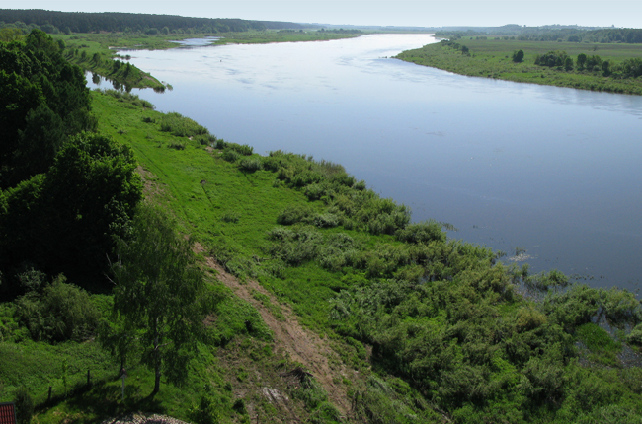
Near Jurbarkas flows largest Lithuanian river Nemunas, here is the longest bridge over the river

Slide 8
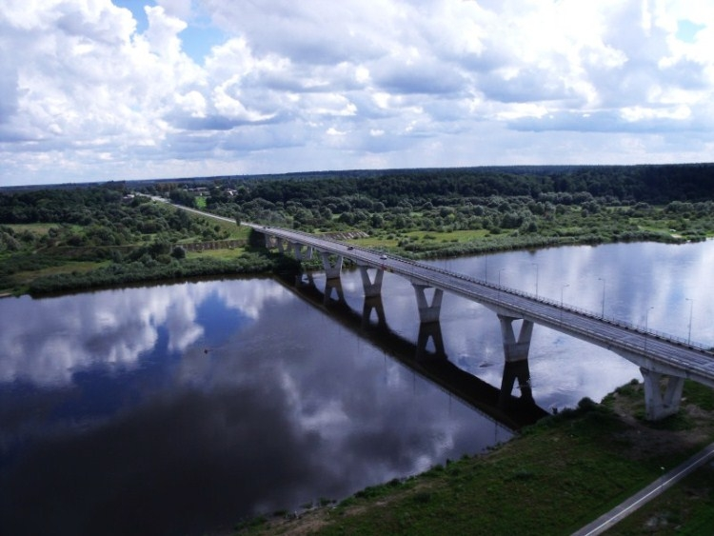

Slide 9
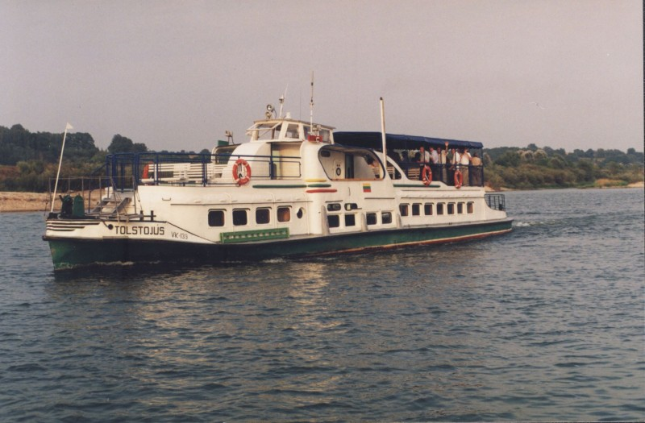

Slide 10
Jurbarkas municipality

Slide 11
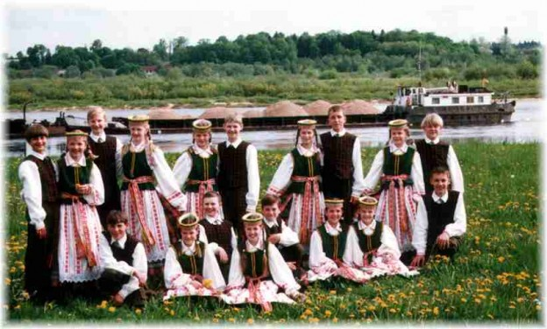
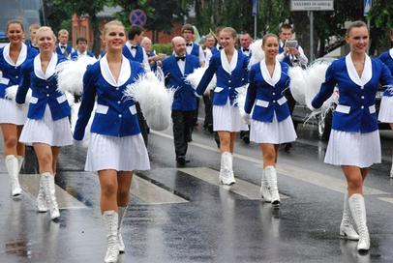
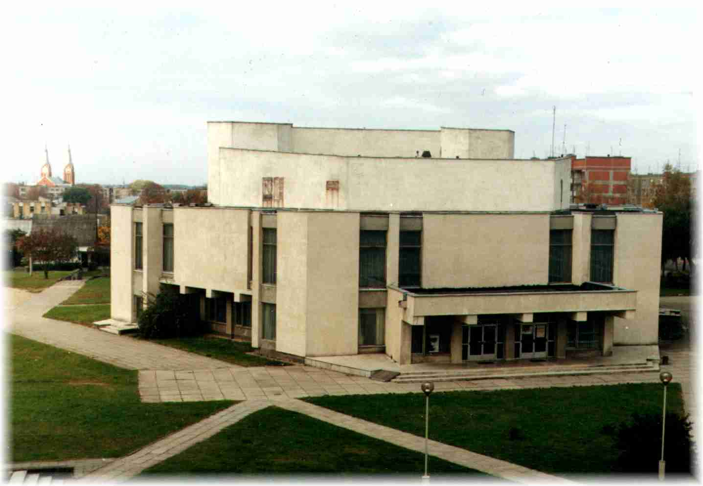
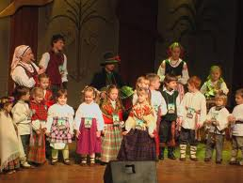
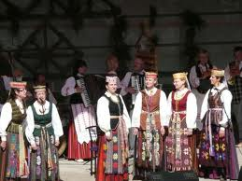
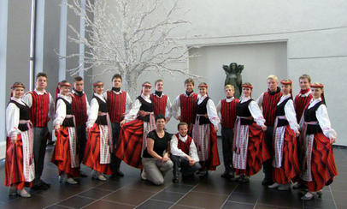
Culture
Center

Slide 12
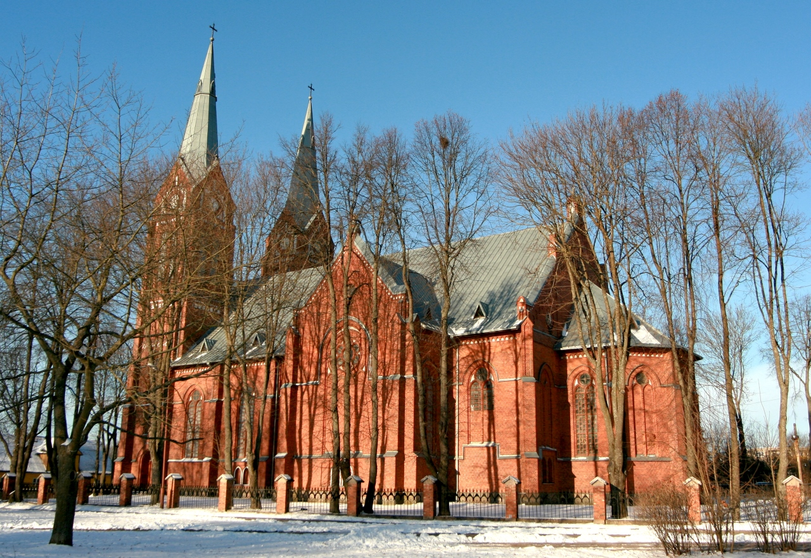
Jurbarkas Church

Slide 13
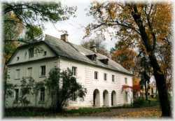
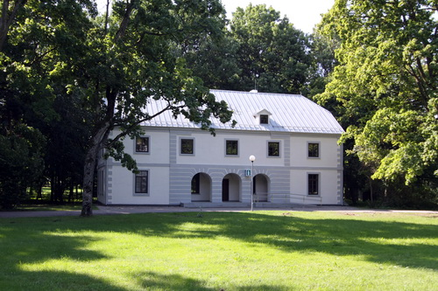
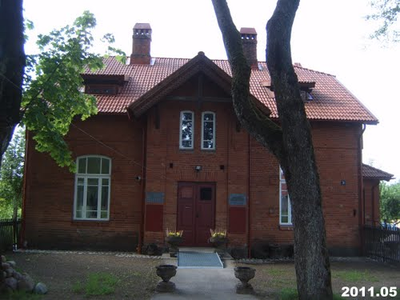
Jurbarkas museums

Slide 14
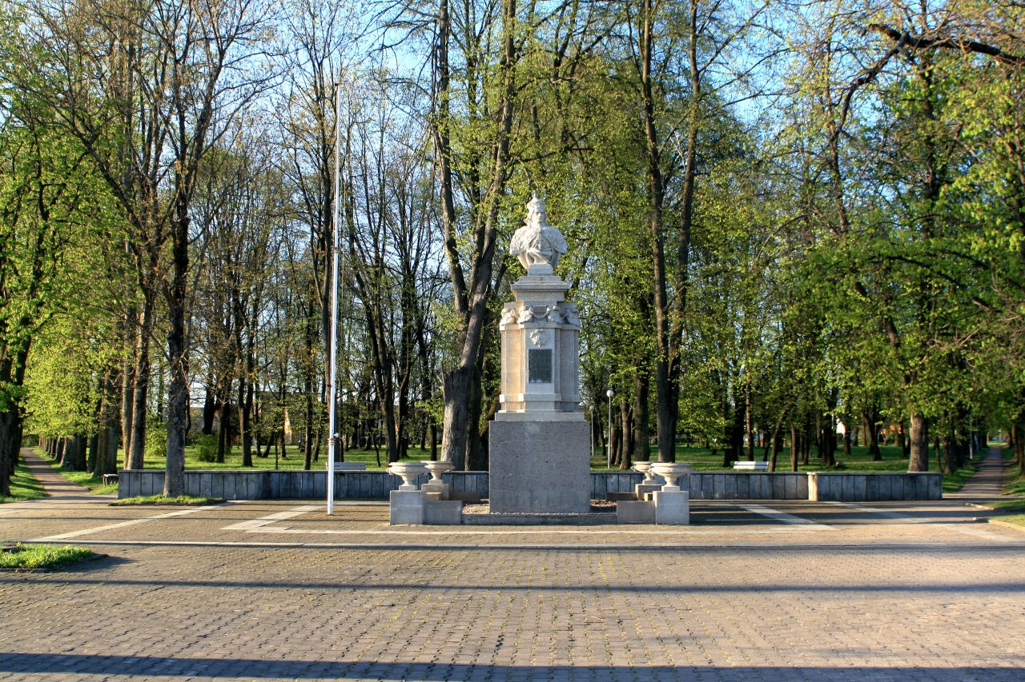
In Jurbarkas there are several beautiful parks

Slide 15
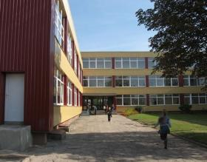
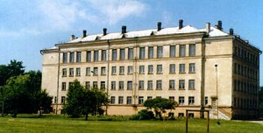
In Jurbarkas there are 3 secondary schools

Slide 16
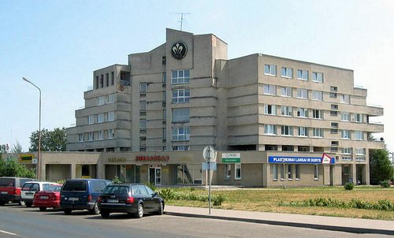
HOTEL “JURBARKAS”

Slide 18
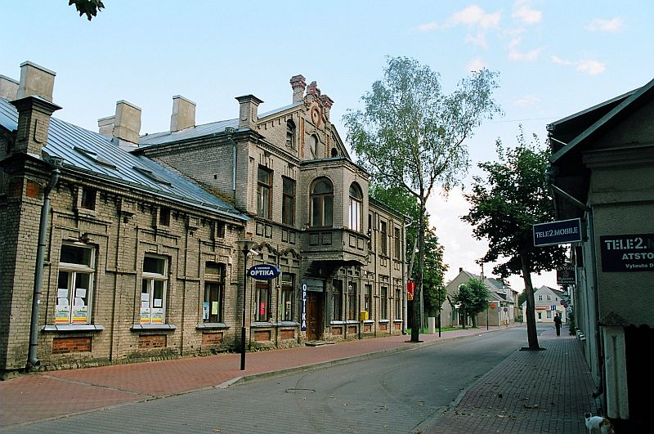

Slide 19
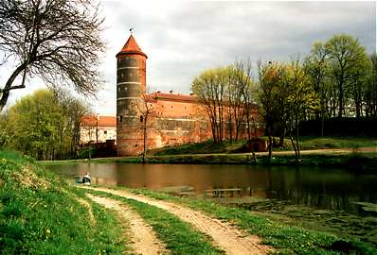
Near Jurbarkas there are several wonderful castles

Slide 20
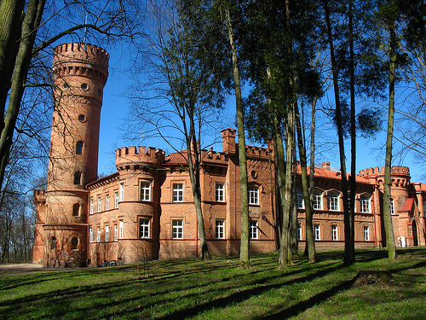

Slide 21
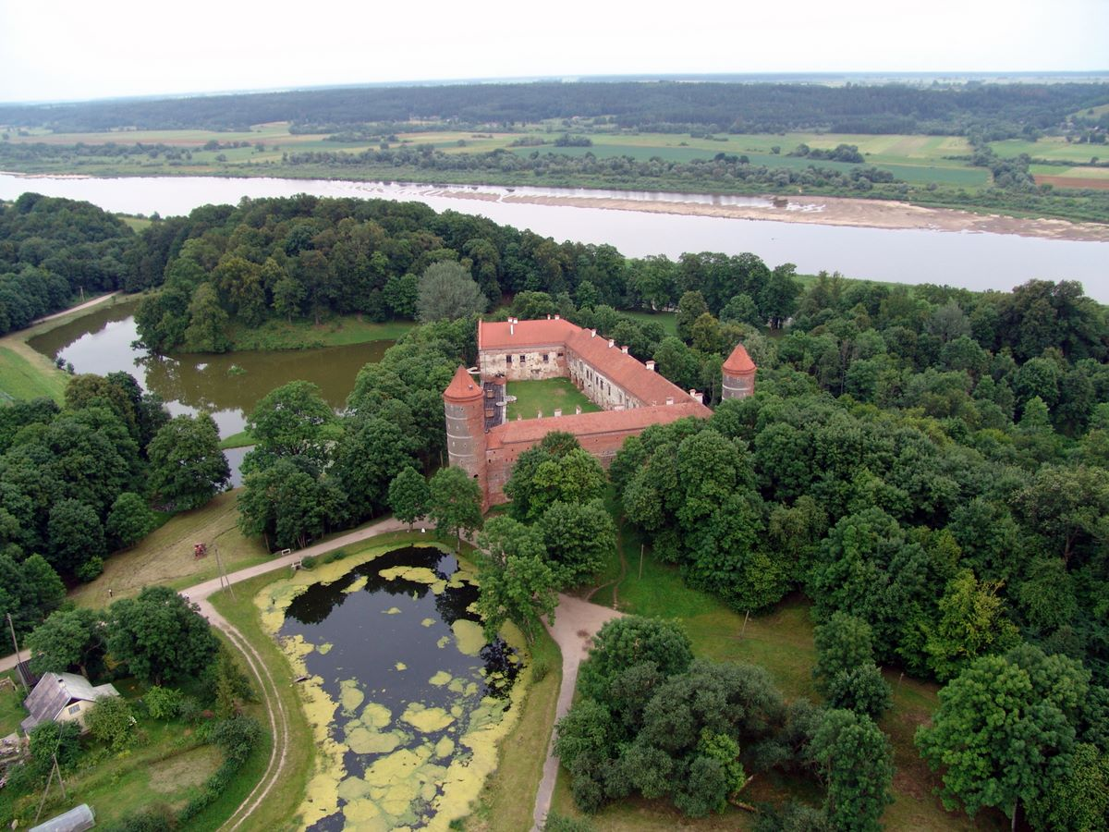

Slide 22
We love our town JURBARKAS !

