Slide 1
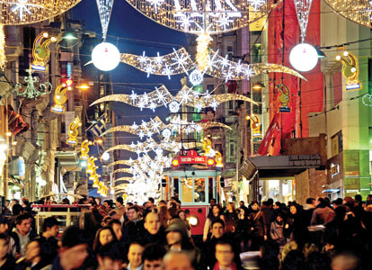
CHRISTMAS IN TURKEY

Slide 2
Turkey may not strike you like a traditional place to celebrate Christmas. But the salubrious weather and unique celebration styles will give you all the more reasons to celebrate Christmas in Turkey this year!

Slide 3
The roots of Santa Claus lay in Turkey, to be precise in Patara near Myra. Already in the 4th century A.D.E. St Nicholas dropped bags of money down the chimneys to help people. But today, in a country with a 98% Muslim population, Christmas is a day like any other day. Yet, spending Christmas in Istanbul is not that odd an idea — here’s why.

Slide 4
As the winter sets in, we know that the most awaited festival is approaching. And, this season of the festival is going to last long from welcoming Santa Claus to celebrating the beginning of a new joyous year. And, if you wish to escape the snow and chilly weather, there is no better way than celebrating Christmas in Turkey.

Slide 5
Turkey sounds a bit different from the regular ones, right? Yes, it is! You will find a lot of differences in the style of celebration like Christmas food in turkey as it is not a Turkish festival. However, Christmas is celebrated with full fervour. Istanbul Christmas market is something you should watch out for.

Slide 6
Friday is the day on 25th December 2020, the day of Christmas, when the whole world will celebrate the most awaited festival of the year. A normal business day for the Turks while an awesome stress buster and festivity locator for tourists. Considering the Turkish Christmas traditions, the celebration of this festival almost seems impossible right? Because we tend to think that Turkey is a Muslim country and why would it celebrate Christmas! It is a Muslim country but it is not impossible or something weird to celebrate Christmas. Turks have a fine art of making money and started becoming popular amongst expats since 2004. And Christmas is a season to give an opportunity to the restaurant owners and bars a chance to make some currency.

Slide 7
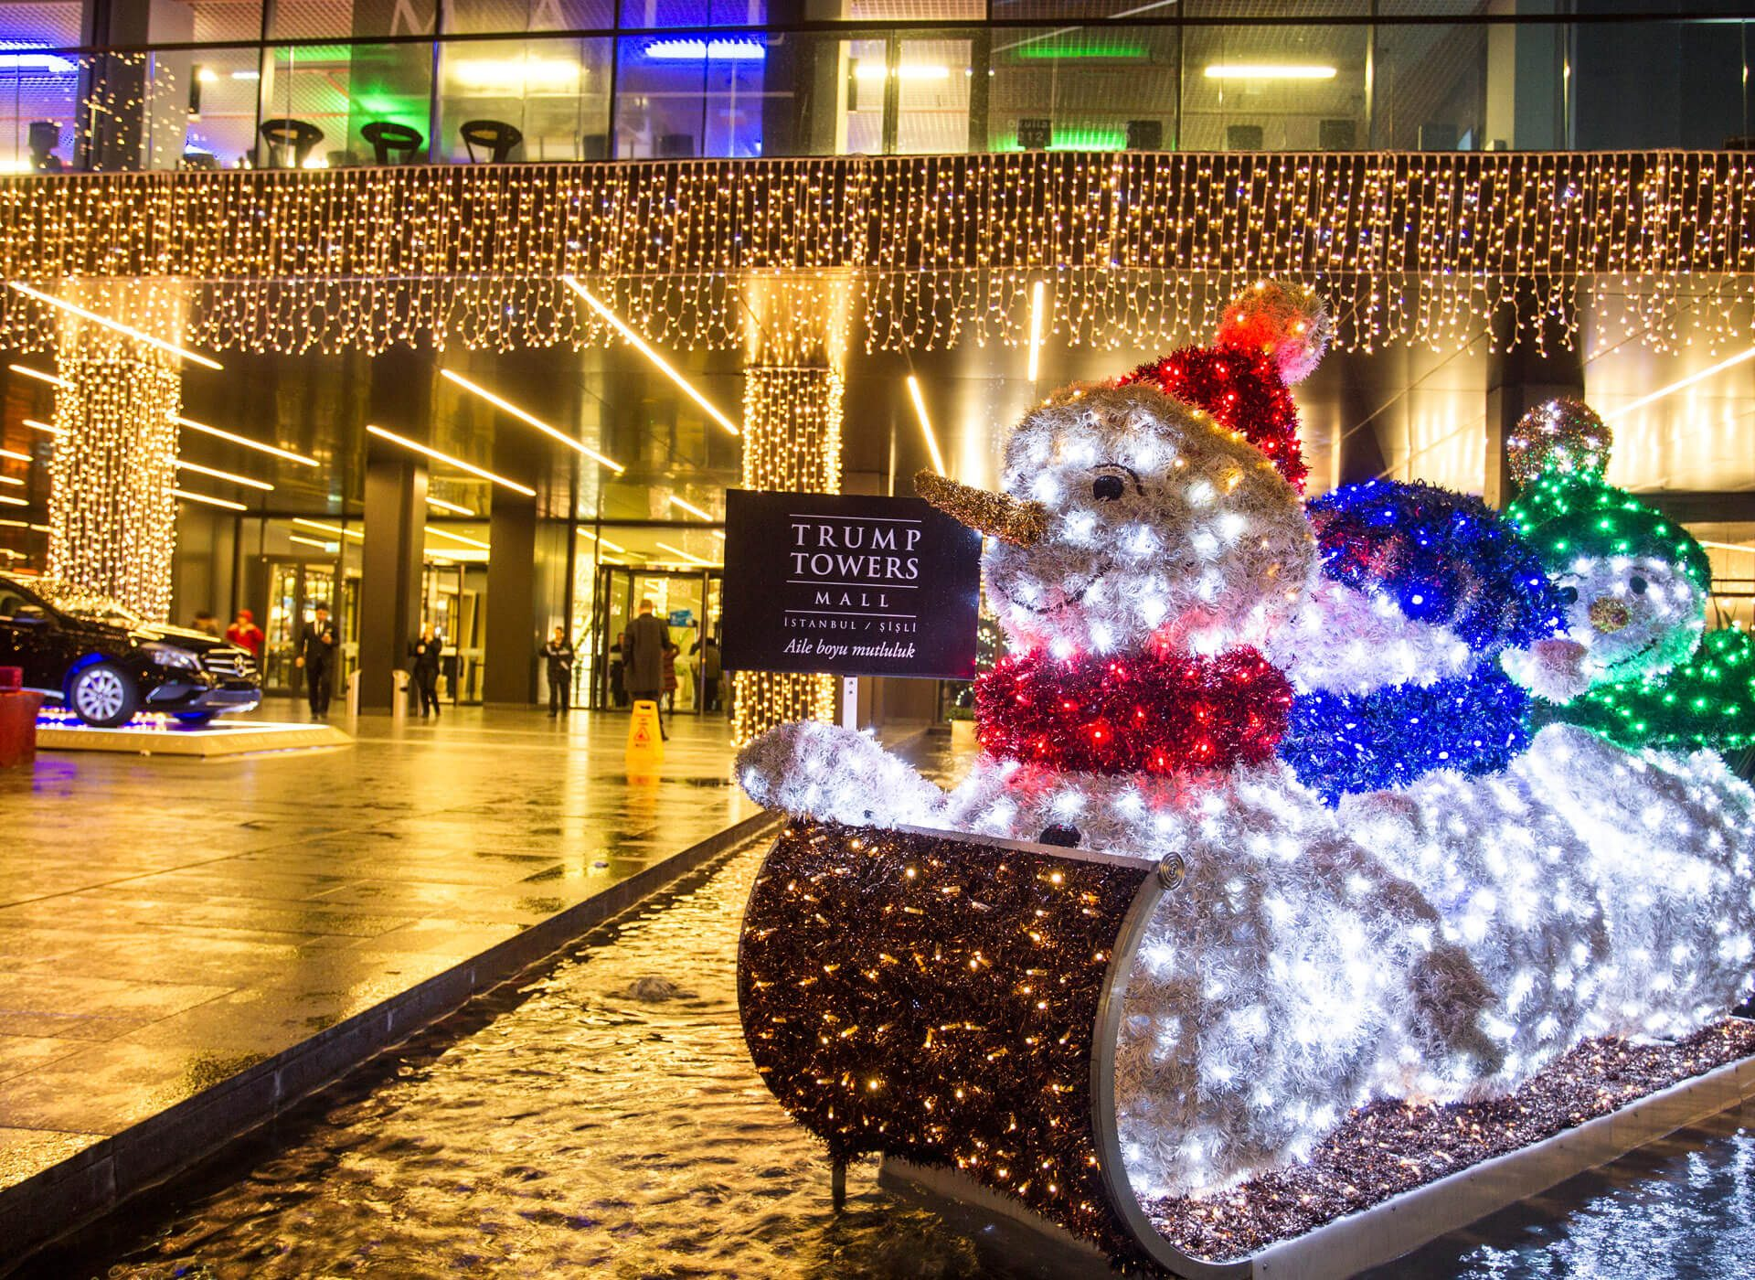
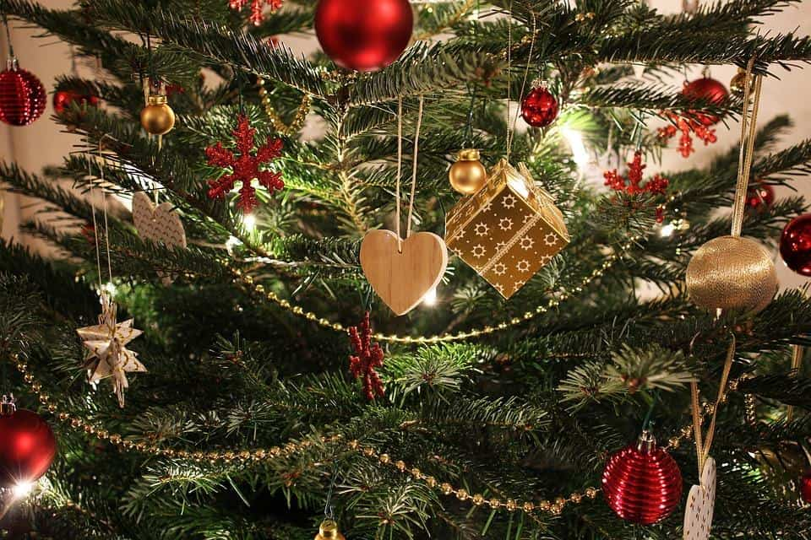
Shopping at Christmas Time in Turkey
You are not going to find streets laden with Christmas lights and a 50 foot Christmas tree in the town square. Neither will you walk in a shop to find staff wishing you a happy Christmas through false smiles, while Jingle bells is playing in the background.
You might however stumble upon a place that is selling Christmas items. Just the other day, I stumbled across a shop (actually it was a bar) that was selling small Christmas trees for 150TL (approximately $80). Depends on how much you are willing to spend.

Slide 8
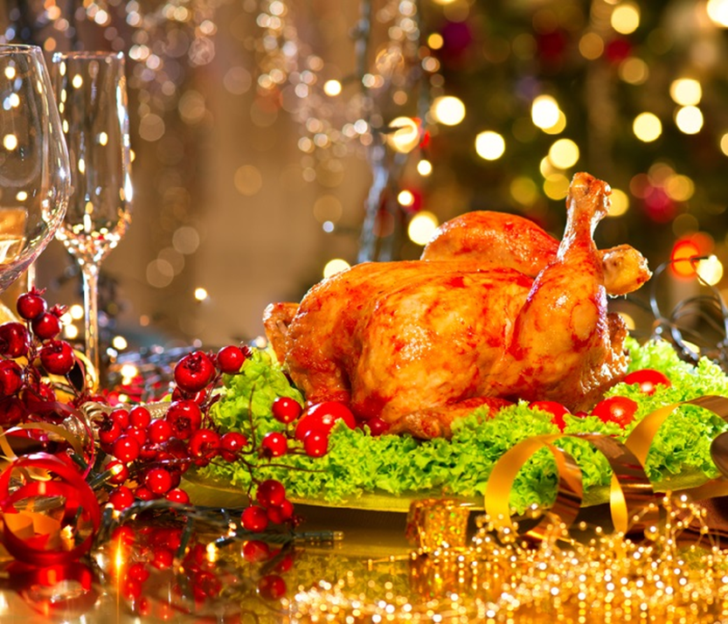
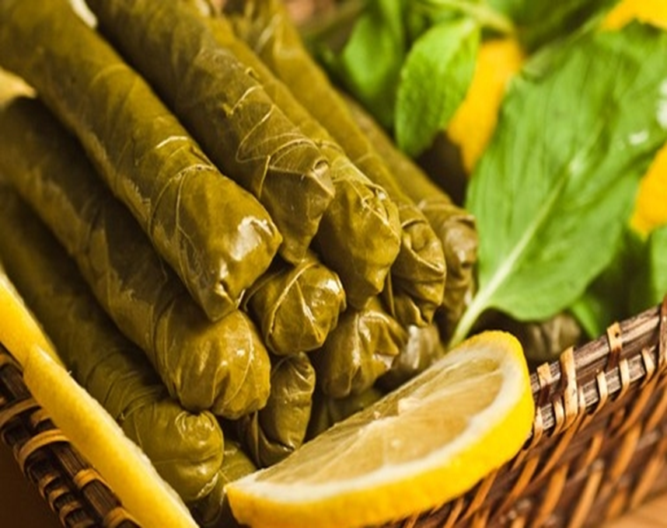
The Turkish Christmas Dinner
Now this is where the Turks will pull out all the stops for you. In areas where there are a lot of ex-pats, the restaurants will provide you with a full dinner and entertainment for the day.
Average price is 20 to 50 dollars depending on what is included. If the restaurant has connections, they would have received boxes of Christmas crackers and Paxo stuffing, from ex-pats flying out especially for Christmas. Leaf rolls are one of many traditional meals that are served in Turkey for Christmas

