Slide 1
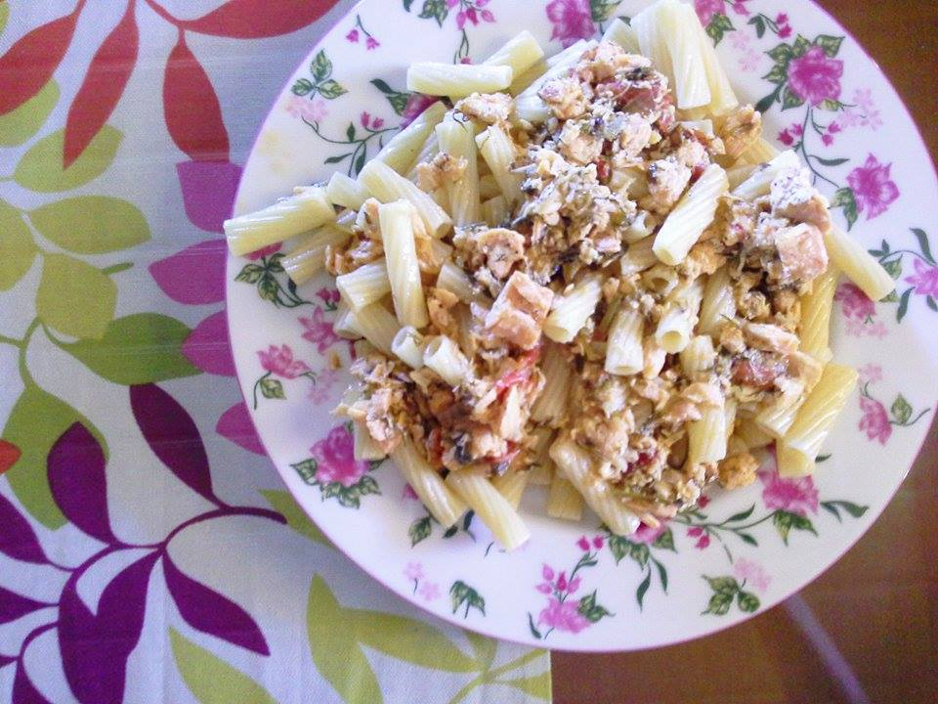
SALMON WITH CROCUS
Sofia Maria
3rd Junior High School of Corinth

Slide 2
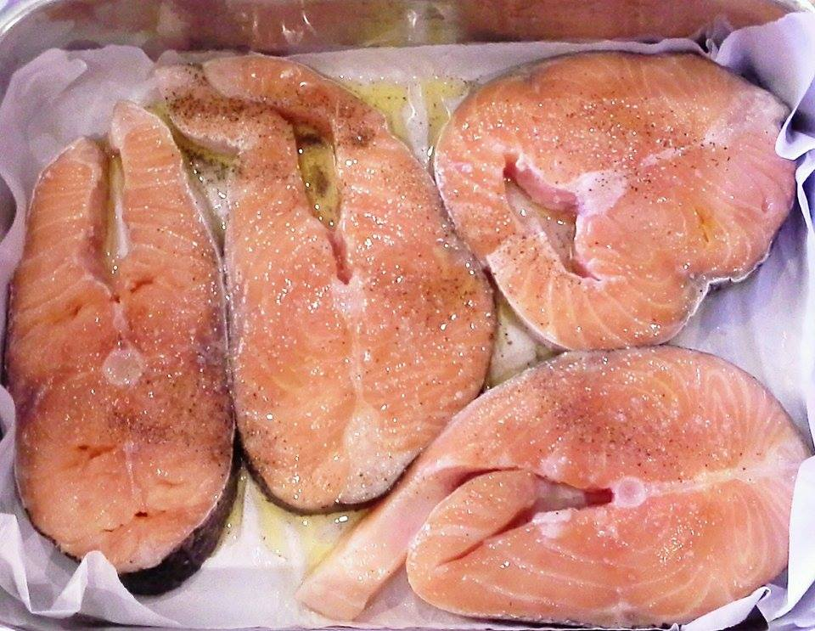
Ingredients:
1kg skin-on salmon fillets

Slide 3
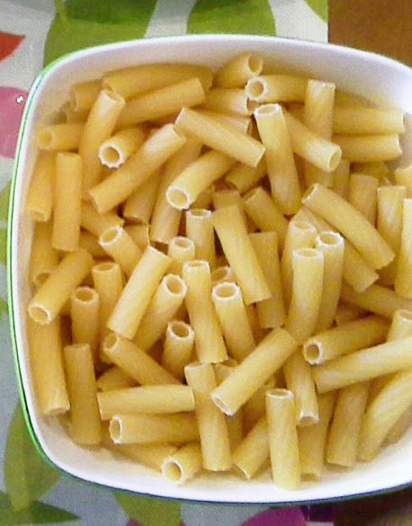
½ kilo of pasta

Slide 4
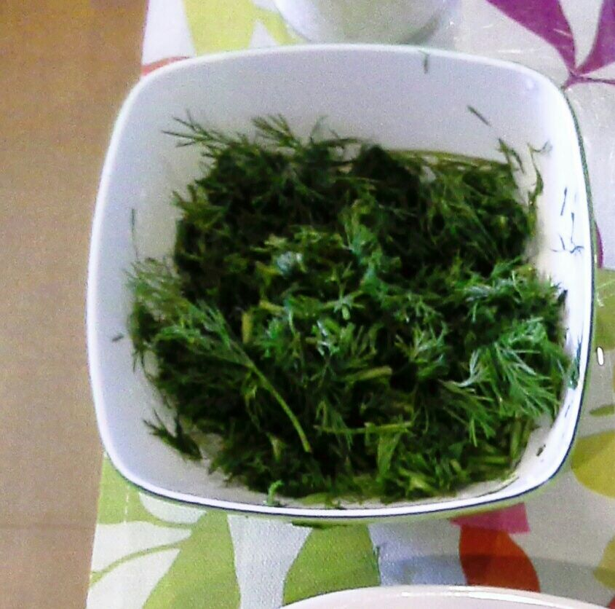
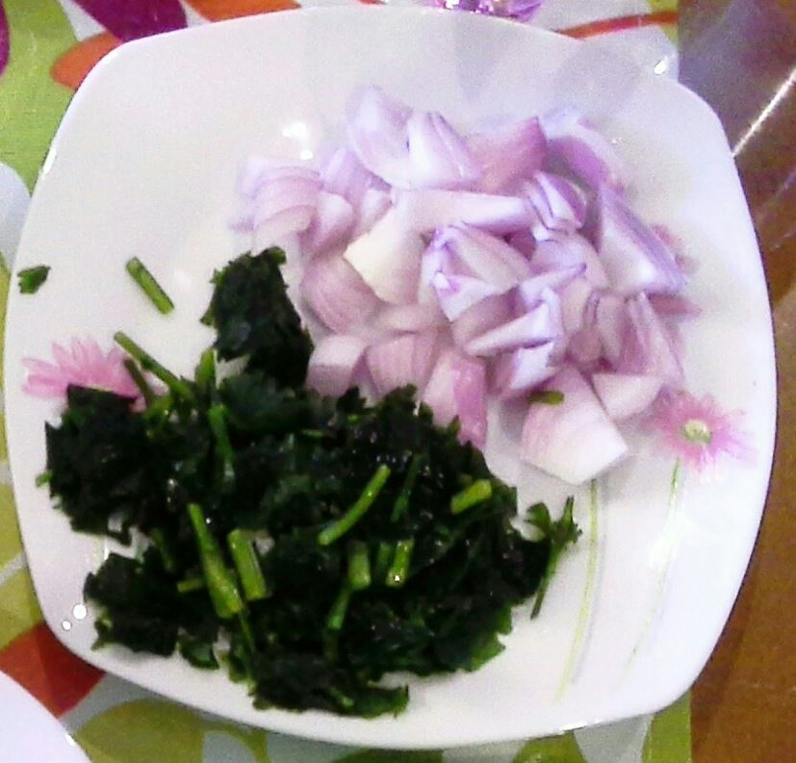
1/3 bunch of minced dill
1/3 chopped parsley and 1 small onion, chopped

Slide 5
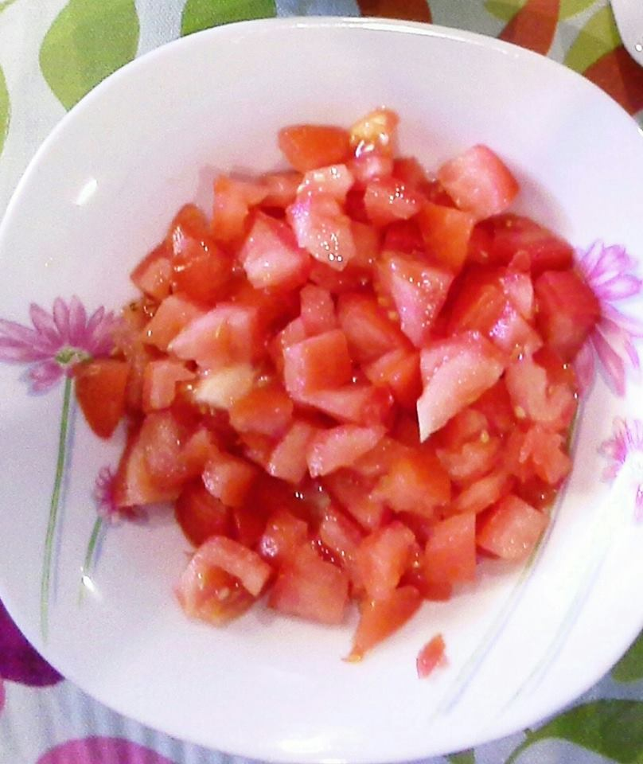
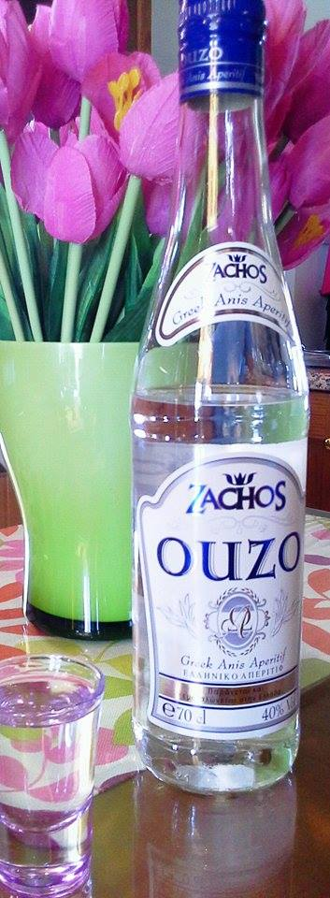
2 chopped tomatoes
2 shots of ouzo

Slide 6
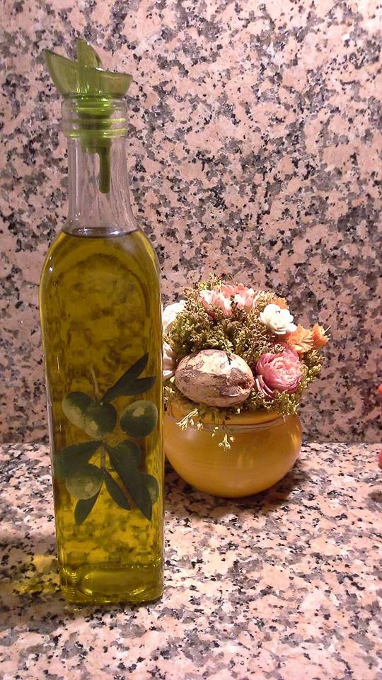
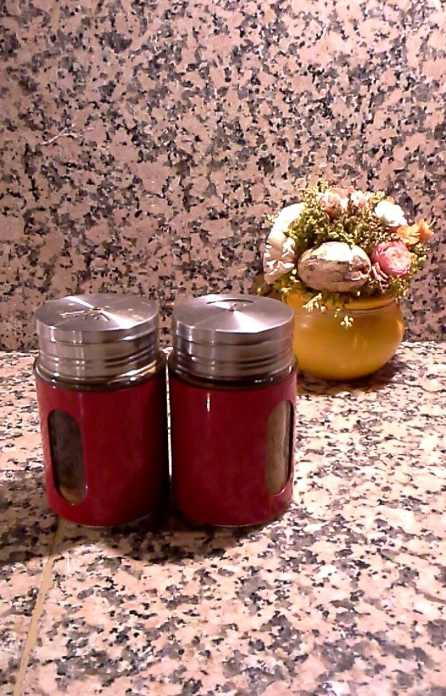
1 teaspoon salt
1 teaspoon pepper
5 tablespoons olive oil

Slide 7
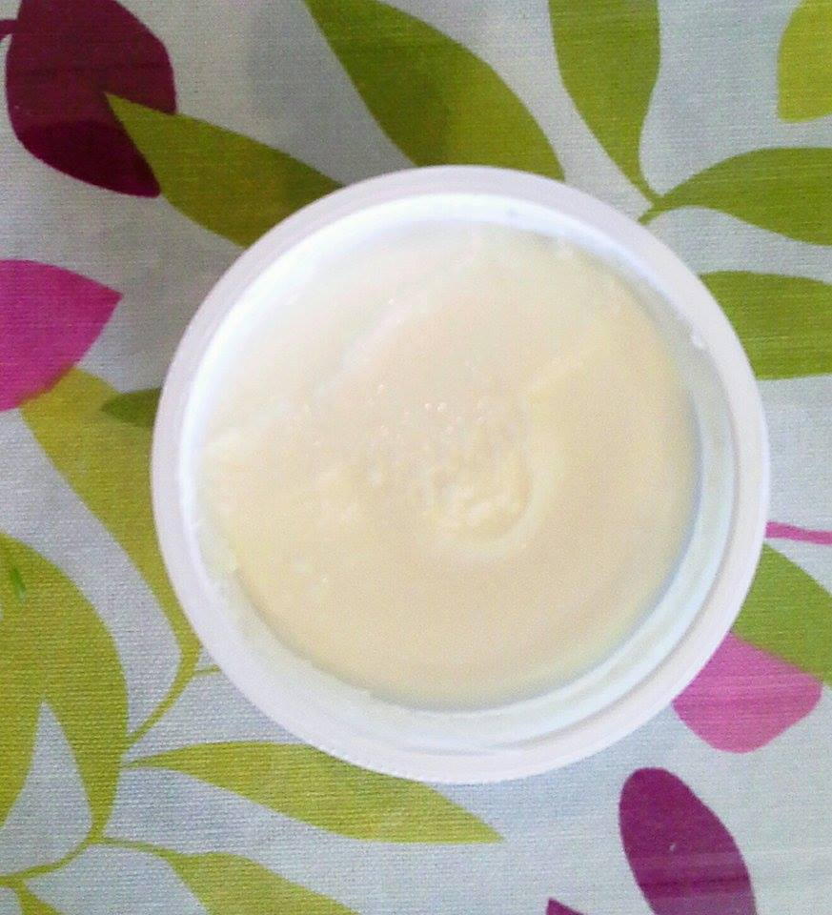
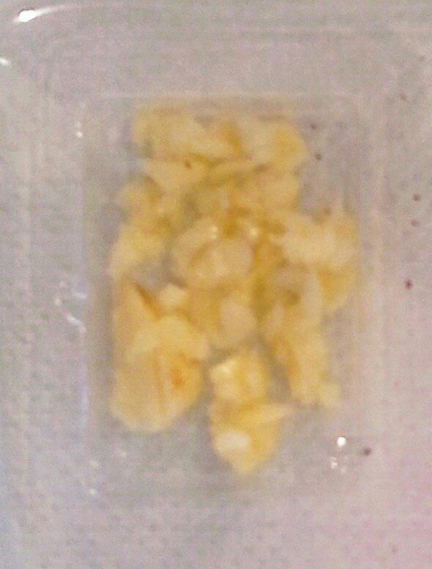
250gr cream cheese
2 chopped cloves garlic

Slide 8
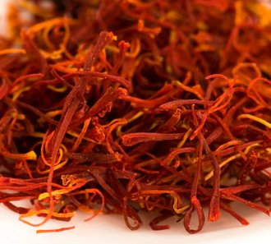
And of course…
7 crocus threads steeped in ½ cup hot water for ½ an hour

Slide 9
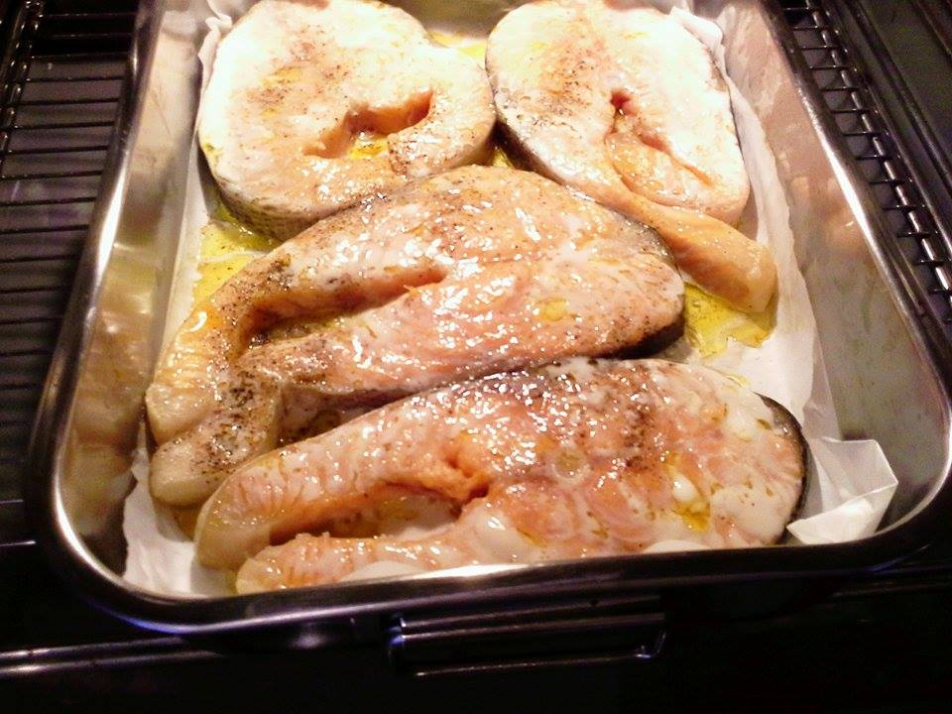
Instructions
Put the salmon in the baking tin ,add salt, pepper and oil and cook in the oven for 15 minutes.

Slide 10
Heat the oil in a pan and add the onion and the garlic. Cook for 2 minutes, add the tomatoes and cook for another 2 minutes. Finally ,add the ouzo and simmer for 10 minutes.

Slide 11
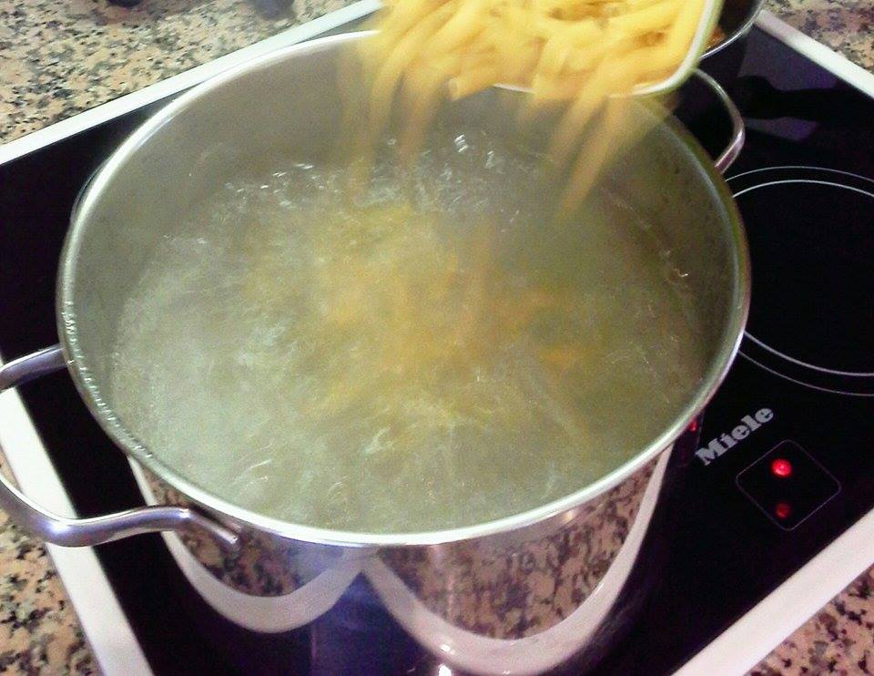
Boil the pasta in a large pan of water with a pinch of salt.

Slide 12
Finish the sauce by adding the cream cheese, the crocus, the dill, the parsley, some salt and pepper and finally, the salmon cut in chunks.

Slide 13
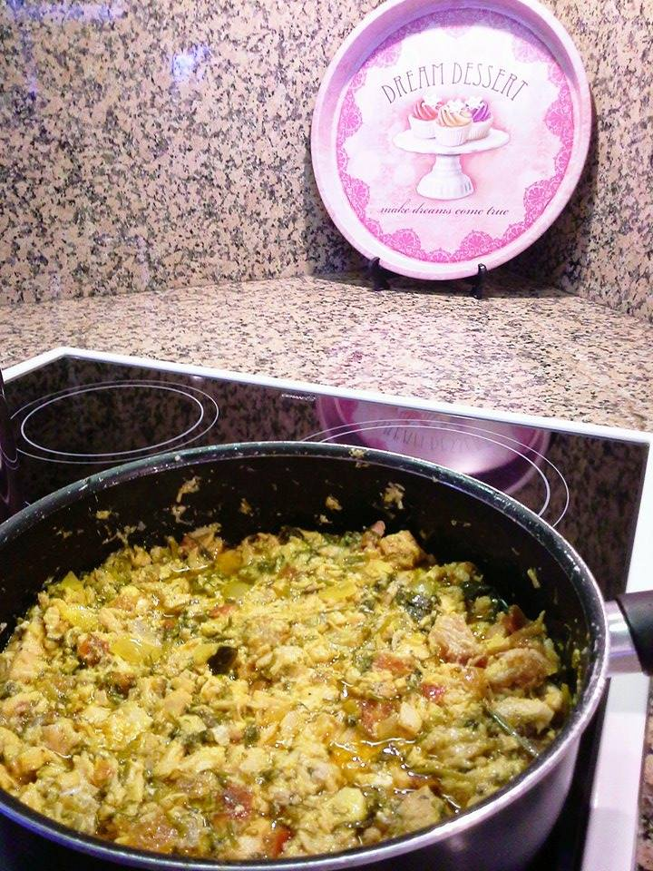
We have almost finished….

Slide 14
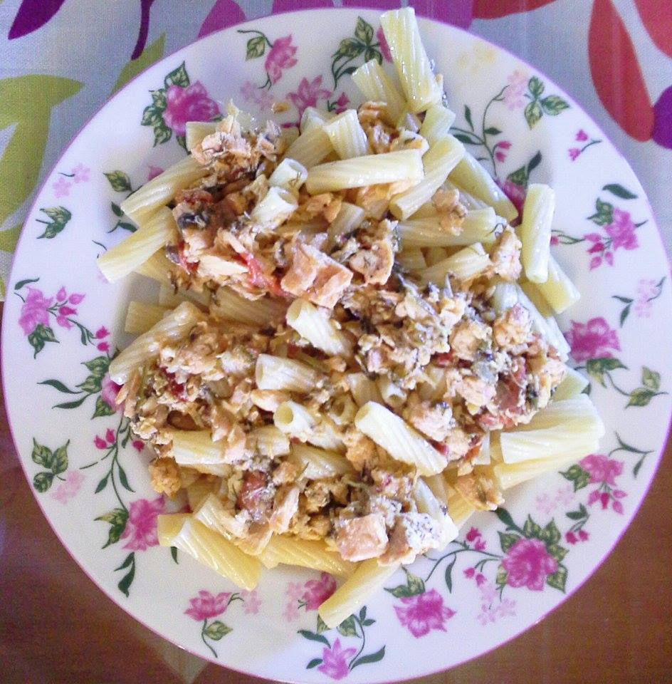
Ready!!!!

