Slide 1
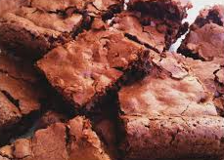
BROWNIE WITH NUTS

Slide 2
"Brownie with Walnuts "
Ingredients:
125 grams of chocolate to melt
125 grams of unsalted butter
150 grams of sugar
2 large eggs
75 grams of chopped walnuts
75 grams of cake flour
1 tablespoon ground cinnamon
1 tablespoon vanilla sugar

Slide 3
Directions
Preheat oven to 350°F.
Butter a square baking pan.
Melt the butter and chocolate chips together and remove from heat.
In a separate bowl, combine dry ingredients.
When the chocolate/butter mixture has cooled a little whisk in the eggs and the vanilla ( it is important to cool the chocolate/butter mixture or the eggs will cook).

Slide 4
Add the ingredients and whisk to combine.
Stir in the chopped walnuts.
Pour into the prepared baking pan.
Bake for 40 to 45 minutes or until a knife inserted into center comes out clean.
Ready to serve! (It is delicious with vanilla ice-cream)

