Slide 1
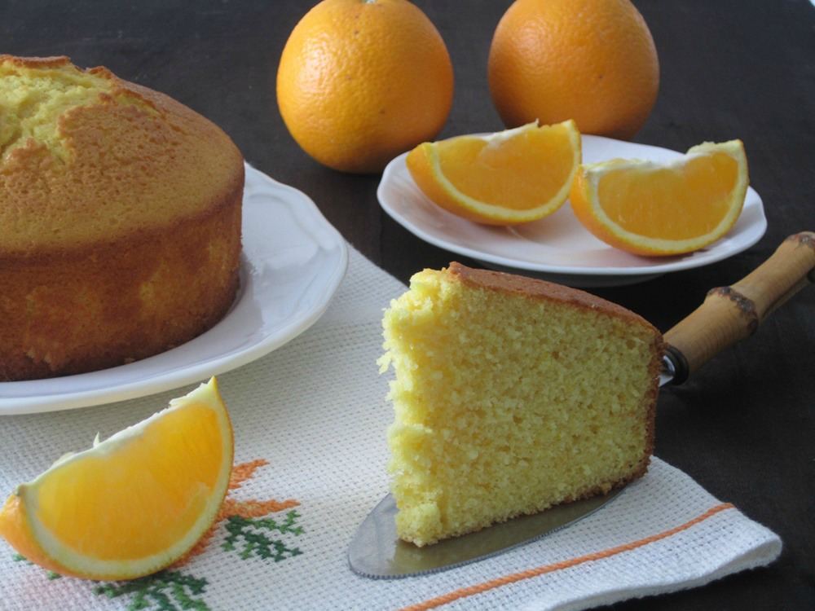
SOFT ORANGE CAKE

Slide 2
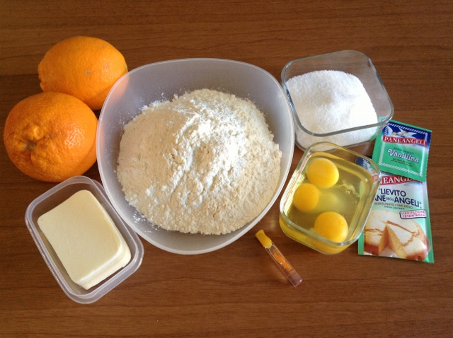
Ingredients
2 or 3 organic oranges
280 g. flour
250 g. sugar
3 eggs
80 g. butter or oil
1 packet of baking powder and 1 of vanilla powder

Slide 3
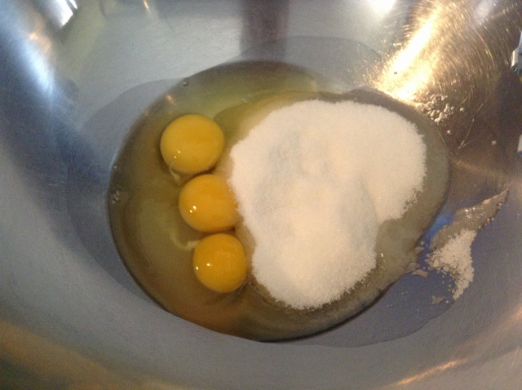
Whisk in a bowl the eggs and sugar with an electric mixer or by hand . Continue beating for 15 minutes , it's the only way the eggs will swell , becoming light and fluffy , and the cake will become spongy.
Preparation

Slide 4
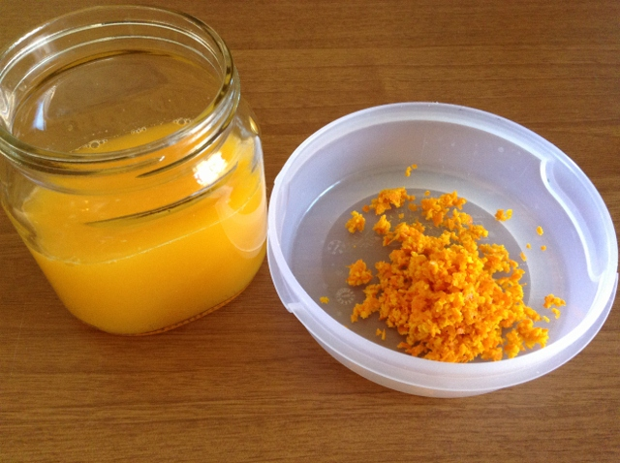
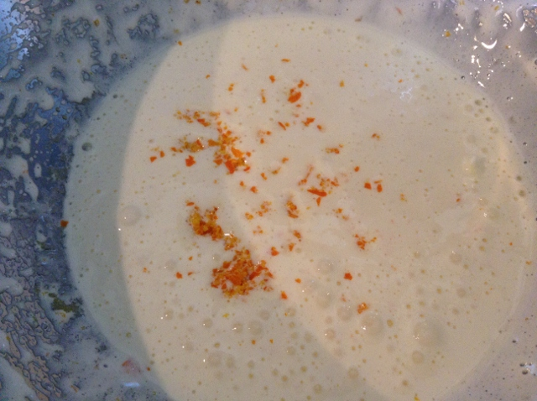
Choose oranges untreated when you use zest , and add it to the eggs compound.

Slide 5
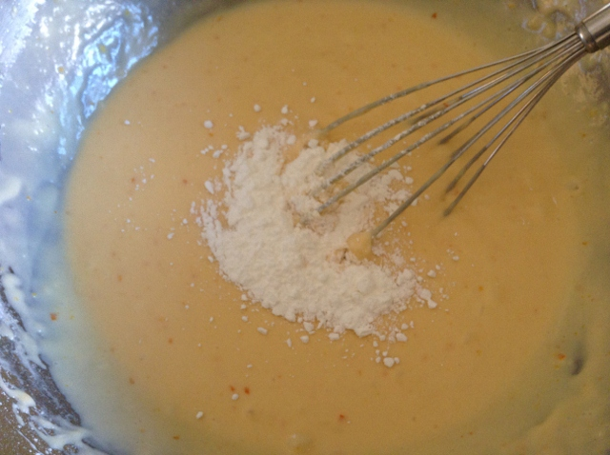
Continue adding oil or melted butter and orange juice, while continuing to stir .
Finally add the sifted flour with the baking powder and the grated rind of an orange . Mix well .

Slide 6
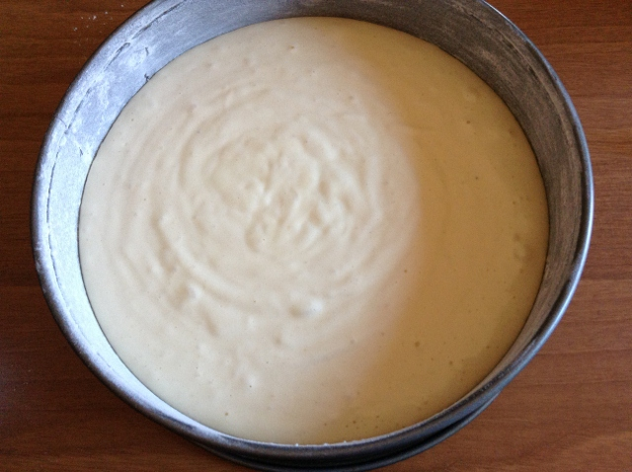
Preheat oven to 180 ° . Grease and flour a cake pan of 24-26 cm in diameter . Pour in the mixture and bake in the oven for about 30-35 minutes .

Slide 7
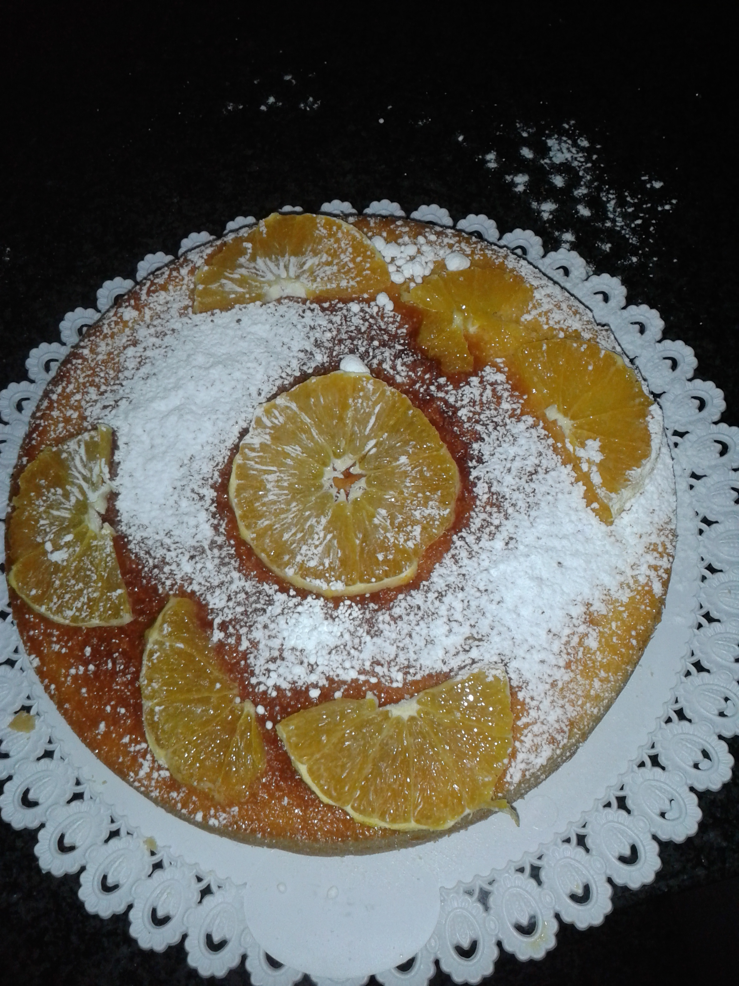
The cake is ready

